Slide 1


Principles of Macroeconomics, Version 9.1
John B. Taylor & Akila Weerapana

Slide 2
PUBLISHED BY:
FLATWORLD
©2022 BY FLATWORLD. ALL RIGHTS RESERVED. YOUR USE OF THIS WORK IS SUBJECT TO THE LICENSE AGREEMENT. AVAILABLE HERE
NO PART OF THIS WORK MAY BE USED, MODIFIED, OR REPRODUCED IN ANY FORM BY ANY MEANS EXCEPT AS EXPRESSLY PERMITTED UNDER THE LICENSING AGREEMENT.

Slide 3
CHAPTER 3
The Supply and Demand Model

Slide 4

Introduction
The supply and demand model can explain the following:
During the COVID-19 crisis, why did the price of a ventilator rise by so much?
What causes the price of gasoline to fluctuate?
What causes the price of desktop computers to fall over time, even though the prices of most other goods seem to rise over time?
Why do roses cost more on Valentine’s Day?
Once you understand how the model works, you will find yourself using it over and over again to understand the markets that you come across in your everyday life.

Slide 5
Demand
demand: a relationship between price and the quantity demanded.
price: the amount of money or other goods that one must pay to obtain a particular good.
quantity demanded: the quantity of a good that people want to buy at a given price during a specific time period.
demand schedule: a tabular representation of demand showing the price and quantity demanded for a particular good, all else being equal.

Slide 6
Table 3.1: Demand Schedule for Bicycles (Millions of Bicycles Per Year)
Price | Quantity Demanded | Price | Quantity Demanded
$140 | 18 | $240 | 5
$160 | 14 | $260 | 3
$180 | 11 | $280 | 2
$200 | 9 | $300 | 1
$220 | 7

Slide 7
The Demand Curve
demand curve: a graph of demand showing the relationship between price and quantity demanded.
law of demand: the tendency for the quantity demanded of a good to decline as its price rises.
Note: For a demand curve to be consistent with the law of demand, the demand curve must be downward sloping.

Slide 8
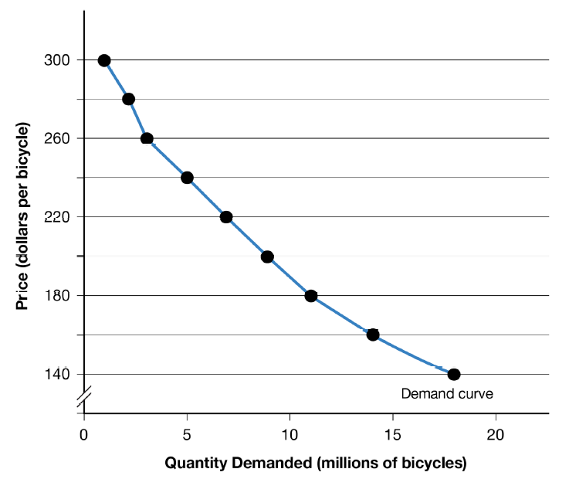
Figure 3.2: The Demand Curve

Slide 9

Video Lecture: The Demand Curve
In general, the price and demand for a good are negatively related. Thus, the demand curve is downward sloping.
This excerpt introduces the supply/demand model by focusing on the demand curve. It explains why it is downward sloping, indicating that, in general, the price and quantity demanded of a good are negatively related. Watch this video through 5:17.

Slide 10
Shifts in Demand
Changes in the following can cause the demand curve to shift to the left or to the right:
Consumers’ Preferences
Consumers’ Information
Consumers’ Income
Number of Consumers in the Market
Consumers’ Expectations of Future Prices
Prices of Closely Related Goods
Substitutes
Complements

Slide 11
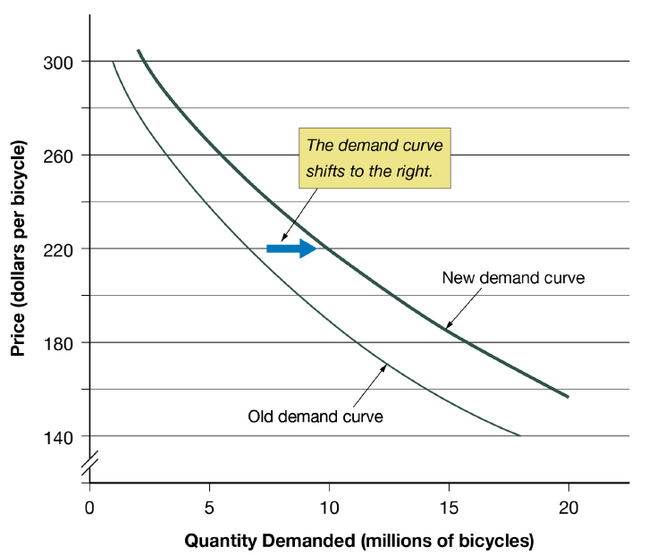
Figure 3.3: A Shift in the Demand Curve

Slide 12
Consumers’ Preferences
Changes in consumers’ preferences or tastes for a product (relative to another product) will change the amount they purchase at a given price.
Example: On college campuses, there has been an increased demand for clothing that is certified as not having been produced in “sweatshops.”

Slide 13
Consumers’ Information
New information available to consumers can result in a change in the quantity that consumers buy of a good, even though the price does not change.
Examples:
Car owners bought less Toyota vehicles after a massive safety recall of Toyota vehicles.
Demand for spinach fell after contaminated spinach was linked to an outbreak of E.coli.

Slide 14
Consumers’ Incomes
normal goods: goods for which demand increases when the consumers’ income rises and decreases when consumers’ income falls.
Examples: shoes, clothing, jewelry
inferior goods: goods for which demand decreases when the consumers’ income rises and increases when consumers’ income falls.
Examples: instant noodles, inter-city bus tickets

Slide 15
Number of Consumers in the Market
More consumers in the market will likely result in a larger demand for the good or service, while fewer consumers will likely result in a smaller demand for the good or service.
Example: The number of teenagers expanded sharply in the U.S. population in the late 1990s leading to increased demand in products marketed to teenagers.

Slide 16
Consumers’ Expectation of Future Prices
Expectations of higher future prices will increase demand now.
Expectations of lower future prices will decrease demand now.
Example: Expectations of higher prices of gasoline in the future tends to make individuals fill up now.

Slide 17
Prices of Closely Related Goods
substitute: a good that has many of the same characteristics as and can be used in place of another good.
Examples:
Coke is a substitute for Pepsi.
Downloaded music is a substitute for music CDs.
complement: a good that is consumed or used together with another good.
Examples:
Gasoline is a complement to SUVs.
Cream is a complement to coffee.

Slide 18
Prices of Closely Related Goods
If two goods are complements, then an increase in the price of one good will result in a decrease in the demand for the other good.
If two goods are substitutes, then an increase in the price of one good will result in an increase in the demand for the other good.

Slide 19
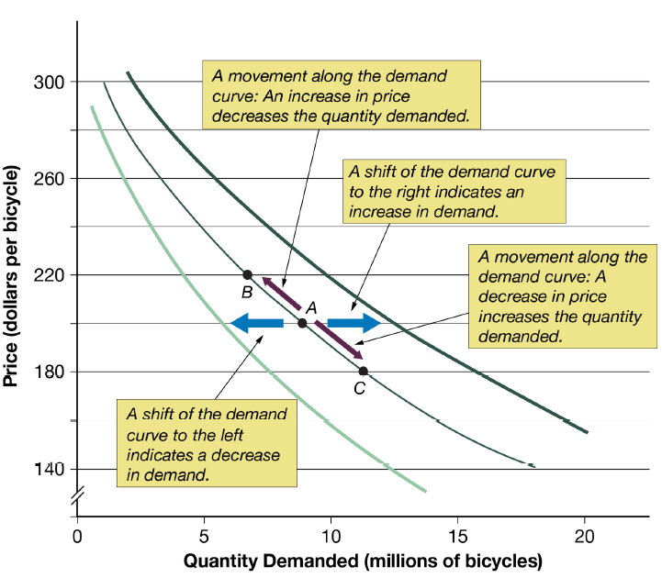
Figure 3.4: Shifts of versus Movements Along the Demand Curve

Slide 20

Video Lecture: Movements Along versus Shifts of the Demand Curve
This excerpt discusses the difference between an event that causes the demand curve to shift versus an event that leads to a movement along the demand curve. Watch this video through 8:07.

Slide 21
Supply
supply: a relationship between price and the quantity supplied, all other things equal.
quantity supplied: the quantity of a good that sellers are willing to sell at a given price during a specific time period.
supply schedule: a tabular representation of the supply curve.

Slide 22
Table 3.2: Supply Schedule for Bicycles (Millions of Bicycles Per Year)
Price | Quantity Supplied
$140 | 1
$160 | 4
$180 | 7
$200 | 9
$220 | 11
$240 | 13
$260 | 15
$280 | 16
$300 | 17

Slide 23
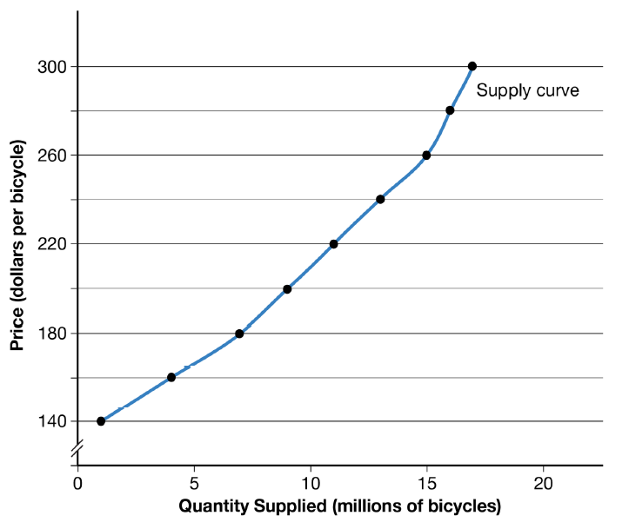
Figure 3.5: The Supply Curve

Slide 24
The Supply Curve
supply curve: the graph of supply showing the relationship between price and quantity supplied.
law of supply: the tendency for the quantity supplied of a good in a market to increase as its price rises.
Note: For a supply curve to be consistent with the law of supply, the supply curve must be upward sloping

Slide 25
Video Lecture: The Supply Curve
The price and supply of a good are positively related.
This excerpt introduces the second part of the demand and supply model, the supply curve. It explains why the supply curve is generally upward sloping, reflecting the fact that the price and quantity supplied of a good are positively related. Watch this video through 10:46.

Slide 26
Shifts in Supply
Changes in the following can cause the supply curve to shift to the left or to the right:
technology,
weather conditions,
prices of inputs used in production,
number of firms in the market,
expected future selling price,
government taxes, subsidies, and regulations.

Slide 27
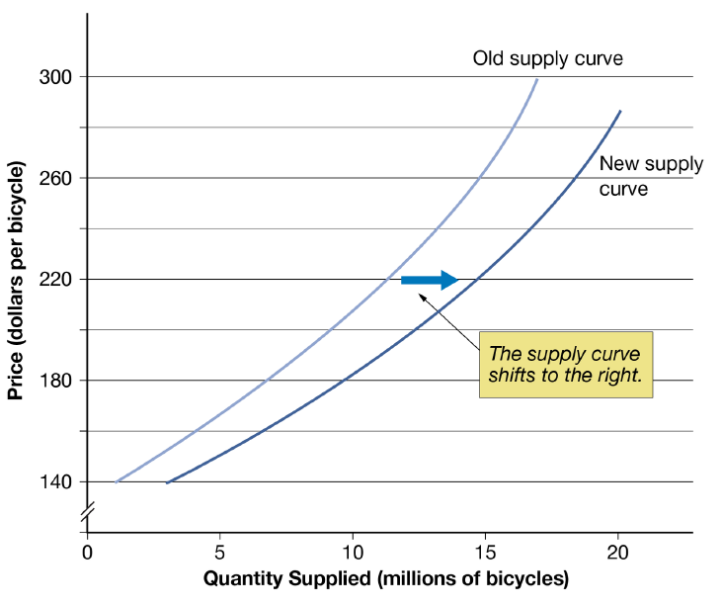
Figure 3.6: A Shift in the Supply Curve

Slide 28
Technology
Anything that changes the amount that a firm can produce with a given amount of inputs can be considered as a change in technology. Improvements in technology will correspond to an increase in supply.
Example: Innovations that decrease the time it takes to produce cars.

Slide 29
Weather Conditions
Droughts, earthquakes, and hurricanes affect how much of certain goods can be produced.
Example: Hurricane Katrina and Rita decreased oil production in Louisiana and Texas.

Slide 30
The Price of Inputs Used in Production
More expensive inputs (raw materials, land, and capital) increases the cost of production of goods and services and may force the firm to sell less at a given price.
Example: Higher prices of imported steel and aluminum in 2018 decreased the production of household appliances.

Slide 31
The Number of Firms in the Market
If the number of firms in the market increases, the supply curve shifts to the right.
If the number of firms in the market decreases, the supply curve shifts to the left.
Example: Removing barriers that prevent foreign car manufacturers from selling cars to the domestic market increases the number of firms producing cars for that country’s domestic market.

Slide 32
Expectations of Future Prices
Expectations of lower selling prices in the future will increase the supply today as firms decide to sell less in the future when prices are lower.
Similarly, expectations of higher selling prices in the future will decrease the supply today as firms decide to sell more in the future when prices are higher.

Slide 33
Government Taxes, Subsidies, and Regulations
An increases in taxes (payments by firms to the government) or a decrease in subsidies (payment by the government to firms) will decrease supply.
A decrease in taxes or an increase in the subsidies will increase supply.
regulations: government policies or rules that control a firm’s behavior. These regulations can affect a firm’s cost of production and thereby affect supply.
Example: Government requirements that food vendors pass sanitary inspection will reduce the number of vendors and decrease supply.

Slide 34
Movements Along versus Shifts of the Supply Curve
Movement along the supply curve occurs when a change in the quantity supplied of a good is brought along by a change in its price.
A shift in the supply curve occurs when a change is brought along by any source other than the price.

Slide 35
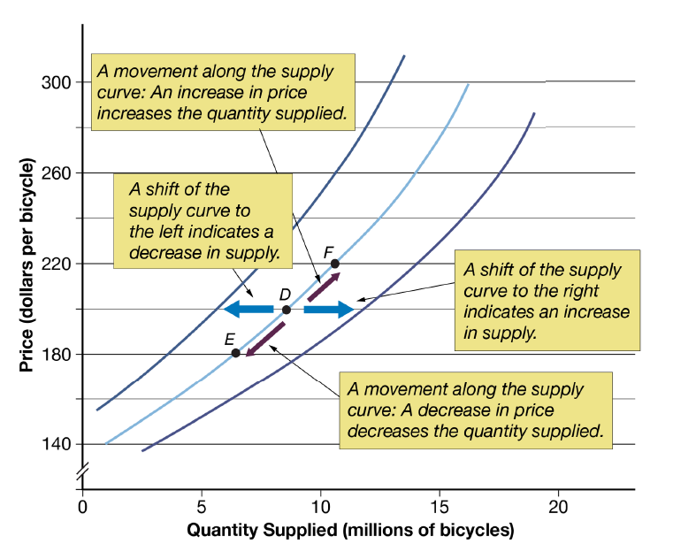
Figure 3.7: Shifts of versus Movements Along the Supply Curve

Slide 36

Video Lecture: Movements Along versus Shifts of the Supply Curve
This excerpt discusses how to distinguish between factors that lead to a shift of the supply curve versus a movement along the supply curve.

Slide 37
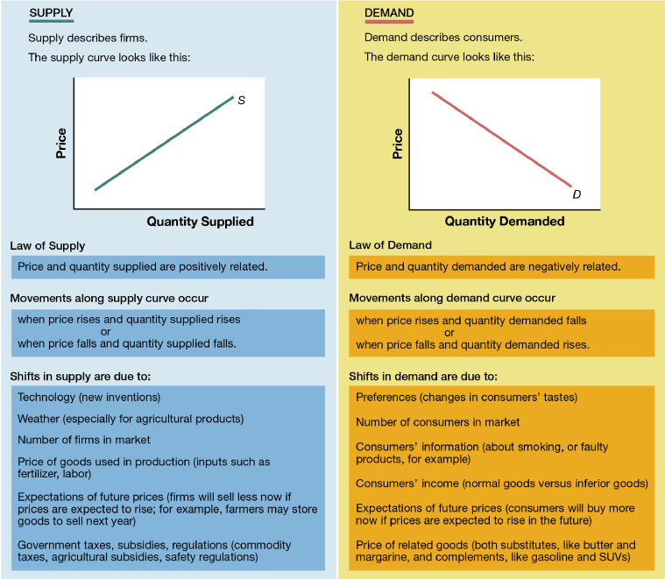
Figure 3.8: Overview of Supply and Demand

Slide 38
Finding the Market Price
equilibrium price: the price at which the quantity that sellers are willing to sell equals the quantity that consumers are willing to purchase.
equilibrium quantity: the quantity traded at the equilibrium price.
market equilibrium: the situation where the price equals the equilibrium price and the quantity traded equals the equilibrium quantity.

Slide 39
Finding the Market Price
shortage (excess demand): a situation in which the quantity demanded is greater than the quantity supplied.
This occurs when the price in the market is below the equilibrium price.
surplus (excess supply): a situation in which the quantity supplied is greater than the quantity demanded.
This occurs when the current price in the market is above the equilibrium price.

Slide 40
Table 3.3: Finding the Market Equilibrium
Price | Quantity Demanded | Quantity Supplied | Shortage, Surplus, or Equilibrium | Price Rises or Falls
$140 | 18 | 1 | Shortage = 17 | Price rises
$160 | 14 | 4 | Shortage = 10 | Price rises
$180 | 11 | 7 | Shortage = 4 | Price rises
$200 | 9* | 9* | Equilibrium* | No change*
$220 | 7 | 11 | Surplus = 4 | Price falls
$240 | 5 | 13 | Surplus = 8 | Price falls
$260 | 3 | 15 | Surplus = 12 | Price falls
$280 | 2 | 16 | Surplus = 14 | Price falls
$300 | 1 | 17 | Surplus = 16 | Price falls

Slide 41
Finding the Equilibrium with a Supply and Demand Diagram
If the price is below the equilibrium, a shortage occurs, causing the price to increase until the price reaches equilibrium.
If the price is above the equilibrium, a surplus occurs, causing the price to decrease until the price reaches equilibrium.

Slide 42
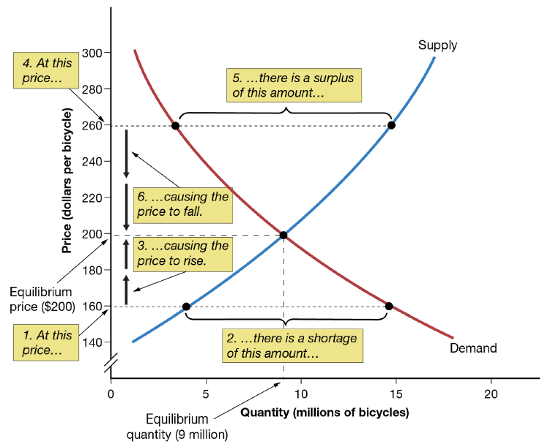
Figure 3.9: Equilibrium Price and Equilibrium Quantity

Slide 43
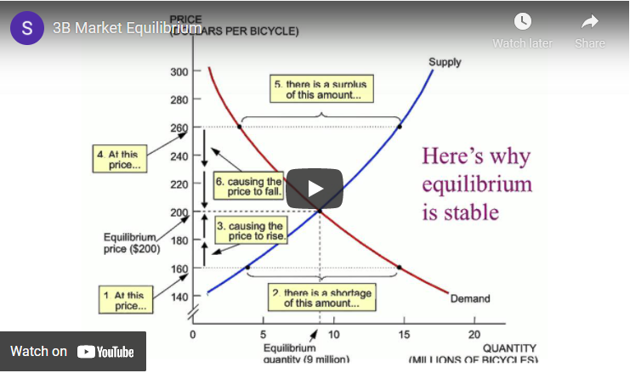
Video Lecture: Market Equilibrium
This excerpt discusses how to find the equilibrium price and quantity using the supply/demand model. Watch this video through 7:31.

Slide 44
Market Outcomes When Supply or Demand Changes
An increase in demand will shift the demand curve to the right, resulting in a higher equilibrium price and quantity. This is illustrated in Figure 3.10(a).
A decrease in demand will shift the demand curve to the left, resulting in a lower equilibrium price and quantity. This is illustrated in Figure 3.10(b).

Slide 45
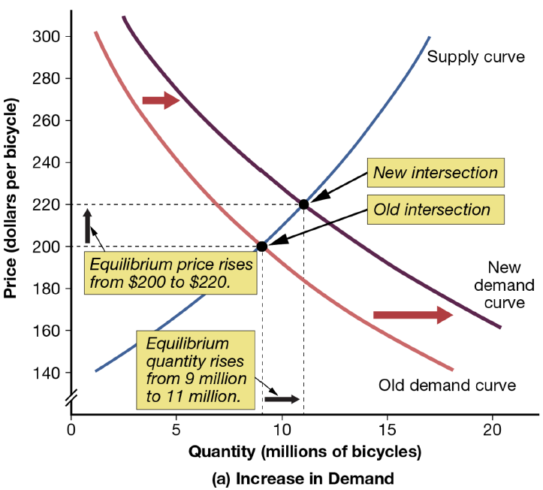
Figure 3.10(a): Effects of a Shift in Demand

Slide 46
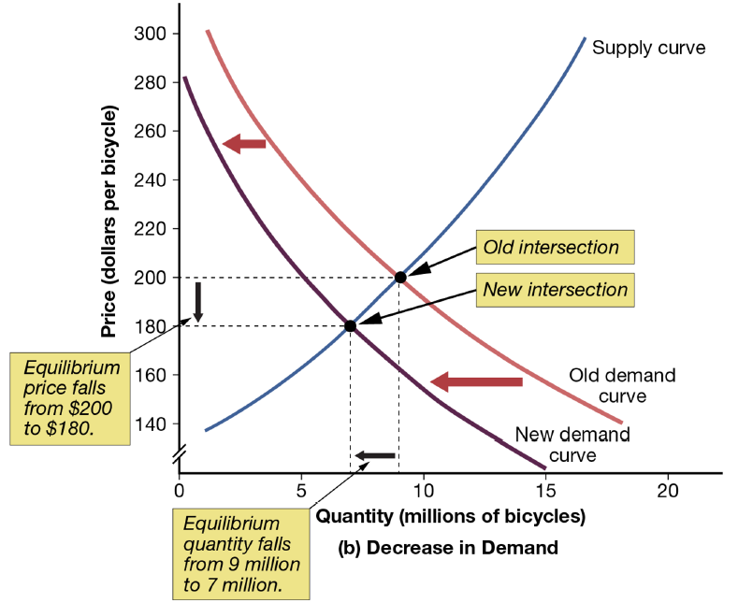
Figure 3.10(b): Effects of a Shift in Demand

Slide 47
Market Outcomes When Supply or Demand Changes
An increase in supply will shift the supply curve to the right, resulting in a lower equilibrium price and a higher equilibrium quantity. This is illustrated in Figure 3.11(a).
A decrease in supply will shift the supply curve to the left, resulting in a higher equilibrium price and a lower equilibrium quantity. This is illustrated in Figure 3.11(b).

Slide 48
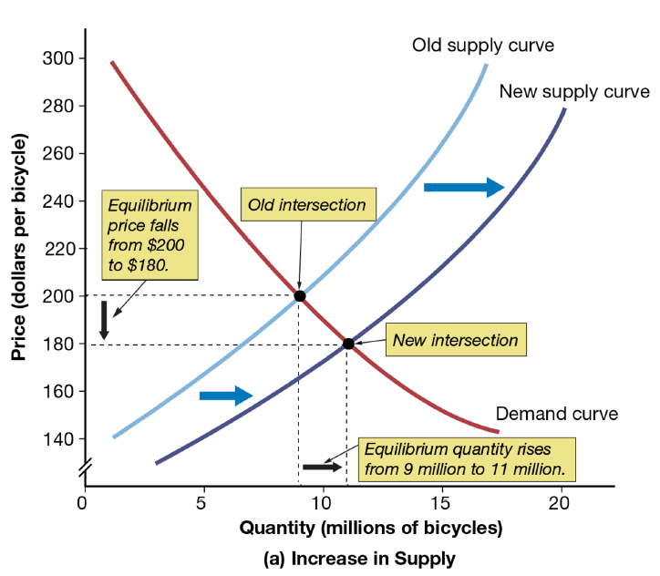
Figure 3.11(a): Effects of a Shift in Supply

Slide 49
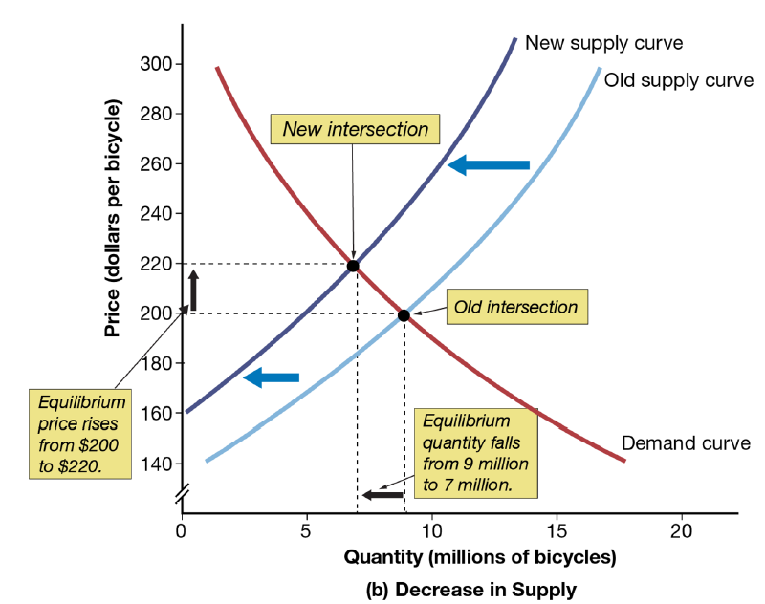
Figure 3.11(b): Effects of a Shift in Supply

Slide 50
Table 3.4: Effects of Shifts in Demand and Supply Curves
Shift | Effect on Equilibrium Price | Effect on Equilibrium Quantity
Increase in demand | Up | Up
Decrease in demand | Down | Down
Increase in supply | Down | Up
Decrease in supply | Up | Down

Slide 51

Video Lecture: What Happens When Supply or Demand Changes?
This excerpt discusses the changes that take place in a market when there is a shift in demand.

Slide 52
Summary
Demand is a negative relationship between the price of a good and the quantity demanded by consumers. It can be shown graphically by a downward-sloping demand curve.
Supply is a positive relationship between the price of a good and the quantity supplied by firms. It can be shown graphically by an upward-sloping supply curve.
We can use the supply and demand model to analyze the impact of changes in factors that move the supply curve or the demand curve or both. By shifting either the supply curve or the demand curve, observations of prices can be explained and predictions about prices can be made.

