Slide 1


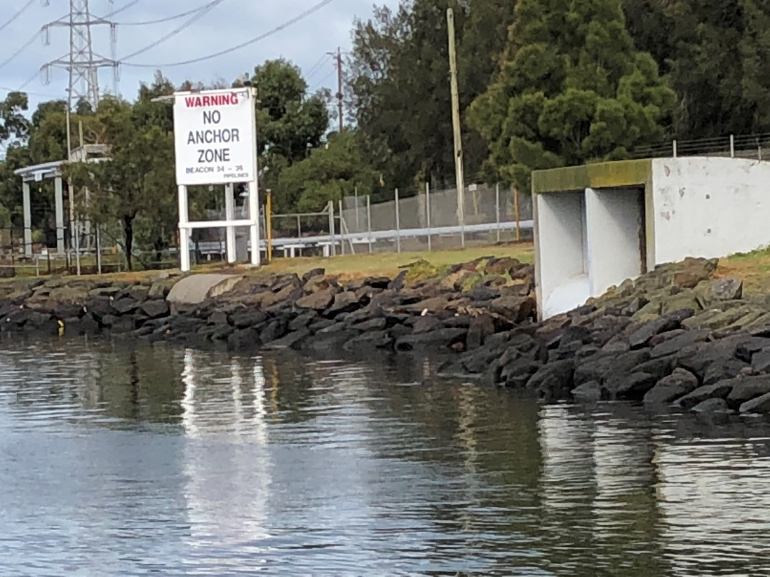
Map Elevation Tool
Notes: Not all slides were discussed during the workshop.
Provided to supplement workshop minutes for reference by MW.
GHD Water
16 December 2019

Slide 2
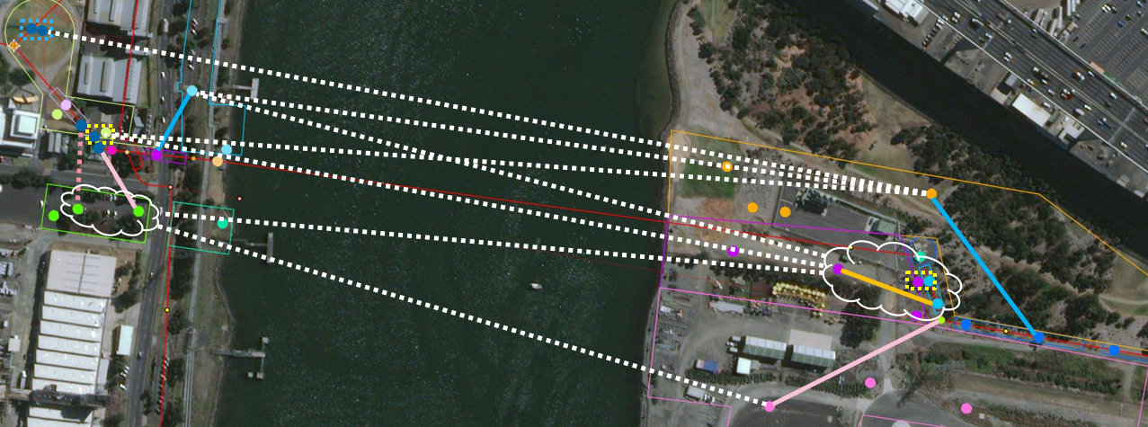
Example
Sometimes we want to get the profile of the land for a pipeline alignment
Prelim assessment where GIS is costly and just want an idea

Slide 3
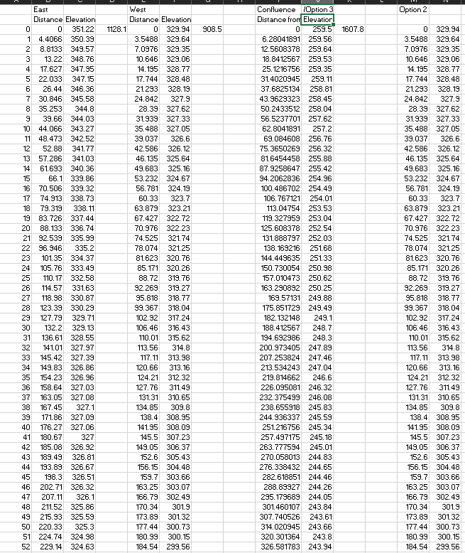
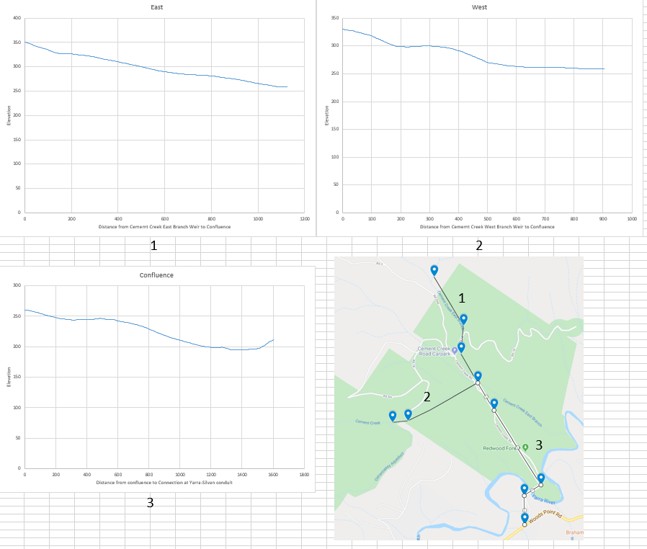
Cement Creek
Task took 3 hours
Need to use a Google Map API that was modified

Slide 4
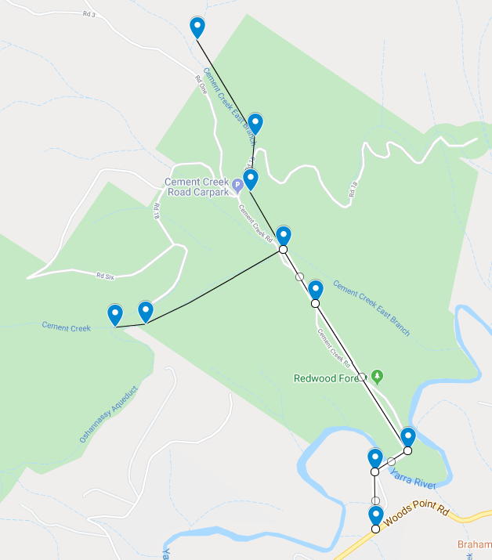
Current Tools
Current tools:
Google Maps
Gives coordinates but very slowly
Has map view that helps us where densely vegetated
Has no elevation tool
Google Earth Pro
Need to install
Shows path and elevation but cannot export data
Aerial view so difficult to see under vegetation
Cannot get co-ordinates of path
GIS
Costly and takes time

Slide 5
Demo
S:/
https://geodesyapps.ga.gov.au/grid-to-geographic
N-E
389157, 5826214
LatLng
-37.704613099, 145.742565545
N-E
388777, 5824826
LatLng
-37.717074532, 145.738043553

