Slide 1
PEcAn: Intro
The Predictive Ecosystem Analyzer
Notes:
This will focus on PEcAn as a workflow; but it is a very specific workflow for model data synthesis. Mike Dietze will present the model-data synthesis “inference engine” part in the next session.

Slide 2
Motivation
Synthesize heterogeneous data
Bridge gap between conceptual and computational models
Summarize what we know, based on available data and mechanistic models
Identify sources of uncertainty -> prioritize data collection and model improvement
Make complex workflows accessible, reproducible, and extensible

Slide 3
Scientific Questions
Ecosystems:
* Biofuel Feedstocks
* Temperate, Tropical, Tundra*
Questions:
* Carbon, Water balance (i.e.,)
* Ecosystem Services (i.e. yield, carbon storage, water use efficiency)

Slide 4
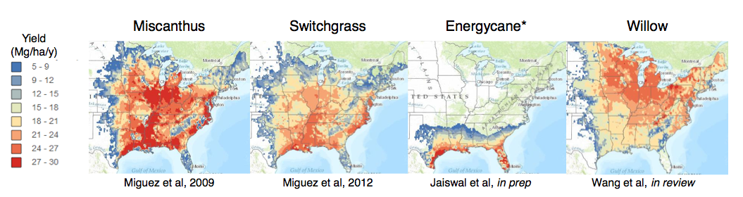
Adding uncertainty
Notes:
Biofuels:
What species?
Where can they be grown?
How much can they produce?
What are ecological consequences?

Slide 5
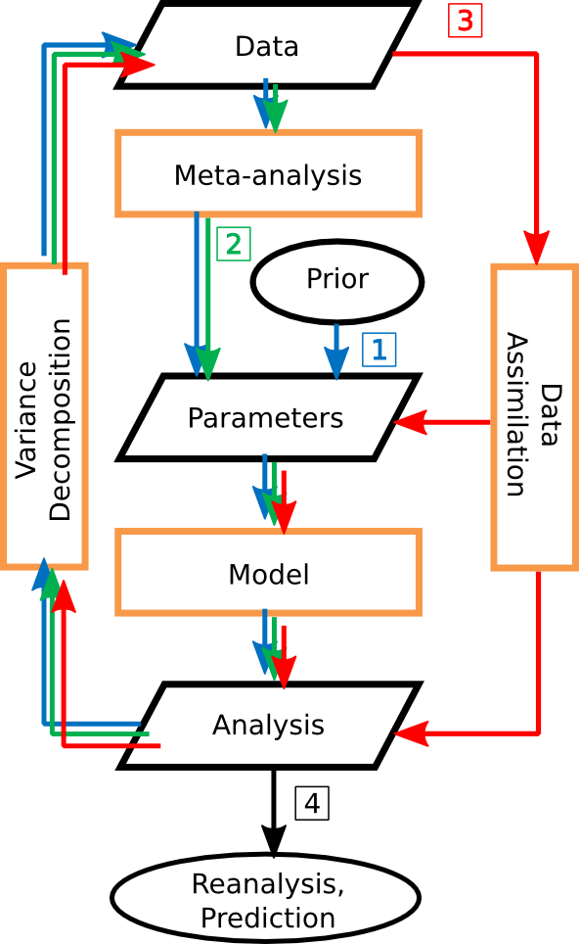
Design
Modular:
models can be coupled within PEcAn
PEcAn can be embedded into other workflows
High level functions
e.g. ‘run.meta.analysis’; ‘start.model.runs(model)’
Web Interface
Remote execution of simulation models on HPC
Adoption of existing standards, libraries where possible
Virtual Machines → easy to get up and running

Slide 6
Modules
Analysis:
Meta-analysis
Data assimilation
Visualization
Priors
Uncertainty
more …
Utilities:
QAQC
Database
Logger
Settings
Models (min 2 functions each):
Ecosystem Demography v2
BioCro
Sipnet
Dalec
Notes:
Modularity is a key feature
each module is an “R” package
Each model requires two translator functions: 1) write inputs and executable
2) Convert outputs

Slide 7
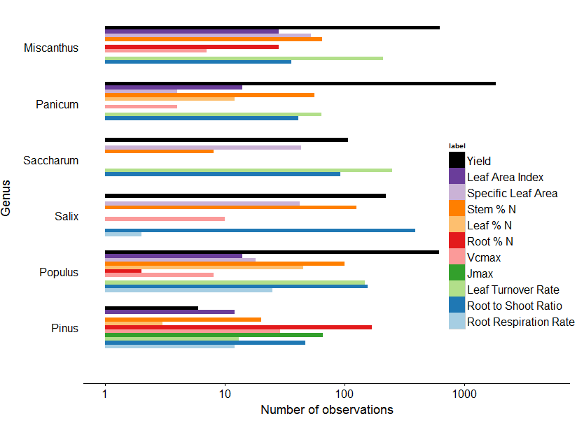
BETYdb: Informatics Backend
Traits, Yields,
Ecosystem Services
Site
Citation
Covariates
Treatment
Cultivar
Variable
Management
Species
Prior
Functional Type
Notes:
Start with data, our foundation

Slide 8
BETYdb (part II): Model provenance
Runs
Ensembles
Workflows
Site
Posteriors
Inputs
Models
Traits, Yields,
Ecosystem Services
Site
Machines
Variable
Citation
Covariates
Functional Type
Treatment
Cultivar
Variable
Management
Species
Prior
Functional Type

Slide 9
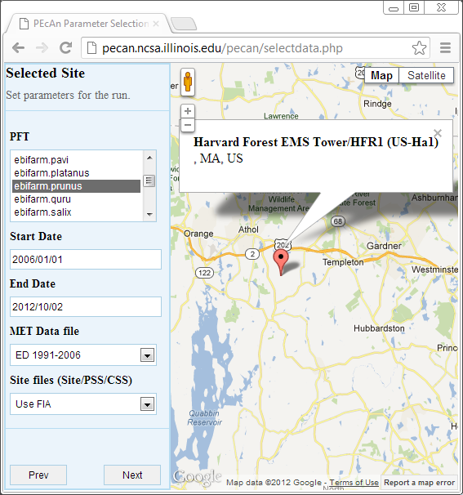
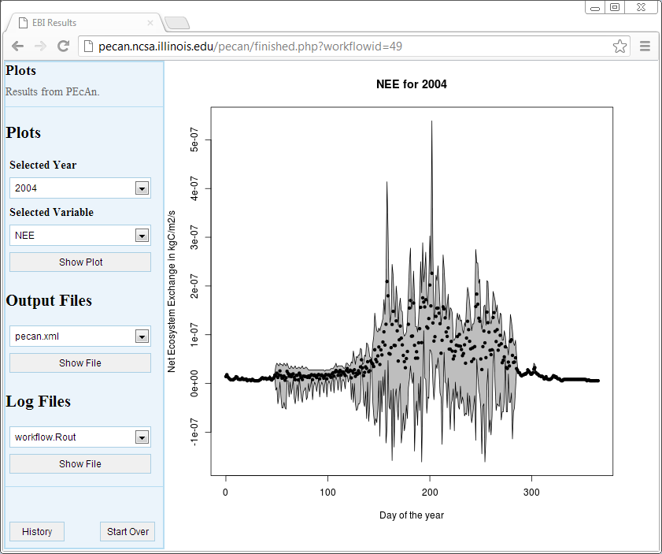
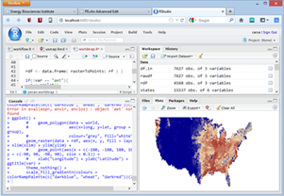
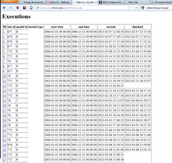
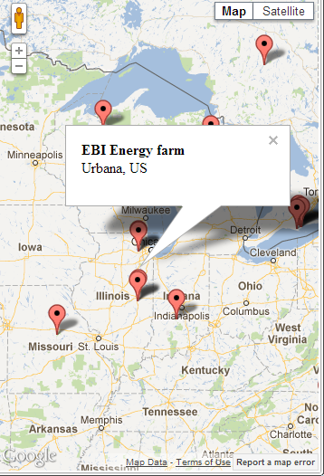
PEcAn: Web Interface
Configure Run
Visualize, Export Results
Analysis in R
Review Previous Runs
Notes:
Available as a virtual machine. This facilitates teaching

Slide 10
Future Directions
Model Intercomparisons
Integration into existing workflows
Automated ‘real-time’ data assimilation
Improved web-interface – enable end users to ask new questions

Slide 11
PEcAn: How To
The Predictive Ecosystem Analyzer
Notes:
This will focus on PEcAn as a workflow; but it is a very specific workflow for model data synthesis. Mike Dietze will present the model-data synthesis “inference engine” part in the next session.

Slide 12
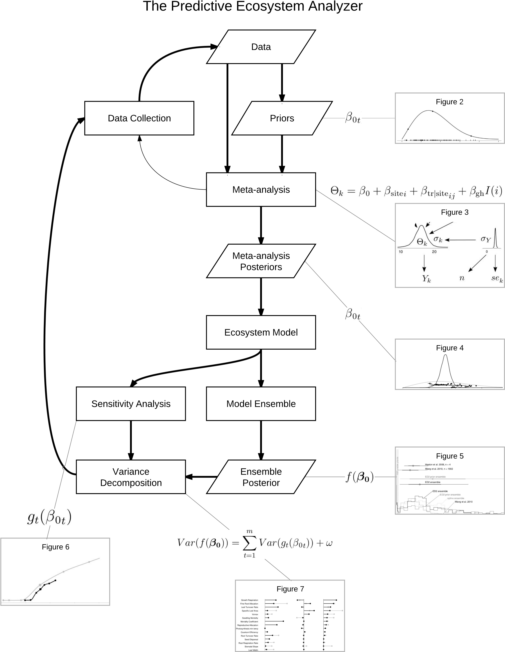
Methods
Add Data
Create Priors
Plant Functional Types
Meta-analysis

Slide 13
Add Data
BETYdb: strives for ‘homogenization’, which is a difficult process that – without exception - requires human to interpret data
Documentation
* BETYdb Data Entry
*

Slide 14
Create Priors
Add Data
Create Priors
Plant Functional Types
Meta-analysis

Slide 15
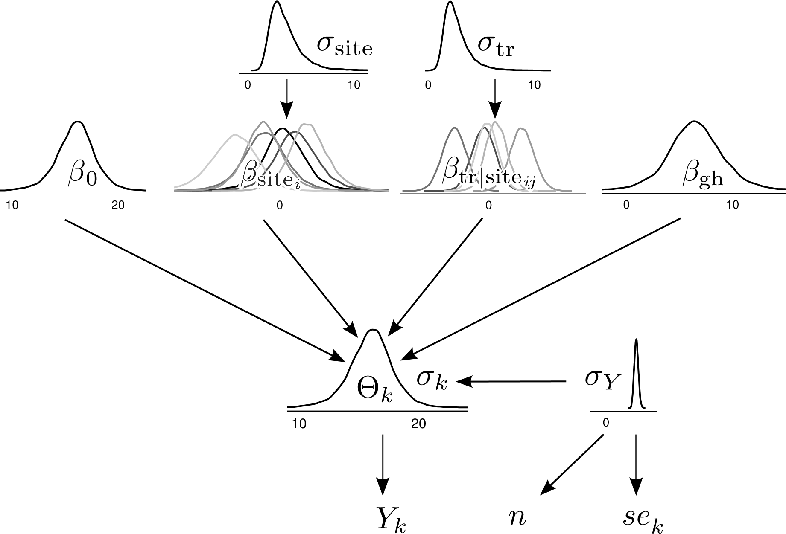

Meta Analysis
Notes:
A relatively straightforward model. Ultimately, β₀ , the global trait mean, is the model parameter.
1. The Overall Data Model
Where Y_{k} is the sample mean of the k^{th} unique site by treatment combination (sample unit),
Θ_{k} is the unobserved ’true’ value of the trait for the k^{th} sample unit.
2. The linear regression
The meta-analysis partitions trait variability into among site, among treatment, and within-unit variance.
The unobserved ’true’ trait mean Θ_{k} is a linear function of the global trait mean, β₀ plus random effects for study site (β_{sitej}) and treatment (β_{tr|sitei}j) and a fixed effect for greenhouse (β_{gh}):
i indexes study site, j indexes each treatment within a study, and I(i) is an
indicator variable set to 0 for field studies and 1 for studies conducted in a greenhouse,
growth chamber, or pot experiment. The parameter used in the ecosystem model is the
posterior estimate of the global mean trait value, β₀. β₀, has an informed prior functional 239 form and parameter specification that varies by trait and species or PFT.
3. Data Uncertainty
The observation precision (precision = 1/variance) for the k^{th} sample mean, τ_{k}, is
determined based on the within-unit precision, τ_{Y} , and the sample size, n, as τ_{k} = n × τ_{Y}
√
(since SE = SD/ n). A common within sample unit precision, τ_{Y} , is assumed in order
to accommodate literature values with missing sample sizes or variance estimates. The
sample standard error, se_{k}, is drawn from a Gamma distribution with parameters 259 informed by the sample size, n, and within-site precision, τ_{Y} :
Gamma( ) (3)
τ_{Y} has a diffuse gamma prior

Slide 16
Sensitivity Analysis

Slide 17
Variance Decomposition

Slide 18
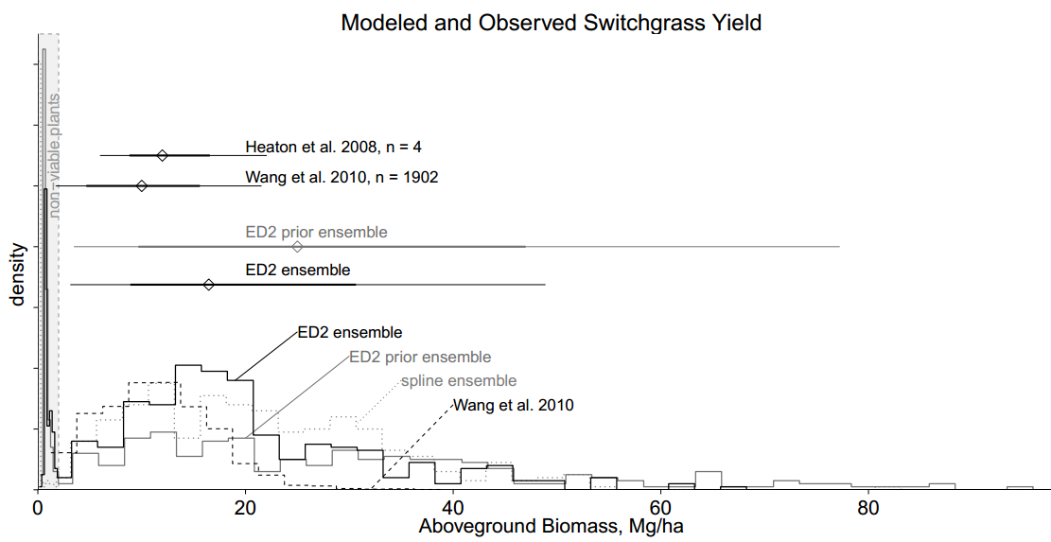
Ensemble Analysis

Slide 19
Methods
Who:
David LeBauer, University of Illinois
Mike Dietze, Boston University
Rob Kooper, National Center for Supercomputing Applications
Shawn Serbin, Brookhaven National Laboratories
Where:
pecanproject.org
github.com/PecanProject
Funding:
Energy Biosciences Institute, NSF

Slide 20
More Information
Who:
David LeBauer, University of Illinois
Mike Dietze, Boston University
Rob Kooper, National Center for Supercomputing Applications
Shawn Serbin, Brookhaven National Laboratories
Where:
pecanproject.org
github.com/PecanProject
Funding:
Energy Biosciences Institute, NSF

