Slide 1
Bias Detection in Coverage
Dayanara Lebron-Aldea Sr. Bioinformatics Scientist 07/01/2021
Interview at EclipseBio

Slide 2

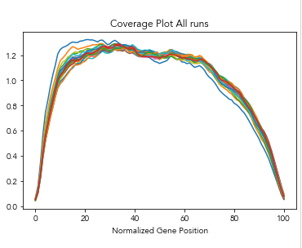
Overview RNA-Seq pipeline
picard - CollectRnaSeqMetrics
Fastq
Quality and Adaptor Trimming
Removal of rRNA and other sequences
PE Alignment with STAR to Human Genome
%exon
%intergenic
%intron
%5’ utr
%3’ utr
Notes:
I will start by showing what the analysis workflow that generated the data I will present in the upcoming slides.
Say how picard calculates this coverage.

Slide 3
Metric Development for Detection of Bias in Coverage
Training Data:
QC mRNA runs (8 samples per run, 4 runs = 32 samples)
Testing Data:
- mRNA new product (several runs ~20)
Ideas:
If we look at the uniformity of coverage spanning from 20-80, ideally the curve will flat out in this area. This creates what we see as a uniform distribution.
A flat line has a slope (m) = 0, therefore if we obtain a slope of 0 or really close to that value in that region, it would mean we have a uniform distribution.
In real cases, we often get a slight 5’ or 3’ bias, so we need to create a range or confidence interval to determine how much bias is acceptable in each direction.
The slope (m) for a coverage plot that has a slight 5’ bias will be m < 0 , and equivalently m > 0 for a slope with a 3’ bias.

Slide 4
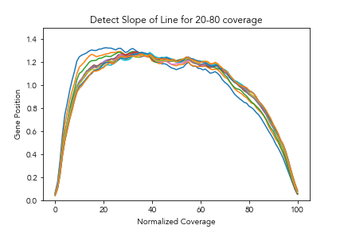
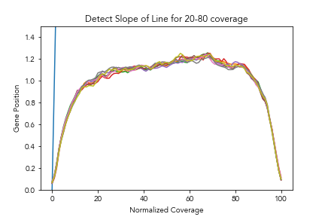
QC: S1 & S2
QC: S3
Slight 5’ bias
Slight 3’ bias
Next Steps
- Using this test data, I proceed to calculate the mean of the slope for each case (individually and as a group ( per run))
- The mean of the slope, and standard deviation of the slope can be used to create a confidence interval.
Notes:
MiSeq599 (Run 1) & MiSeq657 (Run2)
722 Run3

Slide 5
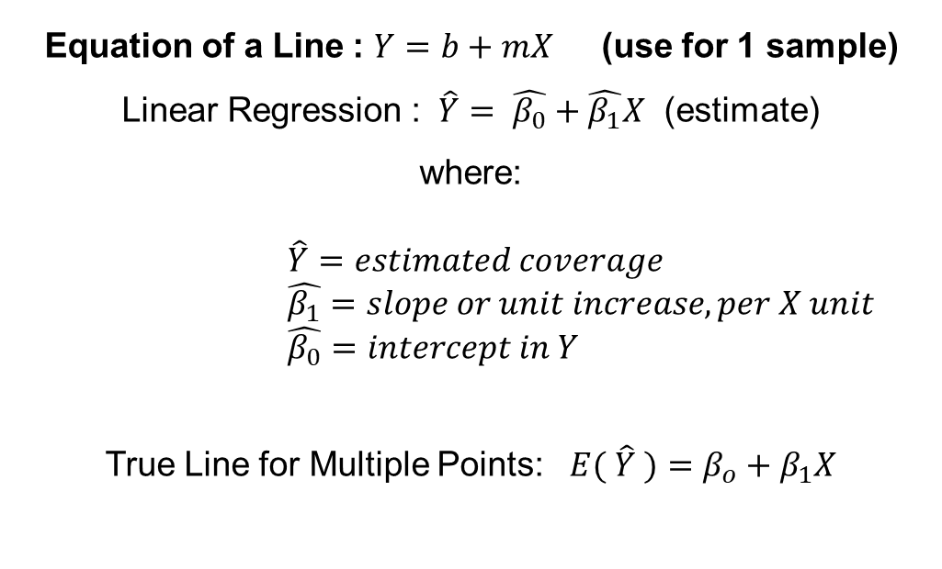
Slope Calculations
Equation of a Line : $Y=b+mX$ (use for 1 sample)
Linear Regression : $\hat{Y}= \hat{β_{0}}+\hat{β_{1}}X$ (estimate) where:
$$\hat{Y}=estimated coverage$$
$$\hat{β_{1}}=slope or unit increase, per X unit$$
$$\hat{β_{0}}=intercept in Y$$
True Line for Multiple Points: $E( \hat{Y} )=β_{o}+β_{1}X$
Linear Regression is a great option for when you want to create a line that summarizes the best possible , a set of data points, while simultaneously minimizing the errors.
This also allows us to utilize all the benefits of a Linear Regression such as confidence intervals in our coefficients and point estimates, in order to draw a pass/fail boundary.

Slide 6
Results
QC Run | Slope | Intercept | Mean Slopes | Max Slopes | Min Slopes
S3 | 0.002895 | 1.06 | 0.00227 | 0.0031 | 0.0011
S2 | -0.003228 | 1.27 | -0.00318 | -0.00289 | -0.003525
S1 | -0.004076 | 1.38 | -0.00484 | -0.00373 | -0.00711
S4 | -0.004193 | 1.30 | -0.00388 | 0.00336 | -0.0048
Slope and intercept are run based, which is calculated through a Linear Regression.
Mean, Max, Min slopes are a summary of individually quantified slopes.
This is a nice way to detect outliers (or in this case, what are the slopes of extremely biased samples)
This enables us to judge how good or pass/fail boundary is.

Slide 7
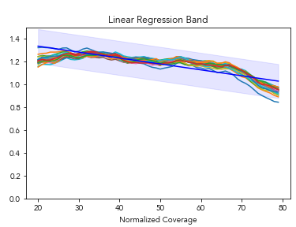
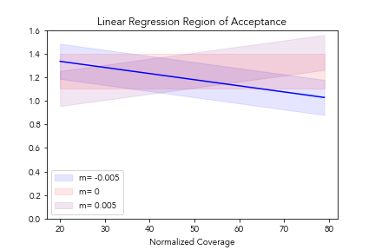

Creating the Boundary
Slopes for acceptable samples that display low 5’ bias range from [-0.002, -0.005].
If we mirror this then for the 3’ bias the range should be the same but with opposite value [0.002, 0.005]
The boundary for failure now is: |m| > 0.005.
|m| is the absolute value of the slope, so that we can cover both positive and negative slopes in just one metric.
$$\hat{Y}=1.438−0.005186X$$
Notes:
What is the slope of the Uplus samples? If putting the Uplus mean slope as the starting point how many std would 0.005 be?

Slide 8
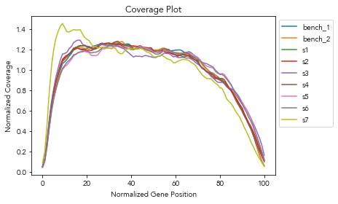
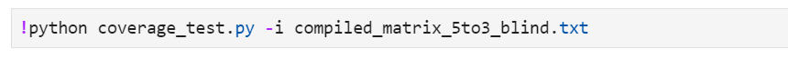
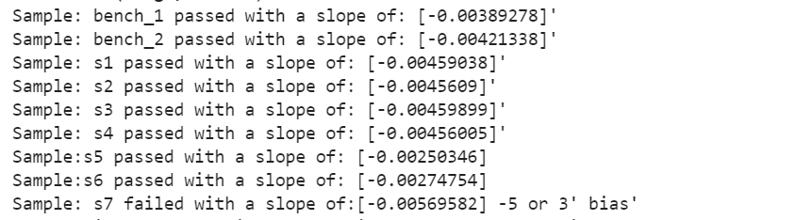
Testing Code with Magic Samples – Blind Test
Coverage Plot
Script Output
Notes:
Should I add how it looks like? Yes
And what they mean.
Re-do

Slide 9
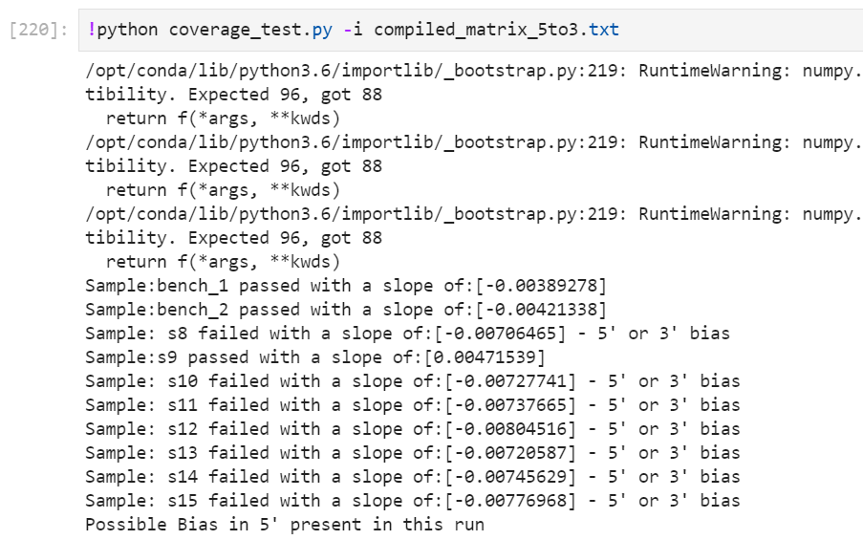
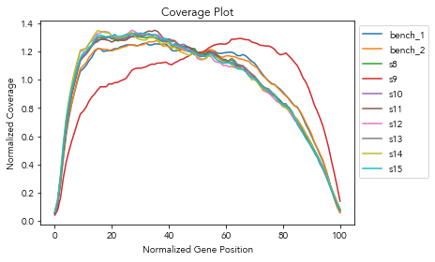
How much bias is acceptable? – |m| > 0.055
Adding piecewise regression to confirm bias.
Script Output
Coverage Plot

Slide 10
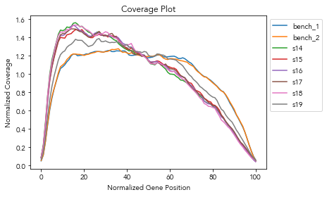
Criteria based on coverage limits
Case scenarios
Method has been developed to look at bias below the 1.25 limit.
Abs(slope) < 0.005
We are seeing different case scenarios:

Slide 11
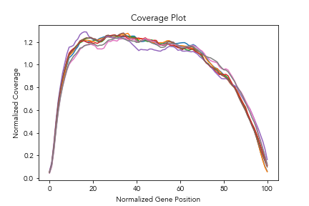
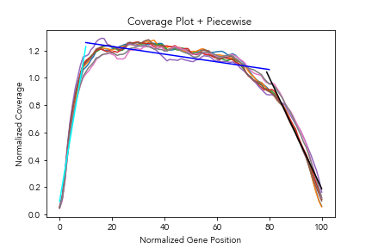
Idea of Piecewise Regression
For each scenario / case where the distribution is consider a pass:
Group passing coverages
Create piecewise regression
Look at mean slope at 0-20, 20-80, 80-100 and draft a 95% c.i

Slide 12
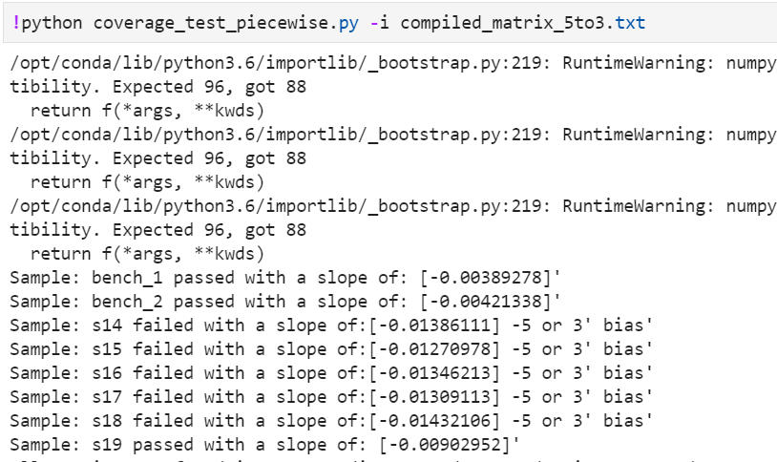
Test
Script Output
Decision Criteria:
If coverage < 1.25 :
pass if abs(m) < 0.0055
If coverage 1.25 – 1.4 :
pass if abs(m) < 0.0099
confirm bias by looking at slope in 0-10 region and 80-100 region.
If coverage > 1.4:
pass if abs(m) < 0.0055.
Tested with 10 more runs (8 samples each):
Recall: 100% (TP/TP+FN)

Slide 13

Conclusion
There are multiple statistical ways of detecting bias in a distribution.
Your method will perform good within the range, or ,for the range of data to which it was designed to.
Always allow for wiggle room in your thresholds, hence using upper bound of 95% c.i.

