Slide 1

A Study of the Survival and Growth of a Fungal Species under Different Conditions
By Daniel Ledesma

Slide 2
Summary
The fungal species under study has been associated with grapevine decline.
The study includes separate experiments to test the effect of temperature, water potential, and PH level on growth of a fungal species. Aim to find effective control strategies.
Influence of water potential on radial colony growth was determined by adding sucrose, KCL, NaCL or Glycerol at appropriate concentration to produce different osmotic potentials.
After 7 days colony diameter was measured along two axes perpendicular to one another and the average of the two diameters was recorded as the radial colony diameter.

Slide 3
Objectives
Want to test if
– Fungi grows the same in different water potential using different solutes
fit curves to show how colony diameter changes with water potential

Slide 4

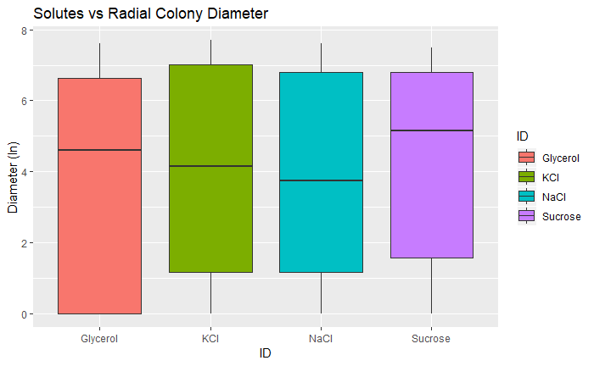
Graphical observations
The mean colony diameter is highest for Sucrose (4,21 cm)
The IQR for Glycerol is the largest amongst the four solutes
KCL produces the value with the largest colony diameter (7.7 cm)
The variance of colony diameter is highest for Glycerol (9.20 cm)

Slide 5
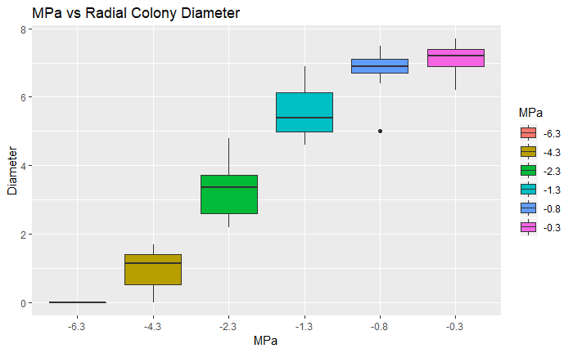
Graphical observations (cont.)
MPa with the highest mean colony diameter is -.3 (highest water potential)
The mean colony diameter increases as the water potential increases
An MPa of -6.3 implies a lower water potential; based on the colony diameter being 0, fungi would not be able to grow in these conditions
There is an outlier at MPa of -.8, which could have been caused by an incorrect observation or another factor that caused the colony to die early

Slide 6
Model fitting
The first model tested (Model 1):
diam=ID+Trial+MPa+ID*Trial+ID*MPa+Trial*MPa+Trial*ID*MPa+MPa^2+ID*(MPa^2)+Trial*(MPa^2)
ID: Glycerol, NaCl, KCl or Sucrose
Trial: 1 or 2
MPa: -6.3,-4.3,-2.3,-1.3,-.8,-.3

Slide 7
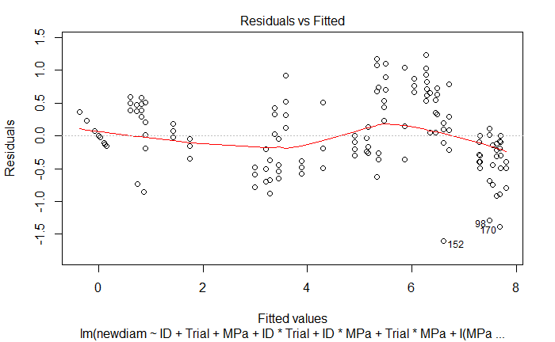
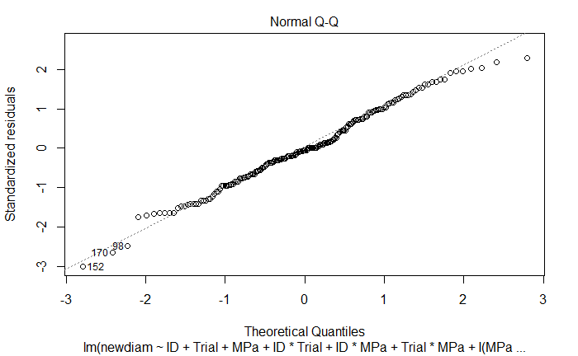
Assumptions for Model 1

Slide 8
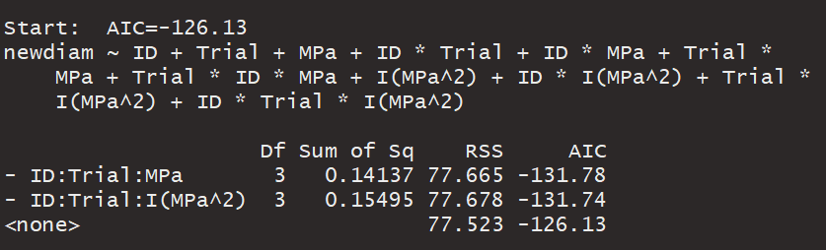
Results for model 1
From this model the variable, when removed, that will reduce the AIC the most is the interaction involving all three variables (ID*Trial*MPa)
This term will be removed from the model and a new model will be fitted

Slide 9
Model fitting
The second model tested (Model 2):
diam=ID+Trial+MPa+ID*Trial+ID*MPa+Trial*MPa+I(MPa^2)+ID*I(MPa^2)+Trial*I(MPa^2)
ID: Glycerol, NaCl, KCl or Sucrose
Trial: 1 or 2
MPa: -6.3,-4.3,-2.3,-1.3,-.8,-.3

Slide 10
Assumptions for model 2

Slide 11
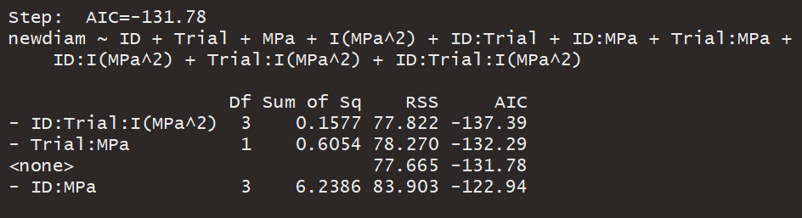
Results for model 2
From this model the variable, when removed, that will reduce the AIC the most is the interaction involving all three variables (ID*Trial*MPa^2)
This term will be removed from the model and a new model will be fitted

Slide 12
Model fitting
The third model tested (Model 3):
newdiam =ID + Trial + MPa + I(MPa^2) + ID*Trial + ID*MPa + Trial*MPa +ID*I(MPa^2) + Trial*I(MPa^2)
ID: Glycerol, NaCl, KCl or Sucrose
Trial: 1 or 2
MPa: -6.3,-4.3,-2.3,-1.3,-.8,-.3

Slide 13
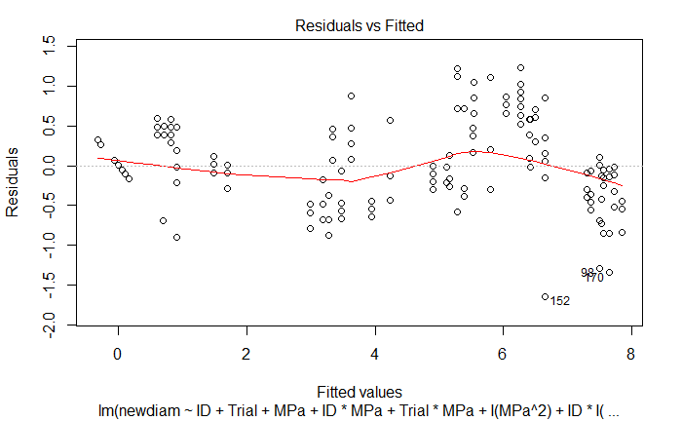
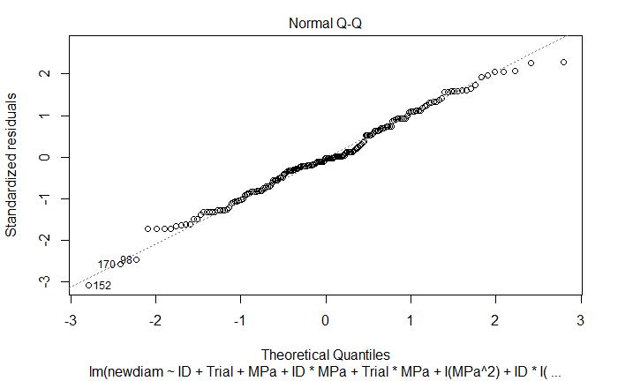
Assumptions for model 3

Slide 14
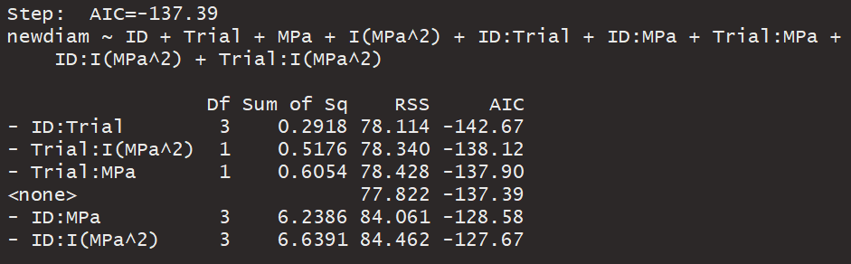
Results for model 3
From this model the variable, when removed, that will reduce the AIC the most is the interaction between ID and Trial (ID*Trial)
This term will be removed from the model and a new model will be fitted to the data

Slide 15
Model fitting
The fourth model tested (Model 4):
diam= ID + Trial + MPa + I(MPa^2)+ ID*MPa + Trial*MPa +ID*I(MPa^2) + Trial*I(MPa^2)
ID: Glycerol, NaCl, KCl or Sucrose
Trial: 1 or 2
MPa: -6.3,-4.3,-2.3,-1.3,-.8,-.3

Slide 16
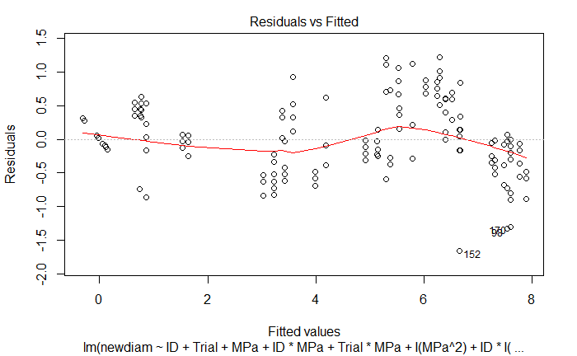

Assumptions for model 4

Slide 17
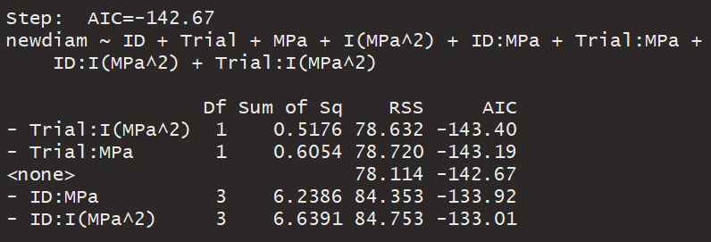
Results from model 4
From this model the variable, when removed, that will reduce the AIC the most is the interaction between Trial and MPa^2 (Trial*MPa^2)
This variable will be removed from the model and a new model will be fitted

Slide 18
Model fitting
The fifth model tested (Model 5):
diam= ID + Trial + MPa + I(MPa^2)+ ID*MPa + Trial*MPa +ID*I(MPa^2)
ID: Glycerol, NaCl, KCl or Sucrose
Trial: 1 or 2
MPa: -6.3,-4.3,-2.3,-1.3,-.8,-.3

Slide 19
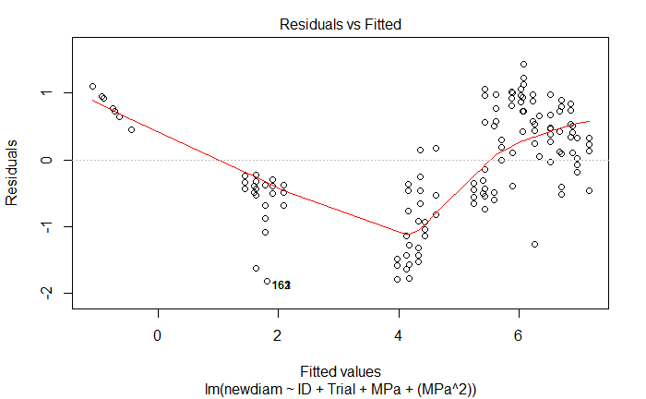
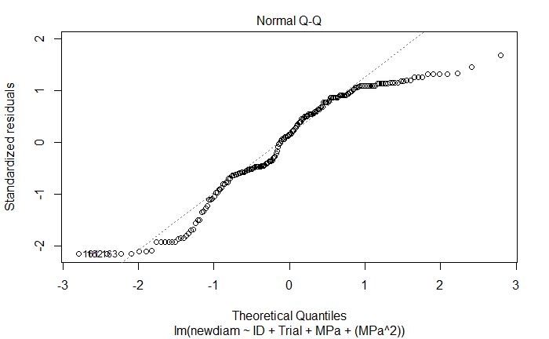
Assumptions for model 5

Slide 20
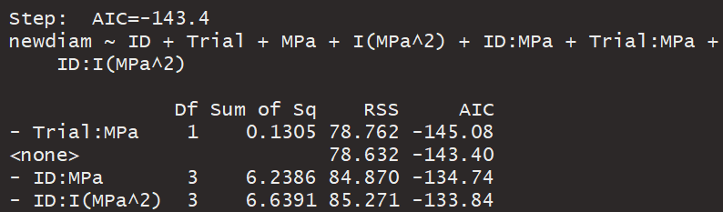
Results from model 5
From this model the variable, when removed, that will reduce the AIC the most is the interaction between Trial and MPa (Trial*MPa)
This variable will be removed from the model and a new model will be fitted

Slide 21
Model fitting
The sixth model tested (Model 6):
Diam= ID + Trial + MPa + I(MPa^2)+ ID*MPa +ID*I(MPa^2)
ID: Glycerol, NaCl, KCl or Sucrose
Trial:1 or 2
MPa: -6.3,-4.3,-2.3,-1.3,-.8,-.3

Slide 22
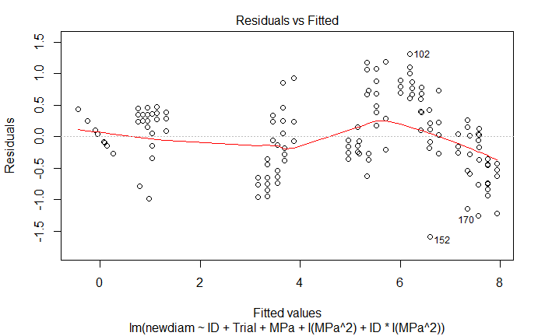
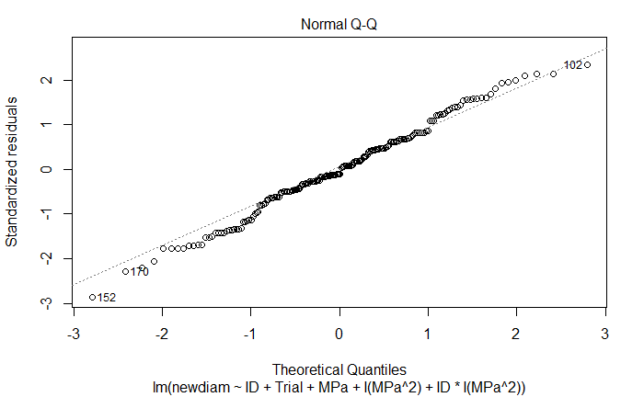
Assumptions for model 6

Slide 23
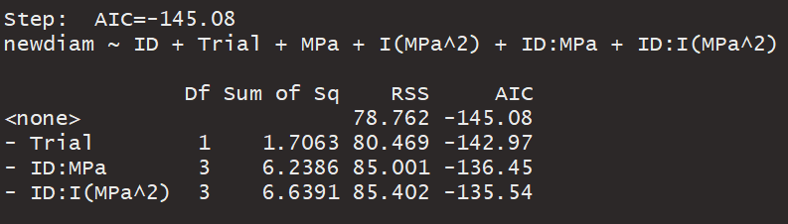
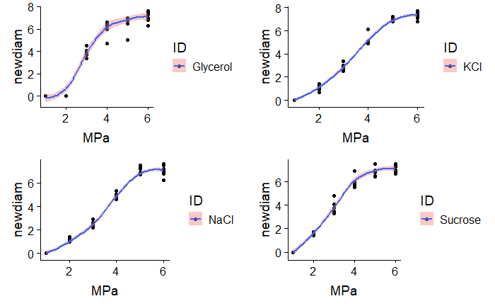
Results from model 6
Based on the output from this model, the procedure indicates that no more terms should be removed and all remaining terms will be the best fit for the model
If Trial is removed the AIC will increase which is not what we want , so therefore it will stay in the model as a significant variable

Slide 24
Conclusion
From testing the six models, model 6 appears to be the model of best fit for the data
This Model includes the best predictors for radial colony growth
However, the R-squared adjusted (.9452), for Model 6, was not much different than the rest of the 5 models.

