Slide 1
Quantitative Image analysis
Questions (and answers?)
https://github.com/dlegland/image-analysis-practical-2023

Slide 2
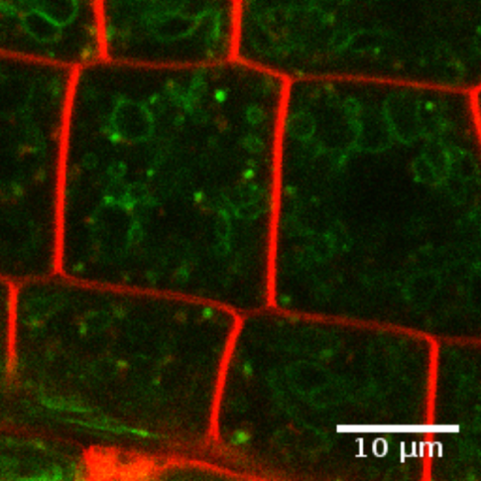
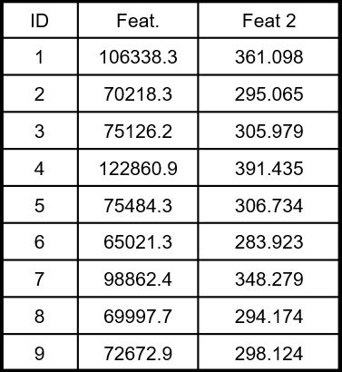
Quantitative image analysis
Typical objectives:
Comparison of modalities
Classification
Modelling
…
Need to quantify information within images
Analysis
Image
Measures

Slide 3
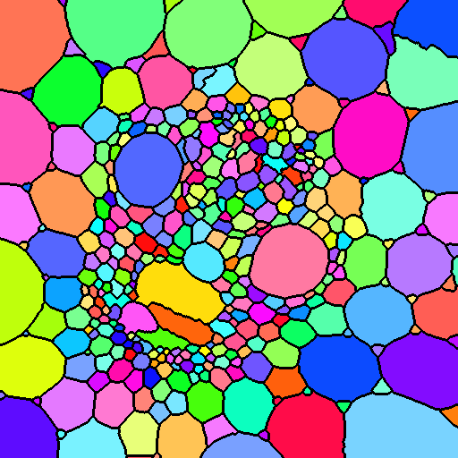
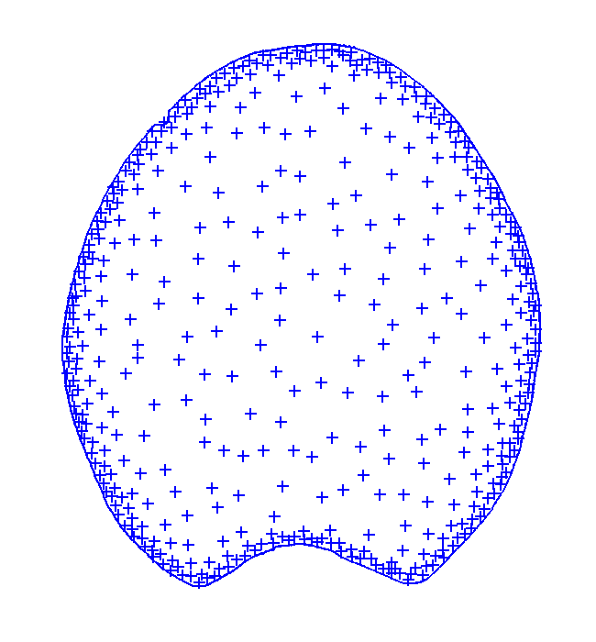
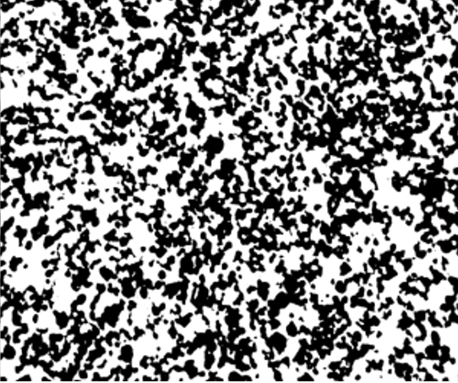
What can we quantify from images?
Regions
Points
Microstructures
Textures
Features:
Size
Shape
Orientation
Intensities
…
Features:
Densities
[co]Localization
Repulsion / attraction
…
Features:
Porosity
Tortuosity
Thickness D°
Pore size D°
…
Features:
Variations of gray levels
Size D°
Orientation
Side note: this is not exhaustive

Slide 4
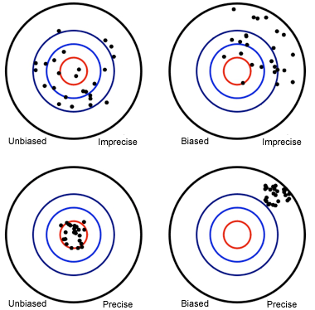
Evaluation of measures quality
Two criteria:
Accuracy
Precision (variability)
Measures
Bias (average error)
Standard deviation

Slide 5

Why (when) it is necessary to consider accuracy (and precision)?
Necessary
Interpretation
Modelling
Multiple software
Combination with other features
E.g. circularity
Not (absolutely) necessary
Group comparison
Classification
Clustering
…

Slide 6
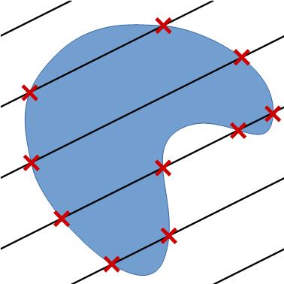
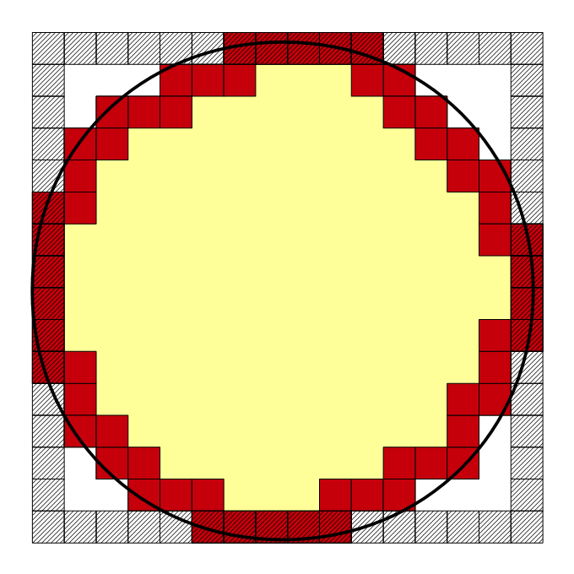



Measurement of perimeter [and surface area]
Idea #1: count border pixels [voxels]
Idea #2: use Crofton formula
$$2πR=8R$$
$$π=4$$

Slide 7
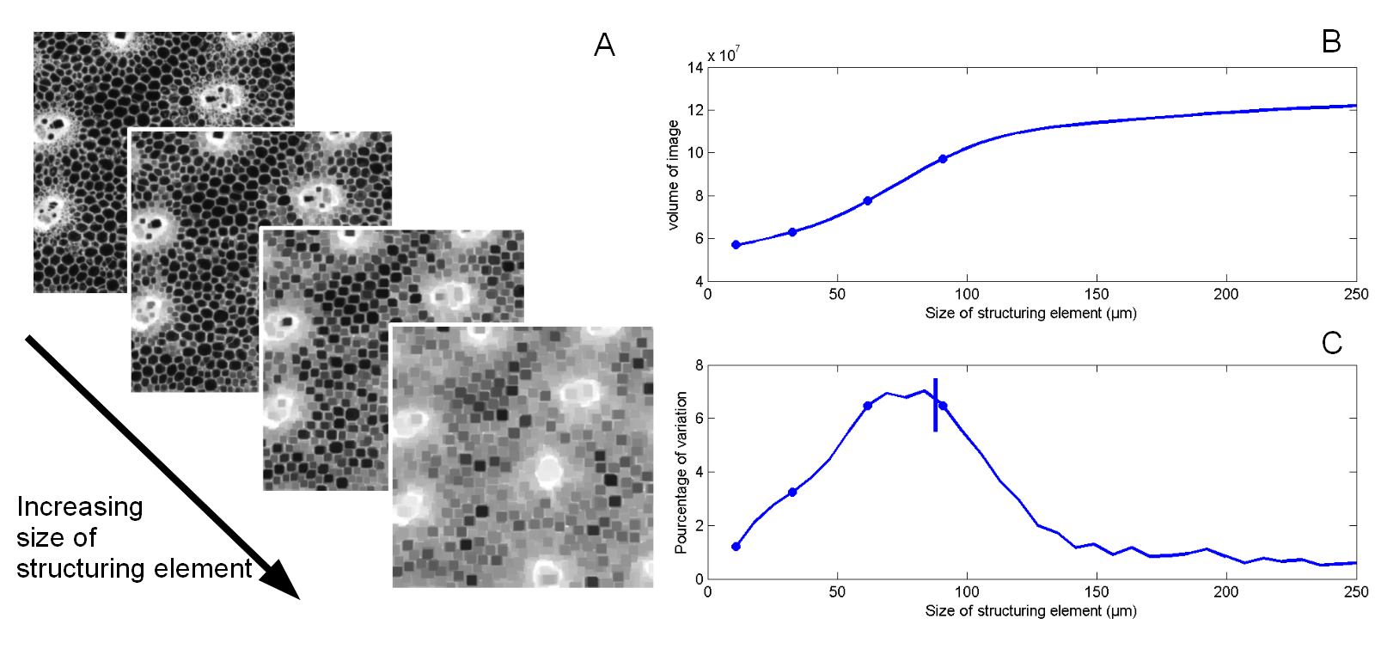
Image texture quantification
Based on gray-level granulometry with morphological filters

Slide 8
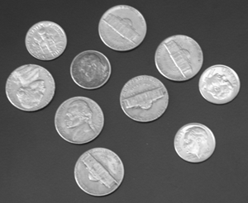
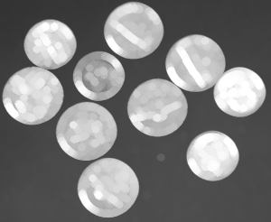
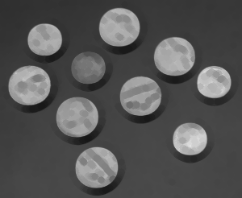
Morphological filters
Dilation
(max filter)
Erosion
(min filter)
Structuring element = neighborhood

Slide 9
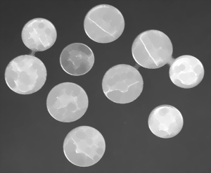

Morphological filters
Closing
(dilation+erosion)
Opening
(erosion+dilation)
Dark regions
disappear
Bright regions
disappear

Slide 10
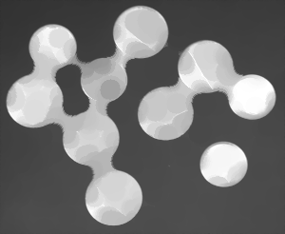
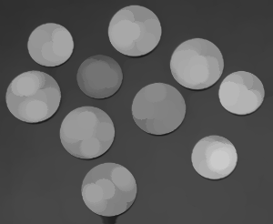
Morphological filters
Closing
(dilation+erosion)
Opening
(erosion+dilation)
Dark regions
disappear
Bright regions
disappear

Slide 11
Iteration of morphological filters with increasing sizes
Provides size distributions
without having to segment

Slide 12
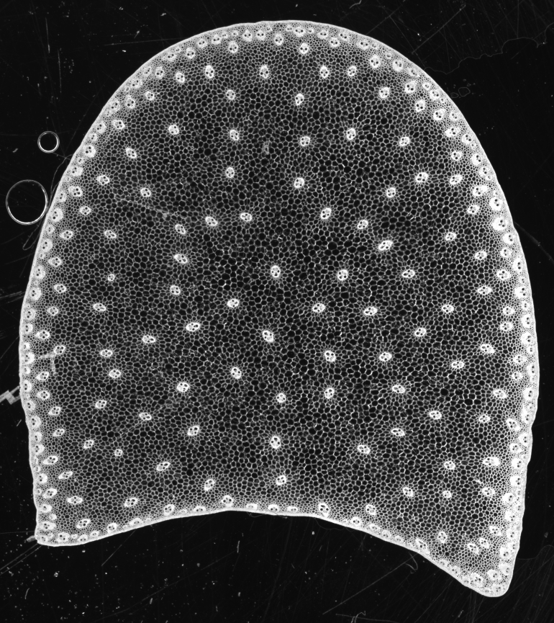
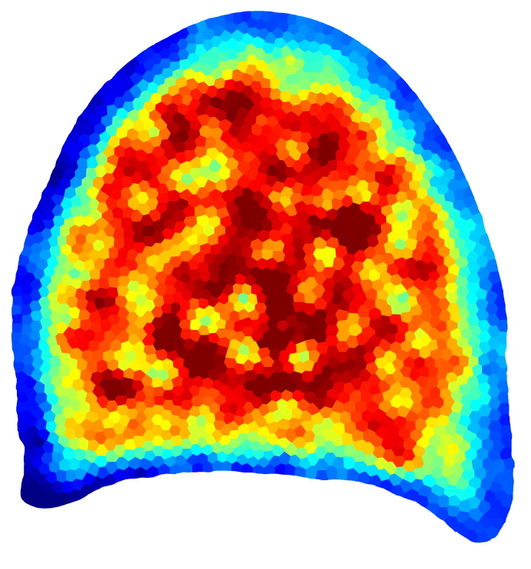
Extensions of granulometry – parametric mapping

Slide 13

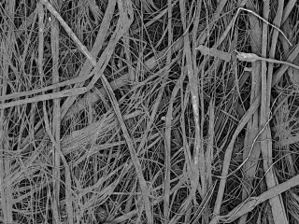
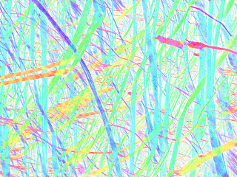
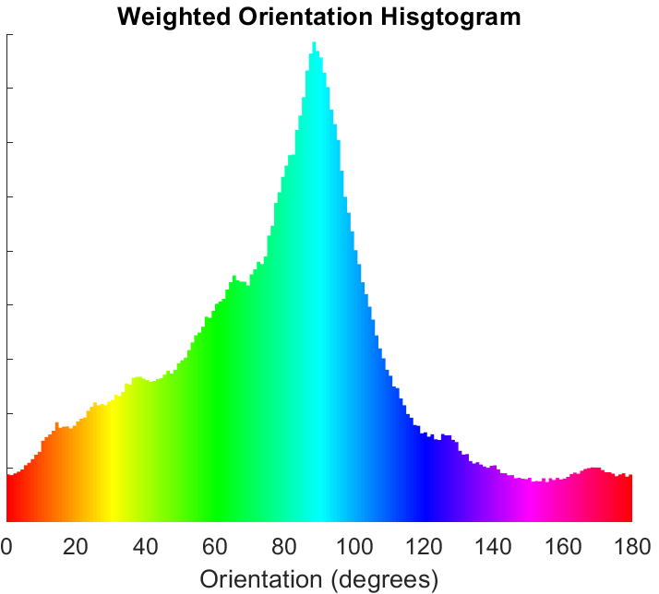
Extension to orientation mapping
Context: use of plant fibers within bio-based materials
Objective: quantify distribution of orientations
Method: granulometry with oriented line SE
Gager et al. (2020)

Slide 14
Any question about the talk?

Slide 15
Some questions before we start
 | Just know it | Use it | Proficient
ImageJ / Fiji
Macro programming
Mathematical morphology
Stereology
Texture analysis

Slide 16
Some questions before we start
How do you use image quantification:
Never use
Blindly provide
Comparison
Modelling
Other?

Slide 17
Practical session
Part 1: validation of image quantification methods
« quality check »
Focus on perimeter
Part 2: image texture analysis
Example on plant tissue images
Use Fiji/ImageJ
(with plugins…)
https://github.com/dlegland/image-analysis-practical-2023

Slide 18
What we will need
ImageJ / Fiji
MorphoLibJ
Perimeter / surface area measure
Morphological filters
« ijtools » Plugins (https://github.com/ijtools)
DigitalShapes plugin
ijGranulometry plugin
ijGeometry library
Macro programming

Slide 19
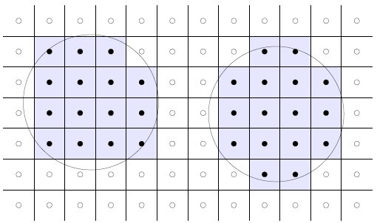
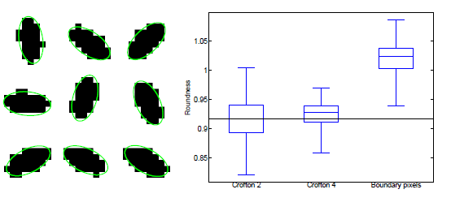
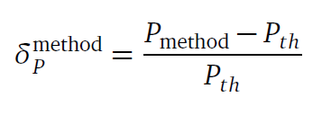
Practical part 1: Validation of image analysis method(s)
Principle:
Generate synthetic shapes with known perimeter
Generete digitized repesentation(s)
Change position + orientation
Measure
Compare with expected value

Slide 20
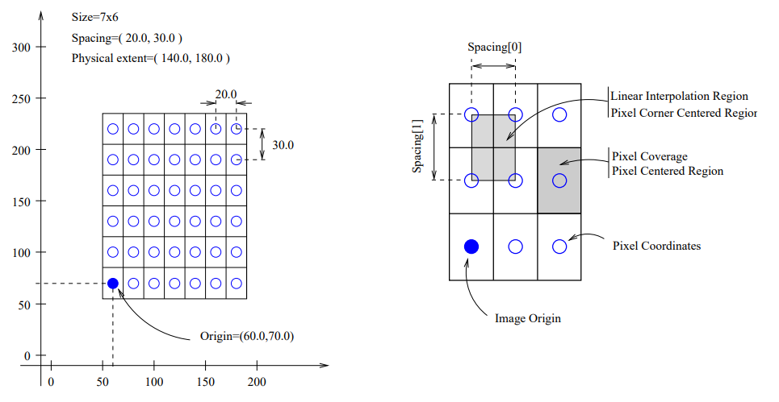
Image coordinate system

Slide 21

Ex. 1.1 Measuring the perimeter of a disk
Run Fiji
Create New Image
200 x 200 uint8
Add a disk:
Plugins -> Digital Shapes -> Fill Disk
Choose Radius = 50
Arbitrary center
Question: perimeter = ?

Slide 22
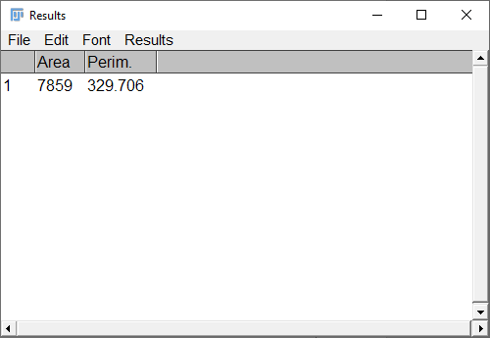
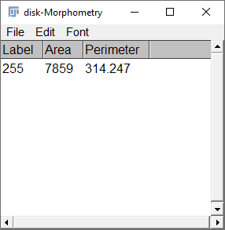
1.1 Measuring the perimeter of a disk
Measuring with ImageJ
Measuring with MorphoLibJ
(relative) error: 4.7 %
(relative) error: 0.02 %

Slide 23
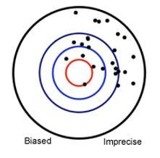
Precision & accuracy
One measurement is not necessarily representative…
Need to integrate over several positions
Either random or by numerical integration
Exercice:
Generate 100 images (or more…)
with various center positions
Measure perimeter
Evaluate mean and std of measurements

Slide 24
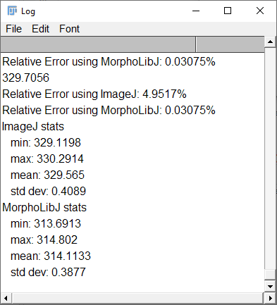
Results for disk

Slide 25
Ex.1.2 Other shapes: square, ellipse…
Repeat exercise with square
Use «Fill Rotated Square » plugin
Choose for example side length = 100
Perimeter = ?
Similar results as for disk?

Slide 26
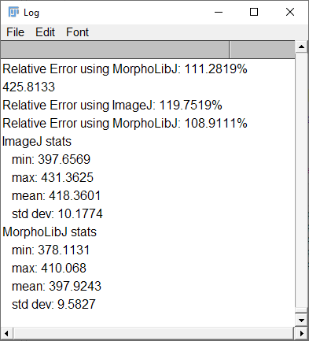
Results for square

Slide 27

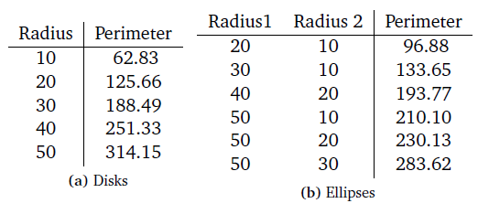
Ex. 1.3 Other shapes: square, ellipse…
Repeat exercise with ellipse
Use «Fill Rotated Ellipse » plugin
Perimeter of an ellipse ?
Numerical integration
Approximations

Slide 28
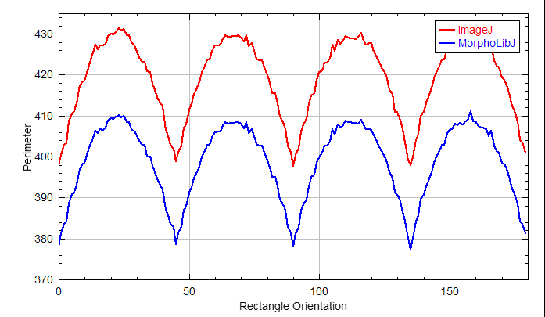
Bonus: impact of orientation
Draw the error of perimeter measured on square (or ellipse) depending on orientation

Slide 29
Bonus: impact of image resolution
Try to evaluate the precision for various pixel sizes
Size = 0.5*D -> 100*D
Try also rectangular pixel (width != height)

Slide 30
Bonus: evaluate error on surface area measure
Sample shapes:
Sphere
Ellipsoid, cylinder, cuboid…
Problem: even distribution of orientations?

Slide 31
Practical outline 2
Image texture analysis
Recall morphological filters
Compute granulometry curves
Interpret!

Slide 32

Demonstration example
We will start with the image “coins.png”
In “practical/granulometry/coins.png”
Pre-exercise: apply morphological filters with various diameters

Slide 33
Run granulometry
Choose « granulometry by Radius… »

Slide 34
Result

Slide 35
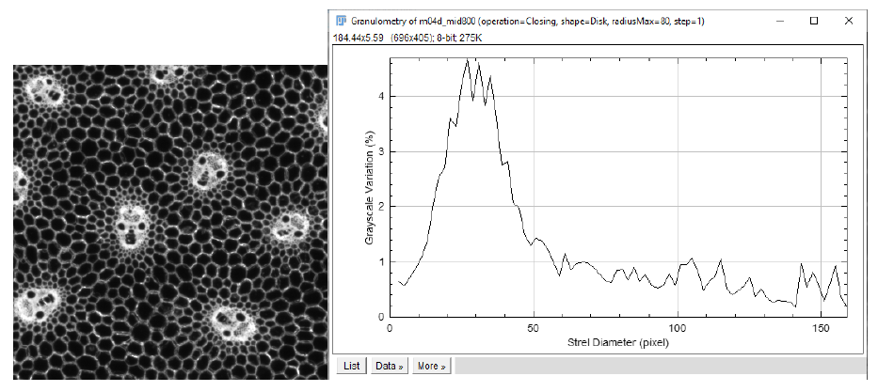
Application to images of plant tissues
Choose one of the images in « maize » directory, and experiment

Slide 36


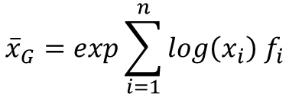
Computation of average size
Mean value from a list of value:
Mean value from a distribution (arithmetic)
Geometric mean from a distribution
$$\overline{x}=\frac{1}{n}\sum_{i=1}^{n}{x_{i}}$$
$$\overline{x}=\sum_{i=1}^{n}{x_{i}{ f}_{i}}$$
$${\overline{x}}_{G}=exp\sum_{i=1}^{n}{log\left(x_{i}\right){ f}_{i}}$$

Slide 37
Study of anisotropy
Try computing granulometry curves with horizontal and vertical elements
And compare

Slide 38
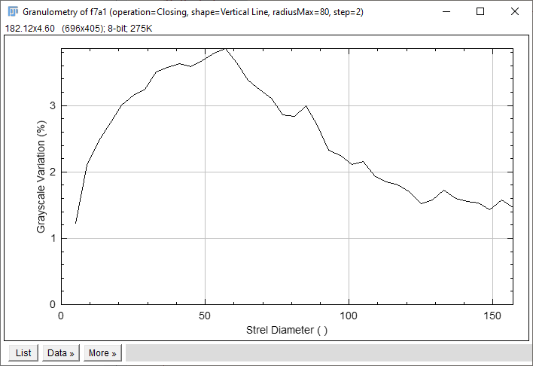
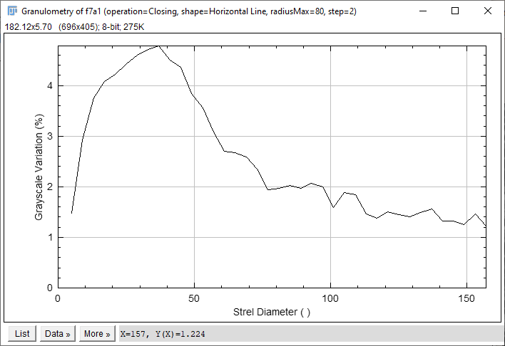
Anistropy – expected result
Vertical direction
Horizontal direction

Slide 39
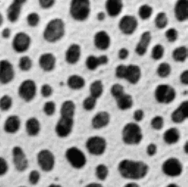
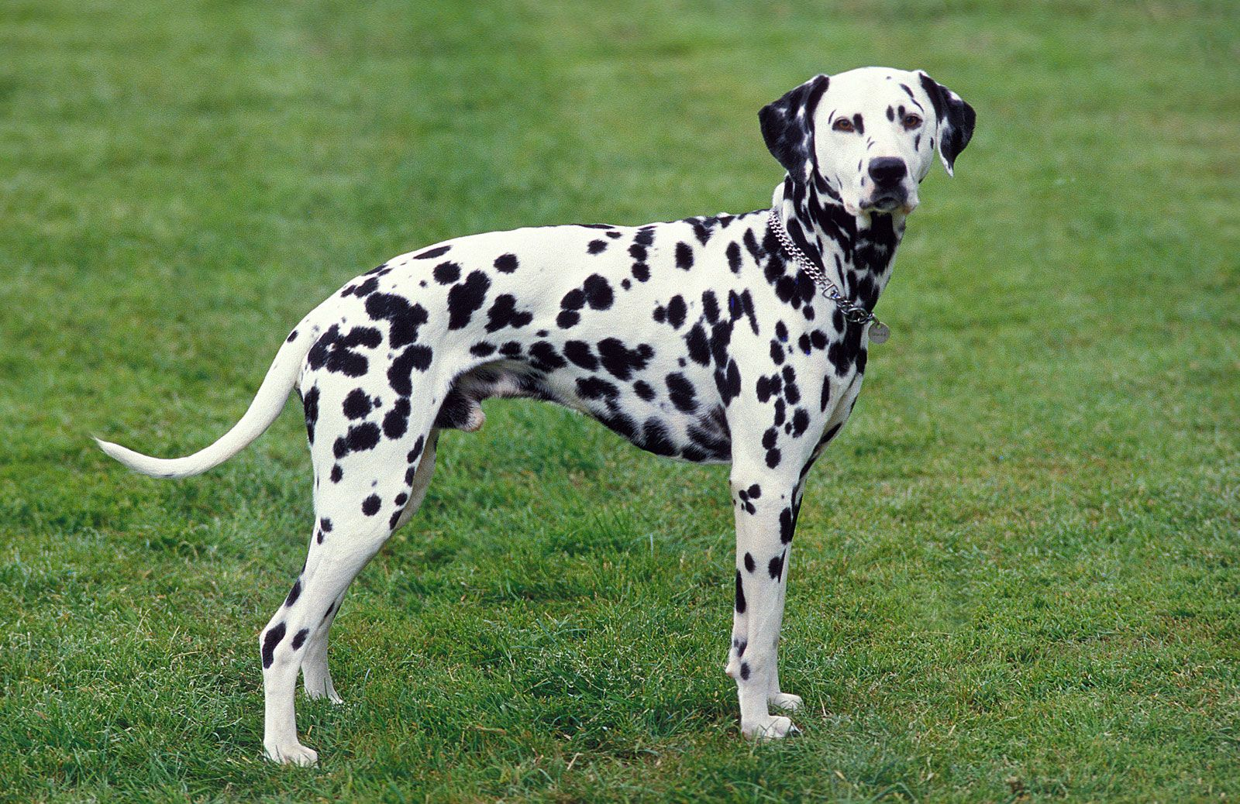
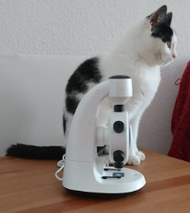
Bonus: try your favorite image

Slide 40
Bonus: try « batch processing »

