Slide 1
Quantitative Image analysis
Questions (and answers?)

Slide 2
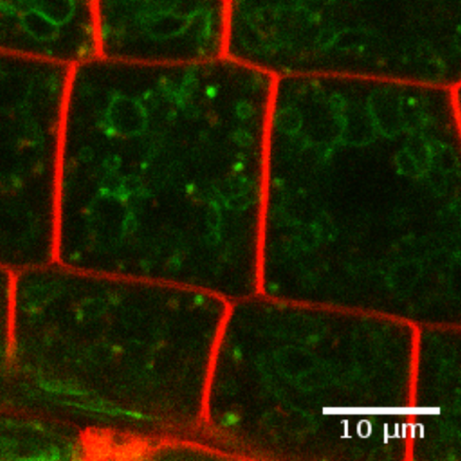
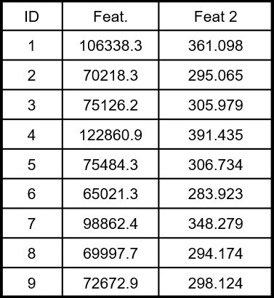
Quantitative image analysis
Typical objectives:
Comparison of modalities
Classification
Modelling
…
Need to quantify information within images
Analysis
Image
Measures

Slide 3
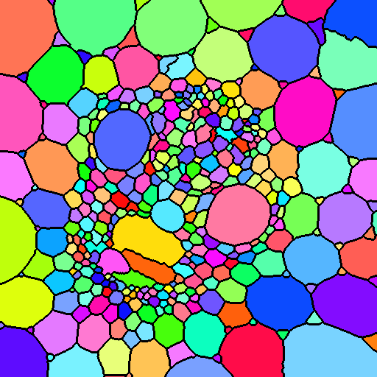
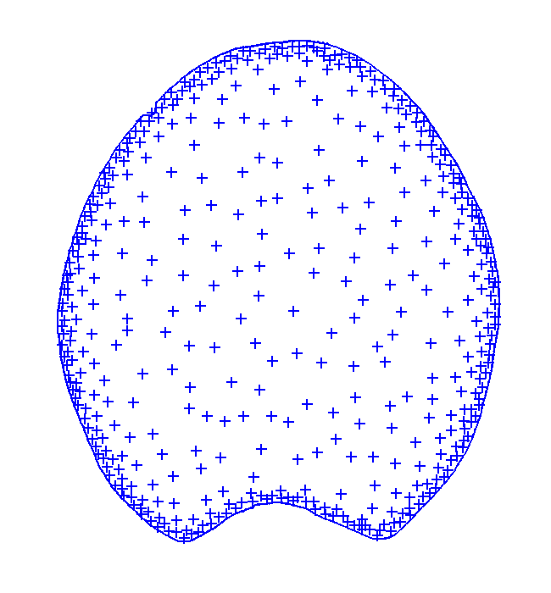
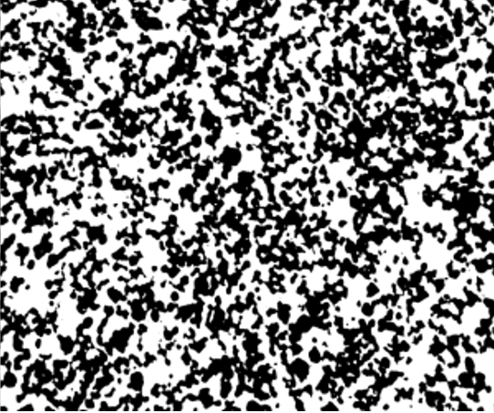
What can we quantify from images?
Regions
Points
Microstructures
Textures
Features:
Size
Shape
Orientation
Intensities
…
Features:
Densities
[co]Localization
Repulsion / attraction
…
Features:
Porosity
Tortuosity
Thickness D°
Pore size D°
…
Features:
Variations of gray levels
Size D°
Orientation
Side note: this is not exhaustive

Slide 4
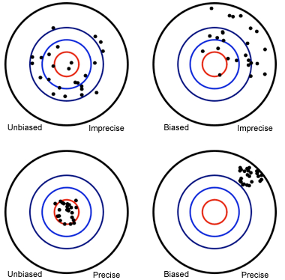
Evaluation of measures quality
Two criteria:
Accuracy
Precision (variability)
Measures
Bias (average error)
Standard deviation

Slide 5

Why (when) it is necessary to consider accuracy (and precision)?
Necessary
Interpretation
Modelling
Combination with other features
E.g. circularity
Not necessary
Group comparison
Classification
Clustering
…

Slide 6
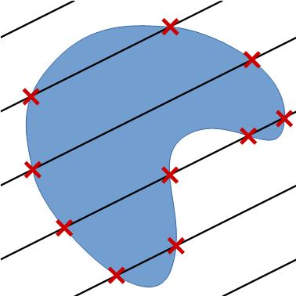
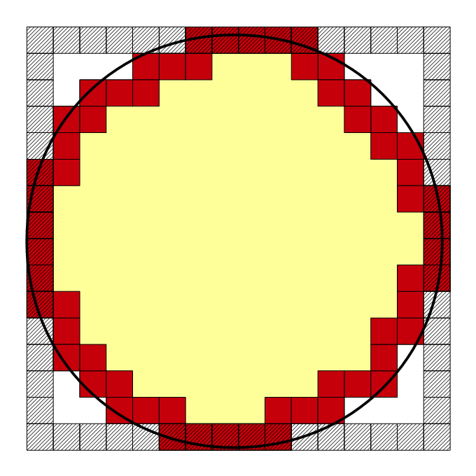



Measurement of perimeter [and surface area]
Idea #1: count border pixels [voxels]
Idea #2: use Crofton formula
$$2πR=8R$$
$$π=4$$

Slide 7
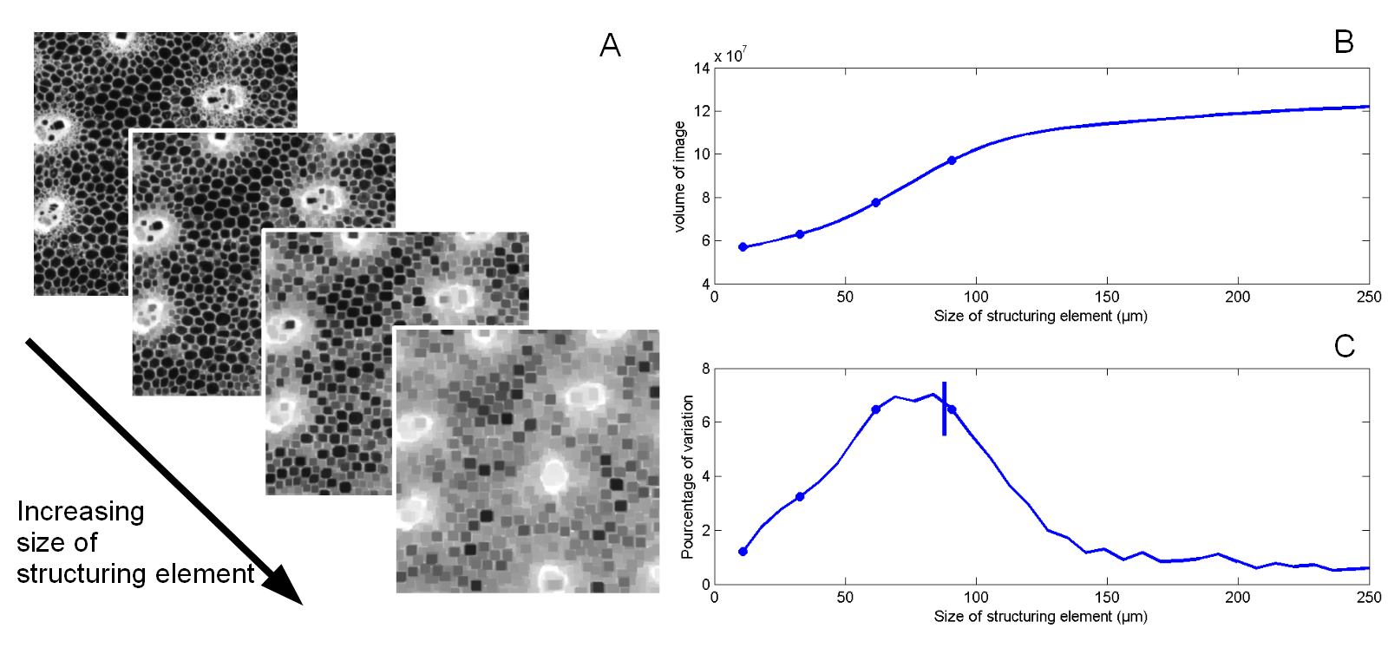
Image texture quantification
Based on gray-level granulometry with morphological filters

Slide 8
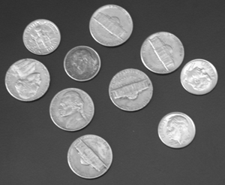
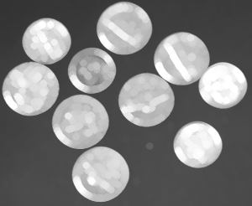
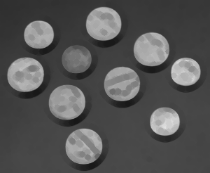
Morphological filters
Dilation
(max filter)
Erosion
(min filter)
Structuring element = neighborhood

Slide 9
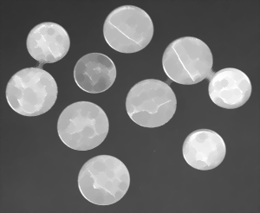

Morphological filters
Closing
(dilation+erosion)
Opening
(erosion+dilation)
Dark regions
disappear
Bright regions
disappear

Slide 10
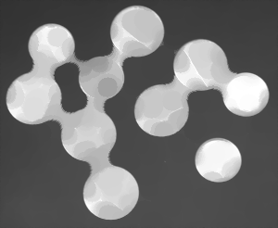
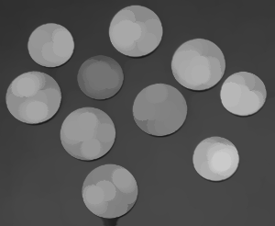
Morphological filters
Closing
(dilation+erosion)
Opening
(erosion+dilation)
Dark regions
disappear
Bright regions
disappear

Slide 11
Iteration of morphological filters with increasing sizes
Provides size distribution
without having to segment

Slide 12
Any question about the talk?

Slide 13
Practical session
Part 1: validation of image quantification methods
« quality check »
Focus on perimeter
Part 2: image texture analysis
Example on plant tissue images
Use Fiji/ImageJ
(with plugins…)
https://github.com/dlegland/image-analysis-practical-2023

Slide 14
What we will need
ImageJ / Fiji
MorphoLibJ
Perimeter / surface area measure
Morphological filters
Plugins
DigitalShapes plugin
ijGranulometry plugin
Macro programming

Slide 15
Some questions before we start
 | Just know it | Use it | Proficient
ImageJ / Fiji
Macro programming
Mathematical morphology
Texture analysis

Slide 16
Some questions before we start
How do you use image quantification:
Never use
Blindly provide
Comparison
Modelling
Other?

Slide 17
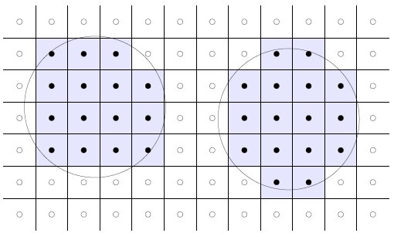
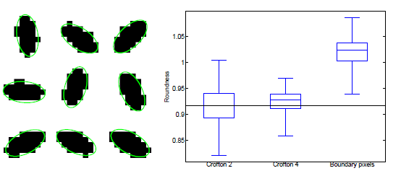
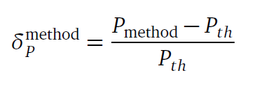
Practical part 1: Validation of image analysis method(s)
Principle:
Generate synthetic shapes with known perimeter
Generete digitized repesentation(s)
Change position + orientation
Measure
Compare with expected value

Slide 18

1.1 Measuring the perimeter of a disk
Run Fiji
Create New Image
200 x 200 uint8
Add a disk:
Plugins -> Digital Shapes -> Fill Disk
Choose Radius = 50
Arbitrary center
Question: perimeter = ?

Slide 19
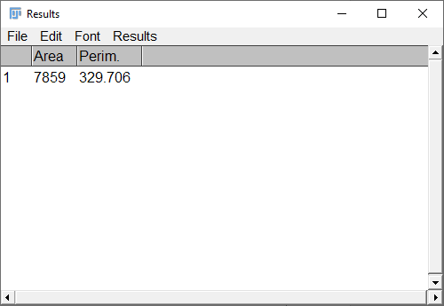
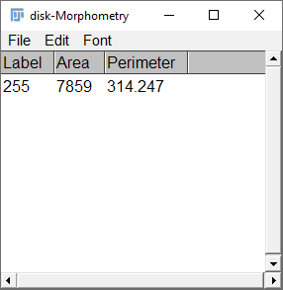
1.1 Measuring the perimeter of a disk
Measuring with ImageJ
Measuring with MorphoLibJ
(relative) error: 4.7 %
(relative) error: 0.02 %

Slide 20
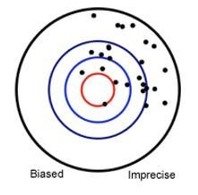
Precision & accuracy
One measurement is not necessarily representative…
Need to integrate over several positions
Either random or by numerical integration
Exercice:
Generate 100 images (or more…)
with various center positions
Measure perimeter
Evaluate mean and std of measurements

Slide 21
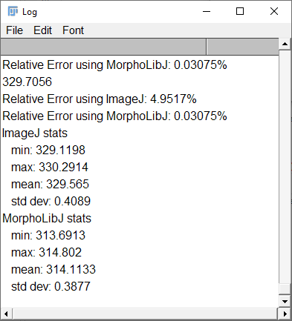
Results for disk

Slide 22
Other shapes: square, ellipse…
Repeat exercise with square
Use «Fill Rotated Square » plugin
Choose for example side length = 100
Perimeter = ?
Similar results as for disk?

Slide 23

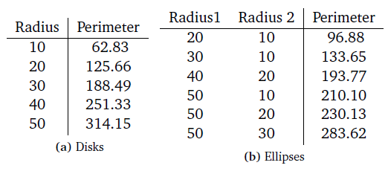
Other shapes: square, ellipse…
Repeat exercise with ellipse
Use «Fill Rotated Ellipse » plugin
Perimeter of an ellipse ?
Numerical integration
Approximations

Slide 24
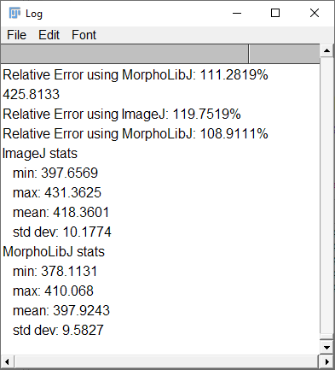
Results for square

Slide 25
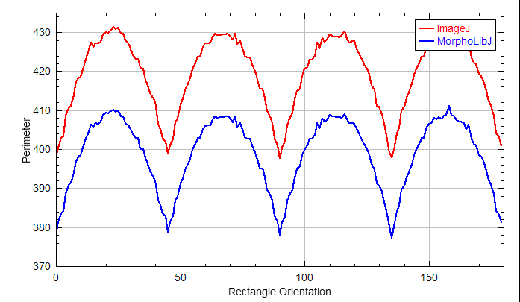
Bonus: impact of orientation
Draw the error of perimeter measured on square (or ellipse) depending on orientation

Slide 26
Bonus: impact of image resolution
Try to evaluate the precision for various pixel sizes
Size = 0.5*D -> 100*D
Try also rectangular pixel (width != height)

Slide 27
Bonus: evaluate error on surface area measure
Sample shapes:
Sphere
Ellipsoid, cylinder, cuboid…
Problem: even distribution of orientations?

Slide 28
Practical outline 2
Image texture analysis
Recall morphological filters
Compute granulometry curves
Interpret!

Slide 29

Demonstration example
We will start with the image “coins.png”
In “practical/granulometry/coins.png”
Pre-exercise: apply morphological filters with various diameters

Slide 30
Run granulometry
Choose « granulometry by Radius… »

Slide 31
Result

Slide 32
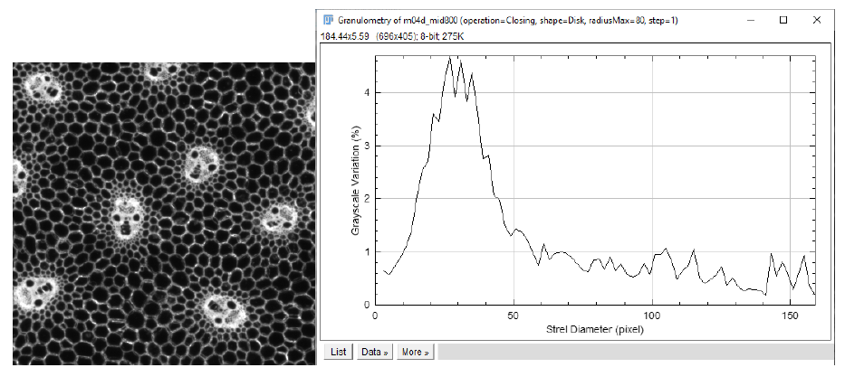
Application to images of plant tissues
Choose one of the images in « maize » directory, and experiment

Slide 33


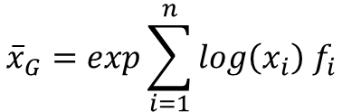
Computation of average size
Mean value from a list of value:
Mean value from a distribution (arithmetic)
Geometrical mean
$$\overline{x}=\frac{1}{n}\sum_{i=1}^{n}{x_{i}}$$
$$\overline{x}=\sum_{i=1}^{n}{x_{i}{ f}_{i}}$$
$${\overline{x}}_{G}=exp\sum_{i=1}^{n}{log\left(x_{i}\right){ f}_{i}}$$

Slide 34
Study of anisotropy
Try computing granulometry curves with horizontal and vertical elements
And compare

Slide 35
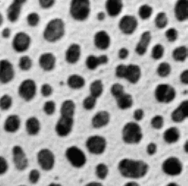
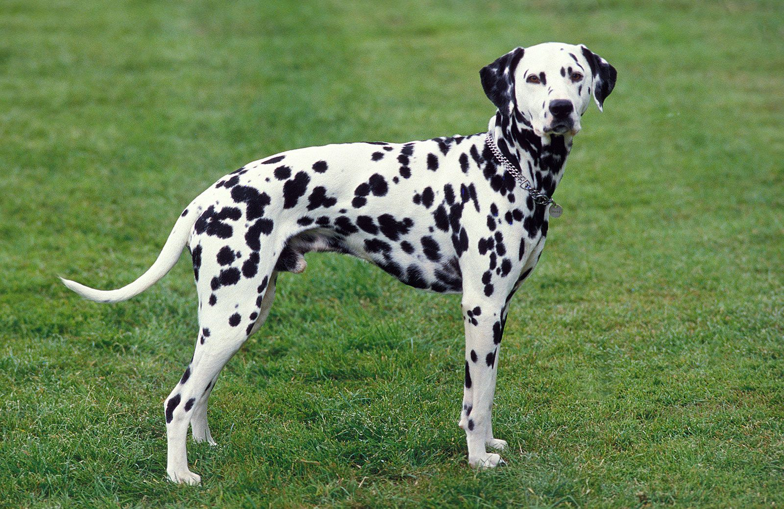
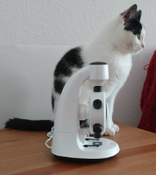
Bonus: try your favorite image

Slide 36
Bonus: try « batch processing »

