Slide 1

Summary

Slide 2

Background CMB
Saha’s equation +equilibrium state:
$\frac{1−X}{X^{2}}=\sqrt{\frac{2}{π}} ζ\left(3\right)η{\left(\frac{T}{m_{e}}\right)}^{\frac{3}{2}} e^{\frac{B}{T}}$ (1)
positive root gives ionisation fraction
From Paddy: Equilibrium densities may not be satisfied at $z_{recomb}$ and ground state recombination will emit $E_{γ}>13.6 eV$ which will re-ionise surroundings

Slide 3

Excited state Ionisation fraction
From Paddy:
$\frac{dX}{dt}=α\left(β\left(1−X\right)−n_{γ}ηX^{2}\right)$ (2)
Where $α=9.78r_{0}^{2}c{\left(\frac{B}{T}\right)}^{\frac{1}{2}}\ln\left(\frac{B}{T}\right)$ (3)
is related to the recombination rate forming excited state H (I was unsure of units of the classical electron radius and c to determine the 9.78 factor but was unable to find a reference to verify and this may lead to an error I’m currently encountering)
And $β$ ($\frac{β}{α}$ in notes) is found by setting (2) = 0 (equilibrium) which gives:
$β=n_{γ}η{\left[eqn\left(1\right)\right]}^{−1}$ (4)
which is also different from the notes
Substituting for $\frac{d}{dt}=−H(1+z)(\frac{d}{dz})$ equation (2) becomes:
$\frac{dX}{dz}=−\frac{α\left(z\right)}{H\left(z\right)\left(1+z\right)}[β\left(z\right)\left(1−X\right)−n_{γ}\left(z\right)ηX^{2}]$ (5)
Which I attempted to solve numerically

Slide 4
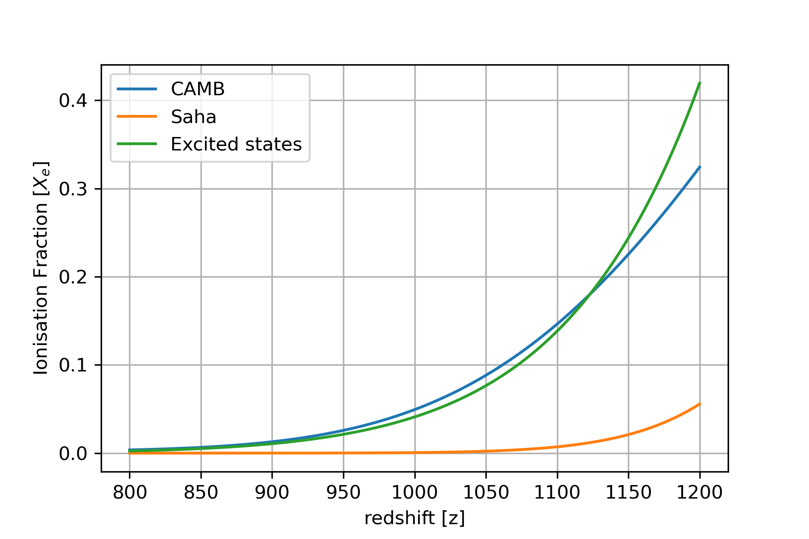
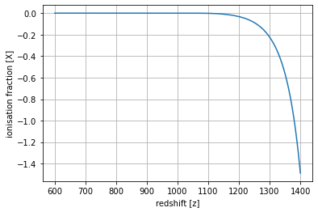

Graphs (mass fraction)
Fig. 1. Ionisation fraction of Saha, CAMB and numerical solution in Paddy (
$X_{e}=2.4×{10}^{−3}\frac{{\left(Ω_{m}h^{2}\right)}^{\frac{1}{2}}}{\left(Ω_{B}h^{2}\right)}{\left(\frac{z}{1000}\right)}^{12.75}$(6)
) which is only valid in region 800 < z < 1200
Graph shows ignoring recombination to ground state results in the decoupling occurring at a later time (from BB)
Fig. 2. Current attempt at solving equation (5) for a wider range of z. Still working on it as it gives negative fractions. By numerical integration. Expect the correct solution to follow CAMB as it considers the excited states separately as well

Slide 5

Recombination redshift
Can find the optical depth of photons using:
$τ=\int_{0}^{t}{n\left(z\right)X\left(z\right)σ_{T}(\frac{dz}{dt})}$ (7)
And the probability of last scattering in redshift [z,z+dz] being
$P\left(z\right)=e^{τ}\frac{dτ}{dz}$
Can compute this for all 3 Ionisation fractions to determine the redshift and redshift width of the LSS
Can also attempt an approximate solution by considering reaction width ($Γ)$ and finding where it equals the Hubble parameter

Slide 6
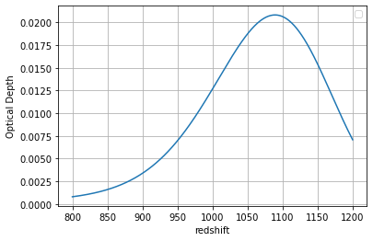
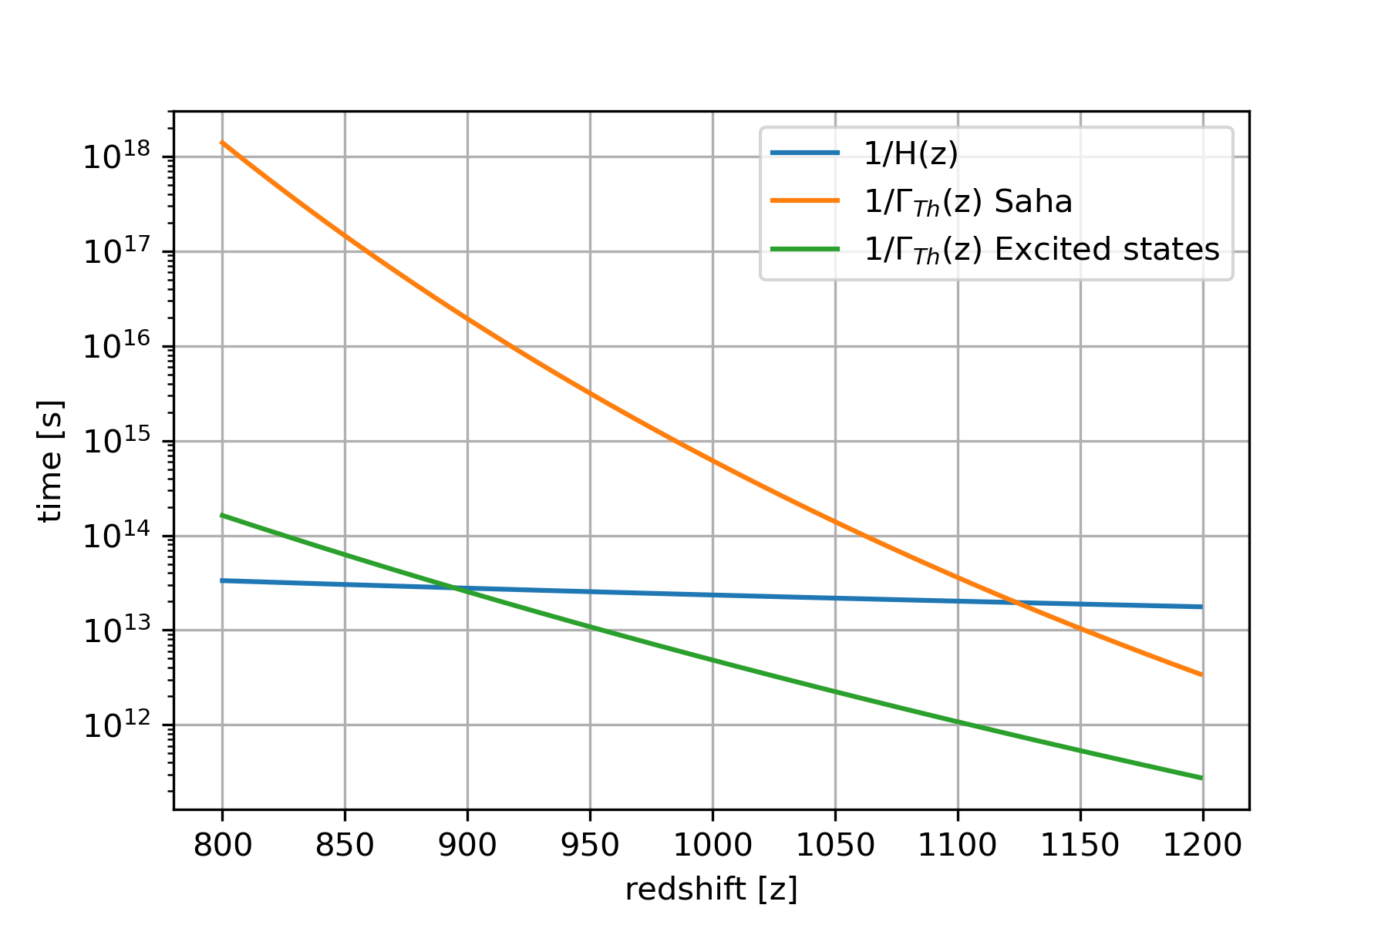

Graphs (Recombination redshift)
Fig. 3. Optical depth of CMB photons vs redshift using CAMB
Fig. 4. Freeze-out estimate of Thompson scattering by comparison with $H=H_{0}E(z)$.
Width was calculated using $Γ=n_{e}σ_{T}c=Xηn_{γ}σ_{T}c$
The Saha equilibrium was at z = 1483

Slide 7

Sachs-Wolfe effect and Multipole expansion
In Newtonian Gauge: $ds^{2}=−dt^{2}\left(1+2Ψ\right)+a^{2}\left(1+2Φ\right)\left(dx^{2}+dy^{2}+dz^{2}\right)$ evaluating $\frac{df\left(x^{μ},P^{μ}\right)}{dλ}=C$
Geodesic equation for $μ=0$ gives
$\frac{dE}{dλ}=−p^{2}[H−HΨ+\frac{∂Φ}{∂t}+\frac{E}{p}\frac{∂Φ}{∂x^{i}}\frac{{\hat{p}}^{i}}{a}$] (8)
Integrating for photon from LSS to $t=t_{0}$:
$\left(\frac{δp}{p}\right){\left.​\right|}_{t=t_{0}}$ = $\left(\frac{δp}{p}\right){\left.​\right|}_{t=t_{LSS}}+\left(Ψ_{LSS}−Ψ_{t_{0}}\right)+\int_{t_{LSS}}^{t_{0}}{\left[\frac{∂Ψ}{∂t}−\frac{∂Φ}{∂t}\right]dt}$ (9)
Know that for perturbation $Δ=\frac{δT}{T}=∑\frac{2l+1}{i^{l}}Δ_{l}P_{l}$ in spherical harmonics and can find multipoles as spherical harmonics

Slide 8
Work required/plan outline
Solve equation (5) and find fitted equation for wider z possibly as a power series
Compute probability of scattering for each function and find maxima and width (approximating as Gaussian)
After approximating X as a series of orthogonal functions, can find convergence of different CONS and determine a reasonable truncation for each group
Find out how to relate Sashs-Wolfe effect to multipole distribution and how to show that graphically (assume Gaussian perturbation?)
Understand transfer functions and lensing window potentials in CAMB
Investigate different perturbation modes and its effect on the CMB spectrum
Using CAMB recreate observed CMB image of real space

Slide 9
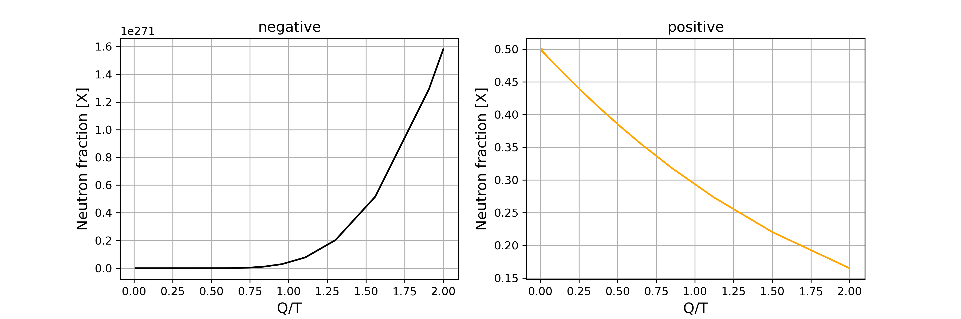
Nucleosynthesis Graphs
Fig. 5, 6

Slide 10
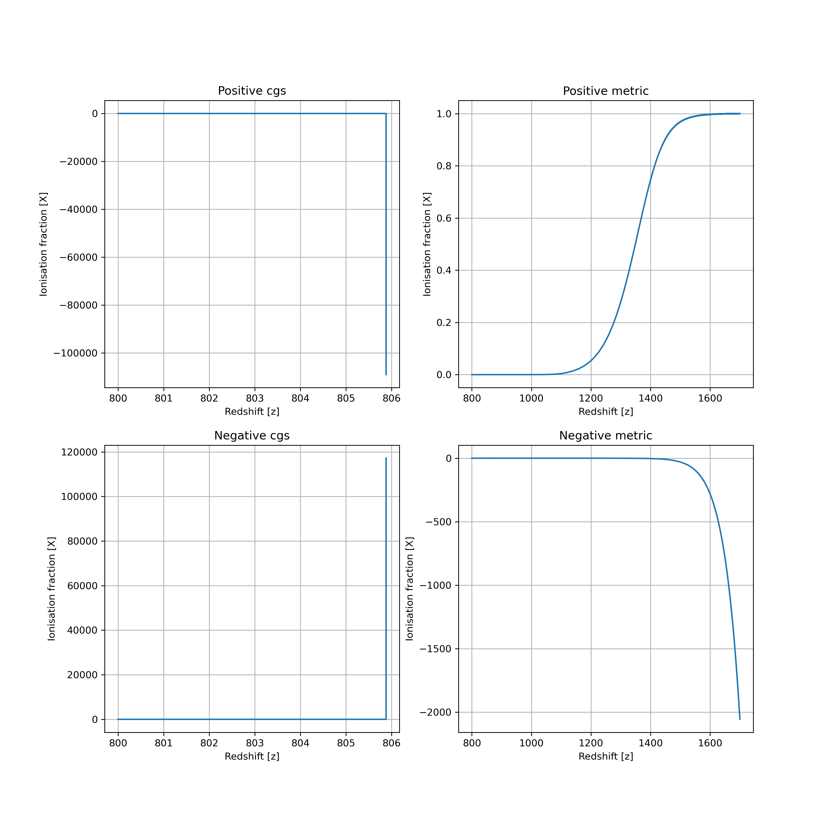
Ionisation fraction solutions
Fig. 7.

Slide 11
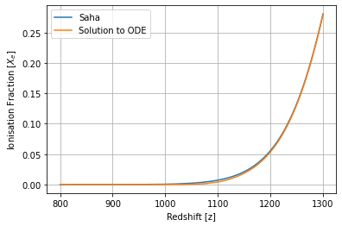
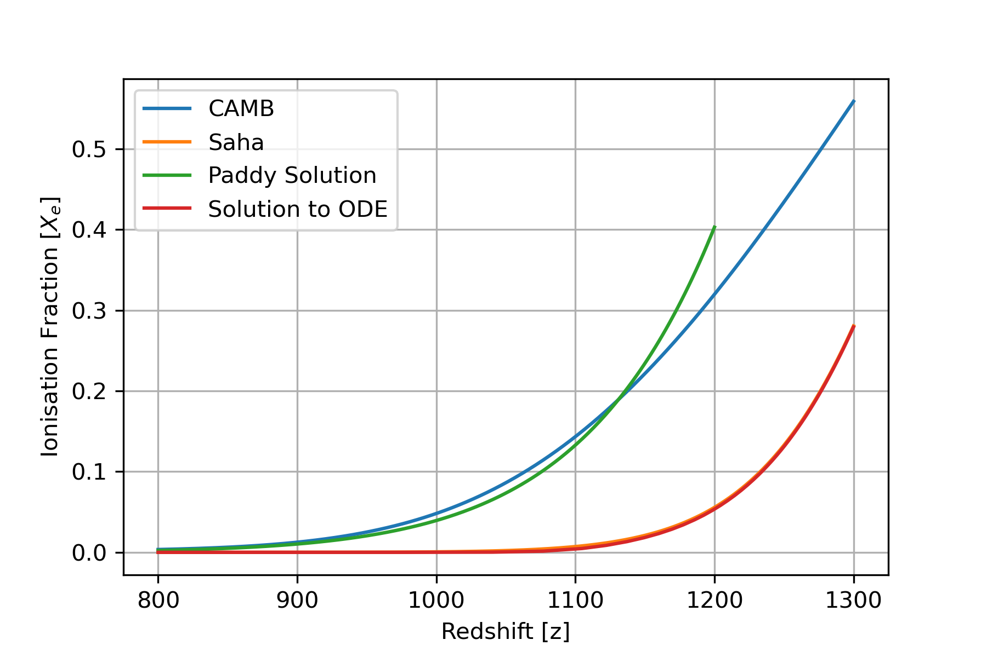
Different solutions
Fig. 8.
Fig. 9.

