Slide 1
뉴스/SNS 데이터 분석 및 딥러닝을 이용한 주가예측
현대 해상

Slide 2
Table of Contents
1. Project Introduction & Schedule
A. Project Introduction
B. Project Schedule
2. Goal & Design
A. Goals stated in the proposal
B. Project Changes
C. Data used in the project
D. Detailed design
3. Project result & future plan
A. Result
B. Future plan
4. QnA

Slide 3



[1-A] Project Introduction (team introduction)
Team - 광운코인
Leader : 이동준
Members : 권 민, 박덕영,
이세영, 장성록
Professor : 이기훈

Slide 4
[1-A] Project Introduction (Project Introduction)
Modeling through stock price data with nonlinear characteristics( that are influenced by temporal flow and influenced by external variables and deep learning suitable for nonlinear model learning. X)
Reduce the risk of investment by predicting the rate of change using the generated model.
Build emotional dictionary using news related to North Korea and forecast price using MLP and GRU, deep running algorithms.
Finally implemented model is provided through Android application.

Slide 5
[1-B] Schedule (Schedule planned)

Slide 6
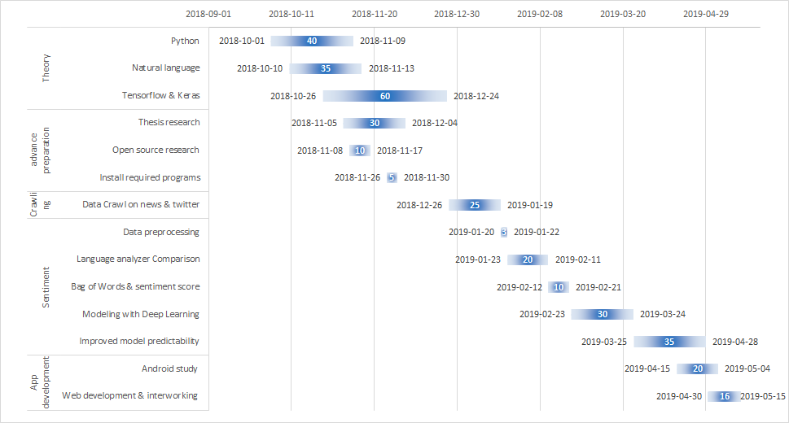
[1-B] Schedule (Actual schedule)

Slide 7
[1-B] Schedule (budget)
Name | Use Case | Details | Budget(\) | Used(\) | Unused(\)
material |  |  | 1,220,000 | 1,180,300 | 39,700
- | RAM | SAMSUNG 16G(개) |  | 473,900
- | GPU | RTX 2070 |  | 636,900
- | Power | 700W |  | 69,500
Literature | Book | security, Android, Linux | 200,000 | 167,400 | 32,600
Office supplies | Server, Escribulator | Lan, power strip, pen | 120,000 | 119,100 | 900
Dinner & refreshments |  |  | 660,000 | 449,000 | 211,000

Slide 8
[2-A] Goals stated in the proposal
Creating Theme-Stocks Prediction model
Predicting stock price of related companies with theme of North Korea
Find the relationship between news/twitter and stocks
Stock price changes on the day when related news such as Summit and Kim Jung Eun New Year
Performance Indicator
Accuracy : 70% ↑
F1 Score : 50% ↑
Provide web application to show project related information
Provided as an Android application

Slide 9
[2-B] Project Changes
word2vec
In the case of news titles, the sentence is too short to be used.
SNS
Trump’s Tweet to reflect was very low, about 260, so only use news data
RNN, LSTM
Use GRU, MLP to get unusual results with low crawled data, high loss rate and low accuracy
Web
implementation to get real – time stock information at Web So proceed to Android Studio

Slide 10
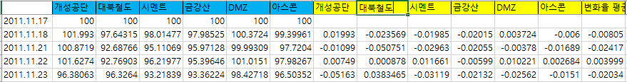
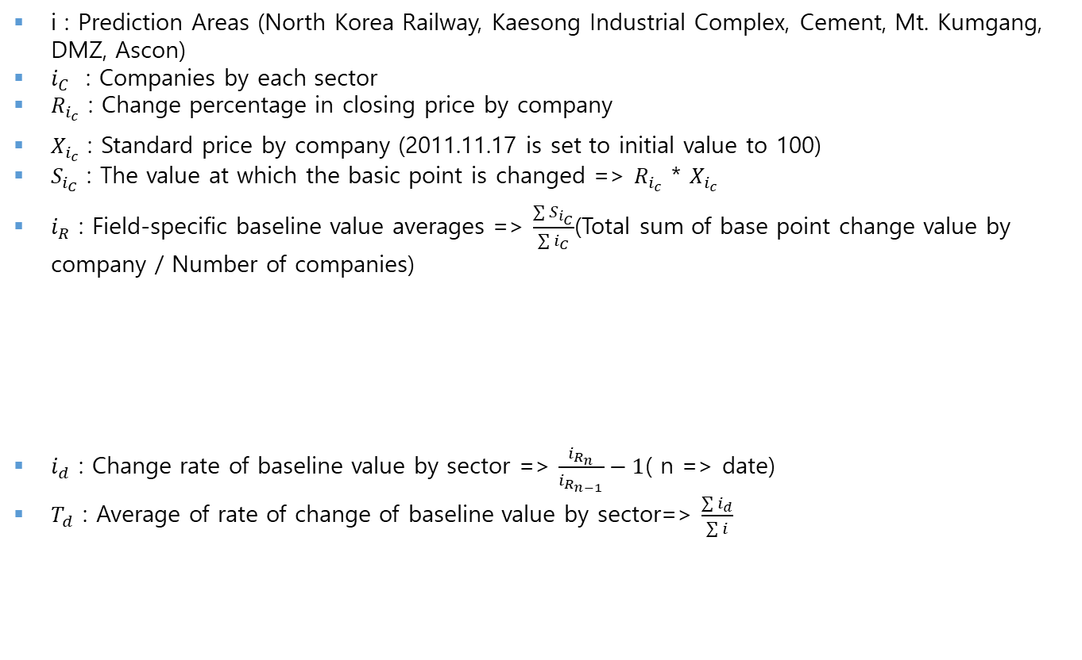
[2-C] Data used in the project (Rate of change in stock price)
i : Prediction Areas (North Korea Railway, Kaesong Industrial Complex, Cement, Mt. Kumgang, DMZ, Ascon)
$i_{C}$ : Companies by each sector
$R_{i_{c}}$ : Change percentage in closing price by company
$X_{i_{c}}$ : Standard price by company (2011.11.17 is set to initial value to 100)
$S_{i_{C}}$ : The value at which the basic point is changed => $R_{i_{c}}$ * $X_{i_{c}}$
$i_{R}$ : Field-specific baseline value averages => $\frac{\sum{S_{i_{C}}}}{\sum{i_{C}}}$(Total sum of base point change value by company / Number of companies)
$i_{d}$ : Change rate of baseline value by sector => $\frac{i_{R_{n}}}{i_{R_{n−1}}}−1$( n => date)
$T_{d}$ : Average of rate of change of baseline value by sector=> $\frac{\sum{i_{d}}}{\sum{i}}$

Slide 11
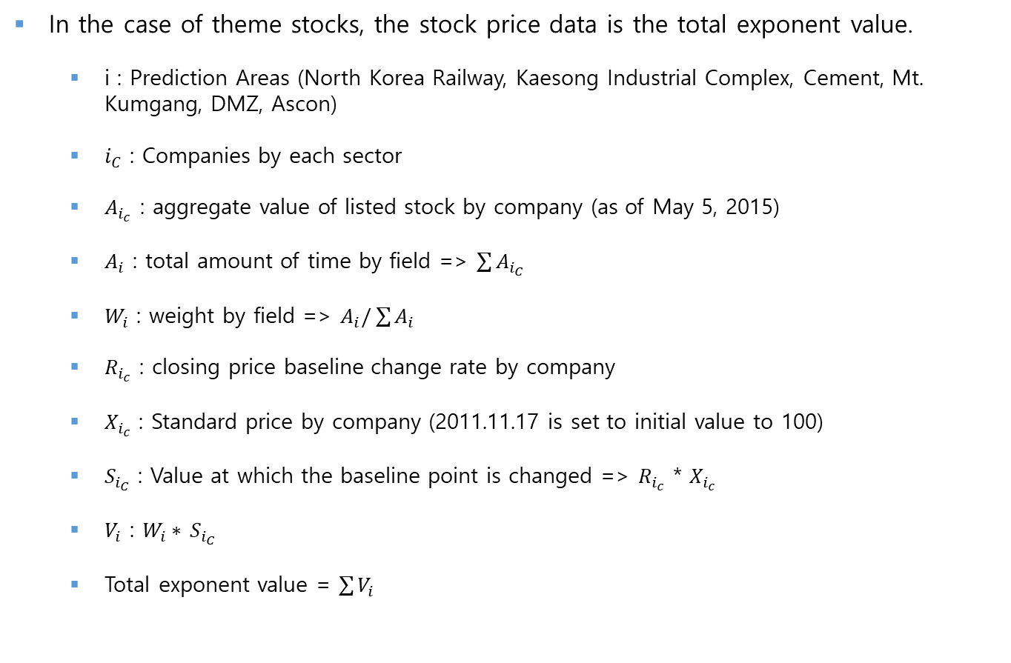
[2-C] Data used in the project (Stock data)
In the case of theme stocks, the stock price data is the total exponent value.
i : Prediction Areas (North Korea Railway, Kaesong Industrial Complex, Cement, Mt. Kumgang, DMZ, Ascon)
$i_{C}$ : Companies by each sector
$A_{i_{c}}$ : aggregate value of listed stock by company (as of May 5, 2015)
$A_{i}$ : total amount of time by field => $\sum{A_{i_{C}}}$
$W_{i}$ : weight by field => $A_{i}/\sum{A_{i}}$
$R_{i_{c}}$ : closing price baseline change rate by company
$X_{i_{c}}$ : Standard price by company (2011.11.17 is set to initial value to 100)
$S_{i_{C}}$ : Value at which the baseline point is changed => $R_{i_{c}}$ * $X_{i_{c}}$
$V_{i}$ : $W_{i}∗$ $S_{i_{C}}$
Total exponent value = $\sum{V_{i}}$

Slide 12
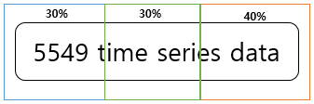
[2-C] Data used in the project (news data)
 | Celebrity | Recent issues | Recent issues | Recent issues | Recent issues | Related Issues | Related Issues
North Korea | Kim Jong-un | North Korea Talks | North Korea sanctions | North Korea missile | North Korea Denuclearization | North Korea provocation | North Korea nuclear
North Korea Railway, Kaesong Industrial Complex, Cement, Mt. Kumgang, DMZ, Ascon.
Search for the interval in which the change of the criteria set in the period (2011.11.17 ~ 2019.03.04) occurred consecutively.
News collection only in the political field in Chosun Ilbo.
Train | Increase | Decrease
More than 3 days | More than +1% | Less than -1%
More than 1 days | More than +4% | Less than -4%
80% used as train data
10% used as validation data
10% used as test data
Notes:
기간 내에서 3일 이상 연속으로 기업들의 종가 기준 변화율의 평균이 +-1%이상 상승/하락한 구간의 데이터 검색
추가로 +-4% 이상 상승/하락한 구간의 데이터도 추가

Slide 13




[2-D] Detailed design (conceptual diagram)
News crawling and data preprocessing
Build emotional dictionary and send it to KERAS model
Generate model using transferred data and stock price data
News data Input
Forward the result after predicting the rate of change

Slide 14
[2-D] Detailed Design (Detailed structure diagram)
Preprocess
Application
normalization
News & Twitter Crawling
Organized by learning data
Create model
Request & Result
tokenization
Stopword Removal
learning data(~2018)
Model
action
Evaluation data(2019~)
Linux
Preprocess
activate model
normalization
Show result using App
Evaluate preprocessed data
tokenization
Stopword Removal
Creating Prediction Model
<Positive & Negative Index>
1 - Daily stock price point value increased by 1%
0 - Daily stock price point value decreased by 1%

Slide 15
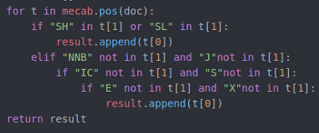

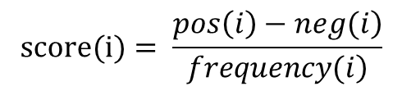
[2-D] Detailed Design (sentiment dictionary)
Word analysis using Mecab in Korean analyzer
Chinese and English are included(verbs, nouns)
Eliminate unnecessary element of dependent nouns,
adverbs, symbol, numbers, etc.
Calculate the score value and how it affects the word-by-word stock flow
$$word\left(i\right)=word$$
$$frequency\left(i\right)=Frequency in crawling news$$
$$pos\left(i\right)=Frequency in news of the rising day$$
$$neg\left(i\right)=Frequency in news of a declining day$$
$$score(i)= \frac{\left.pos\left(i\right)−neg(i\right)}{\left.frequency(i\right)}$$

Slide 16
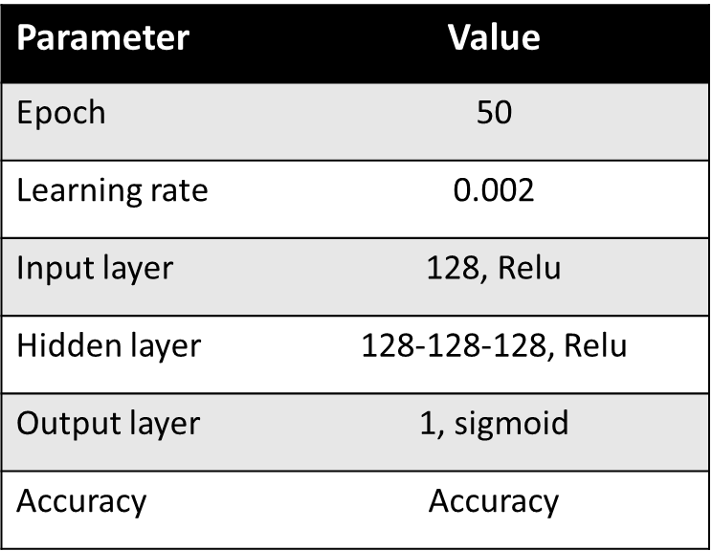
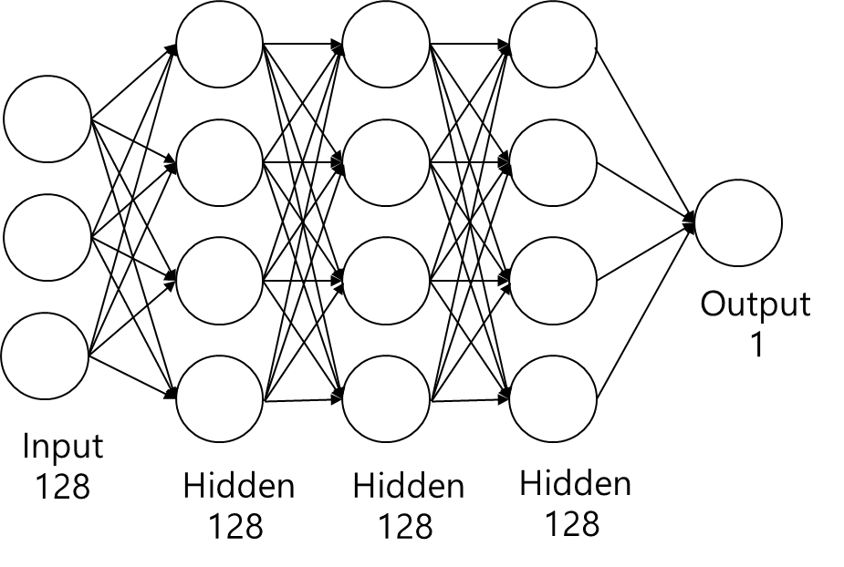
[2-D] Detailed Design (MLP)
Parameter values configured in the model implementation
<MLP parameter>
<MLP>
모델구현에 구성된 Parameter 값

Slide 17
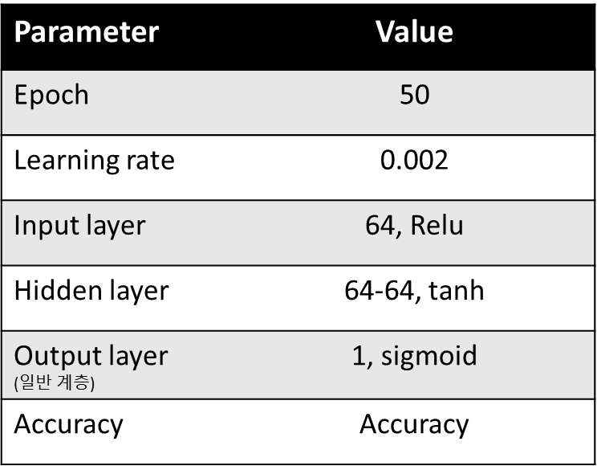
[2-D] Detailed Design (GRU)
Parameter values configured in the model implementation
result
Dense
sigmoid
GRU
64, relu
GRU
64, tanh
GRU
64, tanh
<GRU parameter>
<GRU>

Slide 18
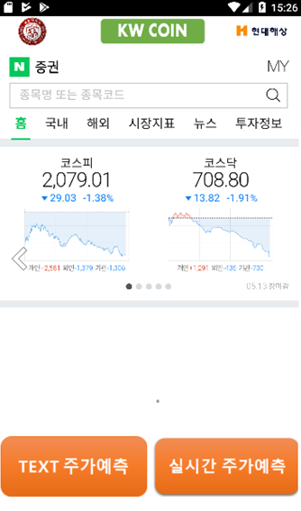
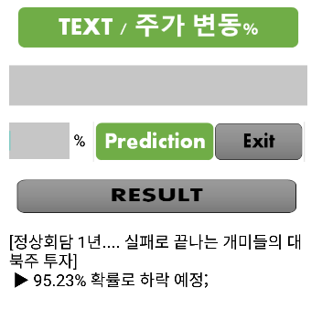
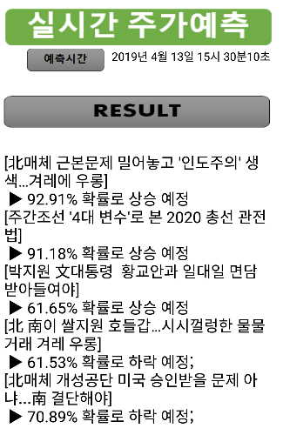
[2-D] Detailed Design (Android Application)
Prediction using Text
- Enter a keyword (article title) to check whether the results from Python crawling are
positive or negative
Real time Prediction
- Calculate real-time stock price change points and show these results to users

Slide 19
[3-A] Project Result
■ Comparison of foreign cases
 | Other Case | MLP | GRU
Accuracy | 74% | 72% | 80%
F1 Score | 0.77 | 0.5 | 0.52
Reference
Accuracy : Insight Centre for Data Analytics, University College Dublin, Ireland
F1 Score : Data Science Lab, Paul Math School

Slide 20

[3-B] Future plan
Utilization plan
Financial data, inflows and outflows, risk appetite, and other information should be added to the analysis for better results
Expansion into a model that can predict each company
Can develop investment model in conjunction with system model in laboratory
It applies not only to North Korea themes but also to other themes
(Chinese stock market, oil price, EU)
Benefits accrued
Working on papers to be held at the Data Research institute

Slide 21
Q n A

