Slide 1
home-energy: a dashboard to view solar power production and energy home energy consumption
By Dominick J. Lemas
@dominicklemas

Slide 2
Background
In 2018, the average annual electricity consumption for a U.S. residential utility customer was 10,972 kilowatthours (kWh), an average of about 914 kWh per month (eia.gov).
Gainesville Regional Utilities (GRU) has the highest residential electricity bill for municipally-owned utilities in the state (GNV Sun).
At roughly $132 per 1,000 kWh — a standard for monthly usage — it’s almost $24 above the state average, according to the latest Florida Municipal Electric Association data from October (GNV Sun).
Florida is a great state for home solar power production.
References:
eia.gov (https://tinyurl.com/y66s68cn)
GNV Sun (https://tinyurl.com/yym8x782)

Slide 3
Objective
Aim 1: Measure home power consumption using wifi enabled device that transmits data to emoncms.org.
Aim 2: Measure solar power production using wifi enabled device that transmits data to solaredge.org.
Aim 3: Integrate home power consumption and solar power production into real-time dashboard using shiny and raspberry pi.

Slide 4






Dashboard Backend
Power Consumption (wats)

Slide 5
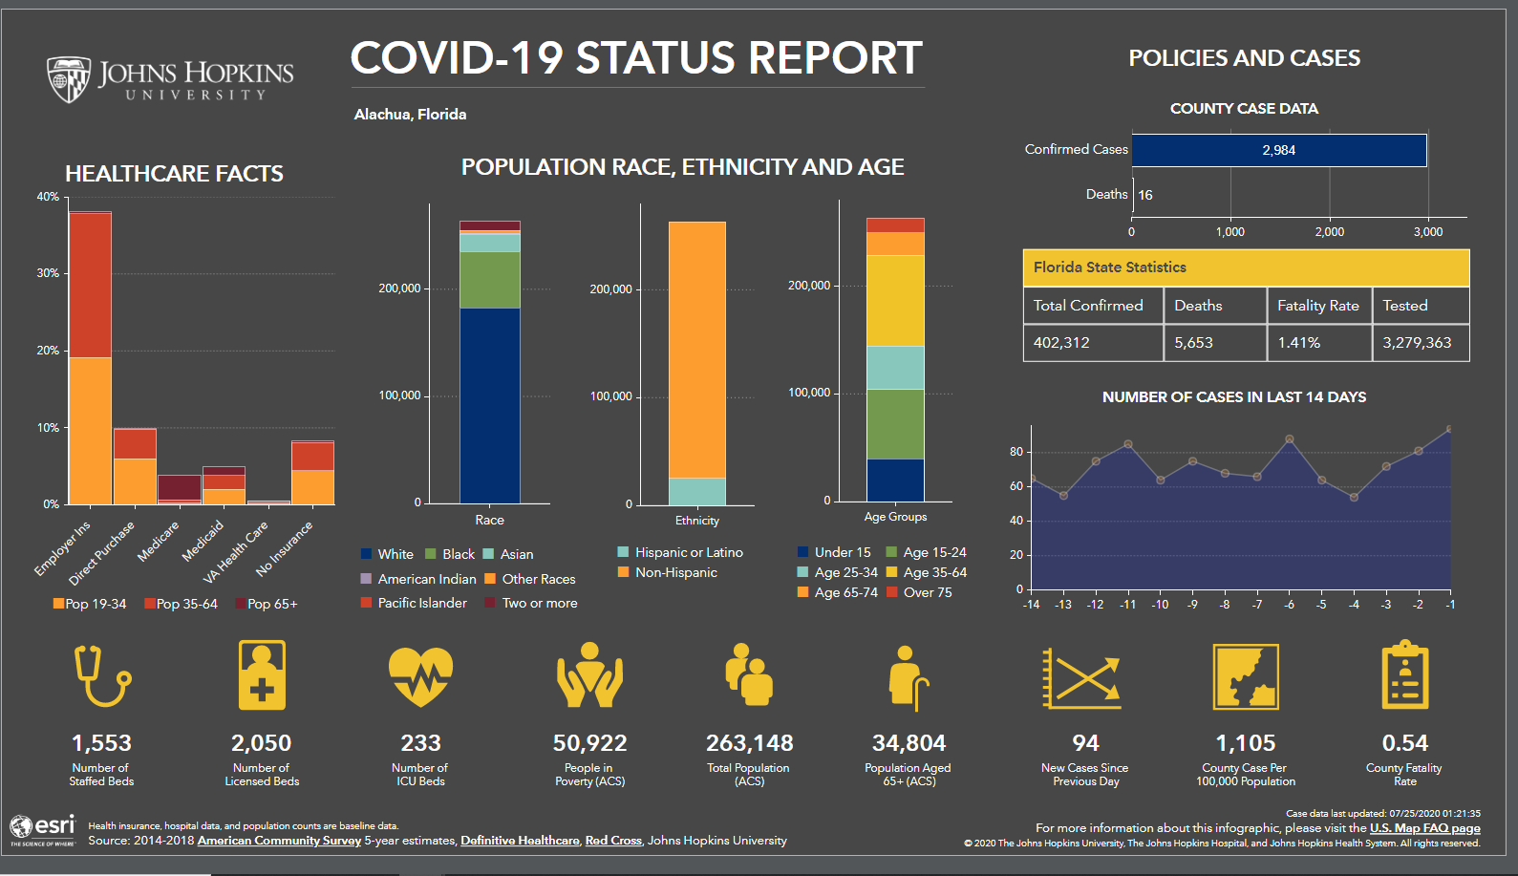
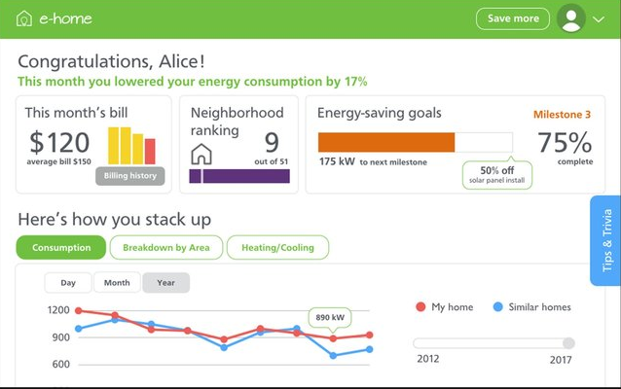
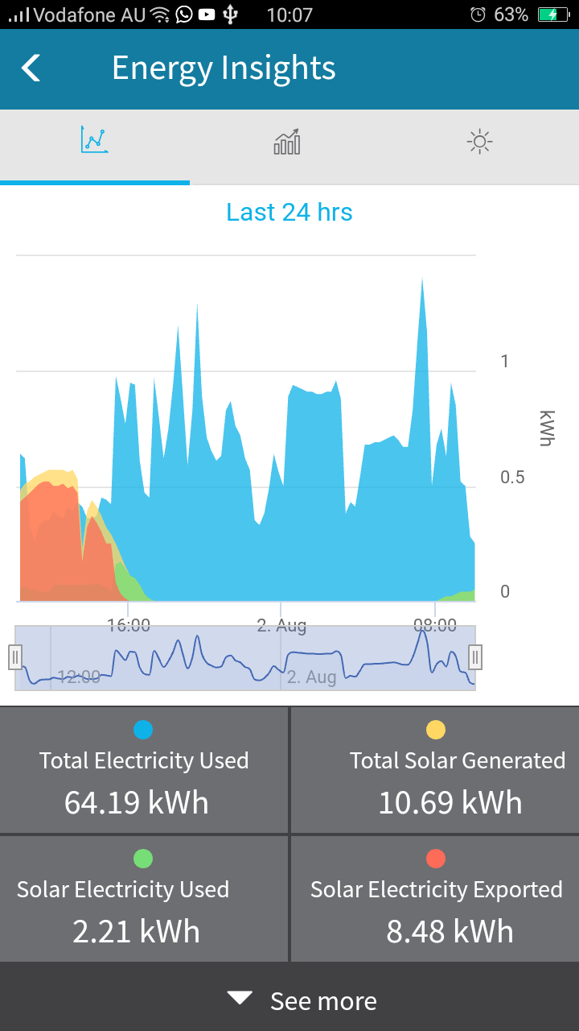
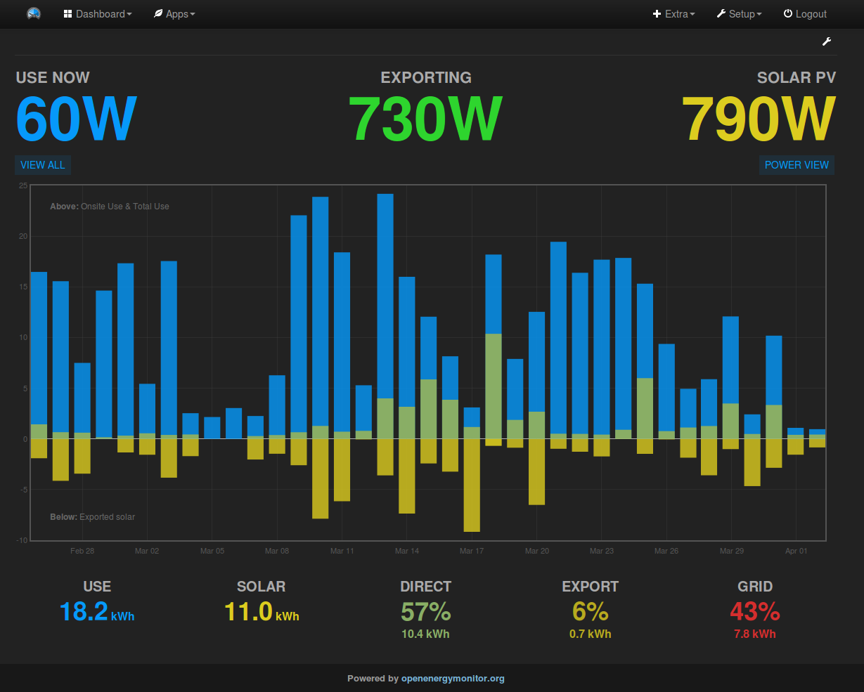
Dashboard Layout Ideas

