Slide 1






Dashboard Backend
Power Consumption (wats)

Slide 2

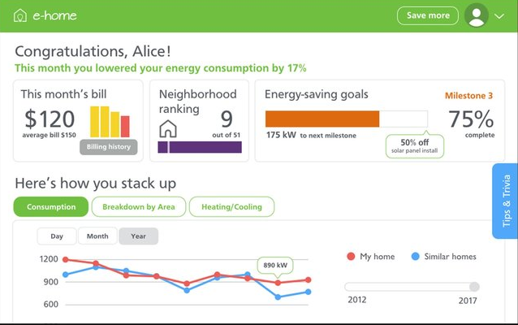
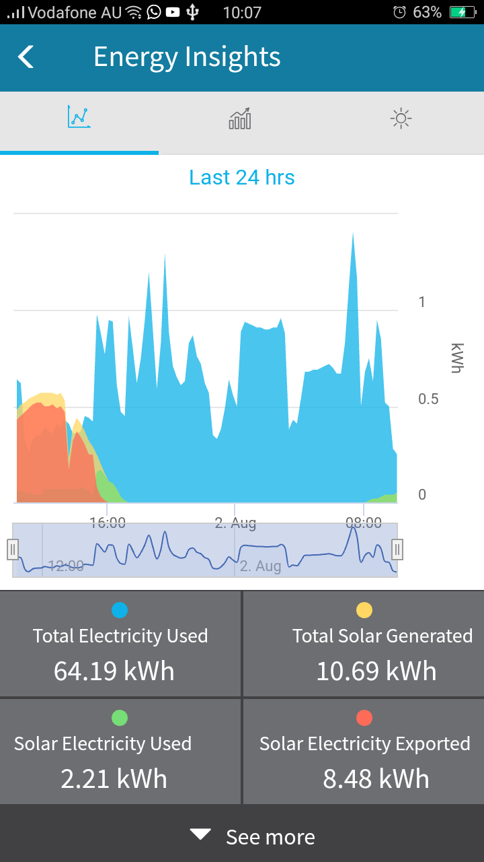
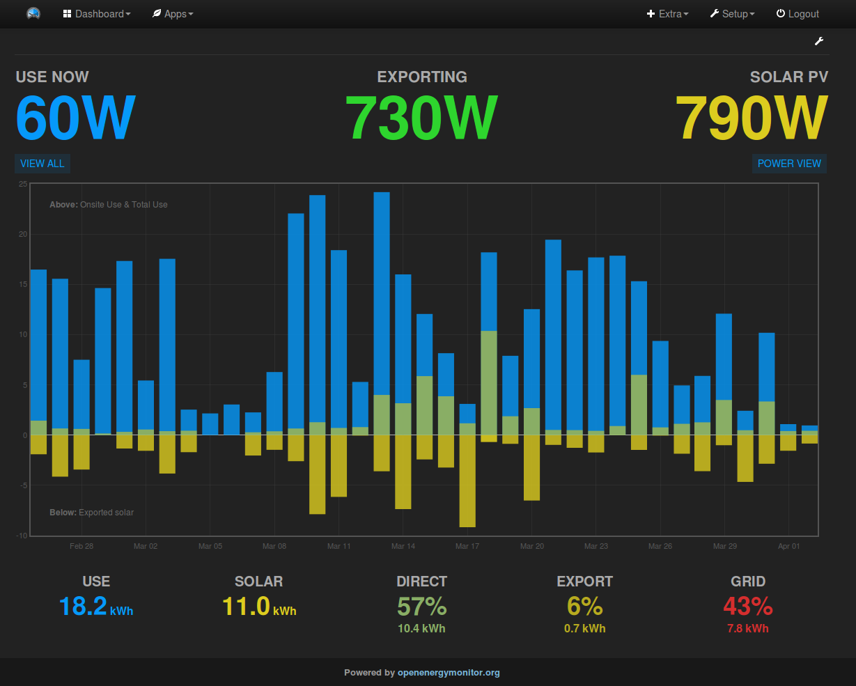
Dashboard Layout Ideas

