Slide 1


Dashboard Backend
home-energy dashboard
Shiny
Redcap data
Facebook data

Slide 2
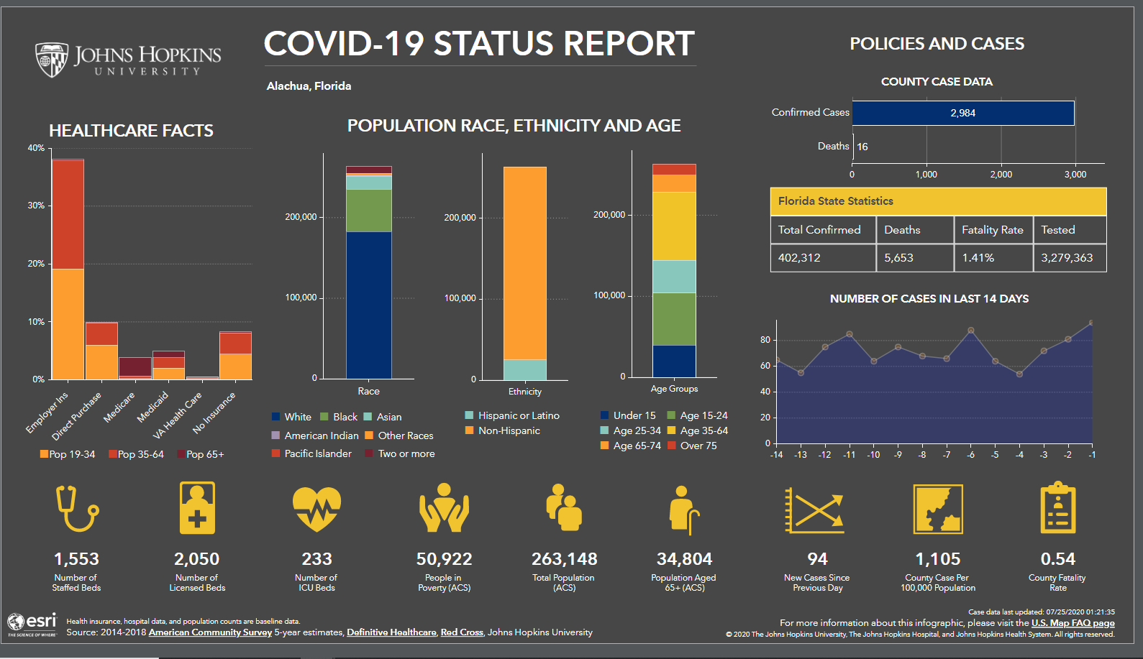
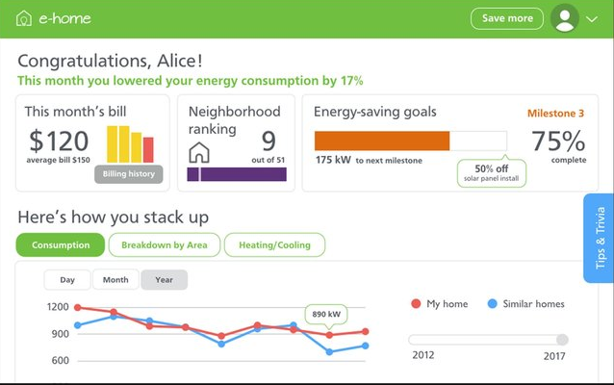
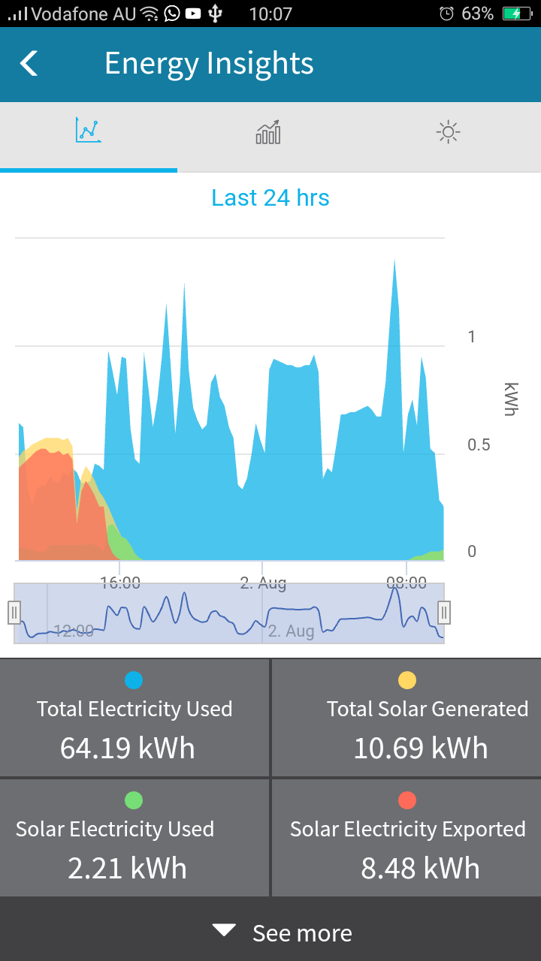
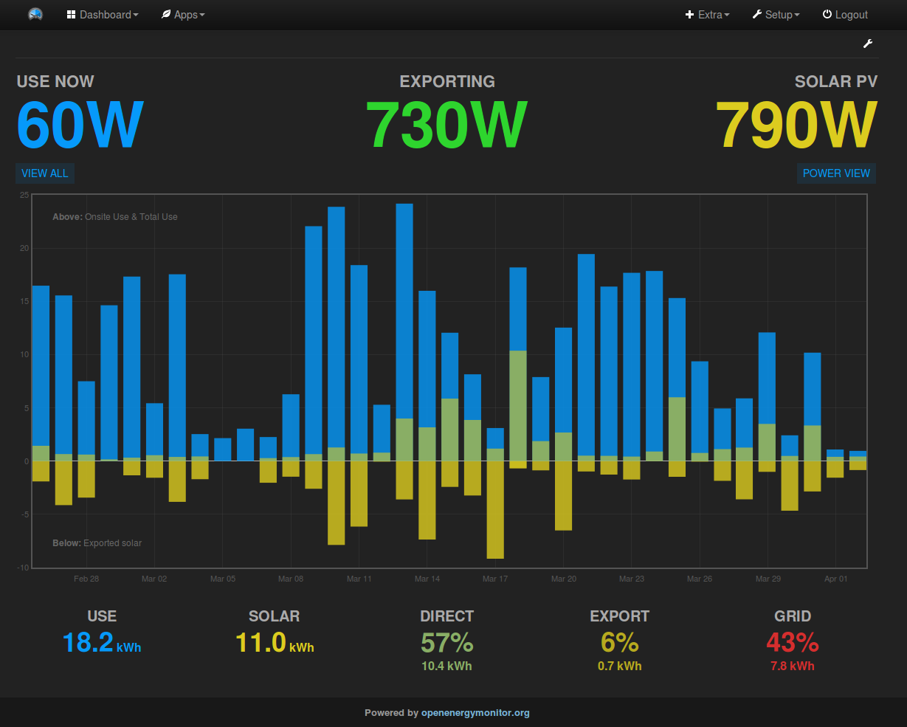
Dashboard Layout Ideas

