Slide 1
National Cybersecurity Center of Excellence
Michael Powell, Principal Investigator
Manufacturing Sector
Manufacturing_nccoe@nist.gov
October 28, 2020

Slide 2
Manufacturing Asset Attributes
Asset Discovery
Full baseline of physical and logical locations
Identification
Manufacturer
Visibility
Continuous identification of newly connected or disconnected devices
Continuous identification of attributes
Disposition
Alerting
Model
OS
IP address
MAC address
Protocols
Firmware
Patch level
Inter-connections
Criticality (high, medium, low)
Detection of deviation from expected network activity
Communication to other devices
Notes:
Asset Discovery: establishment of a full baseline of physical and logical locations of assets
Asset Identification: capture of asset attributes, such as manufacturer, model, operating system (OS), Internet Protocol (IP) addresses, Media Access Control (MAC) addresses, protocols, patch-level information, and firmware versions
Asset Visibility: continuous identification of newly connected or disconnected devices, and IP (routable and non-routable) and serial connections to other devices
Asset Disposition: the level of criticality (high, medium, or low) of a particular asset, its relation to other assets within the OT network, and its communication (to include serial) with other devices
Alerting Capabilities: detection of a deviation from the expected operation of assets

Slide 3
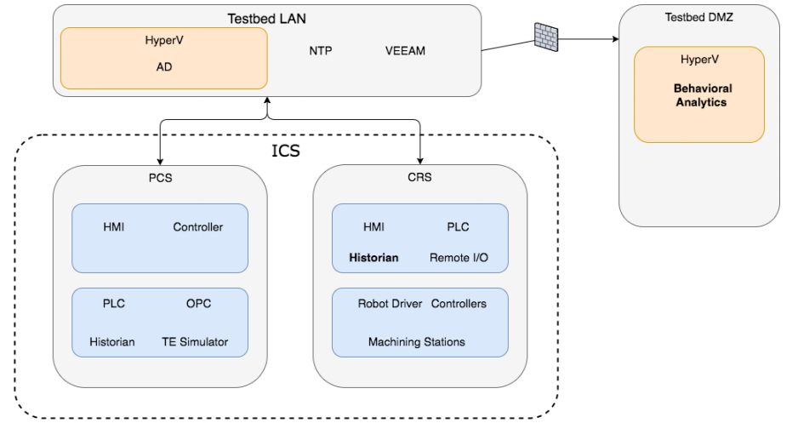
NISTIR 8219
Securing Manufacturing Industrial Control Systems: Behavioral Anomaly Detection
Project focus:
demonstrate behavioral anomaly detection techniques that businesses can implement and use to strengthen the cybersecurity of their manufacturing processes.
Three detection methods:
network-based
agent-based
operational historian/sensor-based
Behavioral Anomaly Detection High Level Architecture

Slide 4
Behavioral Anomalies
Abnormal equipment operations
High trouble call frequency
Sensor disruptions
Door sensor failure
Communication disruptions
Robot coordination failure
Environmental changes
High work cell temperature
Data corruption
Invalid process variable values

Slide 5
Questions?
Michael Powell, Senior Security Engineer
manufacturing_nccoe@nist.gov
301-975-0200

