Slide 1

C4, OpenC2 Information Models, and SCAPv2
OpenC2 Plugfest
28 October 2020
David Kemp, NSA Cybersecurity

Slide 2
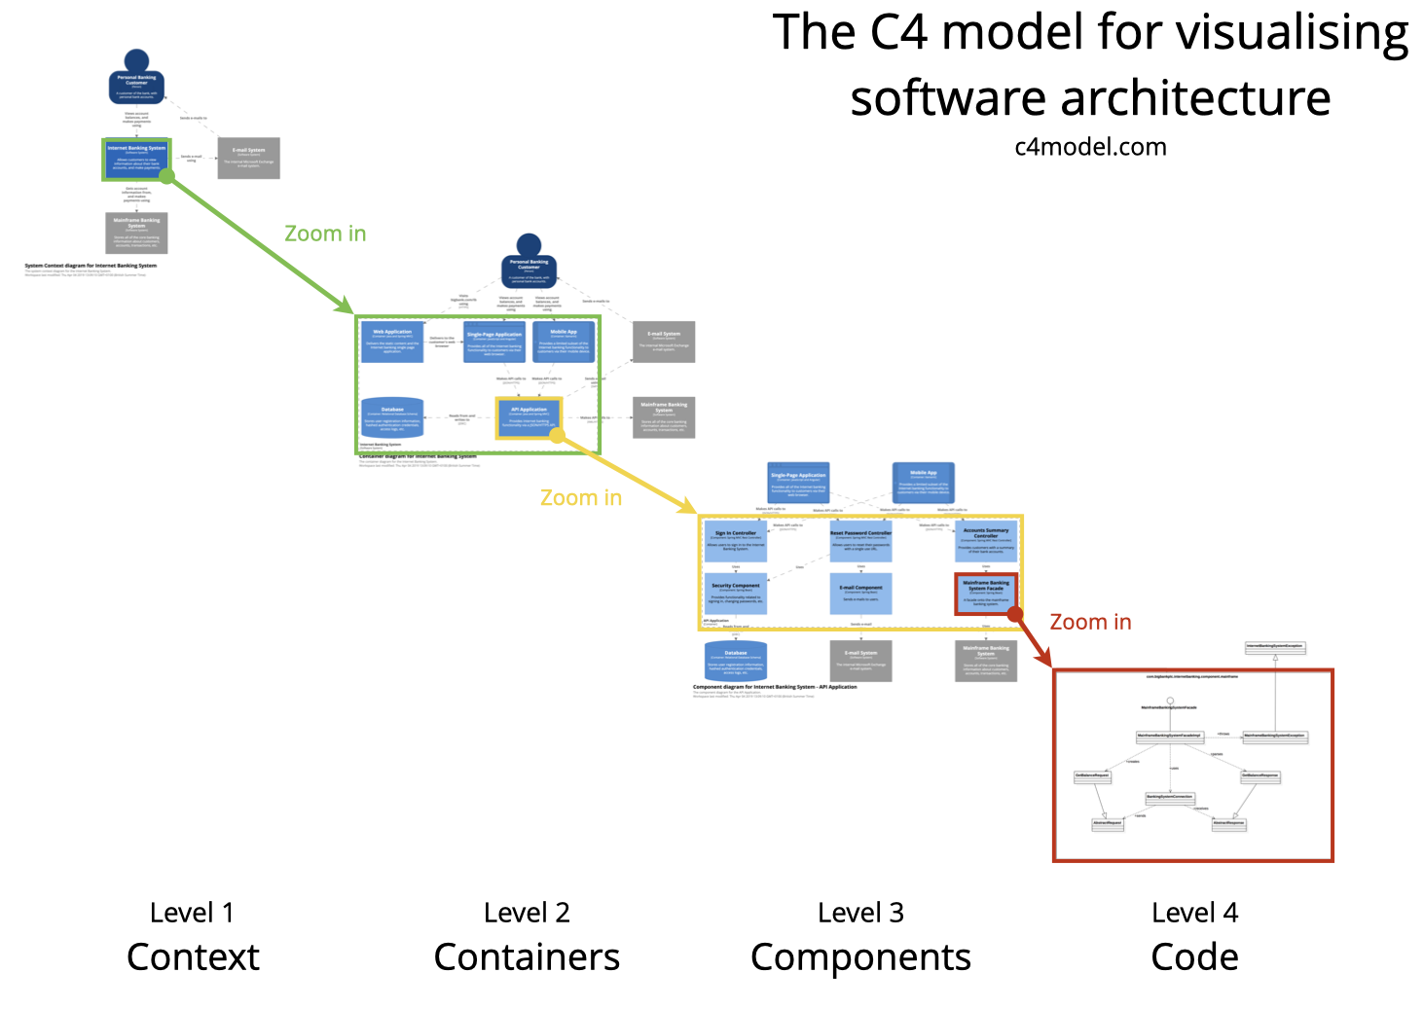
Software Architecture
The C4 model provides a way for software development teams to efficiently and effectively communicate their software architecture, at different levels of detail, telling different stories to different types of audience, when doing up front design or retrospectively documenting an existing codebase.
https://en.wikipedia.org/wiki/C4_model
Notes:
The Open Cybersecurity Alliance is currently in the process
of developing an architecture, and someone suggested
investigating how the C4 model might be applied to it.
According to its description, C4 provides a way for software
development teams to communicate their software architecture
at different levels of detail, when doing up-front design or
documenting an existing codebase.
The name refers to its four levels of decomposition: context,
containers, components, and the code running on a component.

Slide 3
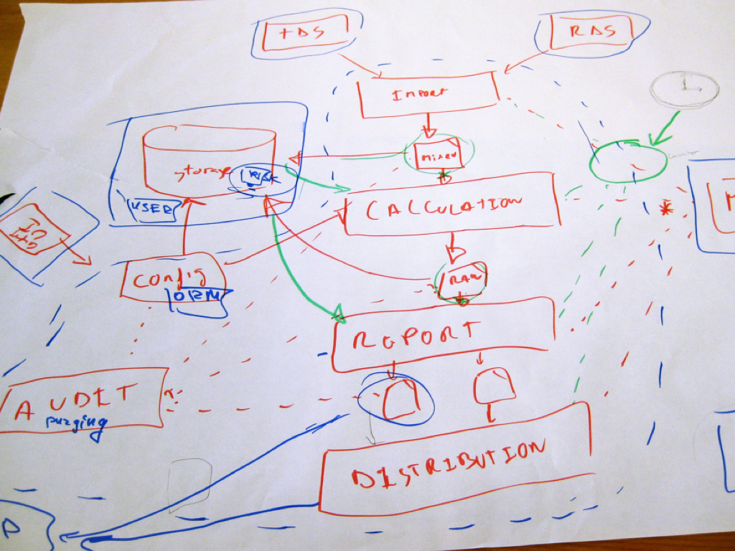

Complexity
Using UML to communicate software architecture is often irrelevant because many teams use much simpler "boxes and lines" diagrams.
You can zoom in to each component to show how it is implemented as code using UML class diagrams, entity relationship diagrams or similar.
This level of detail is not recommended for anything but the most important or complex components ?
Yes, but … interfaces are important.
A
B
Notes:
C4's premise is that traditional system architecture tools
are too complex for most teams to understand,
but that designing complex software can still
benefit from a common approach to decomposition.
Saying that UML is too complex, however, misses the mark.
Developers can use as much or as little of UML as they wish,
and in the simplest case a UML class diagram is itself just
boxes and lines. And although class methods apply primarily
to code at the bottom level, the containers and attributes of a
class diagram can be used at all levels of a C4 architecture.
C4 also ignores the distinction between code and interfaces.
Hiding implementation details while designing around testable
behavior is the foundation of object oriented software.

Slide 4
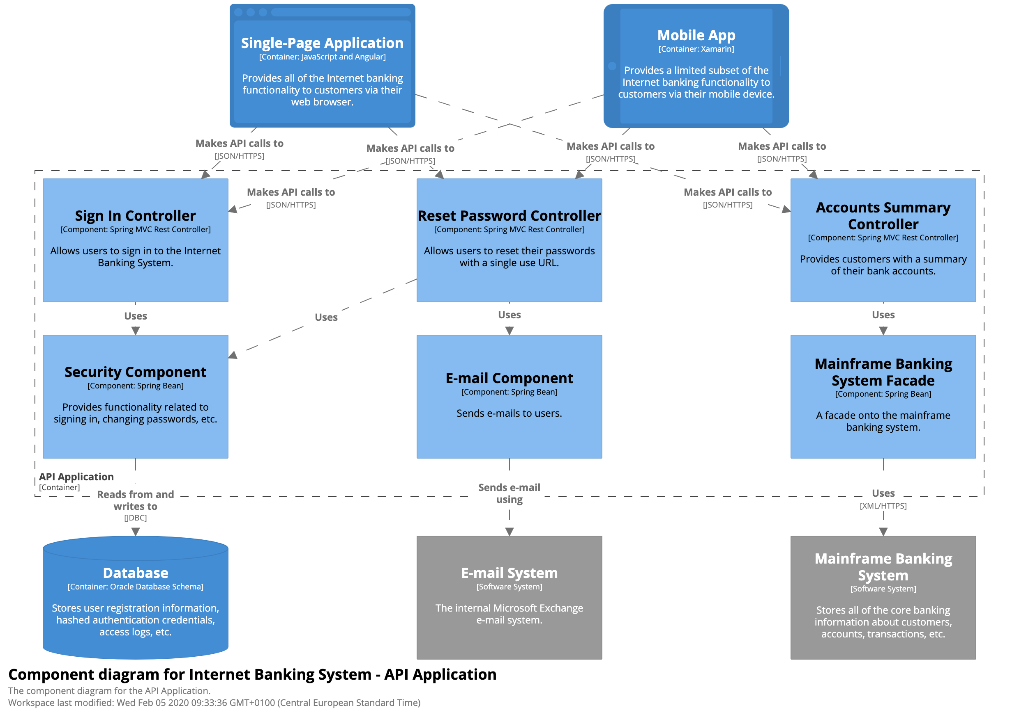
Data Architecture
JSON
C4 focuses on software, not data
But defining data is essential for interoperability between components
"JSON/HTTPS" is not an API
The content used in an API to must be defined
A dynamic diagram can be useful when you want to show how elements in a static model collaborate at runtime to implement a user story, use case, feature, etc. This dynamic diagram is based upon a UML communication diagram.
Notes:
Object oriented design uses APIs to create clear contracts
for services while hiding as much as possible about how those
services do their work.
Each line in an architecture diagram represents an API,
and each API has a purpose. In a banking architecture,
meaningful purposes could include "Check account balance"
or "Authenticate user".
But a line labelled "Make an API call" does not communicate a
meaningful purpose.

Slide 5
Information Modeling and API Design
Problem: C4 focuses on software, not data
Goal: An Interface/Information/Data model that integrates with any software architecture methodology
Solution: Enhance traditional "conceptual, logical, physical" entity relationships to support:
concept refinement
information abstraction
Information Model: defines what components need independently of how it is represented using data.
Components: exchange PDUs in order to obtain information
Messages
Attributes
Abstract Schema
Protocol Data Unit
Level 1 | Level 2 | Level 3 | Level 4
Conceptual Model | Logical Model | Physical Information Model | Physical Data Model
Get an SBOM | SBOM-Req device format | SBOM-Req = Record 1 device UUID 2 format Format | { "action": "query", "target": { "device": "…", "format": "SWID" } }
Notes:
While C4 defines levels of detail based on system composition,
information modeling uses levels based on data abstraction.
This approach has long been used in database design in the
form of entity relationship diagrams.
The highest "conceptual" level describes the purpose of
a relationship or API. Giving a name to all of the APIs in a
system establishes the baseline on which further detail can
be added.
The second or "logical" level gives names to each information
item included in an API.
The bottom level in a database ERD is the physical model.
But for the purpose of designing APIs, OpenC2's information
model breaks that out into two parts.
The physical information model defines the structure
and value constraints of information exchanged over an API.
These correspond directly to the constraints defined by UML.
The physical data model defines how that information is
represented on the wire using formats such as XML or JSON.

Slide 6
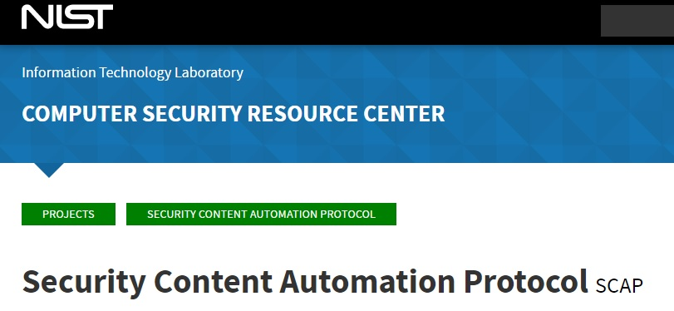
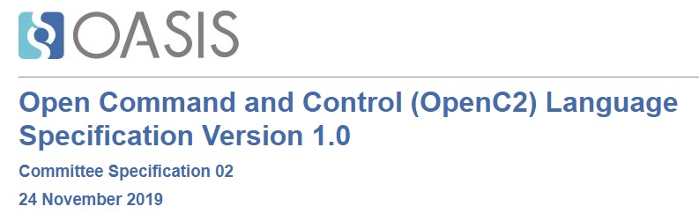
SBOM Use Case using SCAPv2 Prototype
Comply-to-Connect, using:
SCAPv2 Prototype Architecture -- endpoint data collection components
OpenC2 Protocol -- message and content framework
JADN Information Modeling Language -- content definition and refinement
Notes:
The plugfest includes a comply-to-connect use case, which
can be exercised by combining the SCAPv2 prototype architecture,
the OpenC2 protocol, and the JADN information modeling language
developed for OpenC2.

Slide 7
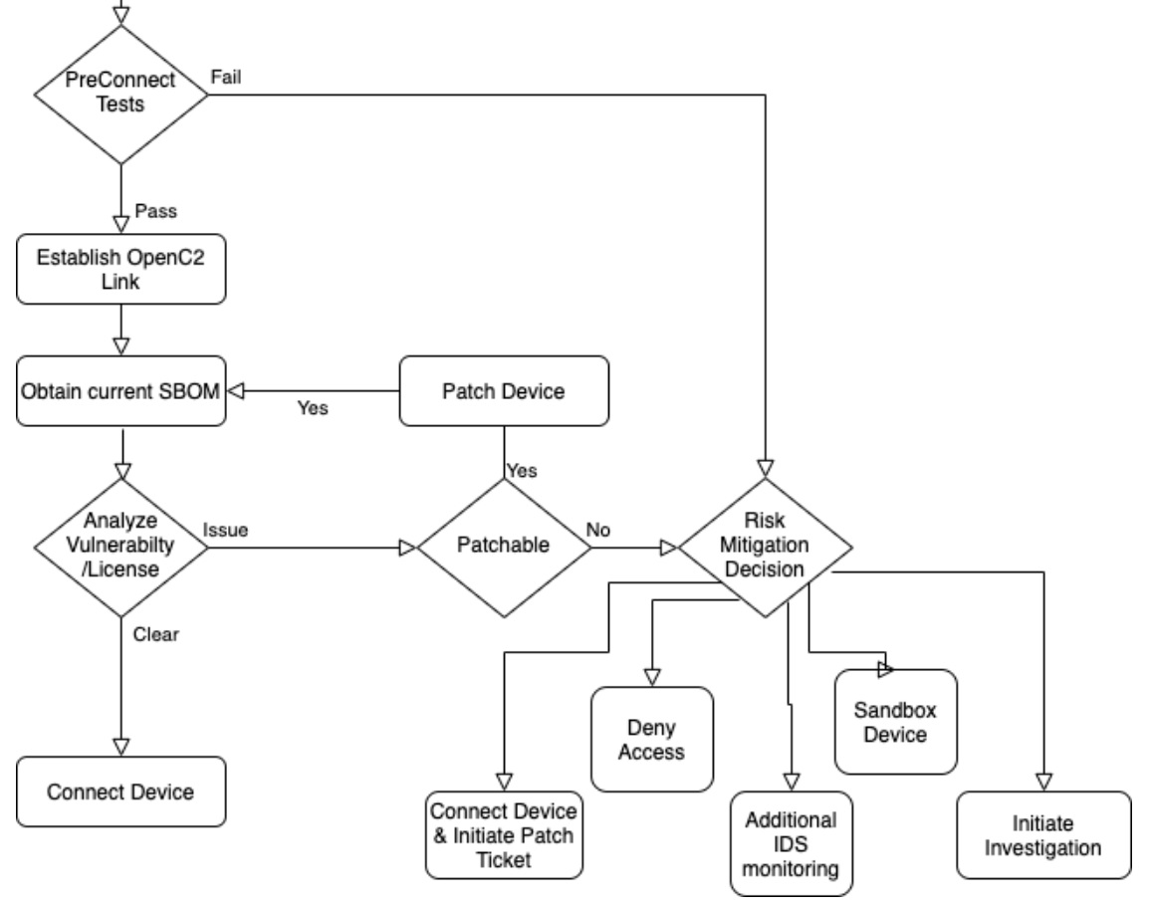
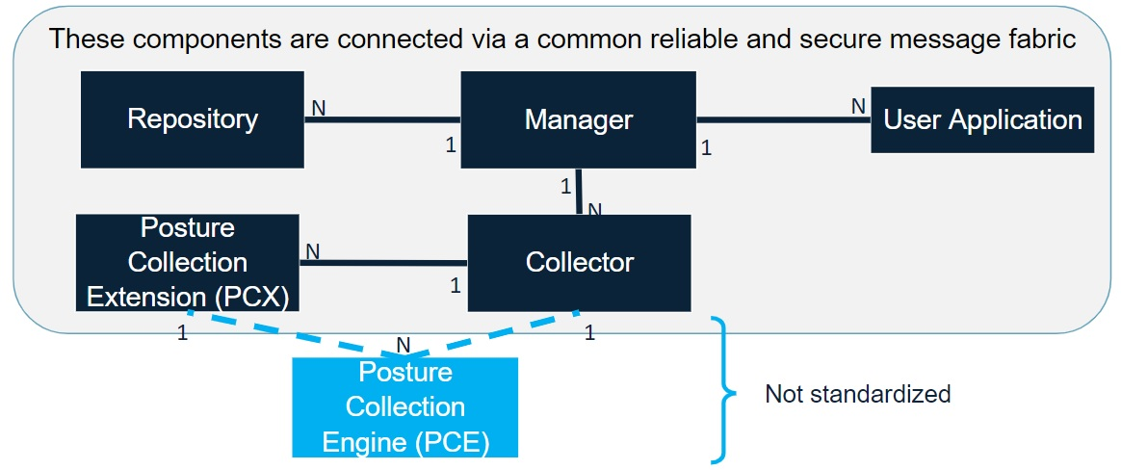
Development Projects
OpenC2 Messaging
SCAPv2 Application
SCAPv2 Data Collection Prototype
OpenC2 Software Bill of Materials Proof of Concept
https://github.com/oasis-tcs/openc2-usecases/tree/master/SBOM-PoC
Notes:
This effort explores how to use the OpenC2 protocol within
the SCAP prototype. A separate effort would take the SBOM
returned by SCAP and use it in a network access decision.

Slide 8
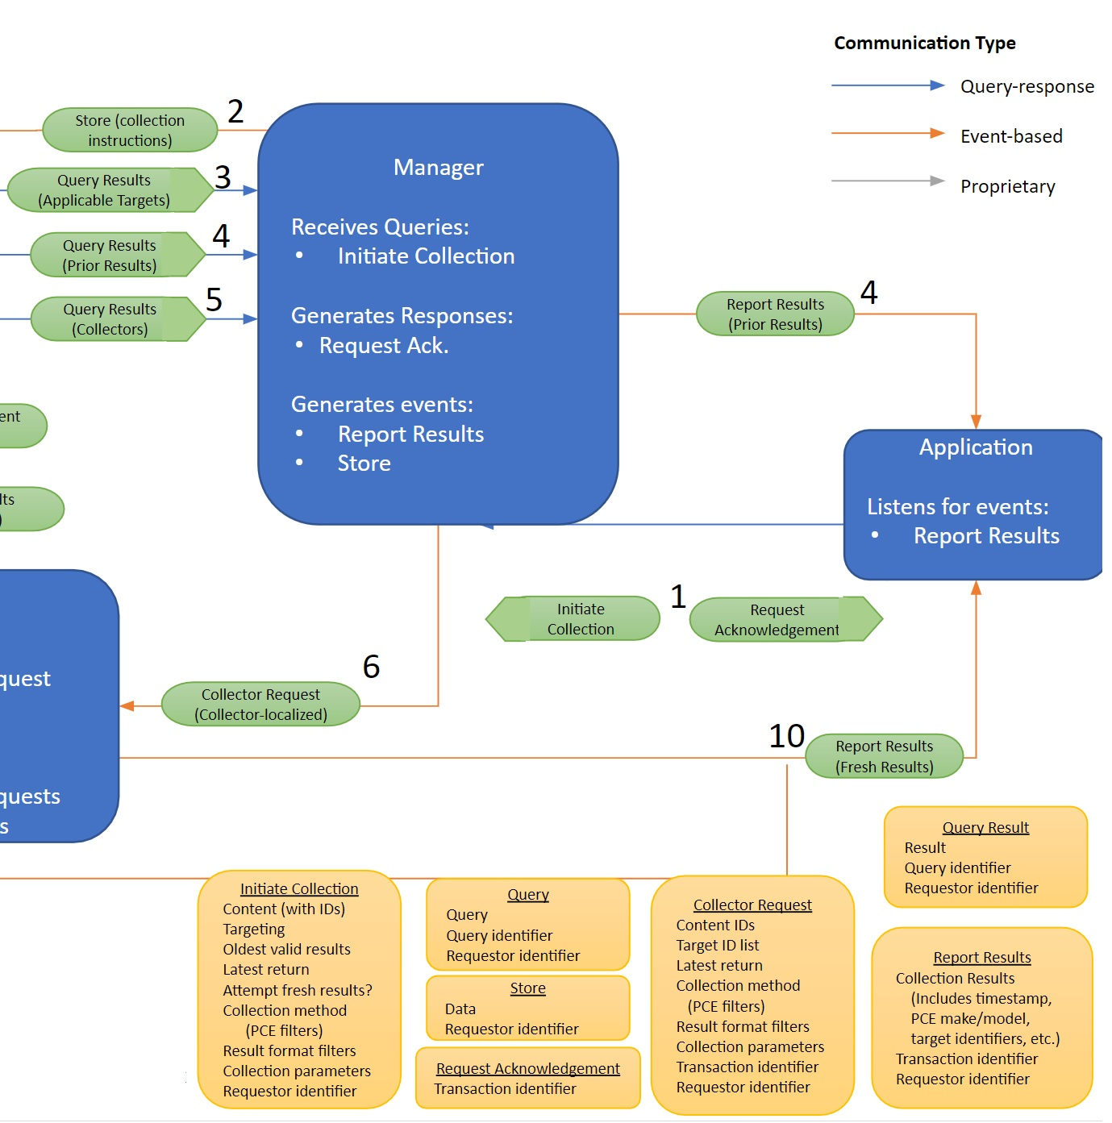
SCAPv2
Data Collection Experiment
or: "How to OpenC2-ize a system spec"
Conceptual Design (messages)
List each Message sent between components
1a. Initiate Collection
1b. Request Acknowledgement
2. Store (collection instructions)
3a. Query (Applicability)
3b. Query Results (Applicable Targets)
Every Message needs a unique name
Message names used by SCAPv2 team ("Initiate Collection") reflect purpose (verb)
Content names ("Assessment-Instructions") refer to data structure (noun)
Notes:
Mitre developed an SCAPv2 architecture document and a system
diagram for the Endpoint Data Collection Experiment.
The OpenC2 team worked with them to develop a
4-level information model for the experiment.
The conceptual model shown here assigns message names to each
of the communications shown in the experiment.

Slide 9
SCAPv2
Data Collection Experiment
Conceptual Design (messages)
Assign Content name used in each Message
1a. Initiate Collection is a request message with specified content
1b. Request Acknowledgement is a response message, no content
2. Store (collection instructions) shown as event, but may need ack
3a. Query (Applicability) is a request, need content
3b. Query Results (Applicable Targets) is a response, need content
4a. …
For each Message:
* pick an Action(verb) for each request. Target(noun) = name of content
* define content types and attributes
Example: 1a: Initiate Collection message might contain
Action = scan, Target = Assessment-Instructions
Logical Design (attributes)
Notes:
The logical design lists attributes of each message by name,
but with no additional detail

Slide 10
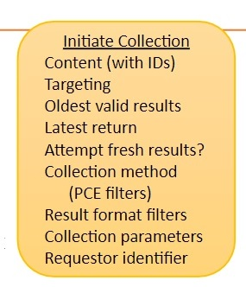
SCAPv2 Actuator Profile
Physical Design (information model with types)
Initiate Collection message:
Target Name: Assessment-Instructions
Target Type: Record (JSON object)
Assessment-Instructions = Record
1 content Assessment-Content
2 targets Assessment-Target [1..*]
3 oldest DateTime
4 latest DateTime
5 refresh Boolean
6 methods PCE-Filter [1..*]
7 formats Result-Format [1..*]
8 params Collection-Parameters
9 requestor Requestor-ID
Assessment-Content = String
Assessment-Target = String
PCE-Filter = String
Result-Format = String
Collection-Parameters = String
Requestor-ID = Binary /uuid
Make up attribute names and types
"Content (with IDs)" is from the system description
"content" is a (made-up) attribute name (could be better)
"Assessment-Content" is a (made-up) type name
"Targeting" sounds vaguely plural, so give it multiplicity [1..*]
"Oldest valid results" sounds like a date-time, but may be more
Create stubs (String) for unknown types
Guess that "Requestor identifier" might be a UUID
Do the same for all Messages
OpenC2 schema for Data Collection Experiment is now defined in sufficient detail for experimenting. Fill in stubs later.
OpenC2 JADN Interface Definition Language
Notes:
The physical information model is created by assigning types
to each attribute. This is an iterative process starting at
the top level of each message. Lower level detail can be
stubbed out, and the data collection experiment
can be run using what has been specified.

Slide 11
SCAPv2 Actuator Profile
Physical Design (information model with types)
Physical Data Model
(serialized data)
carried in
Initiate Collection Message
Assessment-Instructions = Record
1 content Assessment-Content
2 targets Assessment-Target [1..*]
3 oldest DateTime
4 latest DateTime
5 refresh Boolean
6 methods PCE-Filter [1..*]
7 formats Result-Format [1..*]
8 params Collection-Parameters
9 requestor Requestor-ID
Assessment-Content = String
Assessment-Target = String
PCE-Filter = String
Result-Format = String
Collection-Parameters = String
Requestor-ID = Binary /uuid
Protocol
Message
Content
{
"action": "scan",
"target": {
"scapv2": {
"assessment": {
"content": "foo",
"targets": ["foo", "bar"],
"oldest": "2020-08-23T22:07:48+00:00",
"latest": "2020-09-23T22:07:48+00:00",
"refresh": false,
"formats": ["foo", "bar"],
"params": "a bunch of stuff",
"requestor": "22023fda-6596-45c7-96ac-ab31915a7be1"
}
}
}
}
OpenC2 Command
OpenDXL payload serialized as JSON
OpenC2 JADN Interface Definition Language
Notes:
The physical data model is generated each time the
information model is modified, allowing rapid prototyping
and testing of ideas

Slide 12

The End (backups follow)

Slide 13
What Is OpenC2?
Protocol: http, mqtt, opendxl, …
Headers: carried in Protocol or Message
Payload: Message or Content (as indicated by media-type)
Protocol
{
"request_id": "32cd9168-338f-11e4-0d01-0050569b7
"body": {
"openc2": {
"request":
}
}
}
Content: control structure and cybersecurity vocabulary for discrete actions
Action (verb): allow, deny, contain, scan, query, restart, …
Target (noun): device, file, ip address, ip connection, url, …
Args: additional details: where and how to perform the action
Actuator (function): packet filtering, intrusion prevention, assessment, ...
Message: content-agnostic payload structure
Headers
Content-type (openc2), Message-type (request, response, notification)
Content
Protocol: message bindings for transport protocols
HTTPS, MQTT, OpenDXL, ...
Information Modeling Language
abstract syntax for content in JSON, CBOR, XML, ... formats
machine-readable schema ⇒ property tables, IDL, UML diagrams, node-edge graphs
Message
Content
{ "action": "contain",
"target": {
"device": {
"hostname": "testdevice.local.com"
}
}
}
or using Compact JSON:
["contain", "device": {...}]
Friendly Encoding: https://www.w3.org/2011/10/integration-workshop /s/ExperienceswithJSONandXMLTransformations.v08.pdf

Slide 14
OpenC2 Actuator Profiles
Protocol: http, mqtt, opendxl, …
Headers: carried in Protocol or Message
Payload: Message or Content (as indicated by media-type)
Protocol
{
"request_id": "32cd9168-338f-11e4-0d01-0050569b7
"body": {
"openc2": {
"request":
}
}
}
Message
Language Specification: defines the Content structure and a cybersecurity vocabulary of simple common objects:
Target (noun): device, file, ip address, ip connection, url, …
Actuator Profiles: define application-specific objects that may be simple or complex:
Target (noun):
slpf/rule_number
scap/assessment (to be defined)
Device (OpenC2 Consumer) supports parts of the core Language and one or more Actuator Profiles
https://github.com/oasis-tcs/openc2-usecases/tree/master/SBOM-PoC/Schemas
{ "action": "delete",
"target": {
"slpf": {
"rule_number": 34
}
}
}
Content

Slide 15
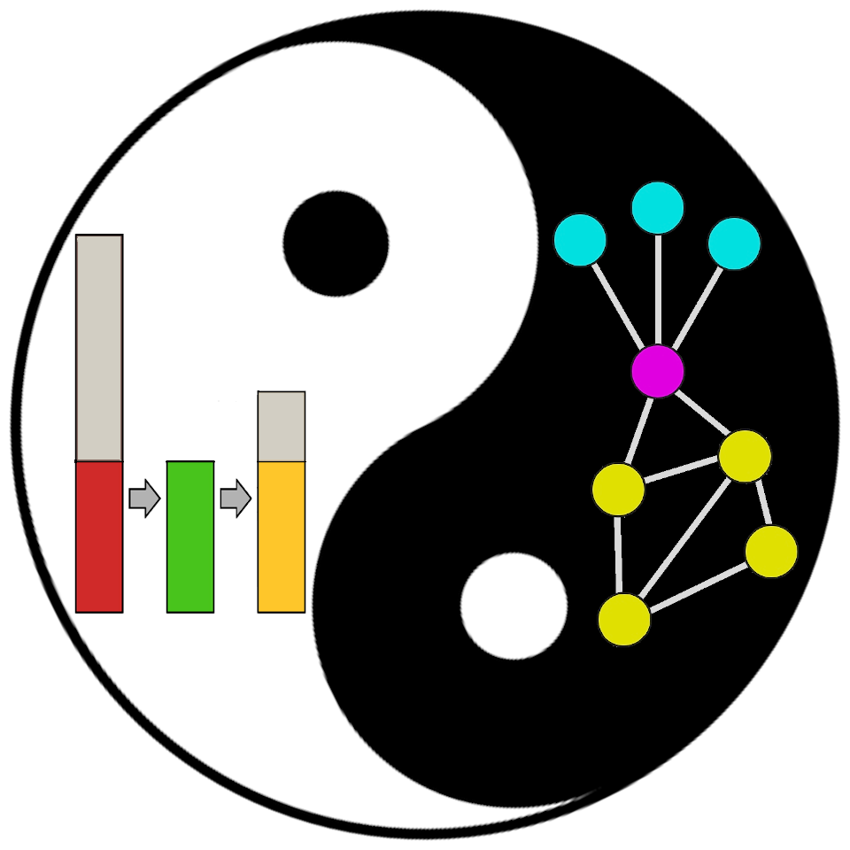
OpenC2 Information Modeling
OpenC2 created the JADN formal information modeling language based on information theory and graph theory.
A package is a namespace for a collection of type definitions
Every type definition is a graph node
Types define the information (entropy) contained in data instances
Serialization rules define data formats used to represent information instances
Graph structure:
Encourages normalization and reuse of named types
Supports evolution from conceptual design to concrete schemas.
An IM is used to both generate specifications and validate data
Improves quality and ensures consistency
IM is a normative definition, not just "a representation of concepts"
An information model is a representation of concepts and the relationships, constraints, rules, and operations to specify data semantics for a chosen domain of discourse.
Information theory studies the quantification, storage, and communication of information.
Graph theory is the study of graphs, which are mathematical structures used to model pairwise relations between objects.
--- Wikipedia

Slide 16
JSON Abstract Data Notation (JADN) Status
Working Draft 01 about to be published by the OpenC2 Technical Committee
https://github.com/oasis-tcs/openc2-jadn/blob/working/jadn-v1.0-wd01.md
Public comments
Github issues: https://github.com/oasis-tcs/openc2-jadn/issues
OpenC2 public email list: openc2-comment@lists.oasis-open.org
Next Steps - apply JADN to a wider set of use cases:
Security Content Automation Protocol (SCAP) Version 2
SBOM data formats (SPDX, SWID, CycloneDX, …)
...

