Slide 1
UCAP – Unified Cyber Defense Platform
Calvin Smith – Project Lead
Jason Liu – Cyber Architect
Jeremy Powell – Cyber Engineer
Implementing OpenC2 for
Cyber Automation Interoperability
27-28 January, 2020
Distribution Statement A: Approved for Public Release; Distribution is Unlimited; #20-0061; Dated 01/28/2020
© 2020 Northrop Grumman Systems Corporation

Slide 2
Executive Summary
Vision Statement
Deliver Active Cyber Defense Ecosystem in OpenC2 to support customer mission with automated advanced cyber network defense services.
Features
Benefits
Automated Cyber Hygiene Resolution
Real-time Malware Analysis & Classification
Predictive Threat Analysis with Automated Incident Response
Information Sharing
Data Lake for Custom Data Integration
Playbooks in OpenC2 for Risk Mitigation
Improved Cyber Resiliency for Your Network
Rapid Response to Emerging Cyber Threats
Timely Support for Mission Planning
Cost Effective with Open Source
Easy Integration with Open Standards
Distribution Statement A: Approved for Public Release; Distribution is Unlimited; #20-0061; Dated 01/28/2020
Notes:
UCAP is a Cyber Ecosystem developed by Northrop Grumman. It leverages OpenC2 for Active DCO. See the lists for features and benefits.

Slide 3
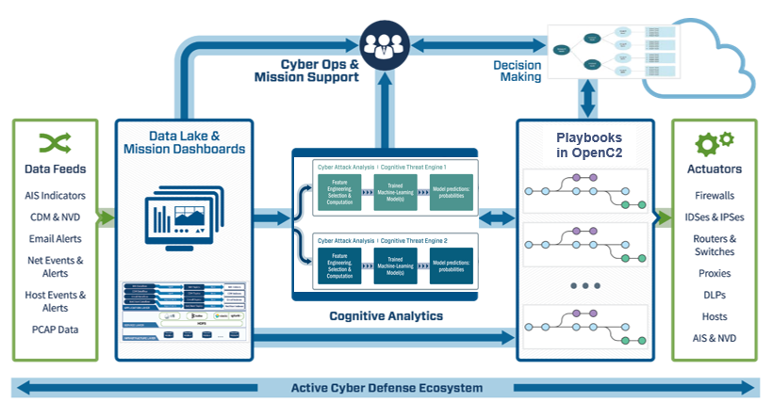
Cyber Automation Framework Leveraging OpenC2 for Active DCO
Built-in Data Lake makes it easy to integrate with customer network environment
Distribution Statement A: Approved for Public Release; Distribution is Unlimited; #20-0061; Dated 01/28/2020
Notes:
This is UCAP Framework, consisting multiple system components.
Data Lake: ingest data in any format, support data streaming
Cognitive Analytics: run on Data Lake, detect and predict cyber threats and risks
Playbooks in OpenC2: mitigate the risks in real-time through communication with Actuators

Slide 4
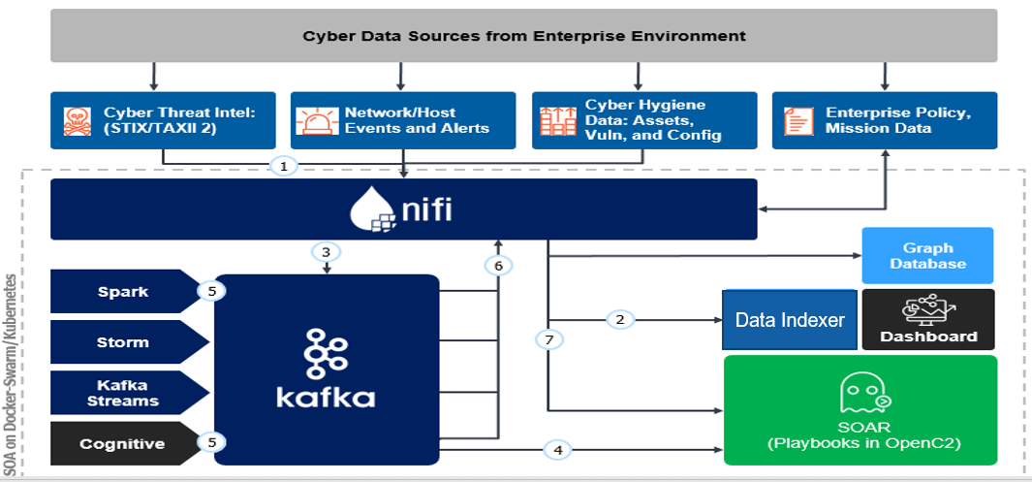
Data Streaming on the Data Lake
Distribution Statement A: Approved for Public Release; Distribution is Unlimited; #20-0061; Dated 01/28/2020
Notes:
This diagram shows typical data processing steps between Data Lake components:
(1) data ingest from tools/sensors; (2) all events are saved to Elastic for storage and dashboard; (3) select types of events are forwarded to Kafka for stream data processing; (4) some events are forwarded immediately to SOAR for actions; (5,6,7) other events are processed with analytics with results being sent to SOAR for actions.

Slide 5
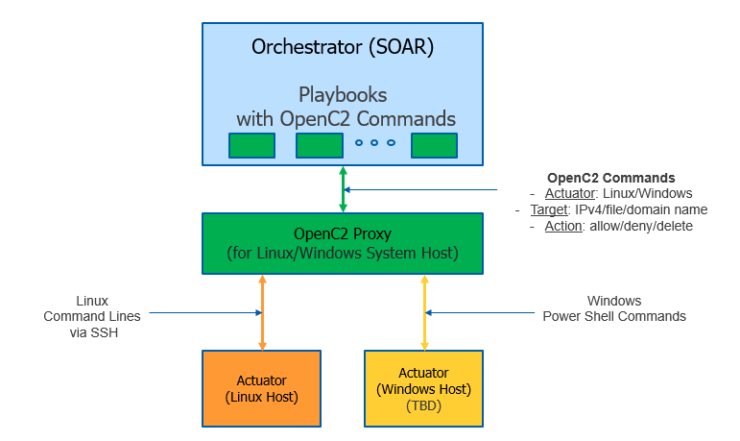
OpenC2 Implementation (in 3 Layers)
Distribution Statement A: Approved for Public Release; Distribution is Unlimited; #20-0061; Dated 01/28/2020
Notes:
We take a layered approach to OpenC2 implementation: (SOAR layer) Playbooks are developed in OpenC2 commands, which are actuator agnostic and easily portable; (OpenC2 Proxy layer) OpenC2 Command is interpreted on OpenC2 Proxy, converted to actuator specific commands, and sent to the intended actuator for execution; (Actuator layer) where platform specific commands are executed on the actuator for the desired functions, e.g. deny an IP address, delete a file, block a domain name, and etc.

Slide 6
Cyber Use Cases in OpenC2
Use Case 1: Cyber Hunt and Incident Response
Hunt and respond to emerging cyber threats
Maintain cyber resiliency for mission support
Use Case 2: Cybersecurity Compliance
Fix non-compliant OS settings
Keep good cyber hygiene
Use Case 3: Data Exfiltration via DNS Tunnel
Detect hidden cyber threat with advanced technology
Stop data loss in real-time
Distribution Statement A: Approved for Public Release; Distribution is Unlimited; #20-0061; Dated 01/28/2020
Notes:
Here are three(3) use cases leveraging OpenC2 standard.

Slide 7
Use Case 1: Cyber Hunt & Incident Response (Leveraging OpenC2 Standard)
The Problem
Cyber Intel provides valuable information about emerging cyber threats, but the information is not used in timely manner for effective cyber defense
It often results in prolonged existence of cyber threats, lateral movement and extensive damage to the network and/or mission
The Solution (full automation w/o human in the loop)
Ingest Cyber Threat Intel, e.g. IOCs, to Data Lake in real-time
Launch Cyber Hunt Task to look for presence of new threats on your network
If any cyber threats are detected, highlight them and display risk on dashboards
Automated launch of playbook(s) in OpenC2 to mitigate the risks
Distribution Statement A: Approved for Public Release; Distribution is Unlimited; #20-0061; Dated 01/28/2020
Notes:
With the first use case we show how to hunt and respond to emerging cyber threats with playbooks in OpenC2.

Slide 8
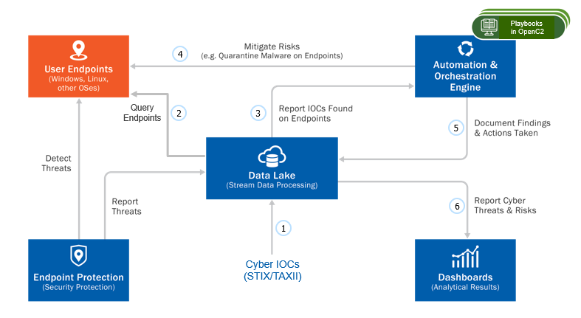
Use Case 1: Workflow Diagram (Playbooks in OpenC2)
Distribution Statement A: Approved for Public Release; Distribution is Unlimited; #20-0061; Dated 01/28/2020
Notes:
The workflow of use case 1: (1) ingest of a cyber IOC in STIX/TAXII; (2) query endpoints to detect existence of the cyber threats specified in the IOC; (3) report detection of the cyber threats to SOAR for action; (4) automated initiation of playbooks in OpenC2 to neutralize the cyber threats; (5,6) report the cyber threats with actions taken, and display results on dashboards

Slide 9
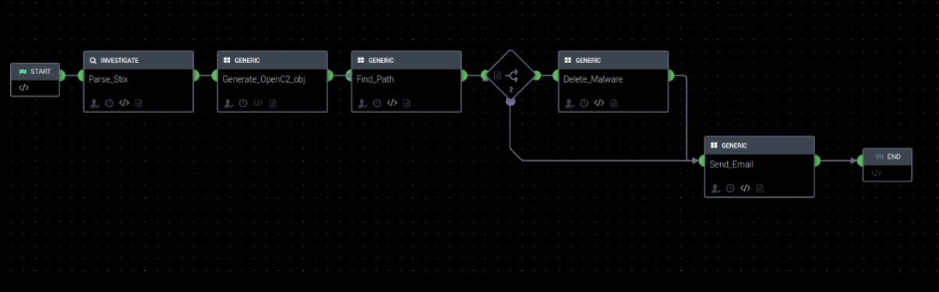
Use Case 1: Playbook in OpenC2
Distribution Statement A: Approved for Public Release; Distribution is Unlimited; #20-0061; Dated 01/28/2020
Notes:
This is a screenshot of the use case 1 playbook in OpenC2 commands.

Slide 10
Use Case 2: Cybersecurity Compliance (Leveraging OpenC2 Standard)
The Problem
Enterprise or agency often requires implementation of certain security standards for network devices and user endpoints to ensure policy compliance
Non-compliant settings are not corrected in timely manner introducing vulnerabilities that are subject to cyber attacks
The Solution (full automation w/o human in the loop)
Ingest compliance assessment results to Data Lake in real-time
Highlight the non-compliant settings and cyber risks on dashboards
Launch playbooks in OpenC2 to correct the non-compliant settings
Distribution Statement A: Approved for Public Release; Distribution is Unlimited; #20-0061; Dated 01/28/2020
Notes:
With the second use case we show how to fix non-compliant OS settings on endpoints upon discovery and maintain good cyber hygiene.

Slide 11
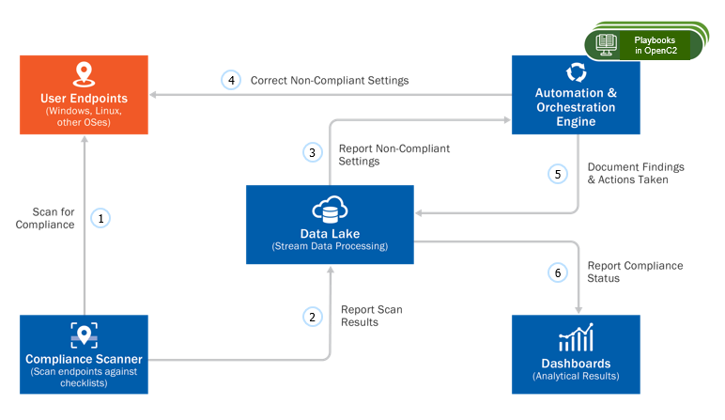
Use Case 2: Workflow Diagram (Playbooks in OpenC2)
Distribution Statement A: Approved for Public Release; Distribution is Unlimited; #20-0061; Dated 01/28/2020
Notes:
The workflow of use case 2: (1) scan endpoints against the select OS checklists; (2) ingest the scan results to Data Lake; (3) report the non-compliant settings to SOAR for action; (4) automated initiation of playbooks in OpenC2 to correct the non-compliant settings on the endpoints; (5,6) report the non-compliant settings with actions taken, and display results on dashboards.

Slide 12
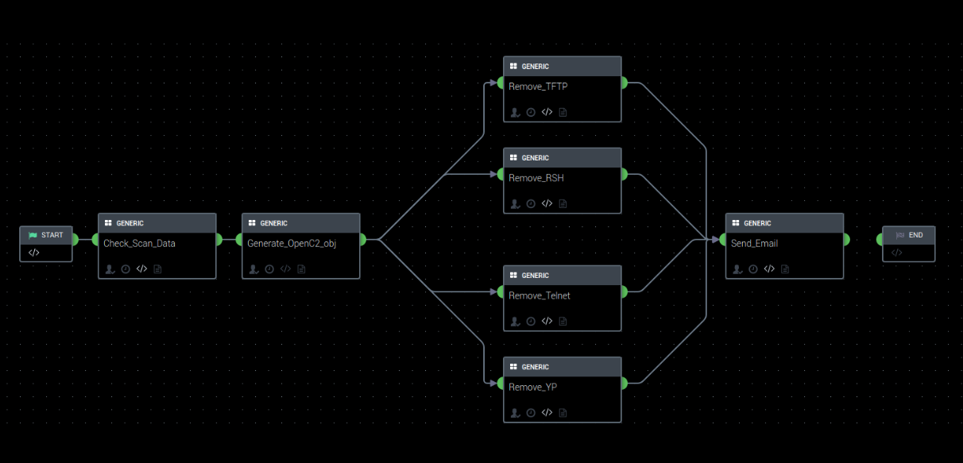
Use Case 2: Playbook in OpenC2
Distribution Statement A: Approved for Public Release; Distribution is Unlimited; #20-0061; Dated 01/28/2020
Notes:
This is a screenshot of the use case 2 playbook in OpenC2 commands.

Slide 13
Use Case 3: DNS Data Exfiltration (Leveraging OpenC2 Standard)
The Problem
DNS traffic is often not checked and inspected at perimeter firewall
Adversaries could take advantage to exfiltrate information out
The Solution (full automation w/o human in the loop)
Ingest DNS logs to Data Lake in real-time
Detect anomalies with an Advanced Analytics
Highlight the anomalies on dashboards
Launch Playbooks in OpenC2 to block the DNS domain name(s)
Distribution Statement A: Approved for Public Release; Distribution is Unlimited; #20-0061; Dated 01/28/2020
Notes:
With the third use case we show how to block data exfiltration attempts via hidden DNS tunnel upon detection using advanced analytics. Again, we use OpenC2 to block the domain name on the receiving end.

Slide 14
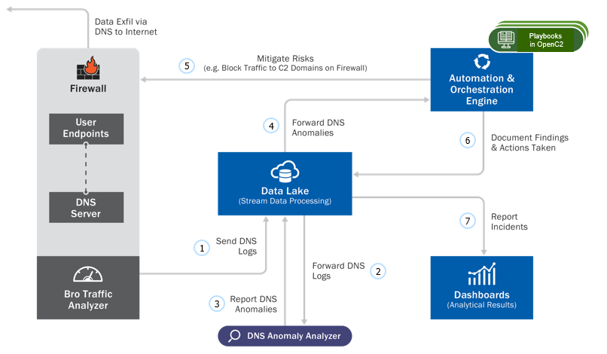
Use Case 3: Workflow Diagram (Playbooks in OpenC2)
Distribution Statement A: Approved for Public Release; Distribution is Unlimited; #20-0061; Dated 01/28/2020
Notes:
The workflow of use case 3: (1) ingest of DNS logs to Data Lake; (2) forward/stream DNS logs to DNS Anomaly Analyzer; (3) report DNS anomaly alerts to Data Lake; (4) forward anomaly alerts to SOAR for action; (5) automated initiation of playbooks in OpenC2 to block the hidden DNS tunnel, effectively stopping the data exfiltration; (6,7) report the cyber threats with actions taken, and display results on dashboards.

Slide 15
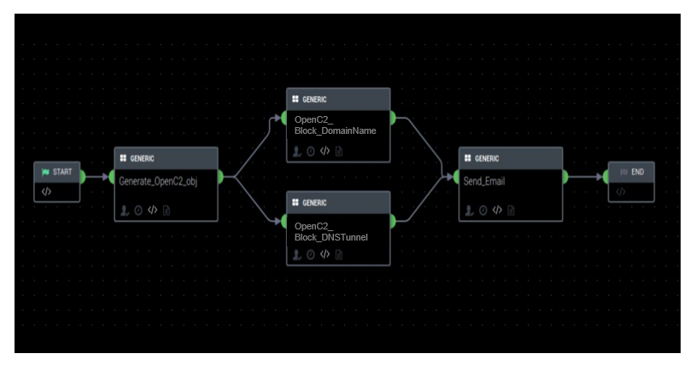
Use Case 3: Playbook in OpenC2
Distribution Statement A: Approved for Public Release; Distribution is Unlimited; #20-0061; Dated 01/28/2020
Notes:
This is a screenshot of the use case 3 playbook in OpenC2 commands.

Slide 16
Take Aways
Continuously monitor your network and devices
Don’t wait, take actions in real-time
Share information, it helps everyone
Solve hard problems with technologies
Save cost with standards – Go for OpenC2!
Distribution Statement A: Approved for Public Release; Distribution is Unlimited; #20-0061; Dated 01/28/2020
Notes:
Our lessons learned. The conclusion – OpenC2 has a great potential!

