Slide 1
Nashville’s Thursday traffic has indeed changed!
(just not that much)

Slide 2
NULL HYPOTHESIS
Team Two is excited to report that Thursday traffic is not all that special.
But Wednesday’s are!

Slide 3
Unexpected Results
Wednesdays are busier than Thursdays (and sometimes Fridays!)
Nashville has yet to catch up with 2020 traffic volume.

Slide 4
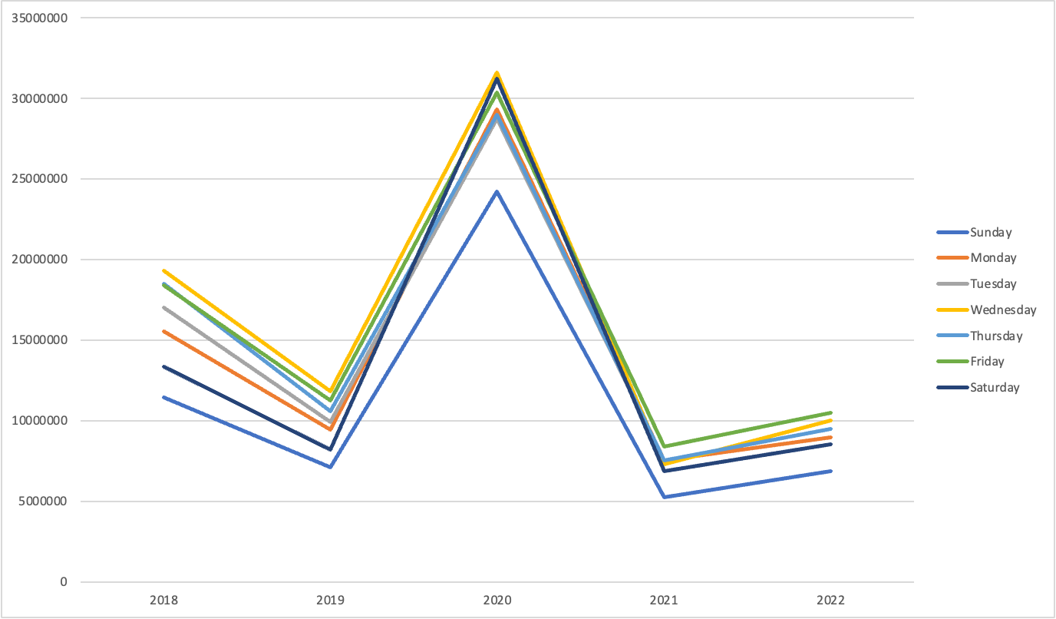

Slide 5
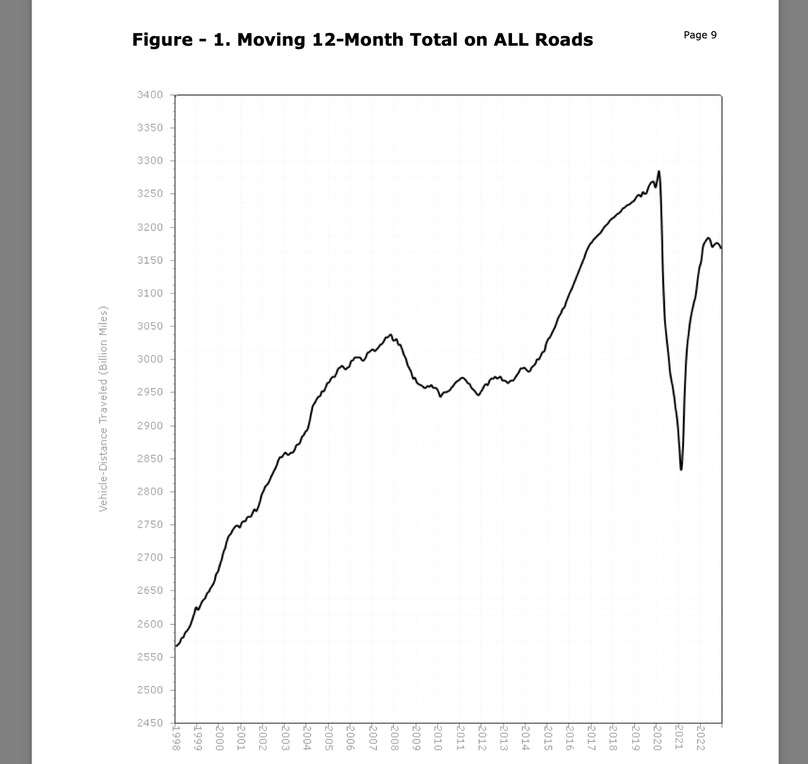

Slide 6
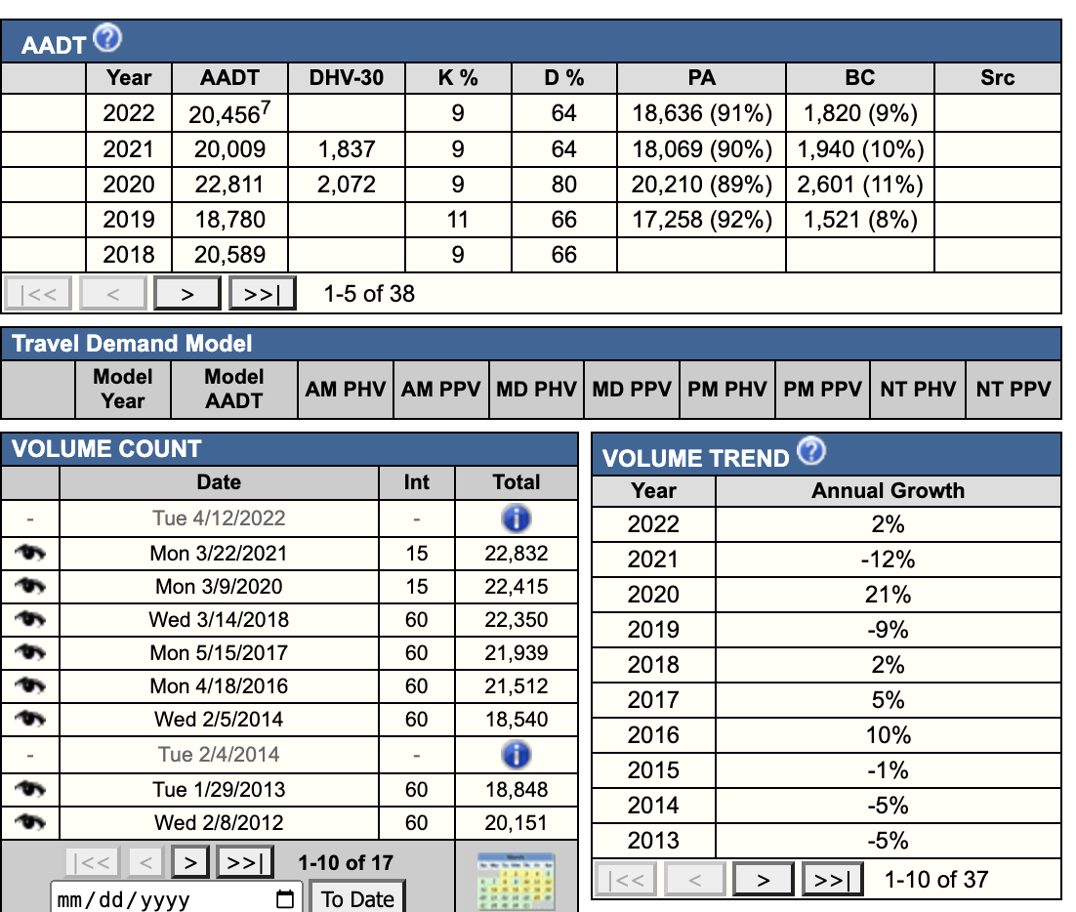

Slide 7
Limitations
There are only 6 stationary local counting stations that have operated 24 hours a day every day for 5 years straight. We wish there we 600.
We always need more time.
We always need more money.
We always needed more resources.

Slide 8
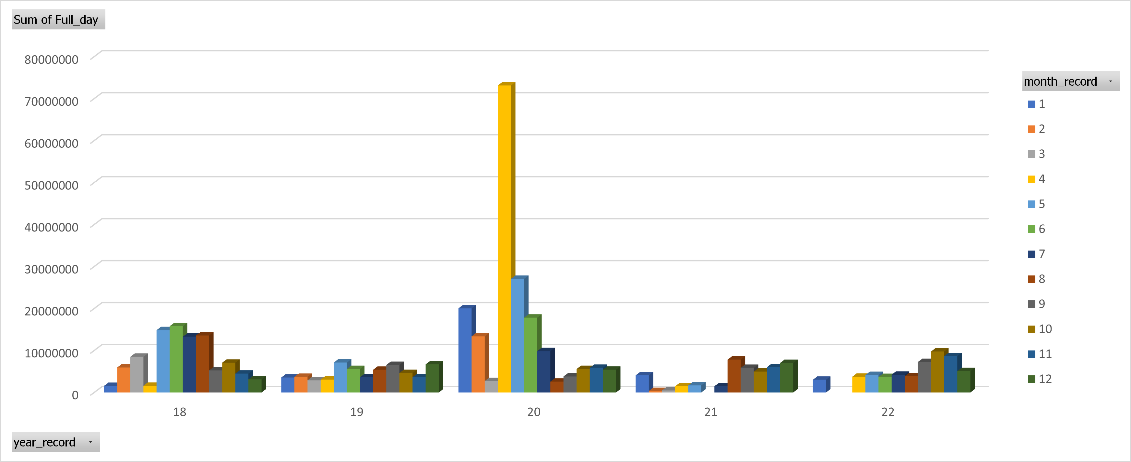

Slide 9
Follow Up Research
What’s going on with Wednesdays?

