Slide 1
Recidivism
Released from prison, returning after some time

Slide 2

The questions
What are the chances of a released inmate to return to jail ?
Is it possible to predict if a specific individual will return to jail ?

Slide 3
Project Team
Brewer, William
Linn, Dale
Shannon, Kiara
Troche, Hugo
Guidance:
Ahmad Mousa
Joshua Steir

Slide 4
Presentation Structure
Introduction
By William Brewer
Technical Description of the Coding Process
By Dale Linn
Conclusions
By Kiara Shannon & Hugo Troche
Audience: Bootcamp students and instructors

Slide 5


Slide 6

References
PublicData:NIJ_s_Recidivism_Challenge_Full_Dataset.csv:https://data.ojp.usdoj.gov/Courts/NIJ-s-Recidivism-Challenge-Full-Dataset/ynf5-u8nk/about_data
Background: https://data.ojp.usdoj.gov/stories/s/daxx-hznc

Slide 7
The file for analysis
Date Created: July 15,2021
25,835 records - each record is a person
54 fields, characteristics and circumstances of the individual, compiled specifically to study Recidivism

Slide 8
Characteristics and circumstances
ID, Number
Gender, Plain Text
Race, Plain Text
Age_at_Release, Plain Text
Residence_PUMA, Number
Gang_Affiliated, Boolean
Supervision_Risk_Score_First, Number
Supervision_Level_First, Plain Text
Education_Level, Plain Text
Dependents, Plain Text
Prison_Offense, Plain Text
Prison_Years, Plain Text
Prior_Arrest_Episodes_Felony, Plain Text
Prior_Arrest_Episodes_Misd, Plain Text
Prior_Arrest_Episodes_Violent, Plain Text
Prior_Arrest_Episodes_Property, Plain Text
Prior_Arrest_Episodes_Drug, Plain Text
Prior_Arrest_Episodes_PPViolationCharges, Plain Text
Prior_Arrest_Episodes_DVCharges, Boolean
Prior_Arrest_Episodes_GunCharges, Boolean
Prior_Conviction_Episodes_Felony, Plain Text
Prior_Conviction_Episodes_Misd, Plain Text
Prior_Conviction_Episodes_Viol, Boolean
Prior_Conviction_Episodes_Prop, Plain Text
Prior_Conviction_Episodes_Drug, Plain Text

Slide 9
Characteristics and circumstances
Prior_Conviction_Episodes_PPViolationCharges, Boolean
Prior_Conviction_Episodes_DomesticViolenceCharges, Boolean
Prior_Conviction_Episodes_GunCharges, Boolean
Prior_Revocations_Parole, Boolean
Prior_Revocations_Probation, Boolean
Condition_MH_SA, Boolean
Condition_Cog_Ed, Boolean
Condition_Other, Boolean
Violations_ElectronicMonitoring, Boolean
Violations_Instruction, Boolean
Violations_FailToReport, Boolean
Violations_MoveWithoutPermission, Boolean
Delinquency_Reports, Plain Text
Program_Attendances, Plain Text
Program_UnexcusedAbsences, Plain Text
Residence_Changes, Plain Text
Avg_Days_per_DrugTest, Number
DrugTests_THC_Positive, Number
DrugTests_Cocaine_Positive, Number
DrugTests_Meth_Positive, Number
DrugTests_Other_Positive, Number
Percent_Days_Employed, Number
Jobs_Per_Year, Number
Employment_Exempt, Boolean
Recidivism_Within_3years, Boolean
Recidivism_Arrest_Year1, Boolean
Recidivism_Arrest_Year2, Boolean
Recidivism_Arrest_Year3, Boolean
Training_Sample, Number

Slide 10

Action Plan
Preprocess the data
NaN data
Gain knowledge of data with Pivot Tables
Build the model
Train, Test, Split
Logistic Regression
Confusion Matrix
Correlation Matrix
Loss, Accuracy

Slide 11
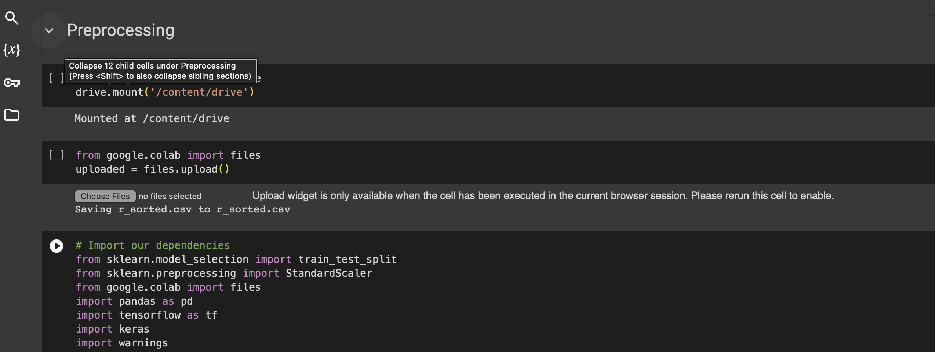
Technical Description of the Coding Process

Slide 12

Conclusions

Slide 13
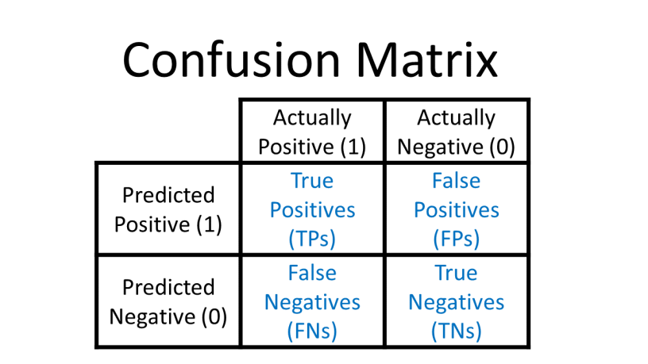
Confusion Matrix

Slide 14
Main conclusions
1 xx
2 yy
3 zz

