Slide 1

Start With the Hard Clues Toward a SaberMetrics OF Jeopardy!
Dr. David Letzler
NYC Data Science Academy

Slide 2
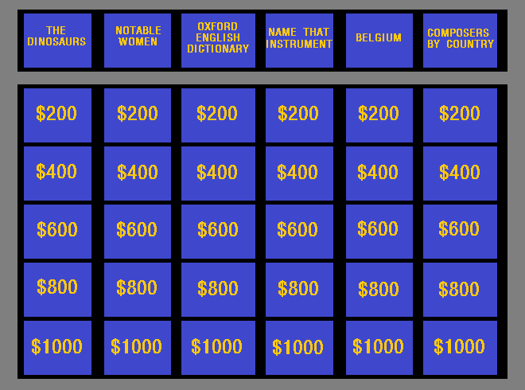
This is “Jeopardy!”
“Jeopardy!” is America’s longest-running quiz show, with over 7,000 aired episodes in its current run
Hosted by Alex Trebek, 1984-present
Each episode has two rounds with 30 questions, plus a single-question final round

Slide 3

The J! Archive is a fan-created website that archives nearly all questions and game-score data asked on Jeopardy!
It includes nearly 330,000 answers/questions/categories/etc. from over 5,000 episodes
70 MB of data, including metadata about each clue and the score from each individual round

Slide 4
How Important are Each of the Three Rounds To the Final Result?
We can compute “Win Probability Added” for each round
Each player begins with a 33% chance of victory. By the end of Final Jeopardy!, one player has a 100% of victory.
If each round were equal and independent, the average winner would increase win probability by 22.2% each round.

Slide 5
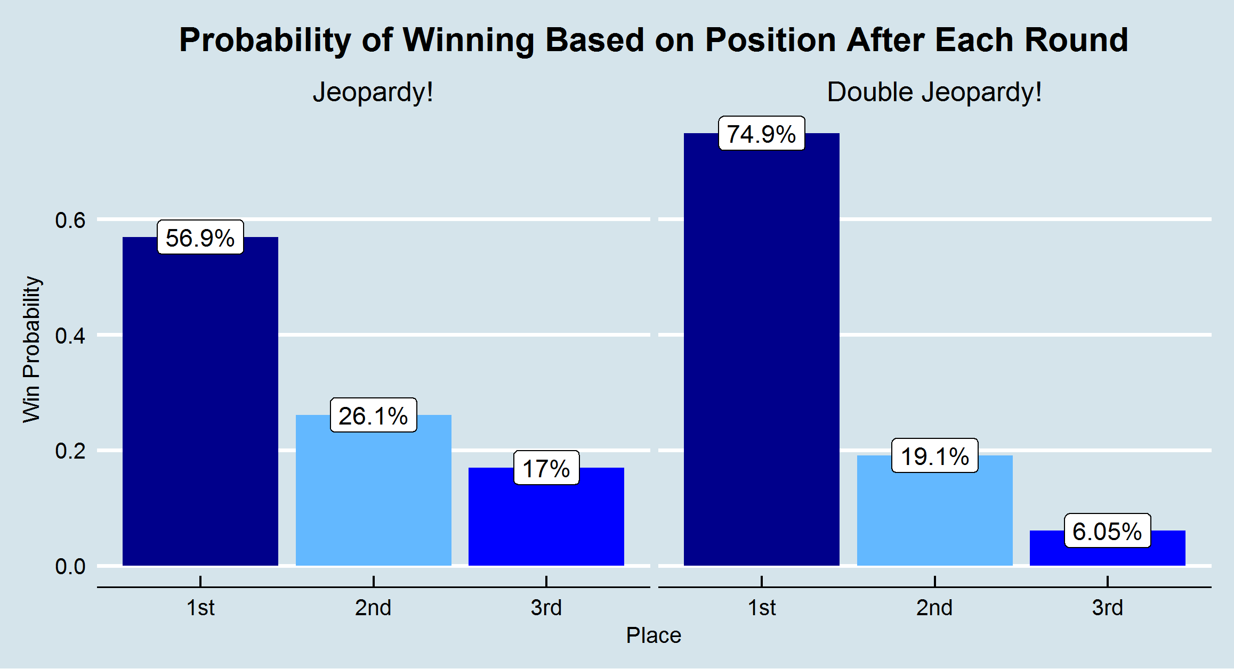
Each Round does Matter!
The average winner’s probability steadily increases over the course of the game. No round is unimportant.
But wait…

Slide 6
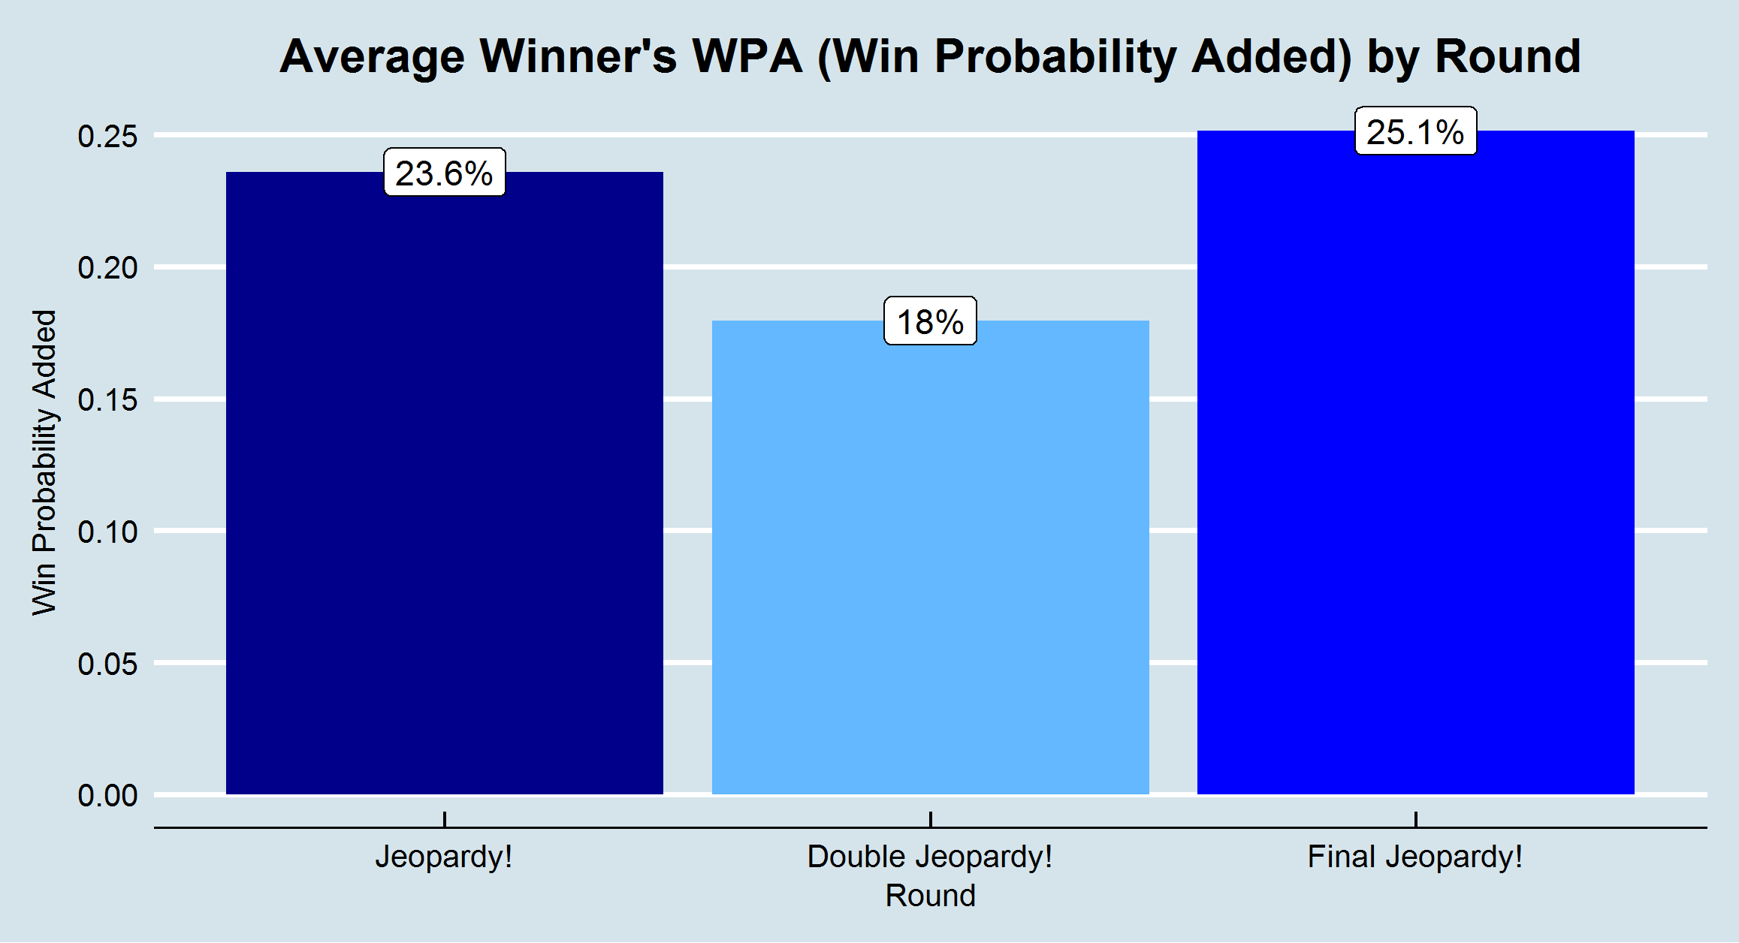
Why Is the First Round so Important?
The questions are worth twice as much in the second round.
Why does the first have more importance to the average winner?
Because…

Slide 7
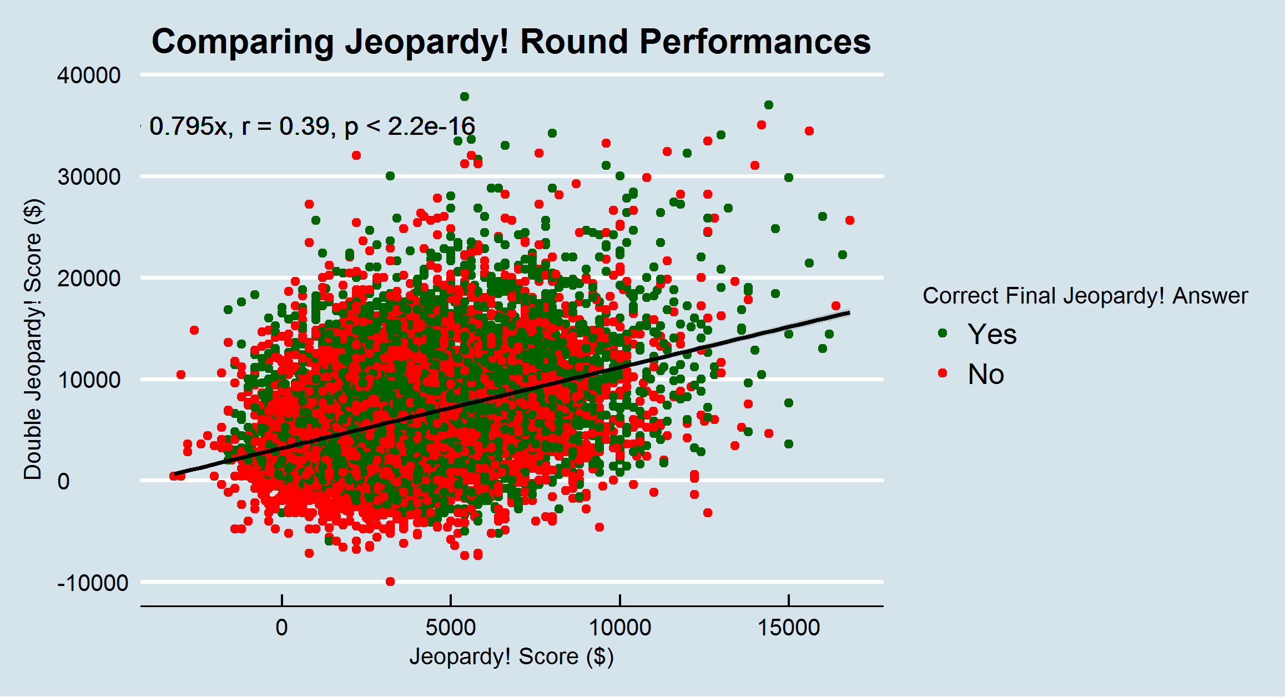
“Jeopardy!” Is a Game of Skill*
First and second round scores are not independent.
The first-round leader is likely to be the best player, hence likeliest to score the best in the second round.
However…

Slide 8
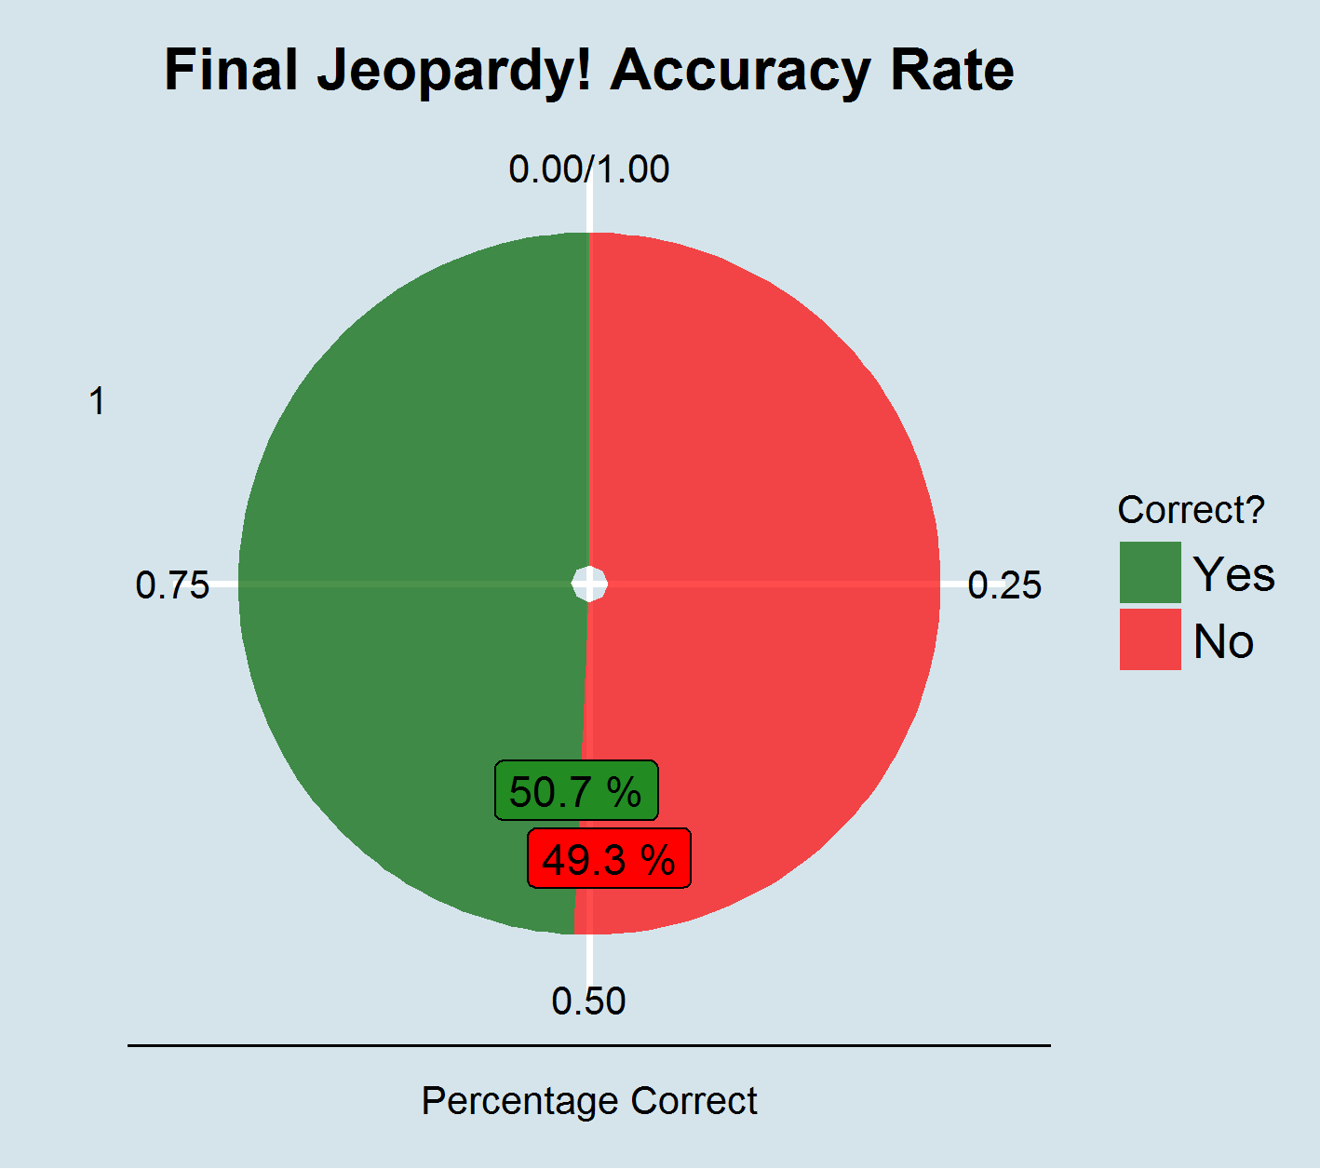
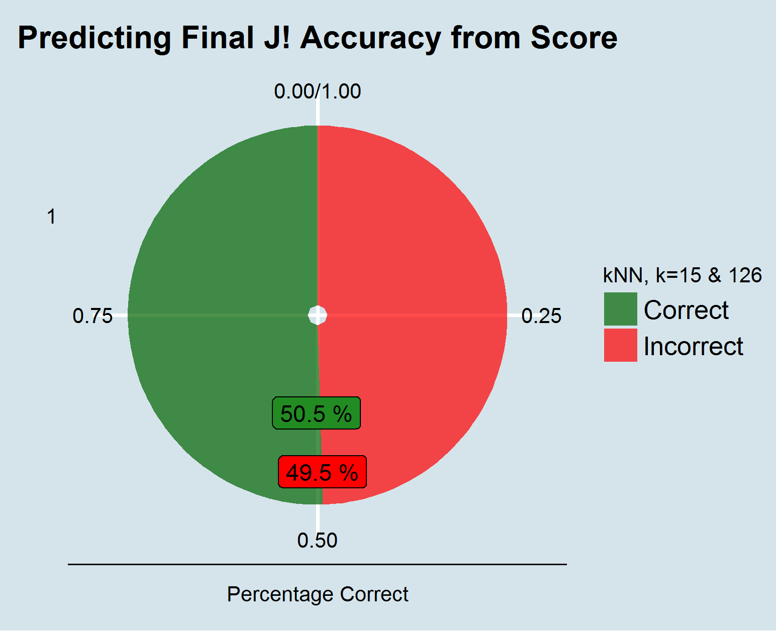
*…Except For Final Jeopardy!
Final Jeopardy! is a complete crapshoot.

Slide 9
Which Questions Pay the Most?
Clues with higher values tend to be harder. Do they pay out better?
Question values are doubled in Double Jeopardy! Are the questions commensurately harder, or are the stakes just increased?
We can calculate expected buzz payoffs for each question level, based on actual game results.

Slide 10
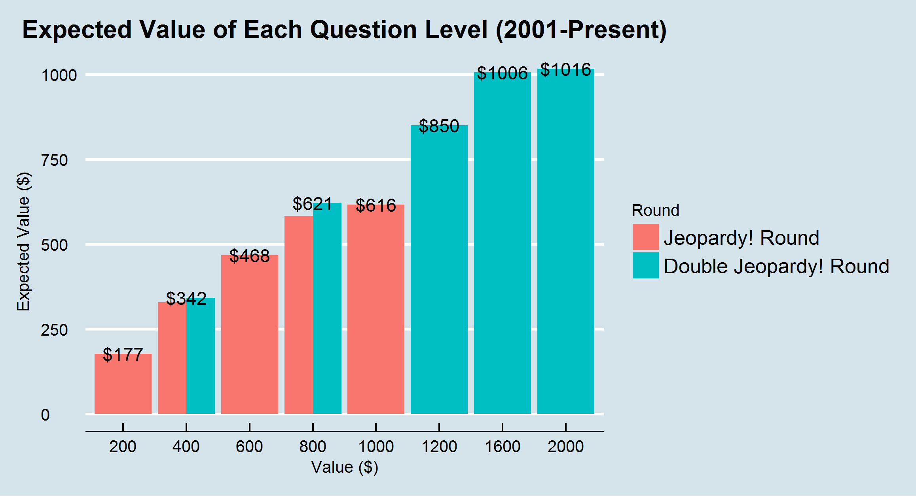
Go For the Hard Questions
Higher-value questions are more difficult.
Double Jeopardy! questions are harder than their Jeopardy! equivalents.
However, the increased payoff more than compensates for the difficulty.
And yet…

Slide 11
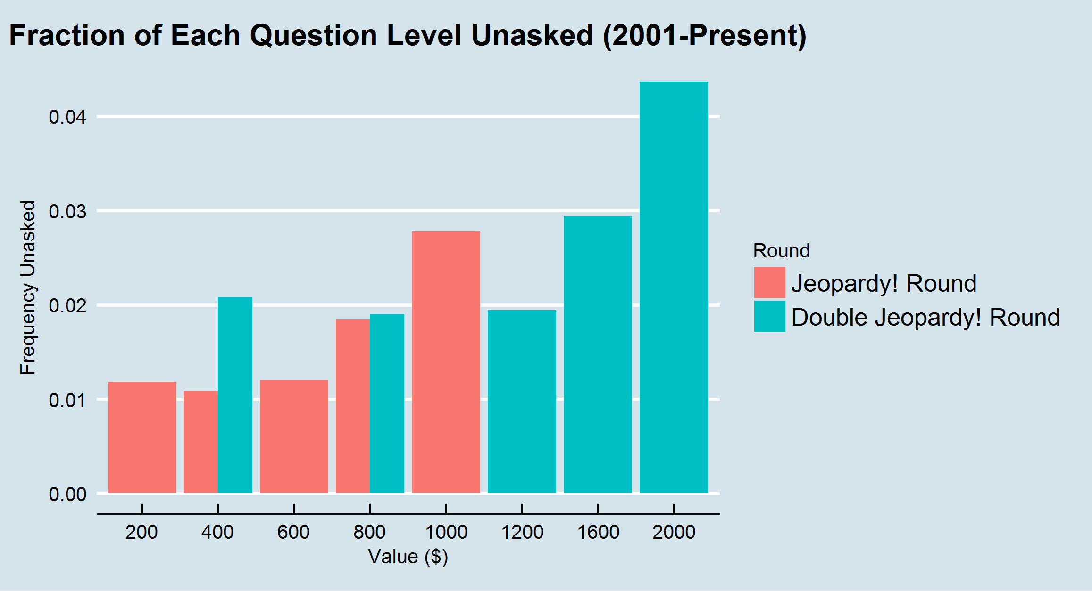
Hard Questions Are Least Likely to Be Picked
Even though they have higher yields, the higher value questions in each round are most often left unasked when time runs out.
Players habitually start with easier clues.
Except for a leader playing defense, that is the wrong strategic move.

Slide 12
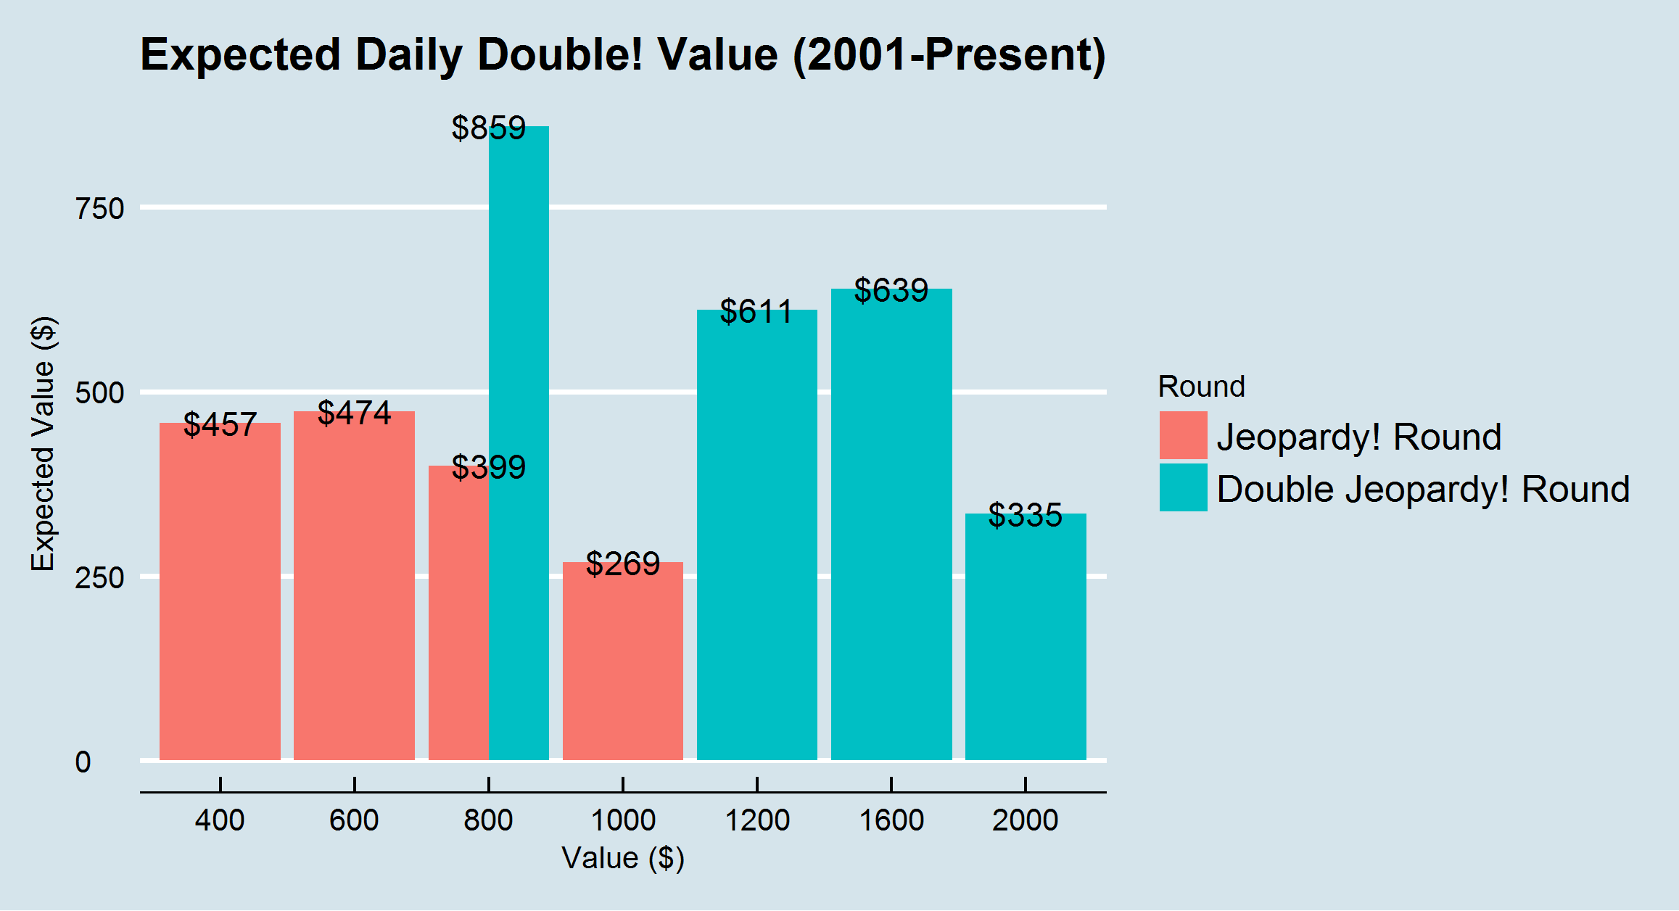
It’s Not That LUCKY to Get a Daily Double
Daily Doubles allow players to wager what they want, but force them to answer.
The penalty for a wrong answer often outweighs the benefits of the increased wager.

Slide 13
What Topics Should You Study?
Since Jeopardy! has a permanent writing staff and consistent vision, they have tendencies to return to certain topics and correct answers(-in-the-form-of-a-question) over time.
Of the 324,000 clues in the archive, just 300 unique answers account for 8.5% of the total.
Of the 61,000 categories, just 100 unique categories account for nearly 10% of the total.
Examining this data will let us get a sense for the most important topics to study before appearing on “Jeopardy!”

Slide 14
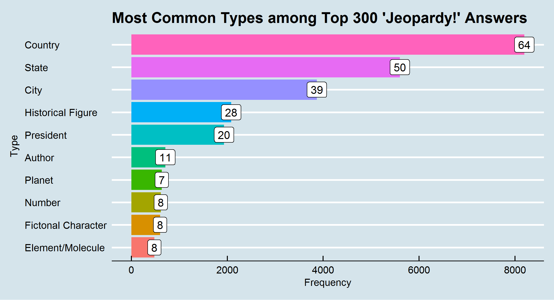
Know Your Place Names and Presidents
Astonishingly, the 32 most-common Jeopardy! answers are place names.
Every state but North Dakota is in the top 300.
Nearly half of all U.S. Presidents are among the top 300.

Slide 15
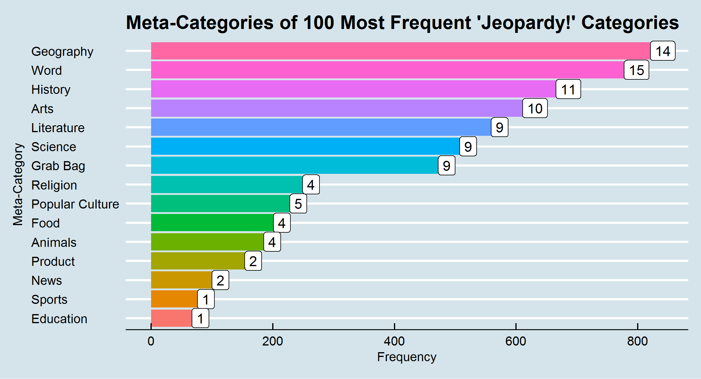
Study Geography and Puns
Jeopardy! is most interested in Geography: there have been over 800 instances of 14 generic geography categories.
Word games like “Before & After” are similarly popular.

Slide 16
The End

