Slide 1
고급 소프트웨어 실습(CSE4152)
Multilayer Perceptron

Slide 2
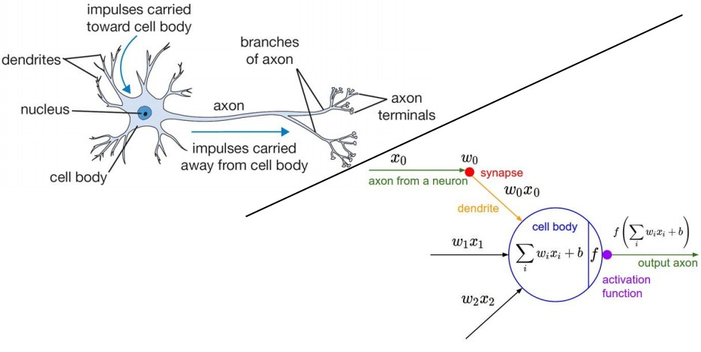
신경망
h+p://cs231n.stanford.edu/slides/winter1516_lecture4.pdf

Slide 3
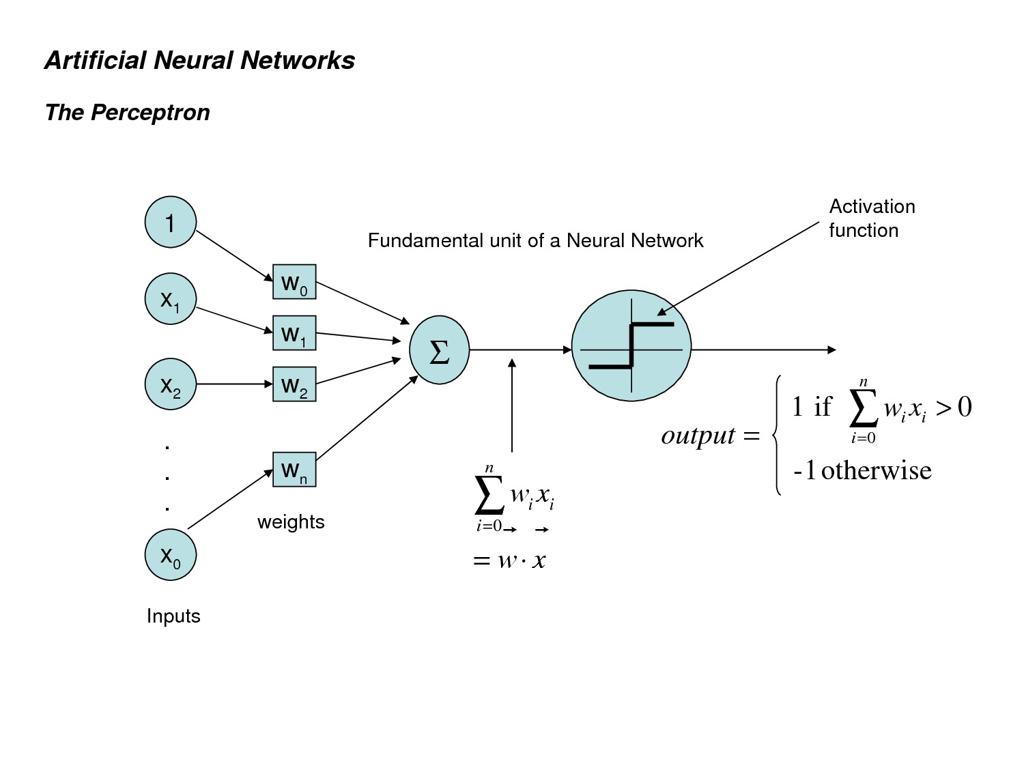
Perceptron
© 2017, SNU BioIntelligence Lab, h+p://bi.snu.ac.kr/

Slide 4


Perceptron
동그라미와 세모를 분리하려면 어떻게 해야 할까?
$$x_{2}$$
$$x_{1}$$
Notes:
퍼셉트론의 출력 값은 앞에서 말했듯이 1 또는 0(-1)이기 때문에 선형분류모형

Slide 5





Perceptron
y = ax + b 형태의 직선을 이용할 수 있다.
$$x_{2}=ax_{1}+b$$
$$x_{2}$$
$$x_{2}>ax_{1}+b \\ x_{2}<ax_{1}+b$$
$$x_{1}$$

Slide 6


Perceptron
일반화해서 표현해 보자.
$${f\left(x_{1},x_{2}\right)=w}_{1}x_{1}+w_{2}x_{2}+b=0$$
$$x_{2}$$
$$f\left(x_{1},x_{2}\right)>0 \\ f\left(x_{1},x_{2}\right)<0$$
$$x_{1}$$

Slide 7









Perceptron
Generalization
1 :
0 :
$${f\left(x_{1},x_{2}\right)=w}_{1}x_{1}+w_{2}x_{2}+b=0$$
$$x_{2}$$
$$w_{1}x_{1}+w_{2}x_{2}+b$$
b
$$w_{1}$$
$$w_{2}$$
1
$$x_{1}$$
$$x_{2}$$
$$x_{1}$$

Slide 8


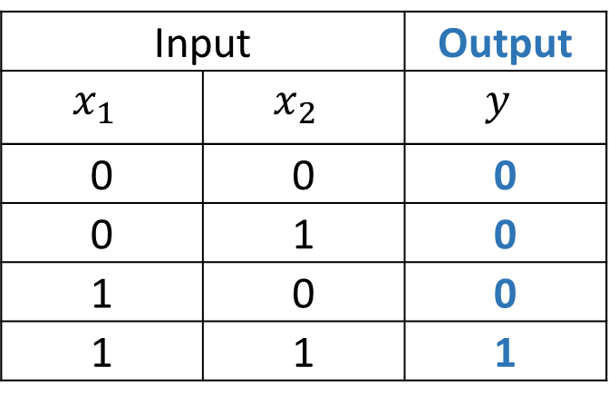
Perceptron – AND 분류
$$x_{2}$$
Input |  | Output
$$x_{1}$$ | $$x_{2}$$ | $$y$$
0 | 0 | 0
0 | 1 | 0
1 | 0 | 0
1 | 1 | 1
0
1
0
0
$$x_{1}$$

Slide 9
Perceptron – AND 분류
$$x_{2}$$
Input |  | Output
$$x_{1}$$ | $$x_{2}$$ | $$y$$
0 | 0 | 0
0 | 1 | 0
1 | 0 | 0
1 | 1 | 1
0
1
0
0
$$x_{1}$$

Slide 10







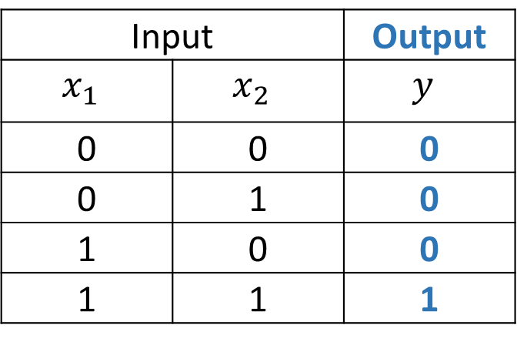

Perceptron – AND 분류
$$x_{2}$$
Input |  | Output
$$x_{1}$$ | $$x_{2}$$ | $$y$$
0 | 0 | 0
0 | 1 | 0
1 | 0 | 0
1 | 1 | 1
0
1
$$+$$
$$−$$
0
0
$$w_{1}x_{1}+w_{2}x_{2}+b$$
$$x_{1}$$
b = -1.5
$$w_{1}=1$$
$$f(x_{1},x_{2}) =x_{1} + x_{2} −1.5$$
1
$$w_{2}=1$$
$$x_{1}$$
$$x_{2}$$

Slide 11
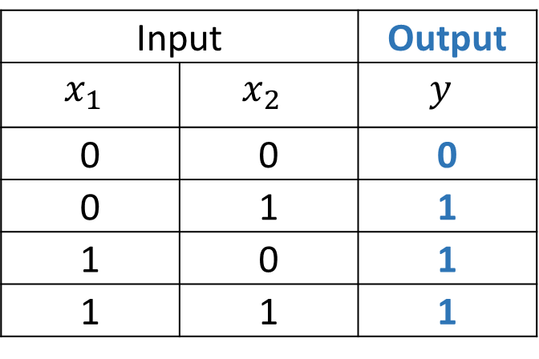
Perceptron – OR 분류
$$x_{2}$$
Input |  | Output
$$x_{1}$$ | $$x_{2}$$ | $$y$$
0 | 0 | 0
0 | 1 | 1
1 | 0 | 1
1 | 1 | 1
1
1
0
1
$$x_{1}$$

Slide 12

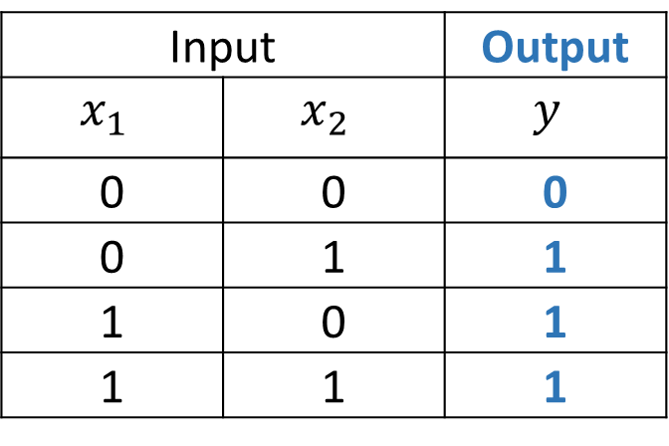
Perceptron – OR 분류
Input |  | Output
$$x_{1}$$ | $$x_{2}$$ | $$y$$
0 | 0 | 0
0 | 1 | 1
1 | 0 | 1
1 | 1 | 1
$$x_{2}$$
1
1
$$+$$
$$−$$
0
1
$$w_{1}x_{1}+w_{2}x_{2}+b$$
$$x_{1}$$
b = -0.5
$$w_{1}=1$$
$$f\left(x_{1},x_{2}\right)=x_{1} + x_{2} −0.5$$
1
$$w_{2}=1$$
$$x_{1}$$
$$x_{2}$$

Slide 13
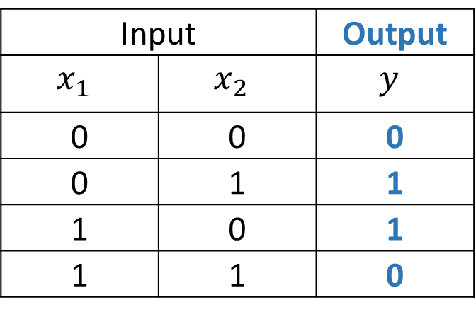
Perceptron – XOR 분류
$$x_{2}$$
Input |  | Output
$$x_{1}$$ | $$x_{2}$$ | $$y$$
0 | 0 | 0
0 | 1 | 1
1 | 0 | 1
1 | 1 | 0
1
0
?
0
1
$$x_{1}$$

Slide 14
Perceptron – XOR 분류
$$x_{2}$$
1이 아니다.
Input |  | Output
$$x_{1}$$ | $$x_{2}$$ | $$y$$
0 | 0 | 0
0 | 1 | 1
1 | 0 | 1
1 | 1 | 0
1
0
?
0
1
$$x_{1}$$

Slide 15
Perceptron – XOR 분류
$$x_{2}$$
Input |  | Output
$$x_{1}$$ | $$x_{2}$$ | $$y$$
0 | 0 | 0
0 | 1 | 1
1 | 0 | 1
1 | 1 | 0
1
0
?
0
1
$$x_{1}$$

Slide 16
Perceptron – XOR 분류
$$x_{2}$$
Perceptron은 XOR을 분류하지 못한다…
Input |  | Output
$$x_{1}$$ | $$x_{2}$$ | $$y$$
0 | 0 | 0
0 | 1 | 1
1 | 0 | 1
1 | 1 | 0
1
0
?
0이 아니다.
0
1
$$x_{1}$$

Slide 17


Perceptron – XOR 분류
그러나, 어떤 모델을 이용하여 직선 두 개를 나타낼 수 있다면?
$$x_{2}$$
1
0
!
0
1
$$x_{1}$$

Slide 18
Perceptron – XOR 분류
XOR를 해결할 수 있다!
$$x_{2}$$
Input |  | Output
$$x_{1}$$ | $$x_{2}$$ | $$y$$
0 | 0 | 0
0 | 1 | 1
1 | 0 | 1
1 | 1 | 0
1
0
!
0
1
$$x_{1}$$

Slide 19




Multi-layer Perceptron
z
Layer를 추가하면 해결 가능
$$y_{1}$$
$$y_{2}$$
1
$$x_{1}$$
$$x_{2}$$
1

Slide 20







Multi-layer Perceptron
z
$$y_{1}$$
$$y_{2}$$
1
$$w_{y1x1}$$
$$w_{y1x2}$$
$$w_{y1b}$$
$$x_{1}$$
$$x_{2}$$
1

Slide 21





Multi-layer Perceptron
z
$$y_{1}$$
$$y_{2}$$
1
$$w_{y_{2}x_{1}}$$
$$w_{y_{2}x_{2}}$$
$$w_{y_{2}b}$$
$$x_{1}$$
$$x_{2}$$
1

Slide 22





Multi-layer Perceptron
z
$$w_{zy_{1}}$$
$$w_{zy_{2}}$$
$$w_{zb}$$
$$y_{1}$$
$$y_{2}$$
1
$$x_{1}$$
$$x_{2}$$
1

Slide 23









Multi-layer Perceptron
z
$$x_{2}$$
1
0
$$y_{1}$$
$$y_{2}$$
1
y₁=0
y₁=1
$w_{y1x1}$=1
$w_{y1x2}$=1
$$w_{y1b}=−1.5$$
0
1
$$x_{1}$$
$$x_{1}$$
$$x_{2}$$
1

Slide 24







Multi-layer Perceptron
z
$$x_{2}$$
1
0
$$y_{1}$$
$$y_{2}$$
1
$$w_{y_{2}b}=−0.5$$
y₁=0
y₁=1
$$w_{y_{2}x_{1}}=1$$
$$w_{y_{2}x_{2}}=1$$
$$x_{1}$$
$$x_{2}$$
1
0
1
$$x_{1}$$

Slide 25




Multi-layer Perceptron
$$x_{2}$$
$$y_{2}$$
1
0
0
1
1
0
1
0
$$x_{1}$$
$$y_{1}$$

Slide 26









Multi-layer Perceptron
z
$$w_{zb}=−0.5$$
$$w_{zy_{1}}=−1$$
$$y_{1}$$
$$y_{2}$$
$$w_{zy_{2}}=1$$
$$x_{2}$$
1
0
1
1
0
$$x_{1}$$
$$x_{1}$$
$$x_{2}$$
1

Slide 27
Multi-layer Perceptron 학습
z
MLP 학습이란?
$$y_{1}$$
$$y_{2}$$
1
$$x_{1}$$
$$x_{2}$$
1

Slide 28
Multi-layer Perceptron 학습
z
MLP 학습이란?
학습 자료를 이용하여
W를 추정하는 것
$$y_{1}$$
$$y_{2}$$
1
$$x_{1}$$
$$x_{2}$$
1

Slide 29




Multi-layer Perceptron 학습
z
MLP 학습을 위해 해주어야 하는 일
Input layer의 node 수 결정
Output layer의 node 수 결정
Hidden layer의 node 수 결정
학습 algorithm을 이용한 weight 추정
$$y_{1}$$
$$y_{2}$$
1
$$x_{1}$$
$$x_{2}$$
1

Slide 30
Multi-layer Perceptron 학습
z
MLP 학습을 위해 해주어야 하는 일
Input layer의 node 수 결정
Output layer의 node 수 결정
Hidden layer의 node 수 결정
학습 algorithm을 이용한 weight 추정
$$y_{1}$$
$$y_{2}$$
1
$$x_{1}$$
$$x_{2}$$
1

Slide 31
Multi-layer Perceptron 학습
z
MLP 학습을 위해 해주어야 하는 일
Input layer의 node 수 결정
Output layer의 node 수 결정
Hidden layer의 node 수 결정
학습 algorithm을 이용한 weight 추정
$$y_{1}$$
$$y_{2}$$
1
$$x_{1}$$
$$x_{2}$$
1

Slide 32
Multi-layer Perceptron 학습
z
MLP 학습을 위해 해주어야 하는 일
Input layer의 node 수 결정
Output layer의 node 수 결정
Hidden layer의 node 수 결정
학습 algorithm을 이용한 weight 추정
$$y_{1}$$
$$y_{2}$$
1
$$x_{1}$$
$$x_{2}$$
1

Slide 33
Multi-Layer Perceptron 학습
MLP 학습을 위해 해주어야 하는 일
Input layer의 node 수 결정
Domain에 따라 결정
Output layer의 node 수 결정
Domain에 따라 결정한다
Hidden layer의 node 수 결정
실험을 통해 결정
학습 algorithm을 이용한 weight 추정
Back-propagation알고리즘을 이용하여 레이블 된 학습 자료에 최적 weigh를 추정한다

Slide 34
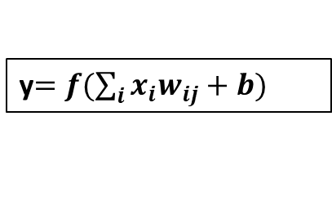
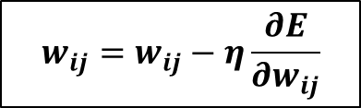
Back-propagation algorithm
학습은 back propagation 알고리즘으로 수행됨
Forward 알고리즘
y$=f(\sum_{i}{x_{i}w_{ij}}+b)$
● ● ●
● ● ●
● ● ●
입력 layer
출력 layer
Hidden layer
Back propagation 알고리즘
$$w_{ij}=w_{ij}−η\frac{∂E}{∂w_{ij}}$$

Slide 35
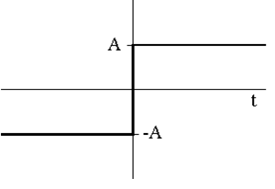
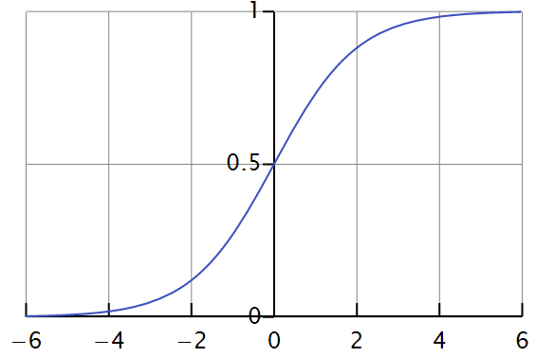
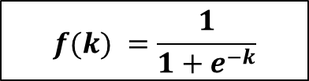
Back-propagation algorithm
Activation 함수로는 sigmoid를 이용한다.
f(k): Logistic sigmoid function
$$f(k) =\frac{1}{1+e^{−k}}$$
왼쪽 함수는 미분이 되지 않는다.

Slide 36
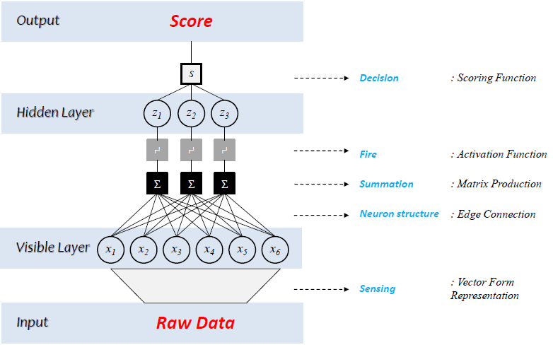
Deep Neural Network
DNN은 input layer, hidden layer, output layer로 구성
Notes:
내용 추가

Slide 37
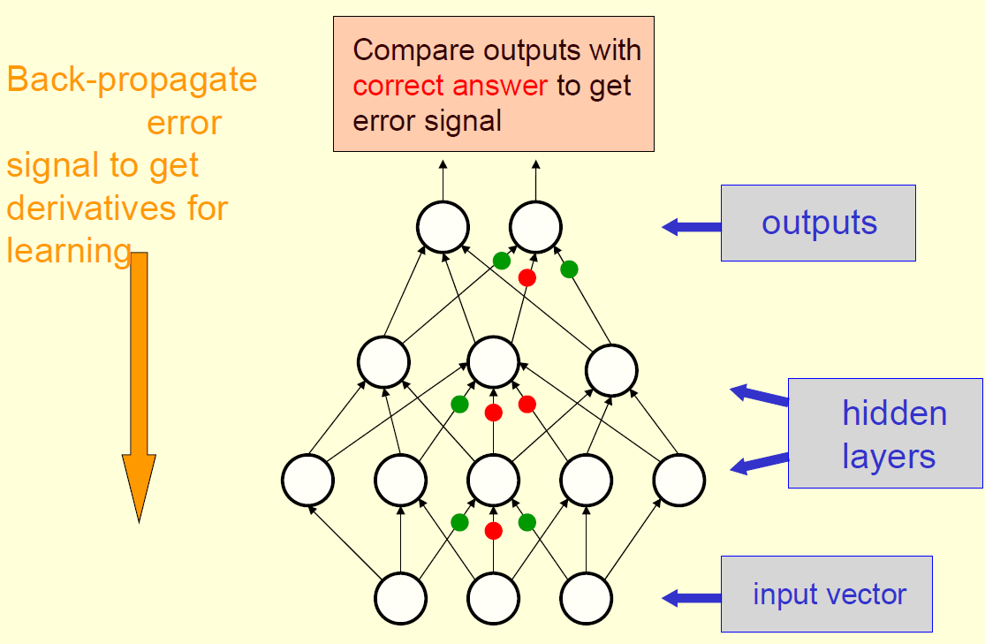
Deep Neural Network
Hidden layer의 개수가 2 이상인 모델을 DNN이라 함
If # of hidden layers <=1 → Shallow neural network
If # of hidden layers >=2 → Deep Neural Network (DNN)
[Hinton, 2013]
Notes:
내용 추가

Slide 38



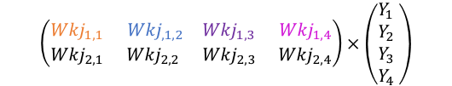







Feedforward
$σ$ : activation function
$$\left(\begin{matrix}\begin{matrix}{Wkj}_{1,1} & {Wkj}_{,1,2} \\ {Wkj}_{2,1} & {Wkj}_{2,2} \end{matrix} & \begin{matrix}{Wkj}_{1,3} & {Wkj}_{1,4} \\ {Wkj}_{2,3} & {Wkj}_{2,4}\end{matrix}\end{matrix}\right)×\left(\begin{matrix}\begin{matrix}Y_{1} \\ Y_{2} \end{matrix} \\ \begin{matrix}Y_{3} \\ Y_{4} \end{matrix}\end{matrix}\right)$$
Output(k)
$$Z_{1}$$
$$Z_{2}$$
$$=\left(\begin{matrix}{σ(Wkj}_{1,1}Y_{1}+{Wkj}_{1,2}Y_{2}+{Wkj}_{1,3}Y_{3}+{Wkj}_{1,4}Y_{4}) \\ {σ(Wkj}_{2,1}Y_{1}+{Wkj}_{2,2}Y_{2}+{Wkj}_{2,3}Y_{3}+{Wkj}_{2,4}Y_{4})\end{matrix}\right)→\left(\begin{matrix}Z_{1} \\ Z_{2}\end{matrix}\right)$$
$${Wkj}_{1,1}$$
$${Wkj}_{1,2}$$
$${Wkj}_{1,3}$$
$${Wkj}_{1,4}$$
$$Z_{k}=Wkj·Y_{j}$$
Hidden(j)
$$Y_{1}$$
$$Y_{2}$$
$$Y_{3}$$
$$Y_{4}$$
$$\left(\begin{matrix}\begin{matrix}{Wji}_{1,1} & {Wji}_{,1,2} & {Wji}_{1,3} \\ {Wji}_{2,1} & {Wji}_{2,2} & {Wji}_{2,3} \end{matrix} \\ \begin{matrix}{Wji}_{3,1} & {Wji}_{3,2} & {Wji}_{3,3} \\ {Wji}_{4,1} & {Wji}_{4,2} & {Wji}_{4,3} \end{matrix}\end{matrix}\right)×\left(\begin{matrix}X_{1} \\ X_{2} \\ X_{3} \end{matrix}\right)=\left(\begin{matrix}\begin{matrix}{σ(Wji}_{1,1}X_{1}+{Wji}_{1,2}X_{2}+{Wji}_{1,3}X_{3}\text{)} \\ {σ(Wji}_{21}X_{1}+{Wji}_{2,2}X_{2}+{Wji}_{2,3}X_{3}\text{)} \end{matrix} \\ \begin{matrix}{σ(Wji}_{3,1}X_{1}+{Wji}_{3,2}X_{2}+{Wji}_{3,3}X_{3}\text{)} \\ {σ(Wji}_{4,1}X_{1}+{Wji}_{4,2}X_{2}+{Wji}_{4,3}X_{3)} \end{matrix}\end{matrix}\right)→\left(\begin{matrix}\begin{matrix}Y_{1} \\ Y_{2}\end{matrix} \\ \begin{matrix}Y_{3} \\ Y_{4}\end{matrix}\end{matrix}\right)$$
$${Wji}_{1,1}$$
$${Wji}_{1,2}$$
$${Wji}_{1,3}$$
Input(i)
$$X_{1}$$
$$X_{2}$$
$$X_{3}$$
$$Y_{j}=Wji·X_{i}$$
Where X,Y,Z are value of neuron.

Slide 39
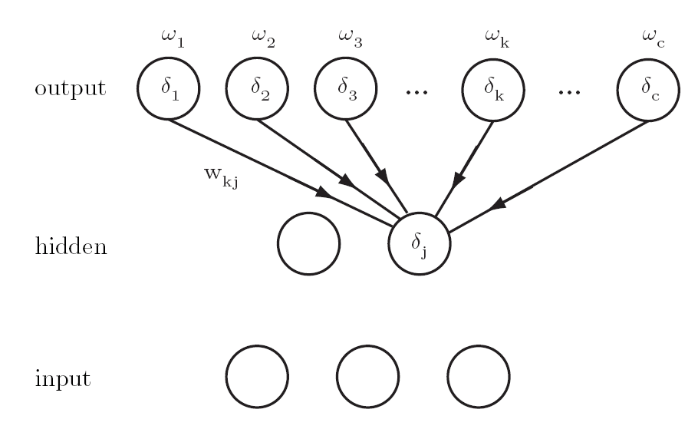


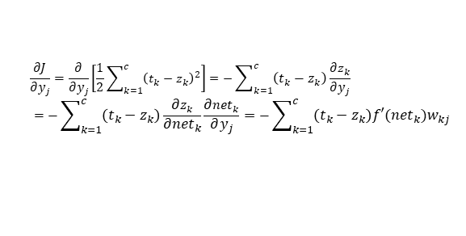
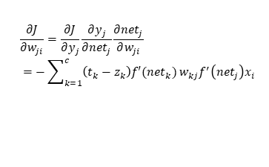

Backpropagation Algorithm
$${net}_{k}=w_{k}^{t}y$$
$${net}_{j}=w_{j}^{t}x$$
$$z_{k}=f\left({net}_{k}\right)$$
$$y_{j}=f\left({net}_{j}\right)$$
$$\frac{∂{net}_{k}}{∂w_{kj}}=y_{j}$$
$$\frac{∂J}{∂w_{kj}}=\frac{∂J}{∂z_{k}}\frac{∂z_{k}}{∂{net}_{k}}\frac{∂{net}_{k}}{∂w_{kj}}=−\left({t_{k}−z}_{k}\right)f^{′}\left({net}_{k}\right)y$$
$$δ_{k}=−\frac{∂J}{∂{net}_{k}}=−\frac{∂J}{∂z_{k}}\frac{∂z_{k}}{∂{net}_{k}}=\left({t_{k}−z}_{k}\right)f^{′}\left({net}_{k}\right)$$
$${∆w}_{kj}=−η\frac{∂J}{∂w_{kj}}=−η\frac{∂J}{∂{net}_{k}}\frac{∂{net}_{k}}{∂w_{kj}}=η\left({t_{k}−z}_{k}\right)f^{′}\left({net}_{k}\right)y_{j}=ηδ_{k}y_{j}$$
$$w_{ji}$$
$$\frac{∂J}{∂w_{ji}}=\frac{∂J}{∂y_{j}}\frac{∂y_{j}}{∂{net}_{j}}\frac{∂{net}_{j}}{∂w_{ji}}$$
$$δ_{j}=−\frac{∂J}{∂{net}_{j}}=−\frac{∂J}{∂y_{j}}\frac{∂y_{j}}{∂{net}_{j}}$$
$$=\sum_{k=1}^{c}{\left(t_{k}−z_{k}\right)f′({net}_{k})}w_{kj}f^{′}\left({net}_{j}\right)=f^{′}\left({net}_{j}\right)\sum_{k=1}^{c}{w_{kj}δ_{k}}$$
$$\frac{∂J}{∂y_{j}}=\frac{∂}{∂y_{j}}\left[\frac{1}{2}\sum_{k=1}^{c}{{\left(t_{k}−z_{k}\right)}^{2}}\right]=−\sum_{k=1}^{c}{\left(t_{k}−z_{k}\right)}\frac{∂z_{k}}{∂y_{j}}$$
$$=−\sum_{k=1}^{c}{\left(t_{k}−z_{k}\right)}\frac{∂z_{k}}{∂{net}_{k}}\frac{∂{net}_{k}}{∂y_{j}}=−\sum_{k=1}^{c}{\left(t_{k}−z_{k}\right)f′({net}_{k})w_{kj}}$$
$$∆w_{ji}=ηδ_{j}x_{i}=η\left[\sum_{k=1}^{c}{w_{kj}δ_{k}}\right]f′\left({net}_{j}\right)x_{i}$$
$$\frac{∂J}{∂w_{ji}}=\frac{∂J}{∂y_{j}}\frac{∂y_{j}}{∂{net}_{j}}\frac{∂{net}_{j}}{∂w_{ji}}$$
$$=−\sum_{k=1}^{c}{\left(t_{k}−z_{k}\right)f′({net}_{k})}w_{kj}f^{′}\left({net}_{j}\right)x_{i}$$

Slide 40
Backpropagation Algorithm
Delta Rule is a rule that if an input node contributes to an error on an output node, then the connection weight of the two nodes is scaled proportionally to the output (z) and the error (e) of the output node.
Loss is the value (Scalar) you want to reduce through the learning of a neural network.
Error is a value (Vector) that indicates how wrong each Neuron is.
Delta is a value (Vector) that you calculate to apply a Delta Rule. Typically, an error multiplied by a differential value is Delta.
Gradient is a value (Matrix) indicating how much weight to update.
Backpropagation Algorithm : Calculate delta of a layer and apply delta rule for each neuron.
error
gradient
$$∆w_{kj}={η\left(t_{k}−z_{k}\right)f^{′}\left({net}_{k}\right)y}_{j}$$
learning
rate
delta
input
(neuron)
Delta Rule
$$\frac{df(x)}{dx}=\frac{d}{dx}\frac{1}{1+e^{−x}}=\frac{d}{dx}{(1+e^{−x})}^{−1}=−{\left(1+e^{−x}\right)}^{−2}\frac{d}{dx}\left(1+e^{−x}\right)=−{\left(1+e^{−x}\right)}^{−2}\left(−e^{−x}\right)$$
$$={\left(1+e^{−x}\right)}^{−2}e^{−x}=\frac{e^{−x}}{{\left(1+e^{−x}\right)}^{2}}=\frac{1}{\left(1+e^{−x}\right)}\frac{e^{−x}}{\left(1+e^{−x}\right)}=\frac{1}{1+e^{−x}}\left(1−\frac{1}{1+e^{−x}}\right)=f(x)(1−f\left(x\right))$$

Slide 41
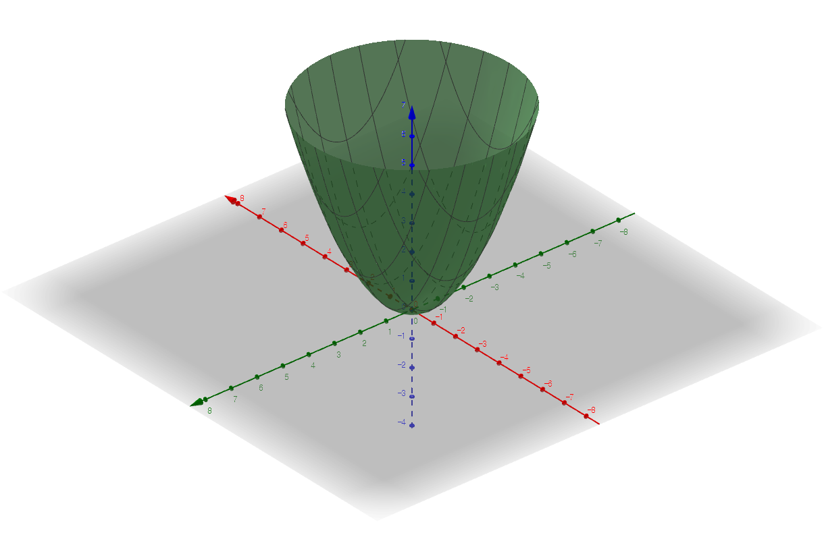
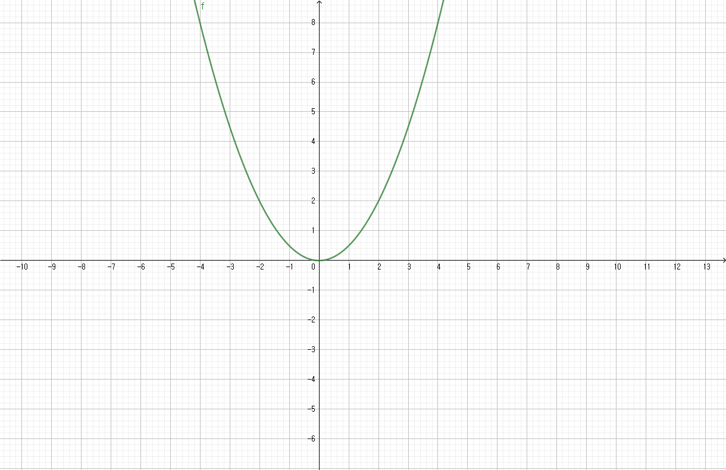
Backpropagation Algorithm
$t_{k}$ : target answer
$$J(W)=\frac{1}{2}\sum_{k=1}^{C}{{(t_{k}−z_{k} )}^{2}}$$
$z_{k}$ : output neuron’s value , $σ$($Wkj·y_{j}$)
O$bjective : t_{k}−z_{k}$= 0. To find these $z_{k}$ , update the weights using the Gradient Decent Algorithm.

Slide 42
Backpropagation Algorithm
$$J(W)=\frac{1}{2}\sum_{k=1}^{C}{{(t_{k}−z_{k} )}^{2}}$$
$t_{k}$ : target answer
$$Typically W contain bias.$$
$W=$ {$w_{1},w_{2}…w_{n},b\} and$
$x=$ {$x_{1},x_{2}…x_{n},1\}$
$z_{k}$ : output neuron’s value , $σ$($Wkj·y_{j}$)
$σ$ : activation function
$z_{k}$ is only changed by the weight associated with the output neuron. That is, the weight of the other output neurons does not affect the outcome of the neurons, so it is safe to think and remove the Sigma symbol.
Gradient (Matrix)
Delta (col vector)
$$×$$
Input neuron
(row vector)
element wise multiplication
Error
(col vector)
$$×$$
Differential value
(col vector)
Gradient :
$${η\left(t_{k}−z_{k}\right)f^{′}\left({net}_{k}\right)y}_{j}$$

Slide 43











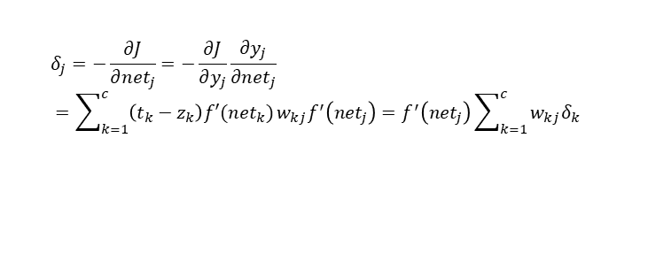









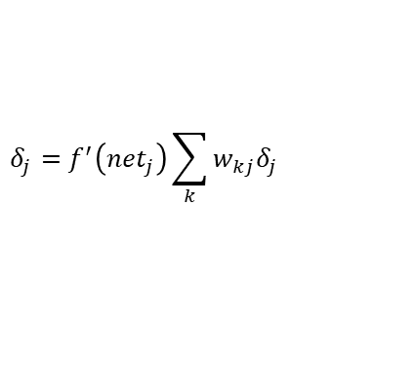




Error backpropagation
$$Z_{1}$$
$$Z_{2}$$
$${δk}_{1}$$
$${δk}_{2}$$
$$δ_{k}=Ek·f′({net}_{k})$$
$$δ_{k}=−\frac{∂J}{∂{net}_{k}}=−\frac{∂J}{∂z_{k}}\frac{∂z_{k}}{∂{net}_{k}}=\left({t_{k}−z}_{k}\right)f^{′}\left({net}_{k}\right)$$
$${Wkj}_{1,1}$$
$${Wkj}_{1,2}$$
$${Wkj}_{1,3}$$
$${Wkj}_{1,4}$$
$$Y_{1}$$
$$Y_{2}$$
$$Y_{3}$$
$$Y_{4}$$
$${δj}_{1}$$
$${δj}_{2}$$
$${δj}_{3}$$
$${δj}_{4}$$
$$δ_{j}=f^{′}\left({net}_{j}\right)\sum_{k}{w_{kj}δ_{j}}$$
$${Wji}_{1,1}$$
$${Wji}_{1,2}$$
$${Wji}_{1,3}$$
$$δ_{j}=−\frac{∂J}{∂{net}_{j}}=−\frac{∂J}{∂y_{j}}\frac{∂y_{j}}{∂{net}_{j}}$$
$$=\sum_{k=1}^{c}{\left(t_{k}−z_{k}\right)f′({net}_{k})}w_{kj}f^{′}\left({net}_{j}\right)=f^{′}\left({net}_{j}\right)\sum_{k=1}^{c}{w_{kj}δ_{k}}$$
$$X_{1}$$
$$X_{2}$$
$$X_{3}$$
$$δ :delta$$

Slide 44






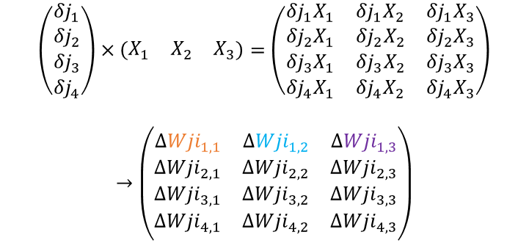



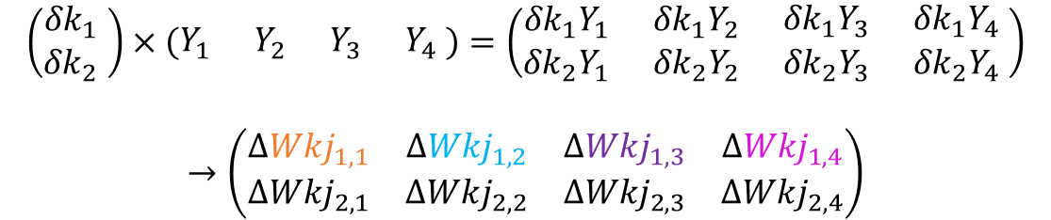

Weight updates
$$Z_{1}$$
$$Z_{2}$$
$$\left(\begin{matrix}{δk}_{1} \\ {δk}_{2} \end{matrix}\right)×\left(\begin{matrix}\begin{matrix}Y_{1} & Y_{2} \end{matrix} & \begin{matrix}Y_{3} & Y_{4} \end{matrix}\end{matrix}\right)=\left(\begin{matrix}\begin{matrix}{δk}_{1}Y_{1} & {δk}_{1}Y_{2} \\ {δk}_{2}Y_{1} & {δk}_{2}Y_{2} \end{matrix} & \begin{matrix}{δk}_{1}Y_{3} & {δk}_{1}Y_{4} \\ {δk}_{2}Y_{3} & {δk}_{2}Y_{4} \end{matrix}\end{matrix}\right)$$
$$→\left(\begin{matrix}\begin{matrix}∆{Wkj}_{1,1} & ∆{Wkj}_{1,2} \\ ∆{Wkj}_{2,1} & ∆{Wkj}_{2,2}\end{matrix} & \begin{matrix}∆{Wkj}_{1,3} & ∆{Wkj}_{1,4} \\ ∆{Wkj}_{2,3} & ∆{Wkj}_{2,4}\end{matrix}\end{matrix}\right)$$
Output(k)
$${δk}_{1}$$
$${δk}_{2}$$
$${Wkj}_{1,1}$$
$${Wkj}_{1,2}$$
$${Wkj}_{1,3}$$
$${Wkj}_{1,4}$$
$$∆w_{kj}=ηδ_{k}Y_{j}=η\left(t_{k}−z_{k}\right)f′\left({net}_{k}\right)Y_{j}$$
(2×4) (2×1)(1×4) (2×1)(1×4)
$$Y_{1}$$
$$Y_{2}$$
$$Y_{3}$$
$$Y_{4}$$
Hidden(j)
$${δj}_{1}$$
$${δj}_{2}$$
$${δj}_{3}$$
$${δj}_{4}$$
$$\left(\begin{matrix}\begin{matrix}{δj}_{1} \\ {δj}_{2}\end{matrix} \\ \begin{matrix}{δj}_{3} \\ {δj}_{4}\end{matrix}\end{matrix}\right)×\left(\begin{matrix}X_{1} & X_{2} & X_{3}\end{matrix}\right)=\left(\begin{matrix}\begin{matrix}{δj}_{1}X_{1} & {δj}_{1}X_{2} & {δj}_{1}X_{3} \\ {δj}_{2}X_{1} & {δj}_{2}X_{2} & {δj}_{2}X_{3}\end{matrix} \\ \begin{matrix}{δj}_{3}X_{1} & {δj}_{3}X_{2} & {δj}_{3}X_{3} \\ {δj}_{4}X_{1} & {δj}_{4}X_{2} & {δj}_{4}X_{3}\end{matrix}\end{matrix}\right)$$
$$→\left(\begin{matrix}\begin{matrix}∆{Wji}_{1,1} & ∆{Wji}_{1,2} & ∆{Wji}_{1,3} \\ ∆{Wji}_{2,1} & ∆{Wji}_{2,2} & ∆{Wji}_{2,3}\end{matrix} \\ \begin{matrix}∆{Wji}_{3,1} & ∆{Wji}_{3,2} & ∆{Wji}_{3,3} \\ ∆{Wji}_{4,1} & ∆{Wji}_{4,2} & ∆{Wji}_{4,3}\end{matrix}\end{matrix}\right)$$
$${Wji}_{1,1}$$
$${Wji}_{1,2}$$
$${Wji}_{1,3}$$
$$X_{1}$$
$$X_{2}$$
$$X_{3}$$
Input(i)
$$δ :delta$$
$$∆w_{ji}=ηδ_{j}X_{i}=η\left({Wkj}^{T}δ_{k}\right)f′\left({net}_{j}\right)X_{i}=η\left({Wkj}^{T}\left(t_{k}−z_{k}\right)f′\left({net}_{k}\right)\right)f′\left({net}_{j}\right)X_{i}$$
(4×3) (4×1)(1×3) (4×2)(2×1) (1×3)

Slide 45
Weight updates (Python)
mlp_numpy_v2.py
Ek = T - Z # (10,1)
Ej = np.matmul(self.wkj.T, Ek) # (100,10)*(10,1)->(100,1)
# f'(netk)=f(netk)*(1-f(netk) -> Z*(1-Z)
deltaK = Ek * self.diffactivation_function(Z) # (10,1), element-wise multiplication
# f'(netj)=f(netj)*(1-f(netj) -> Y*(1-Y)
deltaJ = Ej * self.diffactivation_function(Y) # (100,1)
#Apply multiply between col-vector and row-vector
#So, we transpose for change col-vector to row-vector
self.wkj += self.lr * np.matmul(deltaK, Y.T) # (10,1)*(1,100)->(10,100) np.transpose(netj_Y)
self.wji += self.lr * np.matmul(deltaJ, X.T) # (100,1)*(1,784)->(100,784)
mlp_numpy_v2.1.py
Ek = T - Z # (10,1)
Ej = np.matmul(self.wkj.T, Ek) # (100,10)*(10,1)->(100,1)
# f'(netk)=f(netk)*(1-f(netk) -> Z*(1-Z)
deltaK = Ek * self.diffactivation_function(Z) # (10,1), element-wise multiplication
# f'(netj)=f(netj)*(1-f(netj) -> Y*(1-Y)
deltaJ = self.diffactivation_function(Y) * np.matmul(self.wkj.T, deltaK)
#Apply multiply between col-vector and row-vector
#So, we transpose for change col-vector to row-vector
self.wkj += self.lr * np.matmul(deltaK, Y.T) # (10,1)*(1,100)->(10,100) np.transpose(netj_Y)
self.wji += self.lr * np.matmul(deltaJ, X.T) # (100,1)*(1,784)->(100,784)

Slide 46
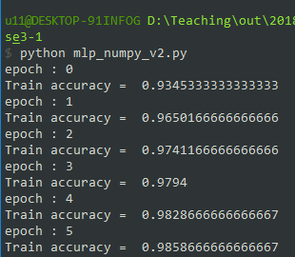
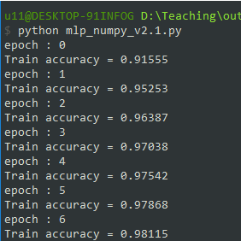
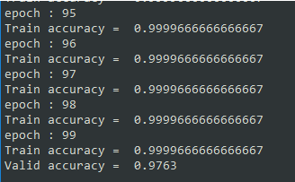
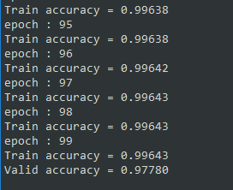
Weight updates
mlp_numpy_v2.py
mlp_numpy_v2.1.py

Slide 47
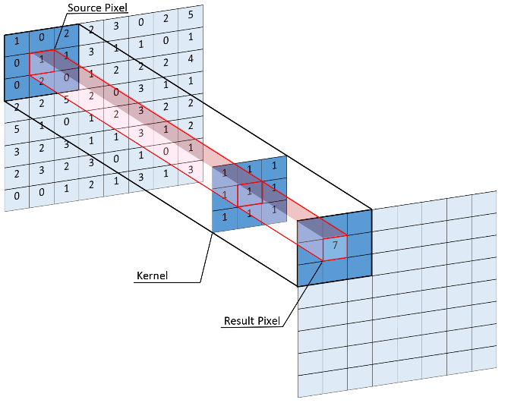
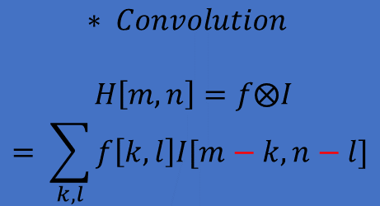
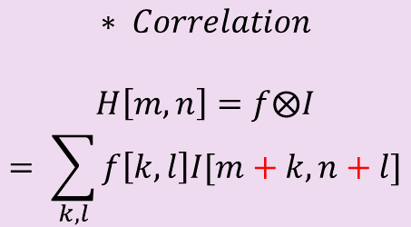
Convolution
Mask
m x n dimension
usually m, n values are odd number
Convolution vs Correlation
New pixel is computed by multiplying each pixel value in the neighborhood with the corresponding weight in the mask and summing these products.
Tensorflow, Caffe – correlation
Theano, Keras – convolution
$$∗ Convolution$$
$$H\left[m,n\right]=f⨂I$$
$$= \sum_{k,l}{f\left[k,l\right]I[m−k,n−l]}$$
$$∗ Correlation$$
$$H\left[m,n\right]=f⨂I$$
$$= \sum_{k,l}{f\left[k,l\right]I[m+k,n+l]}$$
[Equation 1]
[Equation 2]
Concepts of the correlation and convolution operation.

Slide 48
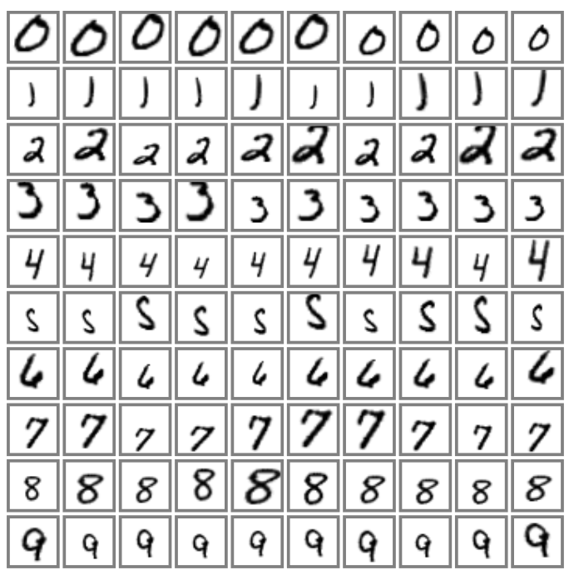
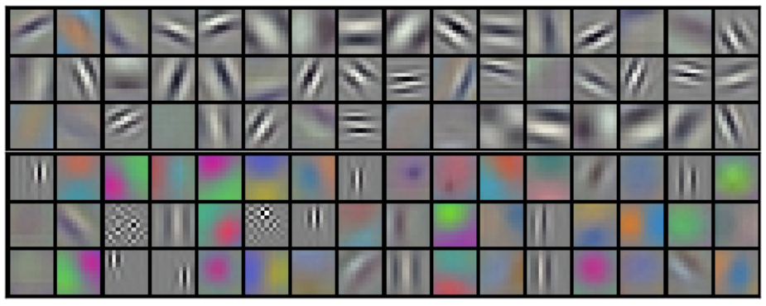
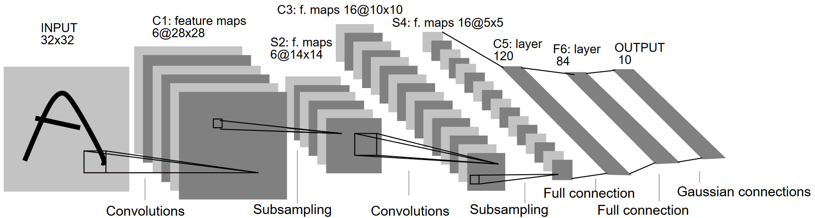
Convolutional Neural Network (LeNet-5)
3 convolution layer, 2 subsampling (pooling) layer
5×5 convolution kernels
~340,000 connections, ~60,000 parameter
Used for Optical Character Recognition (OCR) and character recognition in documents
0 | 0 | 0 | …
0 | 1 | 0 | …
0 | 0 | 1 | …
0 | 0 | 0 | …
0 | 0 | 0 | …
0 | 0 | 0 | …
0 | 0 | 0 | …
0 | 0 | 0 | …
0 | 0 | 0 | …
0 | 0 | 0 | …
w11 | w12 | w13 | w14 | w15
w21 | w22 | w23 | w24 | w25
w31 | w32 | w33 | w34 | w35
w41 | w42 | w43 | w44 | w45
w51 | w52 | w53 | w54 | w55
Example AlexNet kernel

Slide 49
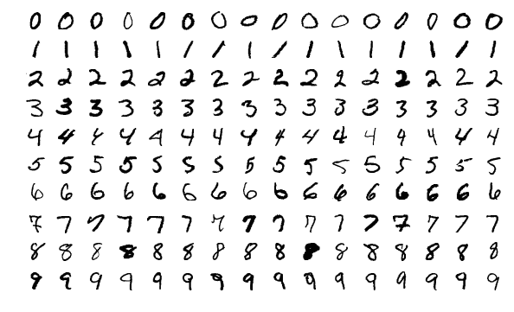
MNIST
60,000 training images
10,000 testing images

