Slide 1
Let’s look at a pretend version of the game with two people named Brittany and Steve.
Brittany is chatting with Steve.
Brittany gives hints about herself and Steve tries to guess what she will pick.

Slide 2
Now let’s look at what a chat is like.

Slide 3
BRITTANY’S SCREEN IS BLUE

Slide 4
STEVE’S SCREEN IS GRAY

Slide 5
ON HER SCREEN, BRITTANY SEES THIS

Slide 6
Waiting for STEVE…

Slide 7
Waiting for STEVE…
I want to eat __________.
Press 1
Press 2
HEALTHY TASTY

Slide 8
AFTER BRITTANY GIVES A HINT, STEVE SEES A MESSAGE FROM BRITTANY

Slide 9
BRITTANY

Slide 10
BRITTANY
I want to eat healthy.
I want to eat healthy.

Slide 11
THEN STEVE HAS TO GUESS WHAT BRITTANY WILL PICK

Slide 12
BRITTANY
Which should I pick?
Press 1
Press 2
APPLES PANCAKES
Notes:
Steve is picking what Brittany would pick

Slide 13
AT THE SAME TIME, BRITTANY ALSO ANSWERS THE SAME QUESTION

Slide 14
Which should I pick?
Press 1
Press 2
APPLES PANCAKES
Notes:
Here Brittany is picking what SHE would pick

Slide 15
STEVE’S ANSWER GETS SENT TO BRITTANY AND BRITTANY’S ANSWER GETS SENT TO STEVE.
IF THEIR ANSWERS MATCH, THEY GET A SMILIE FACE

Slide 16
BRITTANY
Apples
Apples
Apples :)

Slide 17
AT THE SAME TIME, BRITTANY SEES THEIR ANSWERS TOO

Slide 18
STEVE
Apples
Apples
Apples :)
Apples :)

Slide 19
HERE’S A NEW QUESTION

Slide 20
Waiting for STEVE…

Slide 21
Waiting for STEVE…
I want to go somewhere _________ on vacation.
Press 1
Press 2
FUN RELAXING

Slide 22
AFTER BRITTANY ANSWERS, HER HINT GETS SENT TO STEVE

Slide 23
BRITTANY
I want to go somewhere fun on vacation.
I want to go somewhere fun on vacation.

Slide 24
Which should I pick?
Steve is trying to guess what Brittany will pick
Press 1
Press 2
MOUNTAINS BEACH

Slide 25
AT THE SAME TIME, BRITTANY ALSO GIVES HER ANSWER

Slide 26
Which should I pick?
Press 1
Press 2
MOUNTAINS BEACH

Slide 27
THEN STEVE SEES HIS ANSWER
PLUS BRITTANY’S ANSWER
IF THEY’RE THE SAME, THERE WILL BE A SMILIE FACE

Slide 28
BRITTANY
Beach
Mountains
Mountains

Slide 29
AT THE SAME TIME, BRITTANY SEES BOTH OF THEIR ANSWERS TOO

Slide 30
STEVE
Mountains
Mountains
Beach
Beach

Slide 31
SOMETIMES A MAZE POPS UP THAT BRITTANY HAS TO SOLVE TO CONTINUE CHATTING
WHEN THIS HAPPENS, STEVE CONNECTS TO A COMPUTER TO CHAT WITH INSTEAD

Slide 32
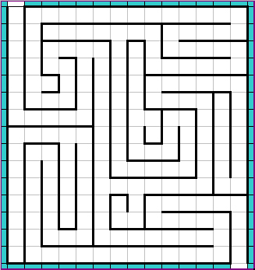
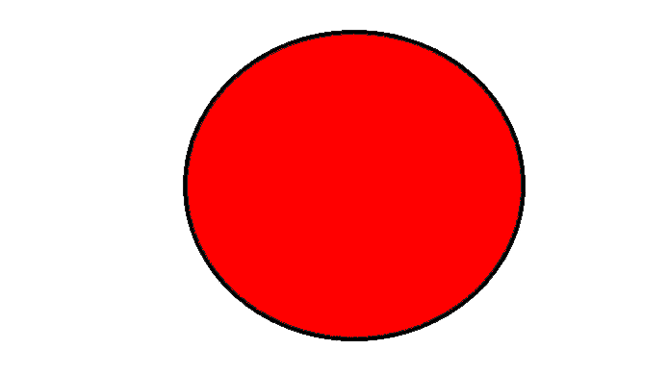
Solve this maze to continue chatting! The computer will let Steve know that you are away

Slide 33
SINCE BRITTANY IS SOLVING THE PUZZLE, STEVE WILL CONNECT TO A COMPUTER TO CHAT INSTEAD

Slide 34
COMPUTER

Slide 35
COMPUTER
Andrew likes to be creative.
Andrew likes to be creative.

Slide 36
Which should he pick?
Press 1
Press 2
MUSIC CLASS
HEALTH CLASS

Slide 37
AFTER STEVE ANSWERS, THE COMPUTER GENERATES A RANDOM ANSWER

Slide 38
THE COMPUTER BASICALLY SPINS A WHEEL TO PICK left or right
right
left
left
right
right
left
left
right

Slide 39
THEN STEVE SEES HIS ANSWER PLUS THE COMPUTER’S ANSWER.
IF THEY ARE THE SAME, A CHECK MARK WILL APPEAR.

Slide 40
COMPUTER
Music
Music ✔
Music ✓

Slide 41
LET’S PRACTICE ANSWERING QUESTIONS. THIS IS NOT A REAL CHAT, SO YOU WON’T SEE ANY FEEDBACK YOU ONLY HAVE A FEW SECONDS TO ANSWER, SO GUESS QUICKLY!

Slide 42
COMPUTER

Slide 43
COMPUTER
Andrew really likes to dance.
Andrew really likes to dance.

Slide 44
Which should he pick?
Press 1
Press 2
FAST & DANCE
SONG
SAD & SLOW
SONG

Slide 45
NEXT QUESTION

Slide 46
BRITTANY

Slide 47
BRITTANY
I don’t like the heat.
I don’t like the heat.

Slide 48
Which should I pick?
Press 1
Press 2
TENNIS
HOCKEY

Slide 49
NEXT QUESTION

Slide 50
BRITTANY

Slide 51
BRITTANY
I want to adopt a dog.
I want to adopt a dog.

Slide 52
Which should I pick?
Press 1
Press 2
PUPPY
KITTEN

Slide 53
NEXT QUESTION

Slide 54
COMPUTER

Slide 55
COMPUTER
Andrew wants to scare other children on Halloween.
Andrew wants to scare other children on Halloween.

Slide 56
Which should he pick?
Press 1
Press 2
WEREWOLF
COSTUME
HIPPIE
COSTUME

Slide 57
NEXT QUESTION

Slide 58
BRITTANY

Slide 59
BRITTANY
I am interested in plants and animals.
I am interested in plants and animals.

Slide 60
Which should I pick?
Press 1
Press 2
AMERICAN HISTORY MUSEUM
NATURAL HISTORY MUSEUM

Slide 61
NEXT QUESTION

Slide 62
COMPUTER

Slide 63
COMPUTER
Andrew wants to play a hard game.
Andrew wants to play a hard game.

Slide 64
Which should he pick?
Press 1
Press 2
Candyland
Chess

Slide 65
NEXT QUESTION

Slide 66
Are you ready for the real chat?
YES NO

