Slide 1
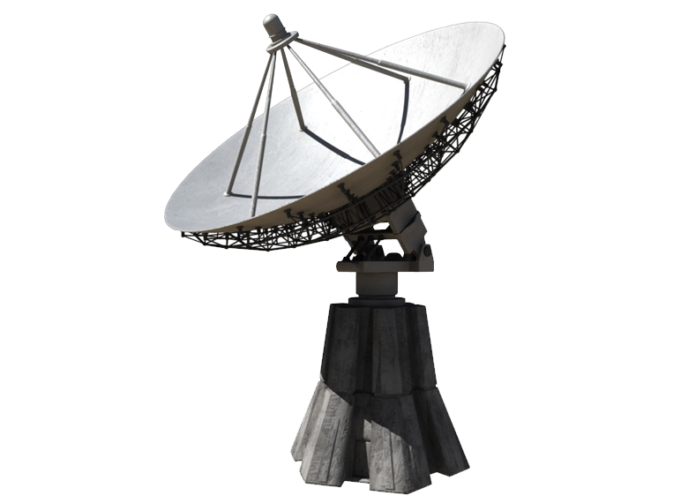

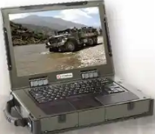
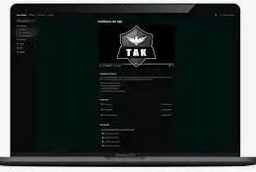




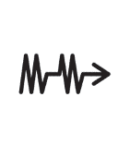
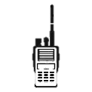


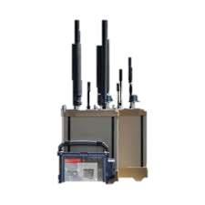
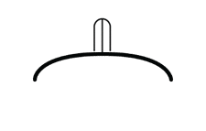
Network Architecture 2.5 (Current)
Mission Command Support Center
Nett Warrior Cloud
Air Defense C2 Cross-Domain
(SEC-SBU)
US FEDHUB
CoT
UK Fed HUB
COCOM
TAK Server
CDS
VMF
VMF
2CR
TAK Server
CoT
MCSC TRAX
Assessment Cell
TRAX Server
NIPR Workstation
MMCS
Nett Warrior NMP
2CR WinTak
Commercial
Internet
Enemy Data
Friendly Data
UK TRIK
Obfuscated CoT
AWS Cloud Server
CoT
OPFOR
TAK
UK ITN
2CR TRAX
OR
TAK
SkyFortress Sensors
J Series
Message
BDE/DIV HUB
(w/ TRIK)
5-4 ADAR
Air Defense C2 Cross-Domain
(SEC-SBU)
Titan System via
MPU5 Network
3/2CR ITN
J Series
Message
TRAX
LEGEND
-----------------------------------------
SIPR
SBU
Should be Green
Obfuscated CoT
TACDS
TAK
Obfuscated CoT
FAAD C2
FAAD C2
Notes:
This diagram represents our current architecture and reflects what would be required to route the message. It also shows what the architecture would look like if the SCG governing the messages changed (see obfuscated CoT). This is also influenced by the proposed technical solution being worked by the PEO M&S Sentinel Team that would allow Sentinel to obfuscate the message at the source. TRAX software is installed on AMDWS to re-format messages for FedHub (Cursor on Target / VMF). This occurs between 5-4 ADAR and MCSC

Slide 2

Network Architecture (with changed SCGs)
Nett Warrior Cloud
US FEDHUB
Intel Community Repository-Fused and enriched with Intel
CoT
UK Fed HUB
Intel Community Data Lake
CoT
2CR
TAK Server
CoT
TRAX Server
Assessment Cell
NIPR Workstation
MMCS
Nett Warrior NMP
2CR WinTak
Commercial
Internet
UK TRIK
Enemy Data
Friendly Data
AWS Cloud Server
CoT
OPFOR
UK ITN
TAK
OR
TAK
SkyFortress Sensors
BDE/DIV HUB
(w/ TRIK)
5-4 ADA
Titan System via
MPU5 Network
3/2CR ITN
CoT
TAK
LEGEND
---------------------------------------------
SIPR
SBU
FAAD C2
J Series
Message
FAAD C2
Notes:
This slide reflects SCG changes for FAAD C2 and Sentinel Radar to shift the classification from Secret to Unclass/SBU.

