Slide 1
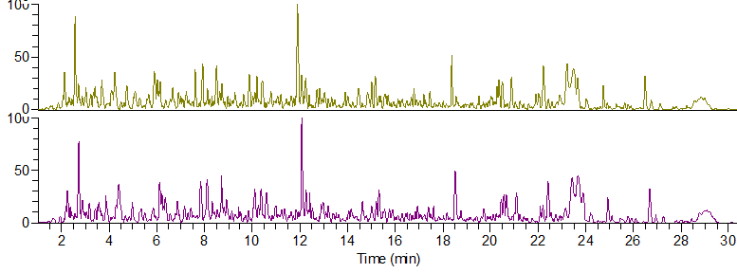
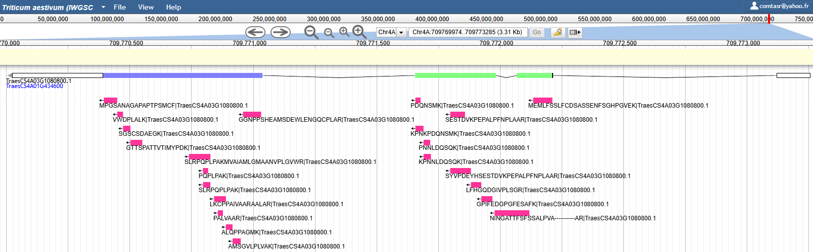
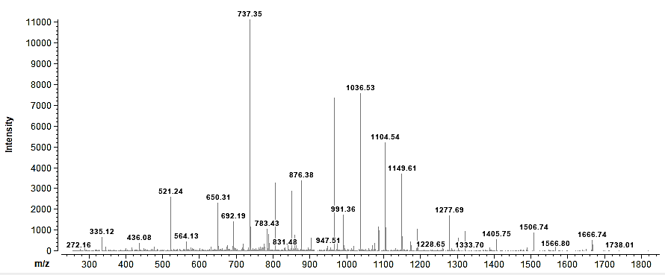
Graphical Abstract
Public raw
LC-MS2 data
Proteome database search
GFF3-based peptide projection
Apollo JBrowse deployment
Intensity
LC separation
MS2 Spectrum
Exon
intron
Intensity
TEPNAIISGMVR
m/z

Slide 2







Figure 1: Overview of the wheat proteogenomic workflow. Genome-based workflow developed in this study involving raw LC–MS/MS reanalysis against the IWGSC RefSeq v2.1 proteome, followed by peptide projection using GFF3 annotation files and generation of browser-ready BED6/BED12 tracks for Apollo JBrowse visualization; details are available in Suppl. Fig. S1 and Jupyter Notebook.
Annotation-aware genomic coordinate reconstruction
Public raw LC-MS2 data
MSV000090572
PXD004720
PXD050500
Raw LC-MS2 files
(.raw, .mzML, .d)
Proteome database search against IWGSC2.1
Intensity
LC separation
MS2 Spectrum
Intensity
TEPNAIISGMVR
m/z
GFF3-guided peptide projection & validation
Exon
intron
Exon
Apollo/JBrowse deployment
Track upload (.bed6/bed12)

Slide 3
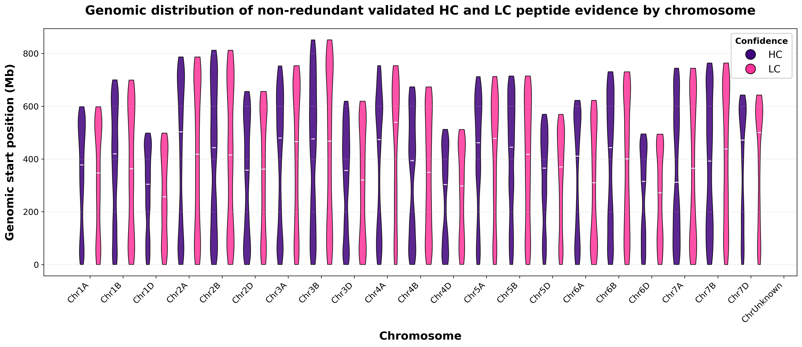
Figure 2: Genome-wide distribution of projected peptide evidence across wheat chromosomes. Violin plot showing genomic coordinate distributions of HC and LC peptide projections for each chromosome.

Slide 4
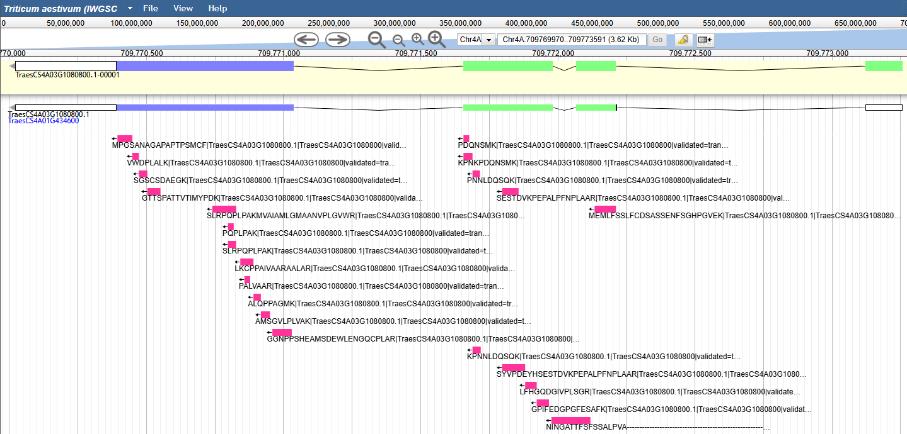
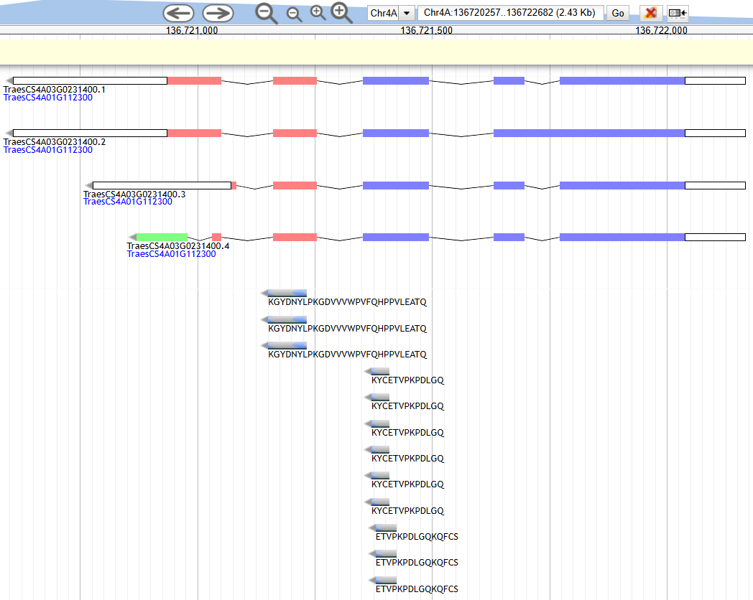
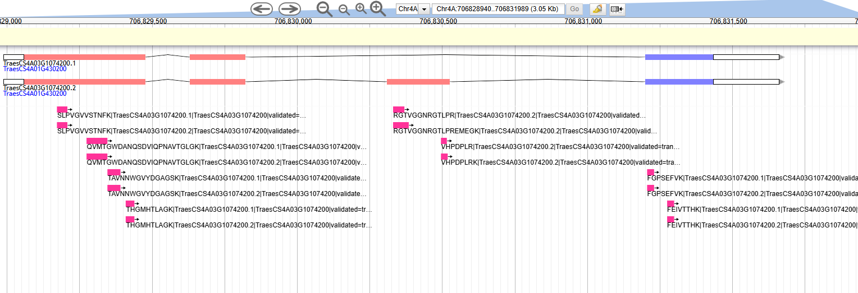
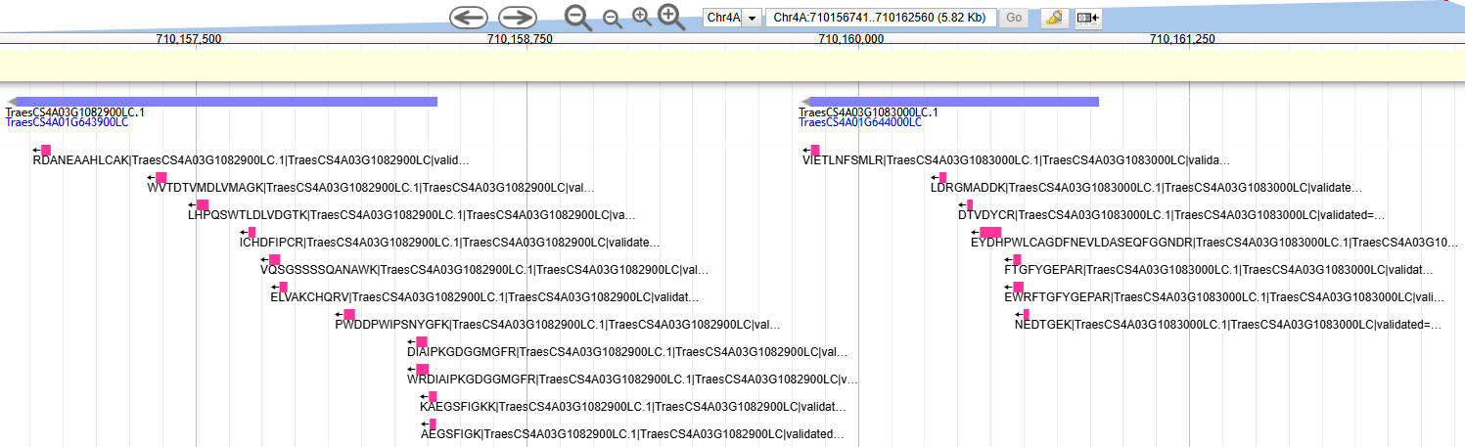
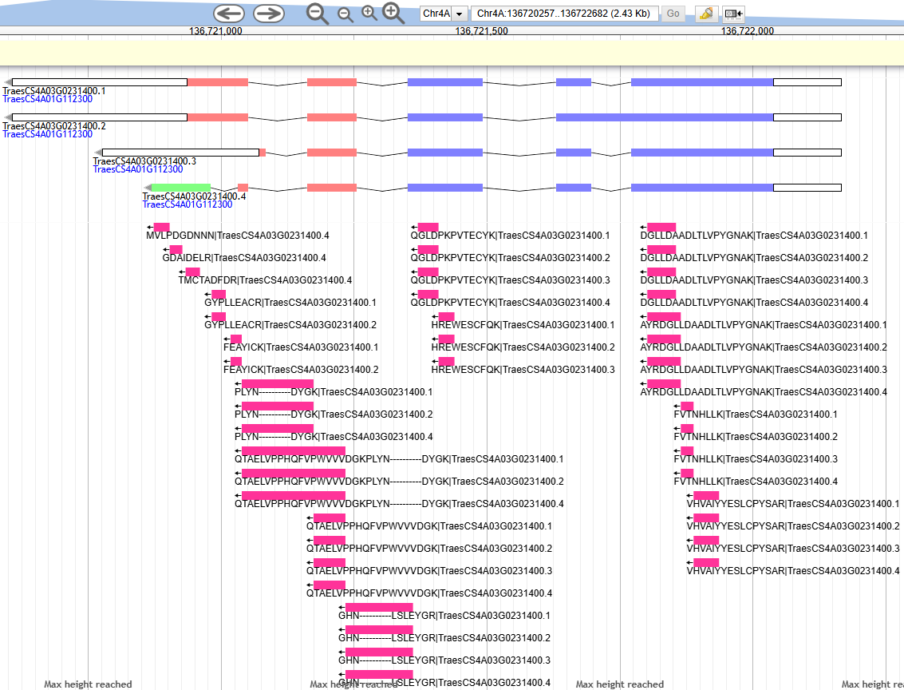
Figure 3: Apollo JBrowse visualization of annotation-aware peptide projections along wheat gene models. (A) Validation of HC gene model TraesCS4A03G1080800.1 supported by extensive projected peptide evidence(Chr4A:709769974..709773595 ). (B) Peptide evidence supporting isoform-specific projections for TraesCS4A03G1074200.1 and TraesCS4A03G1074200.2 (Chr4A:706828843..706831892). (C) Peptide evidence supporting LC gene models TraesCS4A03G1082900LC.1 and TraesCS4A03G1083000LC.1 (Chr4A:710156743..710162562 ), suggesting potential promotion to HC status.
https://bread-wheat-um.genome.edu.au/
comtasr@yahoo.fr
6natERaBkb6B
"style": {"color":"#FF3399"}
Chr4A:709769974..709773595 (3.62 Kb)
Chr4A:709771972..709772129 (158 b)
Chr4A:706828843..706831892 (3.05 Kb)
Chr4A:710156743..710162562 (5.82 Kb)
Chr4A:704253293..704258230 (4.94 Kb) Chr4A:136720257..136722682 (2.43 Kb
A.
Track legend:
genomic sequence
HC gene exon frame 1
HC gene exon frame 2
HC gene exon frame 3
intron
peptides (all tissues)
E.
B.
C.

Slide 5
Supplementary Figure S1. Computational workflow of the genome-guided wheat proteogenomics approach devised in this study. Public LC–MS/MS datasets from PRIDE and MassIVE were retrieved and reprocessed against the IWGSC RefSeq v2.1 HC+LC wheat proteome database using FragPipe/MSFragger. GFF3 annotations were parsed to reconstruct protein–transcript–gene relationships and exon/CDS coordinates. Non-contaminant peptide evidence was integrated with GFF3-derived annotation frameworks and subjected to annotation-aware peptide projection, whereby peptide amino-acid coordinates were converted into exon-aware genomic coordinates and exported as BED6/BED12 tracks. Projection validation involved translation-based peptide reconstruction together with independent BED geometry, chromosome/strand, and protein-coordinate sanity checks. Final validated peptide tracks were used for genome-scale exploratory data analysis (EDA) and Apollo/JBrowse deployment. Detailed computational steps and Python code are provided in the accompanying Jupyter Notebook and GitHub repository, as well as Supplementary File S3.
Genome-guided wheat proteogenomics workflow
1. DATA RETRIEVAL + REFERENCE GENOME + PROTEOME SEARCH
Steps 1–4
FTP download of raw LC–MS2 proteomic and GFF3 genomic files (Unix)
Data conversion (ProteoWizard MSConvert)
Protein database creation with decoy (Galaxy)
Proteome search against IWGSC v2.1 database (FragPipe: MSFragger → PeptideProphet → ProteinProphet)
2. GFF3 ANNOTATION FRAMEWORK
Step 5
ProteinID → TranscriptID → GeneModel → CDS blocks (Python)
3. PEPTIDE EVIDENCE CONSTRUCTION
Steps 6–8
FragPipe output importation (Python)
Non-contaminant peptide–protein–gene evidence (Python)
Protein to gene model projections using GFF3-derived table (Python)
4. GFF3-BASED PEPTIDE PROJECTION
Step 9
Peptide in protein → coding nucleotide coordinates → exon-aware genomic blocks (Python)
5. PEPTIDE PROJECTION VALIDATION
Steps 10, 11
Translation validation: projected genomic blocks → translated peptide → match/mismatch QC (Python)
Independent sanity checks (Python)
6. RESOURCE OUTPUT + INTERPRETATION
Steps 12-25
validated projections exported as BED tracks (Python)
BED tracks permanent upload (Apollo Jbrowse)
EDA (scatter, box, violin, bar, UpSet, circular plots, histograms, Venn diagram, pie chart) (Python)
HC/LC support (Python)
Protein sequence MKWVTFPEPTIDEISLLFSSAY... ↓ Peptide CDS coordinates nt 241–312 ↓ GFF3 exon blocks Exon1 ─ Intron ─ Exon2 ↓ Genomic peptide projection █████-----████
Locates the peptide amino acid sequence within the corresponding protein sequence.
Converts the peptide amino acid interval into coding nucleotide positions.
Retrieves the CDS blocks associated with the corresponding transcript.
Projects coding nucleotide positions onto genomic coordinates.
Collapses projected nucleotide positions into genomic blocks.
Generates an intron-aware peptide display label (exon-spanning junctions shown using dash characters).
Projected genomic blocks █████-----████
↓
Retrieved genomic DNA ATGGCC...GT...AAGTAA ↓ Translated peptide NINGATTFFSSALPVA ↓ Original peptide = NINGATTFFSSALPVA ↓
Evaluation
☑ match
Beside the translation validation, 3 independent sanity checks are performed:
BED geometry check: confirms BED coordinates by checking start coordinates < end coordinates, and that BED block sizes and block starts are consistent with each peptide genomic interval.
Chromosome and strand check: confirms that projected peptides are assigned only to expected wheat chromosomes and valid strand values (`+` or `-`).
Protein-coordinate consistency check: confirms that each peptide projection has coherent amino-acid coordinates, including matching peptide length and valid protein coordinate intervals.
Evaluation:
translated sequence match + successful checks → peptide validated ☑
translated sequence mismatch and/or unsuccessful check → peptide rejected ⮽

Slide 6
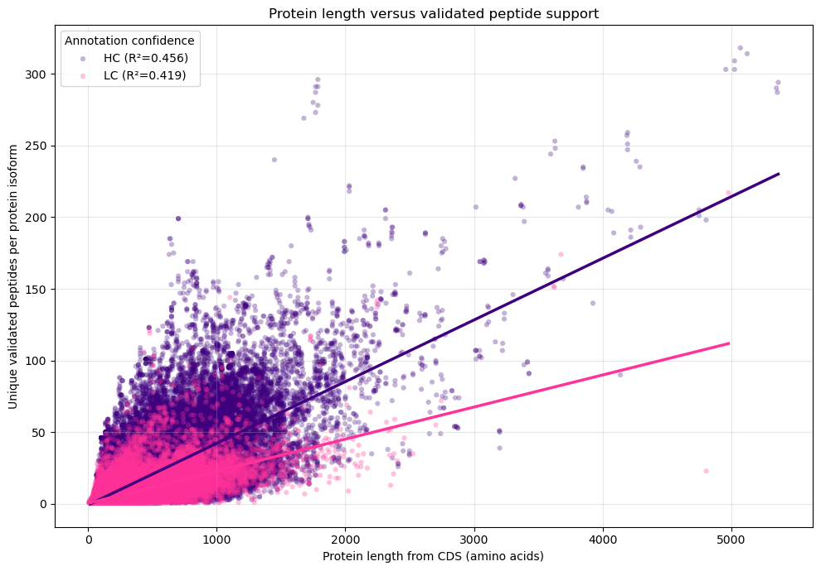
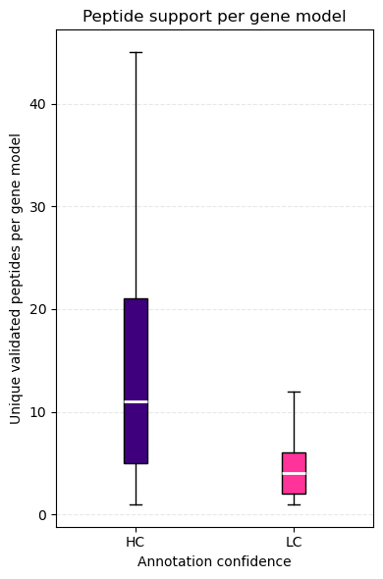
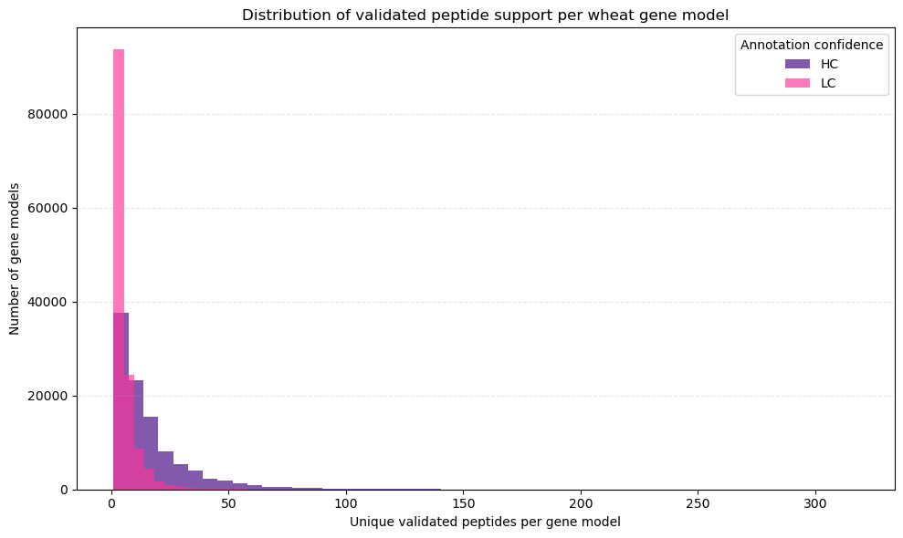
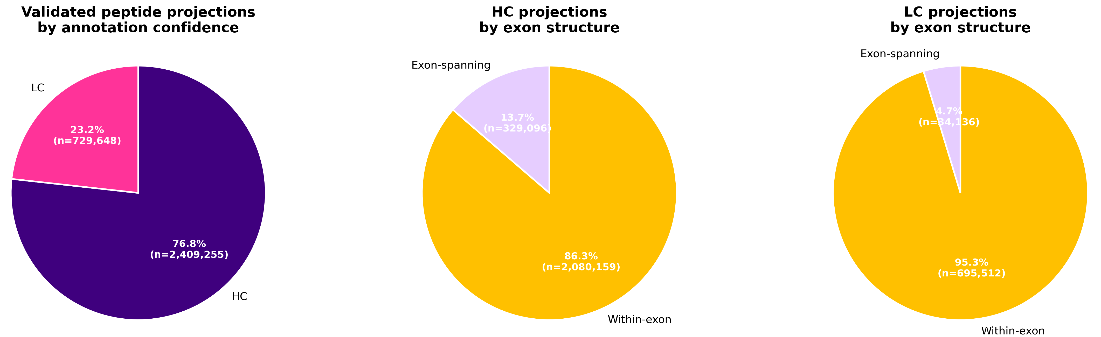
Supplementary Figure S2: Peptide support distributions across HC and LC wheat gene models. (A) Scatterplot showing the relationship between protein length and the number of projected unique peptides per protein isoform, separated by HC and LC annotation confidence. (B) Boxplot comparing projected peptide support between HC and LC gene models. (C) Distribution of projected unique peptides per gene model showing broader and more abundant support for HC annotations. (D) Proportion of non-redundant validated peptide projections assigned to HC and LC gene models. (E) Proportion of HC peptide projections classified as within-exon or exon-spanning. (F) Proportion of LC peptide projections classified as within-exon or exon-spanning.
A.
B.
C.
D.
E.
F.

Slide 7
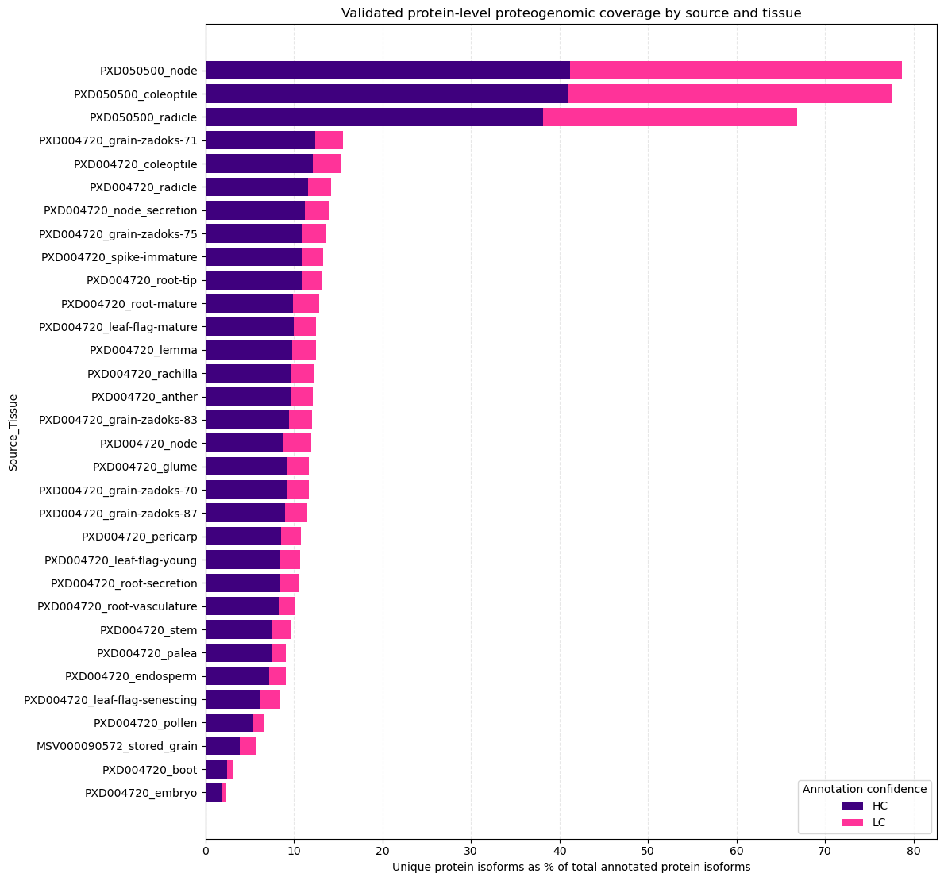
Supplementary Figure S3. Proteogenomic coverage across wheat tissues. Barplot of protein-level coverage showing the percentage of annotated HC and LC gene models supported by projected protein accessions.

Slide 8
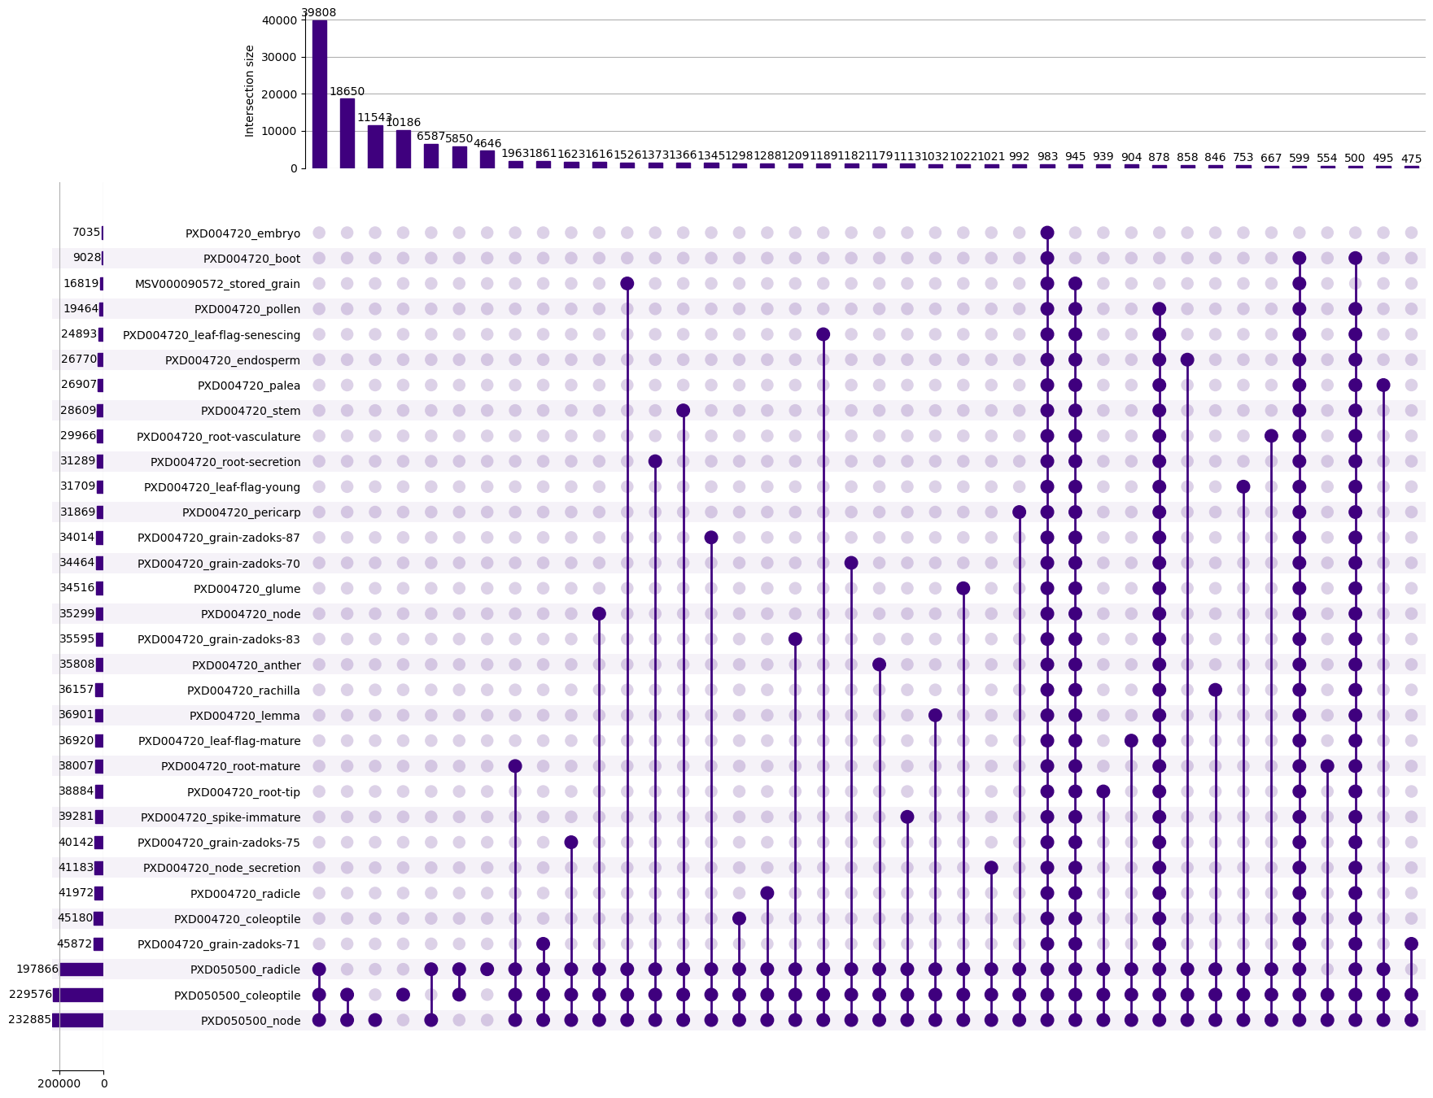
Supplementary Figure S4: UpSet plot of projected protein intersections across wheat tissues. Vertical bars indicate the number of shared projected protein isoforms among tissue combinations, while horizontal bars show the total number of projected protein isoforms identified per tissue. The analysis highlights both broadly shared and tissue-specific proteogenomic signatures across the wheat datasets.

