Slide 1

Proximity Antenna Training for 13.56 MHz
50 Ohm matched antenna

Slide 2
50 Ω matched antenna
50 Ω matched antenna
RC500
RC400
(or
other
Reader)
Rx
Rx-
Circuit
Tx
Matching
Matching
Antenna
Z=50Ω
Z = 50Ω
EMC-
Filter

Slide 3

50 Ω matched antenna
Requirements:
!
1) Matching
load impedance = 50Ω
1) Matching
2) Resonance
2) Resonance
3) Tuning
resonance at 13.56 MHz
4) Q-factor
4) Q-factor
quality factor < 35
quality factor < 100
5) Finetuning
6) Receive Circuit

Slide 4
50 Ω matched antenna
Guideline:
1) Matching
Design a coil
Calculate the parallel capacitance
Tune resonance and impedance
Connect antenna to the RC500
  Tune again
Check (and adjust) the Q-factor
Finetune resonance and impedance
Find the values for Rx-circuit
2) Resonance
3) Tuning
3) Tuning
4) Q-factor
4) Q-factor
5) Finetuning
5) Finetuning
6) Receive Circuit
6) Receive Circuit

Slide 5


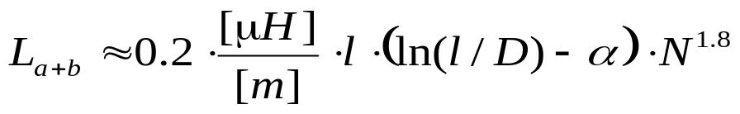
50 Ω matched antenna
Design a coil
L and R of the antenna coil shall be measured
at 13.56 MHz (impedance analyser or L-C-R Meter).
R_{ext}
@13.56 MHz!
R_{coil}
Estimation:
L
L_{a+b} = L: coil inductance
l: length of the conductor circular: l = 2*π*r (r=coil radius)
square l = 4*a (a lateral length)
d: diameter of the conductor
N: number of turns
α: shape factor α =1.07 for circular coils
α=1.54 for square coils

Slide 6
50 Ω matched antenna
Design a coil
1.5
L [µH]
R_{ext}
1
0.5
R_{coil}
0
5
10
15
20
antenna radius [cm]
L
2
N
1
0
5
10
15
20
antenna radius [cm]

Slide 7
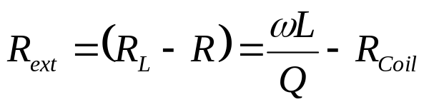
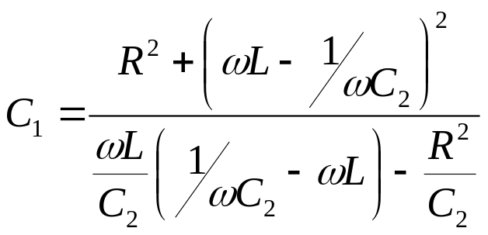
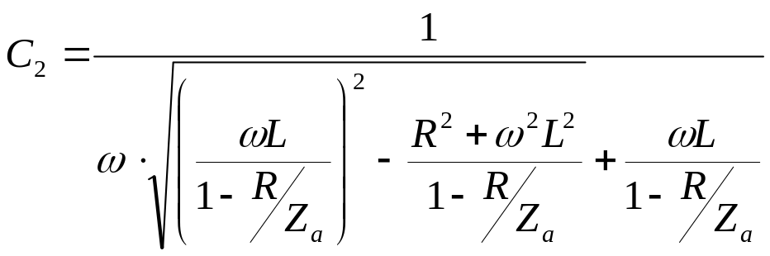

50 Ω matched antenna
Calculate the parallel capacitance
C₁
Consider the power consumption!
R_{ext}
Z_{ant}
R_{coil}
C₂
L
with

Slide 8

50 Ω matched antenna
Tune resonance and impedance
Start
tune phase to 0° ± 10° with C2
possible ?
no
f_{res}>13.56MHz ?
yes
increase
C2
yes
no
yes
Z < Z_{ant}-10%?
decrease
C2
decrease C1
no
yes
Z >Z_{ant}+10% ?
no
Tuning OK
|Z|=Z_{ant} ± 10%
phase=0° ± 10°
increase C1

Slide 9
50 Ω matched antenna
Tune resonance and impedance
1800
80
13.56 MHz
1600
60
1400
40
1200
20
1000
0
|Z_{in}| [Ω]
phase [deg.]
800
-20
600
Z_{ant}
-40
400
-60
200
-80
phase
0
-100
10
11
12
13
14
15
16
17
18
f [MHz]

Slide 10
50 Ω matched antenna
Connect Antenna to the MF RC500
Guideline:
Design a coil
Calculate the parallel capacitance
Tune resonance and impedance
Connect antenna to the RC500
  Tune again
Check (and adjust) the Q-factor
Finetune resonance and impedance
Find the values for Rx-circuit

Slide 11
50 Ω matched antenna
Tune resonance and impedance
Start
Find d_{max}
C₁
Add ΔC
ΔC < 10 pF
R_{ext}
Find max. distance
Z_{ant}
R_{ant}
C₂
yes
distance
increased ?
L_{ant}
decrease C2
no
no ΔC
is added
yes
no
remove ΔC
add 2* ΔC to C2a
add 2* ΔC to C2b

Slide 12
50 Ω matched antenna
Checking the Q-Factor
2.5µs
PHILIPS
Channel A:
500mV/DIV
Timebase:
1µs/DIV
95%
A
send
request command
Reader

Slide 13
50 Ω matched antenna
Checking the Q-Factor
0
1
2
3
Modulator
Source Switch
Serial Data OUT
Envelope
Miller Coder
Modulator
Driver
Tx
Decoder
Source Switch
Mfin / PIN3
Serial
Data
IN
0
1
2
3
Manchester OUT
Subcarrier
Demodulator
Carrier
Demodulator
Manchester
Decoder
Rx
Manchester
w. Subcarrier
Envelope
Mfout / PIN4
MFout
Select Switch
Transmit NRZ
RFU
Subcarrier
Demodulator
7 6 5 4 3 2 1 0
0 1
Digital Test Signal

Slide 14
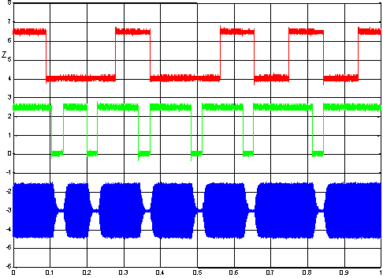
50 Ω matched antenna
Checking the Q-Factor
RC500 test signals
Pin 4 (3):
Transmit NRZ
2V/Dev.
Pin 4 (2):
Envelope
2V/Dev.
RFOut
0.5V/Div.
time in msec

Slide 15
50 Ω matched antenna
Check
Guideline:
Design a coil
Calculate the parallel capacitance
Tune resonance and impedance
Connect antenna to the RC500
  Tune again
Check (and adjust) the Q-factor
Finetune resonance and impedance
Find the values for Rx-circuit

Slide 16
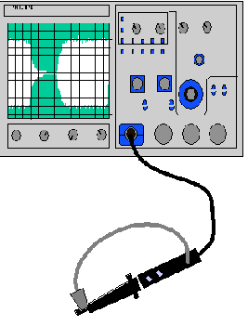


50 Ω matched antenna
Check the cards answer
Startvalue:
Insert RX-Circuitry
Check the card’s answer with oscilloscope (trigger on Pin 4, Envelope)
Get the max. operating distance
“Antenna-Loop”
send
request command
Check the received signal at the RC500 (Pin 4, Manchester)
Reader
Adjust R1 (valid Manchester at min. and max operating distance)
Attention: Input voltage at Pin 29 (Rx) shall not exceed ± 1.5V!

Slide 17
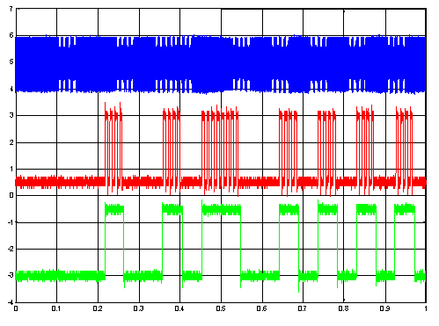
50 Ω matched antenna
Checking the Q-Factor
RC500 test signals
RFOut
1V/Dev.
Pin 4 (4):
Manchester
with Subcarrier
2V/Dev.
Pin 4 (5):
Manchester
2V/Dev.
time in msec

Slide 18
50 Ω matched antenna
Summary
1) Matching
Design a coil
Calculate the parallel capacitance
Tune resonance and impedance
Connect antenna to the RC500
  Tune resonance and impedance
Check (and adjust) the Q-factor
Finetune resonance and impedance
Find the values for Rx-circuit
2) Resonance
3) Tuning
3) Tuning
4) Q-factor
4) Q-factor
5) Finetuning
5) Finetuning
6) Receive Circuit
6) Receive Circuit

Slide 19
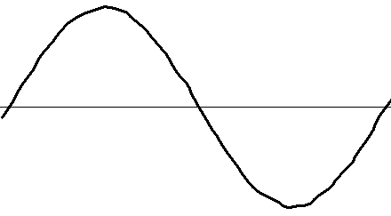
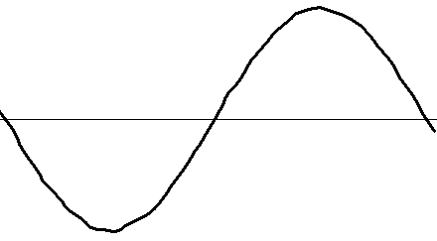
50 Ω matched antenna
Balun
I
The same as directly
matched antenna...
+U
50 Ω
-U
I
Balun (balanced - unbalanced)

Slide 20
50 Ω matched antenna
Compensated antenna
I
I
50 Ω
50 Ω
I
I

Slide 21
50 Ω matched antenna
Principle of the compensated antenna
without compensation
with compensation

Slide 22
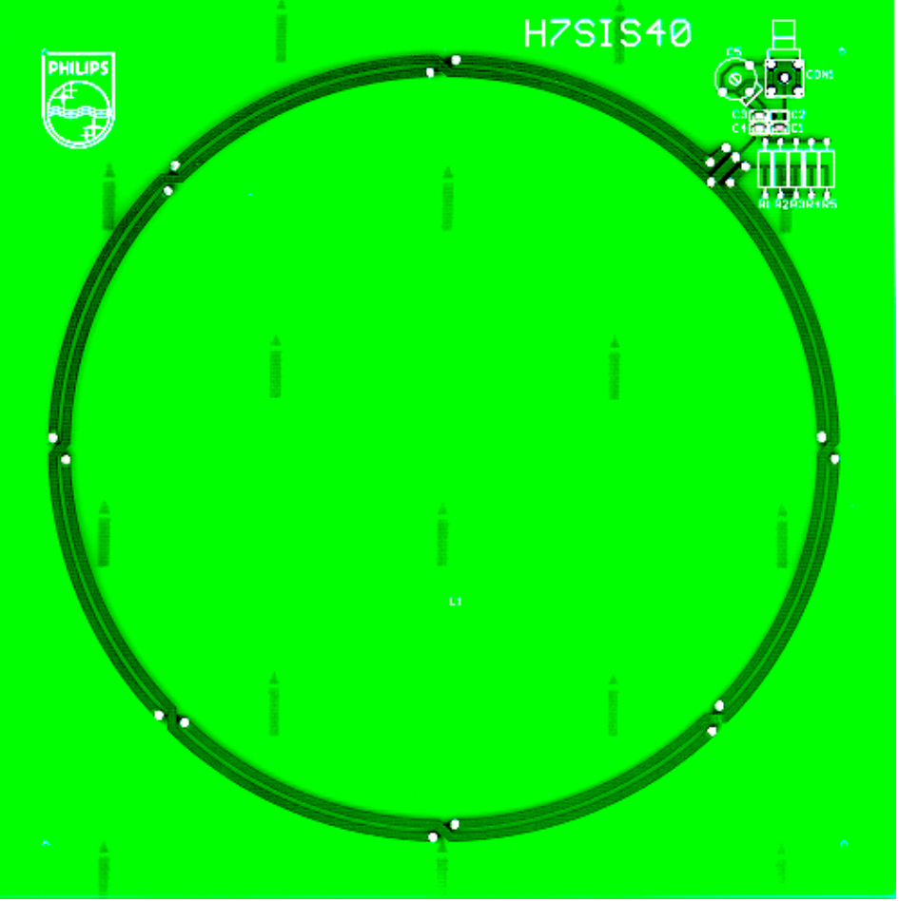
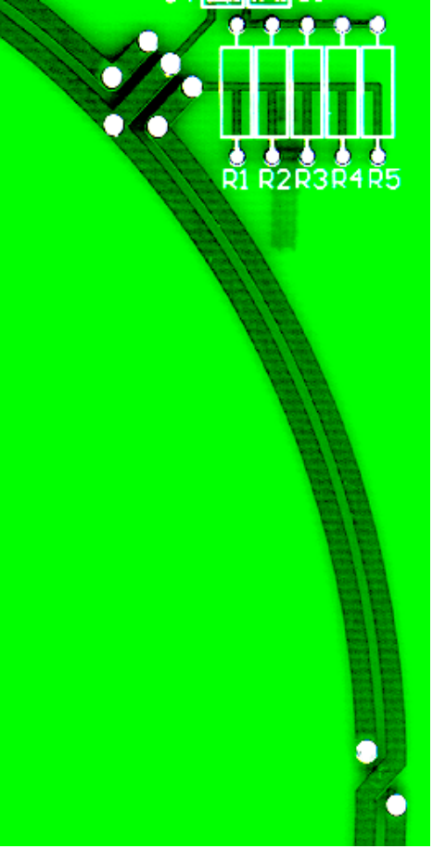
50 Ω matched antenna
Example: Circular antenna
L = 450nH
R = 0.3 Ω

Slide 23
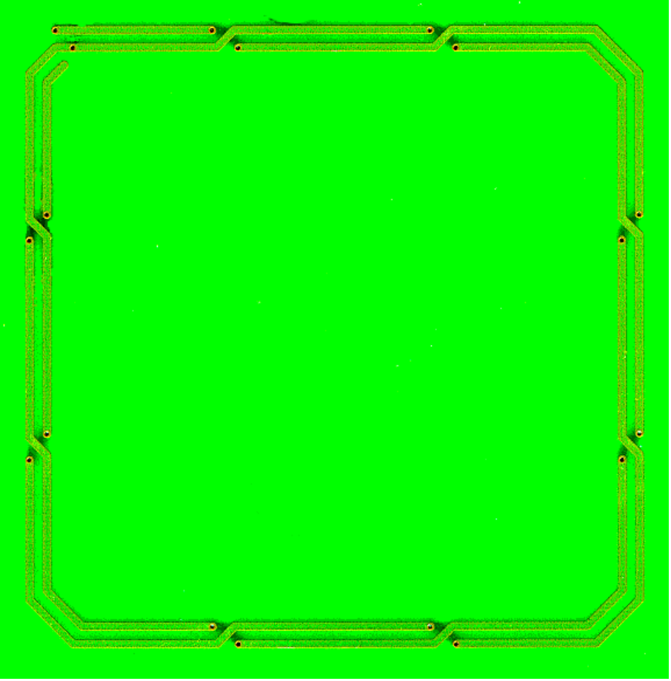
50 Ω matched antenna
Example: Square antenna
L = 700nH
R = 0.3 Ω

