Slide 1


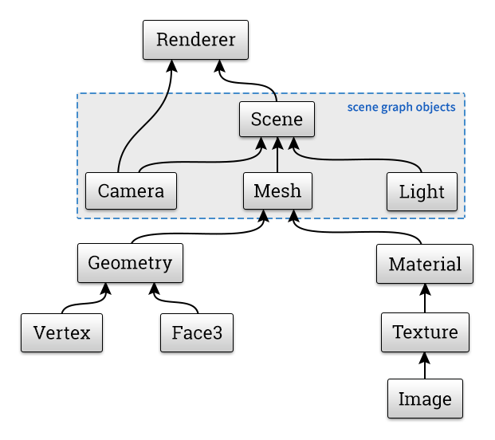
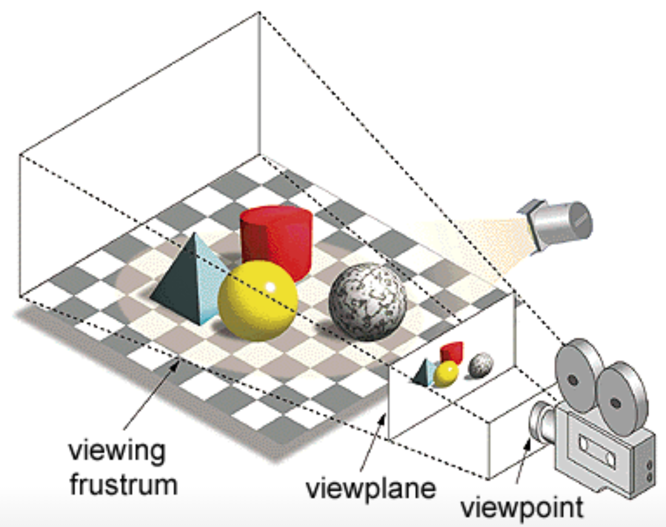
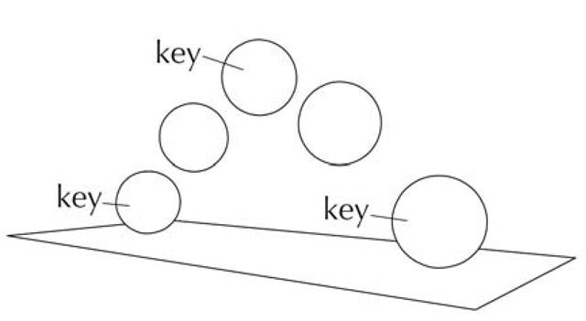
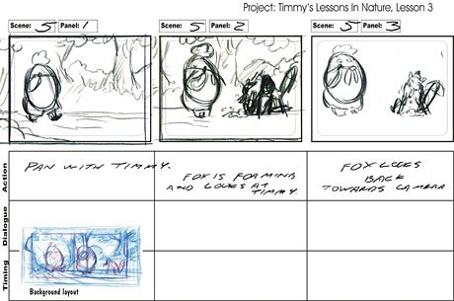
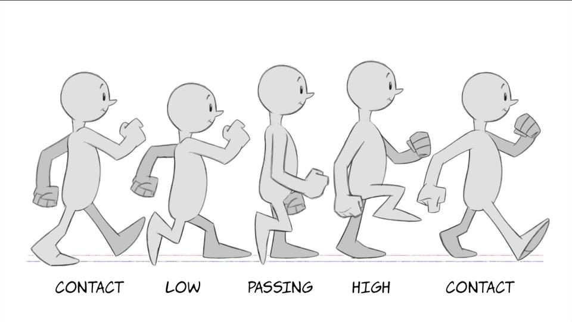
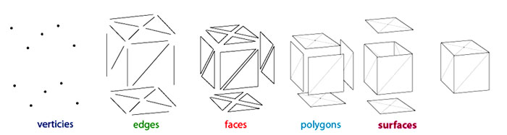
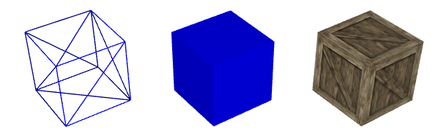
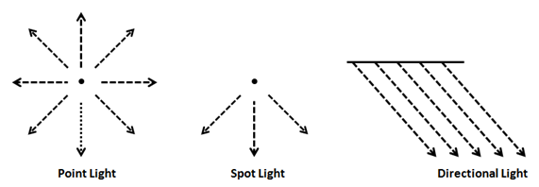
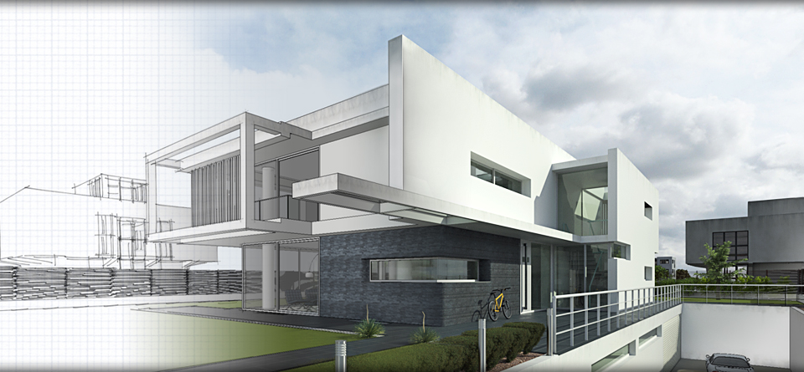
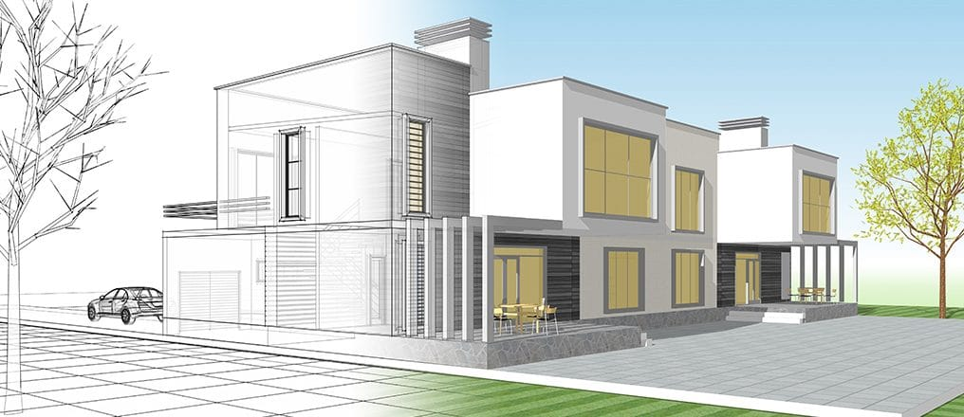
3D Animation with the use of Three.js
Kai-Ming Chow & Daniela A. Rivera
University of Puerto Rico, Río Piedras Campus
Animation
Main Concepts
Scene
Technique that gives the illusion of moving objects using a series of still pictures that capture a small movement and then displayed in rapid succession.
Three.js is a JavaScript library for generating 3D graphics. Also used to create animated 3d graphics in a web browser. Derived from WebGL and created by Ricardo Cabello in 2010.
The 3D models are made up of triangles, which are made up of vertices.
Vertices are specified coordinates within a three-dimensional space.
Face is an area within three vertices which define the surface of the object.
There are world and model coordinates. These can be transformed within the world coordinate system to differentiate the shape of the object, and where it is positioned inside the world.
Transformations are performed to manipulate the objects, by multiplying matrices that contain the information about the coordinate systems.
The geometry and materials are what define the mesh object in Three.js.
Geometry is made up of vertices that define the form of an object.
Material determine how the objects react to light sources.
Textures can be applied to objects, by a process called UV mapping, to simulate real world objects.
[8]
[9]
[1]
[2]
[3]
A camera is placed to determine what can be viewed within the world.
The scene is then displayed on the device screen by colored pixels.
Perspective projection produces a flat image from the 3d models within the view frustum.
Rasterization is a process that approximates the placement of the pixels to coincide with the viewable objects.
In animation, the pixels are altered when the scene is changed on a frame.
3D Animation
[7]
Camera
It's the creation of moving objects through their manipulation in a three dimensional environment.
3 phases to 3D animation: Modeling, layout, and rendering.
Animation Process
1. Concept and storyboarding
2. 3D modeling
3. Texturing
4. Rigging and skinning
5. Animation
6. Lighting
7. Camera settings
8. Rendering
9. Compositing
10. Music and Foley
11. Editing and Final Output
Modeling and texturing
References
Chang, Adric. “The Process of 3D Animation.” Media-Freaks.com
Hughes, John F. Computer Graphics: Principles and Practice, Third Edition.
IntroTutorials1. “WebGL Tutorial 03 - Textured Cube.” YouTube, YouTube, 26 Jan 2016.
“OpenGL 1.1: Geometry” Intrduction to Computer Graphics, by David J. Eck, 2018
“Three.js: A 3D Scene Graph API” Introduction to Computer Graphics, by David J. Eck, 2018
“Three.js” Three.js - Javascript 3D Library, Threejs.org.
[1] “Animation - Keyframe Basics (Essential Skills) (3D Animation Using Maya).” Whatwhenhow RSS, what-when-how.com/3d-animation-using-maya/animation-keyframe-basics-essential-skills-3d-animation-using-maya/.
[2] “The Process of 3D Animation.” Media-Freaks.com, media-freaks.com/the-process-of-3d-animation/.
[3] Connor, Dermot O'. “2D Animation: Walk Cycles Basics.” Lynda.com - from LinkedIn, Lynda.com, 26 Feb. 2016, www.lynda.com/Animation-tutorials/2D-Animation-Walk-Cycles-Basics/434462-2.html.
[4] Bejarano, Antonio Hernández. “Let There Be Light.” Let There Be Light · 3D Game Development with LWJGL 3, lwjglgamedev.gitbooks.io/3d-game-development-with-lwjgl/content/chapter10/chapter10.html.
[5] [6] Hier, David. “David Hier Render Studio: 3D Modelling & Rendering and Architectural & Product Visualisation.” 3D Modelling, www.davidhier.co.uk/modelling.html.
[7] “Polygon Mesh.” Wikipedia, Wikimedia Foundation, 17 May 2018, en.wikipedia.org/wiki/Polygon_mesh.
[8] “Intro to WebGLwith Three.js.” Intro to WebGL with Three.js, davidscottlyons.com/threejs-intro/#slide-16.
[9] “Encyclopedia.” PCMAG, PCMAG.COM, www.pcmag.com/encyclopedia/term/61771/viewing-frustum.
Light sources
[4]
[5]
Rendering
[6]

