Slide 1
Material taught in lecture
Scanner specification language: regular expressions
Scanner generation using automata theory + extra book-keeping

Slide 2
Today
Lexical
Analysis
Syntax Analysis
Parsing
AST
Symbol
Table
etc.
Inter.
Rep.
(IR)
Code
Generation
Executable
code
exe
Goals:
  Quick review of lexical analysis theory
  Assignment 1

Slide 3

Scanning Scheme programs
tokens
LINE: ID(VALUE)
Scheme program text
(define foo
(lambda (x) (+ x 14)))
L_PAREN
SYMBOL(define)
SYMBOL(foo)
L_PAREN
SYMBOL(lambda)
L_PAREN
SYMBOL(x)
R_PAREN
...

Slide 4
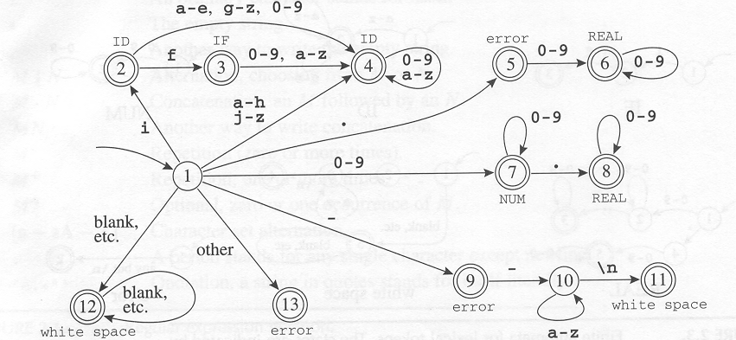
Scanner implementation
What are the outputs on the following inputs:
ifelse
if a
.75
89
89.94

Slide 5
Lexical analysis with JFlex
JFlex – fast lexical analyzer generator
  Recognizes lexical patterns in text
  Breaks input character stream into tokens
Input: scanner specification file
Output: a lexical analyzer (scanner)
  A Java program
text
Scheme.lex
JFlex
Lexer.java
javac
Lexical
analyzer
tokens

Slide 6
JFlex spec. file
Possible source of javac errors down the road
User code
  Copied directly to Java file
%%
DIGIT= [0-9]
LETTER= [a-zA-Z]
YYINITIAL
JFlex directives
  Define macros, state names
%%
Lexical analysis rules
  Optional state, regular expression, action
  How to break input to tokens
  Action when token matched
{LETTER}
({LETTER}|{DIGIT})*

Slide 7
User code
package Scheme.Parser;
import Scheme.Parser.Symbol;
…
any scanner-helper Java code
…

Slide 8
JFlex directives
Directives - control JFlex internals
  %line switches line counting on
  %char switches character counting on
  %class class-name changes default name
  %cup CUP compatibility mode
  %type token-class-name
  %public Makes generated class public (package by default)
  %function read-token-method
  %scanerror exception-type-name
State definitions
  %state state-name
Macro definitions
  macro-name = regex

Slide 9
Regular expressions
r $ | match reg. exp. r at end of a line
. (dot) | any character except the newline
"..." | verbatim string
{name} | macro expansion
* | zero or more repetitions
+ | one or more repetitions
? | zero or one repetitions
(...) | grouping within regular expressions
a|b | match a or b
[...] | class of characters - any one character enclosed in brackets
a–b | range of characters
[^…] | negated class – any one not enclosed in brackets
Notes:
- If the dollar sign ends a regular expression, the expression is matched only at the end of a line.

Slide 10
Example macros
ALPHA=[A-Za-z_]
DIGIT=[0-9]
ALPHA_NUMERIC={ALPHA}|{DIGIT}
IDENT={ALPHA}({ALPHA_NUMERIC})*
NUMBER=({DIGIT})+
WHITE_SPACE=([\ \n\r\t\f])+

Slide 11
Lexical analysis rules
Rule structure
  [states] regexp {action as Java code}
  regexp pattern - how to break input into tokens
  Action invoked when pattern matched
  Priority for rule matching longest string
More than one match for same length – priority for rule appearing first!
  Example: ‘if’ matches identifiers and the reserved word
  Order leads to different automata
Important: rules given in a JFlex specification should match all possible inputs!

Slide 12
Action body
Java code
Can use special methods and vars
  yytext()– the actual token text
  yyline (when enabled)
  …
Scanner state transition
  yybegin(state-name)– tells JFlex to jump to the given state
  YYINITIAL – name given by JFlex to initial state

Slide 13
Scanner states example
Java Comment
YYINITIAL
COMMENTS
‘//’
^\n
\n

Slide 14
<YYINITIAL> {NUMBER} {
return new Symbol(sym.NUMBER, yytext(), yyline));
}
<YYINITIAL> {WHITE_SPACE} { }
<YYINITIAL> "+" {
return new Symbol(sym.PLUS, yytext(), yyline);
}
<YYINITIAL> "-" {
return new Symbol(sym.MINUS, yytext(), yyline);
}
<YYINITIAL> "*" {
return new Symbol(sym.TIMES, yytext(), yyline);
}
...
<YYINITIAL> "//" { yybegin(COMMENTS); }
<COMMENTS> [^\n] { }
<COMMENTS> [\n] { yybegin(YYINITIAL); }
<YYINITIAL> . { return new Symbol(sym.error, null); }
Special class for capturing token information
Notes:
class Token defined elsewhere
Note:
state transitions YYINITIAL<->COMMENT
default rule (with the dot), as the last rule !

Slide 15
Putting it all together – count number of lines
lineCount.lex
import java_cup.runtime.Symbol;
%%
%cup
%{
private int lineCounter = 0;
%}
%eofval{
System.out.println("line number=" + lineCounter);
return new Symbol(sym.EOF);
%eofval}
NEWLINE=\n
%%
<YYINITIAL>{NEWLINE} {
lineCounter++;
}
<YYINITIAL>[^{NEWLINE}] { }

Slide 16
Putting it all together – count number of lines
lineCount.lex
JFlex
Yylex.java
text
javac
Lexical
analyzer
java JFlex.Main lineCount.lex
Main.java
javac *.java
tokens
sym.java
JFlex and JavaCup must be on CLASSPATH

Slide 17
Running the scanner
import java.io.*;
public class Main {
public static void main(String[] args) {
Symbol currToken;
try {
FileReader txtFile = new FileReader(args[0]);
Yylex scanner = new Yylex(txtFile);
do {
currToken = scanner.next_token();
// do something with currToken
} while (currToken.sym != sym.EOF);
} catch (Exception e) {
throw new RuntimeException("IO Error (brutal exit)” +
e.toString());
}
}
}
(Just for testing scanner as stand-alone program)

