Slide 1


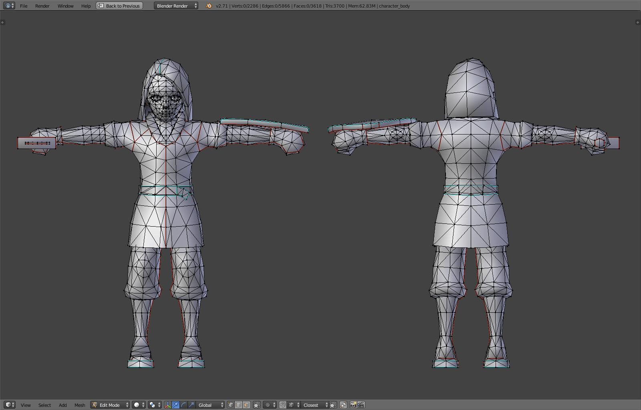
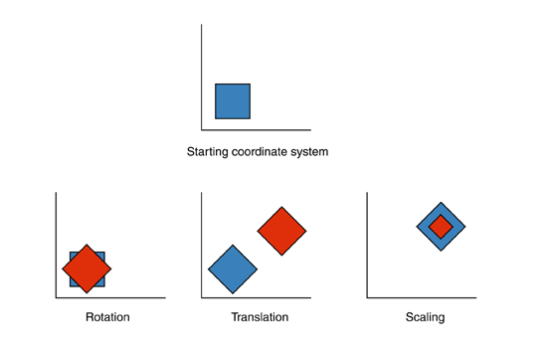
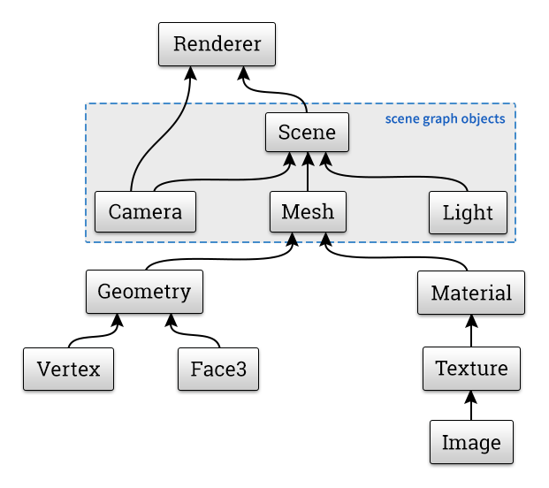
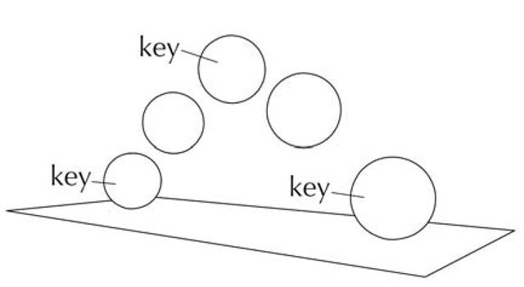
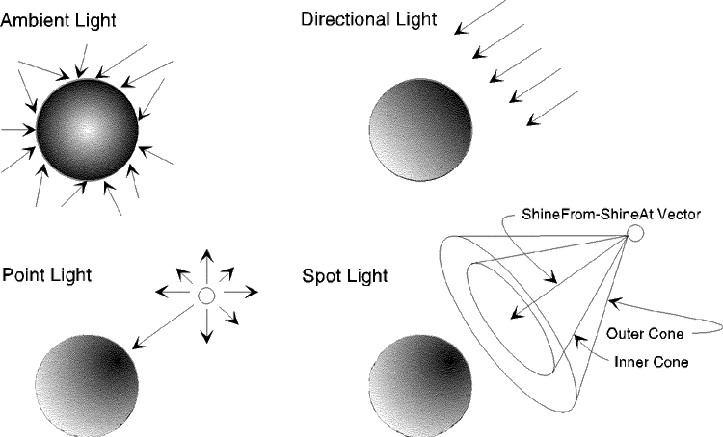
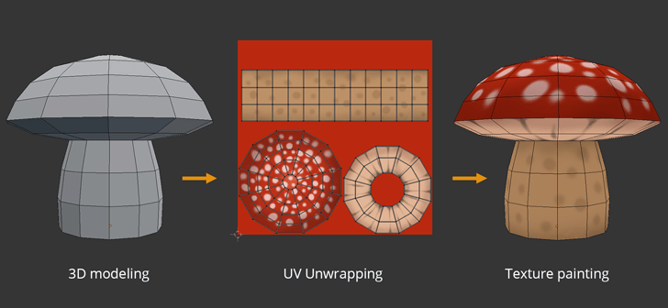
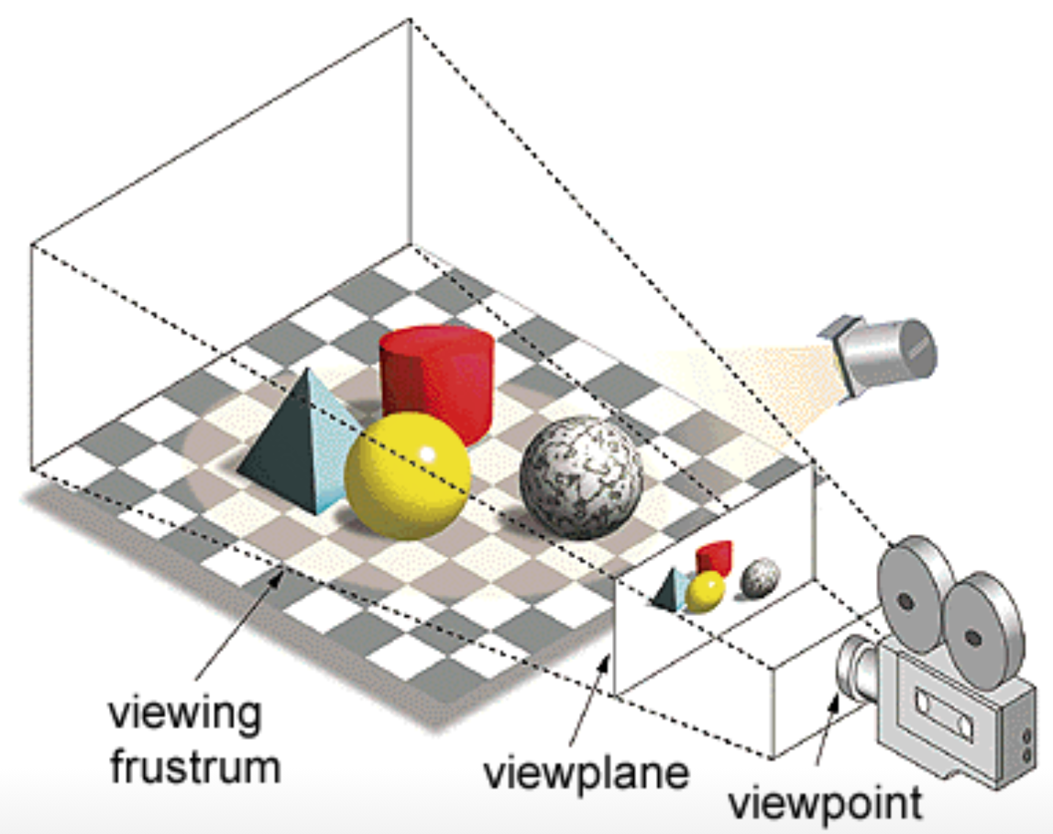
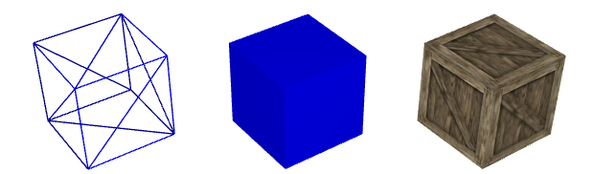
3D Animation with the use of Three.js
Kai-Ming Chow
Daniela A. Rivera
University of Puerto Rico, Rio Piedras Campus
Animation:
Three.js:
Scene:
Animation is the technique that gives the illusion of moving objects using a series of still pictures that capture a small movement and then displayed in rapid succession.
Created by Ricardo Cabello in 2010
A javascript library for generating 3D graphics.
Used to create animated 3d graphics in a web browser.
Derived from WebGL.
Modeling
Transformations
Lighting
Texturing
Main Concepts:
The 3D models are made up of triangles, which are which are made up of vertices.
The vertices are specified by X, Y and Z coordinates within a three-dimensional space.
The area within three vertices is known as a face, which define the surface of the object.
There are world and model coordinates that can be transformed within the world coordinate system to differentiate the shape of the object and where it is positioned inside the world.
Transformations are performed by multiplying matrices that contain the information about the coordinate systems
The geometry and the materials are what defines the mesh object in Three.js.
The geometry consists of vertices of the object and the material determines how the object reacts to light sources.
Textures can be applied to objects, by a process called UV mapping, to simulate real world objects.
A camera is placed to determine what can be viewed in the world.
The scene is then displayed on the device screen by colored pixels.
Perspective projection produces a flat image from the 3d models within the view frustum.
Anything out the frustum will not be rendered, since it will not be viewed anyway (clipping).
In animation, the pixels change when the scene is changed on a frame.
A process called rasterization approximates the placement of the pixels to coincide with the viewable objects.
3D Animation:
.
It's the creation of moving objects through their manipulation in a three dimensional environment.
3 phases to 3D animation: Modeling, layout, and rendering.
References:
Chang, Adric. “The Process of 3D Animation.” Media-Freaks.com
Hughes, John F. Computer Graphics: Principles and Practice, Third Edition.
IntroTutorials1. “WebGL Tutorial 03 - Textured Cube.” YouTube, YouTube, 26 Jan 2016.
“OpenGL 1.1: Geometry” Intrduction to Computer Graphics, by David J. Eck, 2018
“Three.js: A 3D Scene Graph API” Introduction to Computer Graphics, by David J. Eck, 2018
“Three.js” Three.js - Javascript 3D Library, Threejs.org.
Animation Process:
1. Concept and Storyboarding
2. 3D modeling
3. Texturing
4. Rigging and skinning
5. Animation
6. Lighting
7. Camera settings
8. Rendering
9. Composition
10. Music and Foley
11. Editing and Final Output

