Slide 1
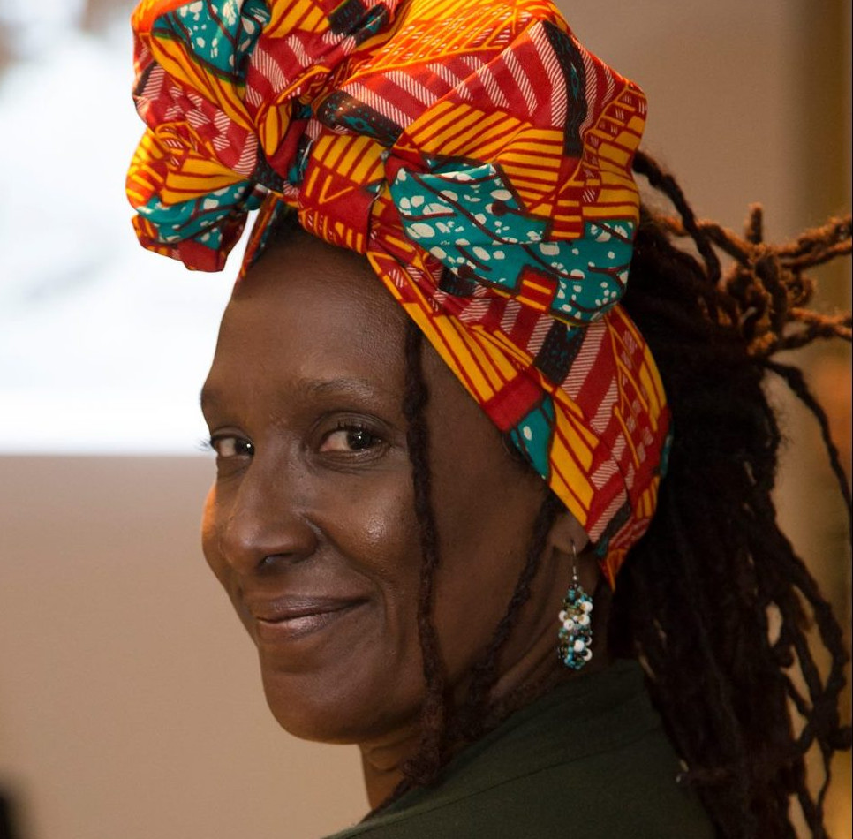
Mayra Santos-Febres
by
Yanela Díaz Martínez
Juan C. Pizarro Cortés
Omar Rosado Ramirez

Slide 2
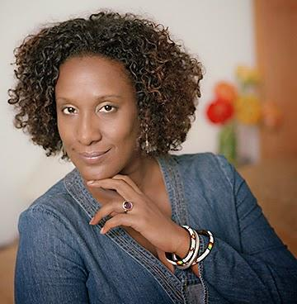
Life and Facts
Born in Carolina, Puerto Rico 1966 ;
B.A. in Hispanic Studies From The University of Puerto Rico, Río Piedras Campus ;
M.A and Ph.D from Cornell University, New York ;
Raised by a Spanish teacher(mother) and a history teacher(father) ;
Written work concentrates on the beauty of the black woman, the discrimination against the marginalized, the afro-latin society, the LGBTQIA society ;

Slide 3
Life and Facts
Executive Director of “El Festival De La Palabra de Puerto Rico” ;
Biggest inspiration to pursue her writing: Teacher Ivonne Sanavitis ;
Began publishing poetry in 1984 in magazines and international newspapers such as:
Casa de las Américas de Cuba ;
Página doce de Argentina ;
Revue Noire de Francia ;
First books published:
Anamú y manigua ;
El orden escapado ;

Slide 4



Notable works
1994
1996
1997

Slide 5



Notable works
2000
2005
2009

Slide 6

Notable works
2012
2015

Slide 7
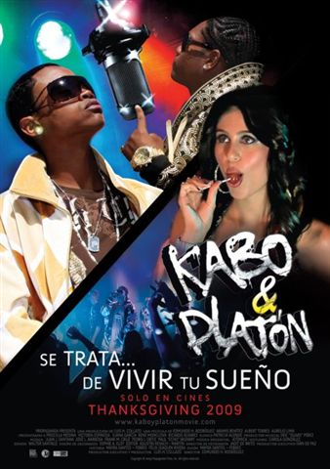
Messages behind the Author

Slide 8
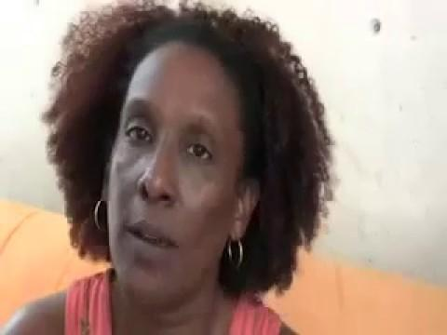

Slide 9
Discussion Questions
Is there racism in Puerto Rico?
Do you think racism is accepted and internalized in our culture?
What are the possible solutions for this problem?

Slide 10
Discussion Questions
How do you think the trans and gay scene are viewed by the general Puerto Rican nowadays?
Why do you think she was inspired to write about trans, gays, drags, etc?
People say you should write what you know. Do you think this can relate to Febres writing Sirena Selena?

Slide 11
Discussion Questions
What message is Mayra trying to transmit by giving Marina her ability?
Do you think the story of Ana Yadira is the internalized racism Juan mentioned ?

Slide 12
Bibliography
PrensaComunitariaPR. “BTV 807 Entrevista Mayra Santos-Febres Sobre Kabo&Platón.”YouTube, YouTube, 29 Dec. 2009, www.youtube.com/watch?v=-qpTPf72TuQ. Accessed on 8, Feb. 2018.
Kelmarierm. “Marina Y Su Olor - Ensayos De Calidad - Kelmarierm.” ClubEnsayos.com - Ensayos De Calidad, Tareas y Monografias, 17 Feb. 2014, www.clubensayos.com/Espa%C3%B1ol/Marina-Y-Su-Olor/1454489.html.
Calis Salgado, Nadia V. “Bowdoin Digital Commons.” Bowdoin Digital Commons, Bowdoin College, 2008, digitalcommons.bowdoin.edu/hispanic-studies-faculty-publications/3/.
Morgado, Marcia. “Literatura Para Curar El Asma.” Entrevista Con Mayra Santos Febres, 2000, www.barcelonareview.com/17/s_ent_msf.htm.

Slide 13
Bibliography
Rfifrance24espanol. “La Escritora Puertorriqueña Mayra Santos Febres Con Jordi Batalle En El Invitado De RFI.” YouTube, YouTube, 27 June 2017, www.youtube.com/watch?v=L7IMER20m_A&t=601s. Accessed 8 Feb. 2018.
“Santos-Febres, Mayra.” Escritores, 20 June 2016, www.escritores.org/biografias/17435-santos-febres-mayra.
“Mayra Santos-Febres Talks Black Beauty and the Power of Words.” Los Afro-Latinos, 25 Jan. 2013, losafrolatinos.com/2012/05/04/mayra-santos-febres-born-to-write/.
Rivera Nieves, Natalia. “Mayra Santos-Febres.” Fundación Nacional Para La Cultura Popular | San Juan, Puerto Rico, 27 June 2014, prpop.org/biografias/mayra-santos-febres/.

