Slide 1
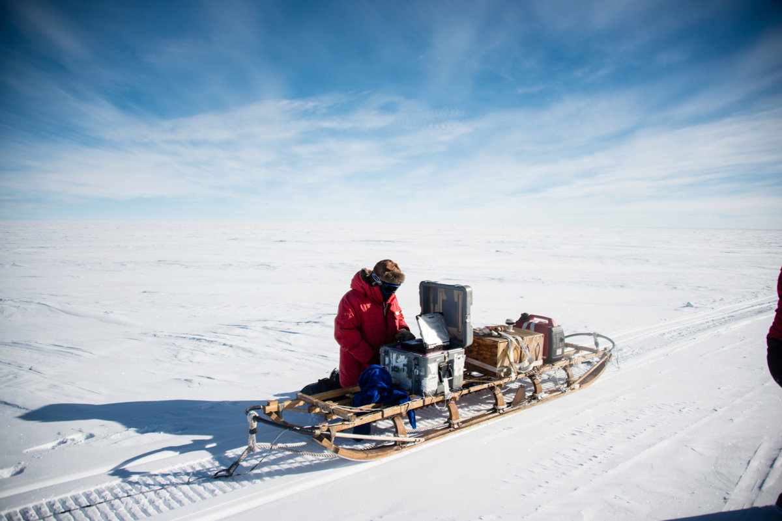
ImpDAR Tutorial
David Lilien
with Ben Hills, Joshua Driscol, Bob Jacobel, and Knut Christianson
U. Maine
November 22nd, 2021

