Slide 1
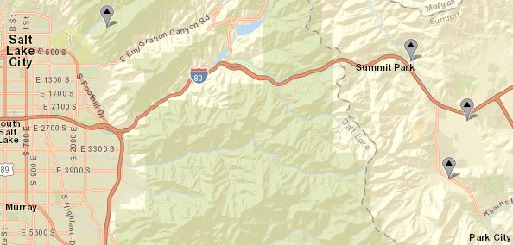
10172200
10133800
10133600

