Slide 1
GeoApp
Team ?
Donghyeon Kim
Jade Kelly-Reskic
Patric Marchant
Dean McHugh

Slide 2
GeoApp - Main MVP Features
Easy to use UI
Offline (& Online) Functionality
Android and iOS compatible
Import & Export as Geo-JSON file
Collect Data
Point, Line, Polygon
Data location needs to be accurate
View Collected Data
Display data in a tabular format
Users are able to filter by data type.
Display data in Google Map Interface
Notes:
Talk about the new map and what it improves on and why we chose it (google maps > every other type of map)
Talk about main features it adds that we needed (Lines and Polygons) as well as how they work

Slide 3
UI Implementation
Side Drawer:
Common navigation pattern
Intuitive
Something else
List Menu:
Simple layout for multiple view options

Slide 4
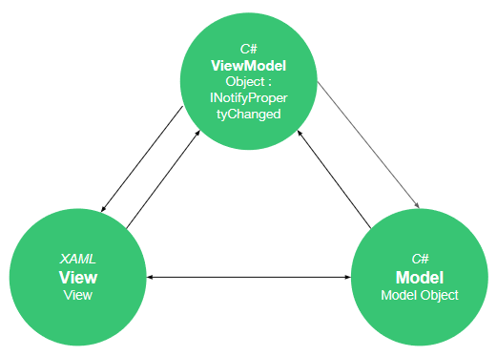
UI Implementation
Components:
Master Detail Page
Stack Layout
Content Page
Content Presenter
Presented in views
Functionality:

Slide 5

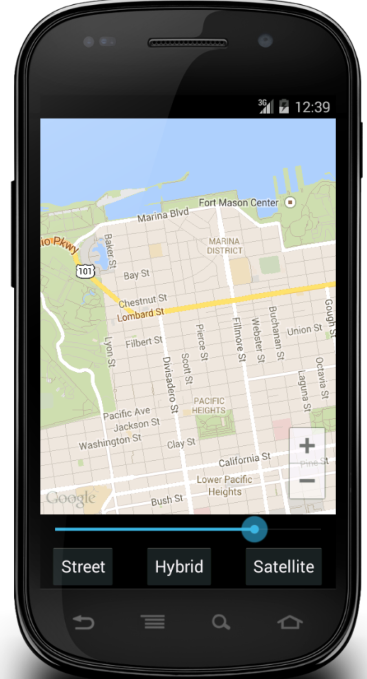
The Map
Xamarin.Forms.Maps Package
Maps package made for Xamarin forms
Uses device’s native maps API
Allows for:
Viewing device’s native map
Plotting points (pins) on the map
Notes:
Talk about original maps package and how it is useful, but doesn’t have the features that we need for our application

Slide 6

The Map
Xamarin.Forms.GoogleMaps library
Built as an extension of Xamarin.Forms.Maps package
Uses API key from Google
Adds features such as:
Plotting
Lines (point to point)
Polygons (multiple points to form a shape)
Circles
Different types of map views
And more
Notes:
Talk about the new map and what it improves on and why we chose it (google maps > every other type of map)
Talk about main features it adds that we needed (Lines and Polygons) as well as how they work

Slide 10
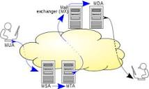


Import & Export Geo-JSON
System.Net.Mail - SMTP (Simple Mail Transfer Protocol)
Used to export collected Geo-JSON through email system
Xamarin.Plugin.FilePicker - NuGet package
Used to select the desired importing file with provided user friendly interface and get its file name and directory path.
Newtonsoft.Json - Json Framework for .NET
Used to serialize and deserialize JSON files
Importing and Parsing JSON files
Notes:
Talk about the new map and what it improves on and why we chose it (google maps > every other type of map)
Talk about main features it adds that we needed (Lines and Polygons) as well as how they work

