Slide 1
Anonymous Types
Strongly-Typed Classes, On The Fly

Slide 2
Introduction
Derick Linkous
dl@steadyscience.com

Slide 3
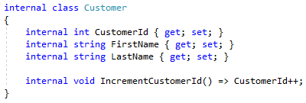
First Class

Slide 4
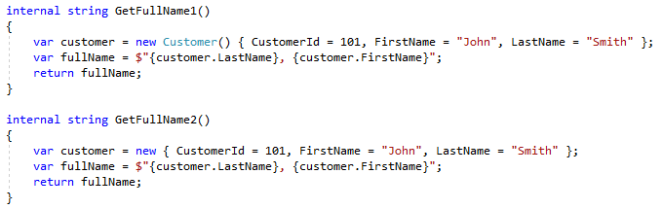
Example 01

Slide 5
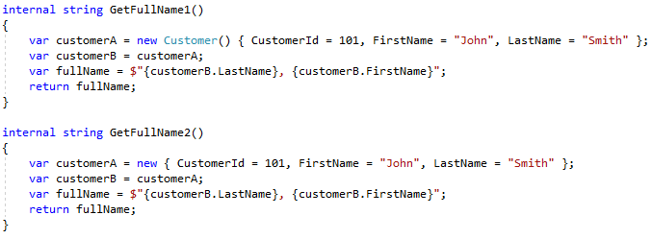
Example 02

Slide 6
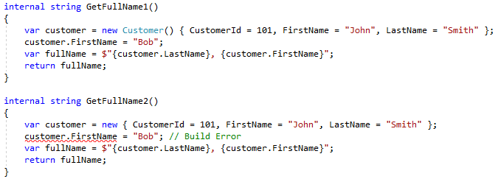
Example 03

Slide 7
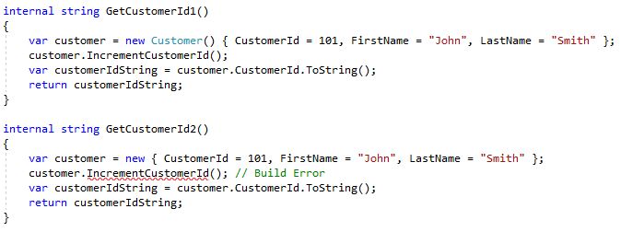
Example 04

Slide 8
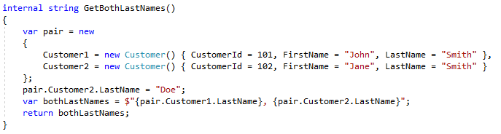
Example 05

Slide 9
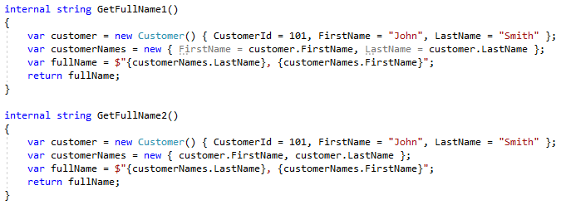
Example 06

Slide 10
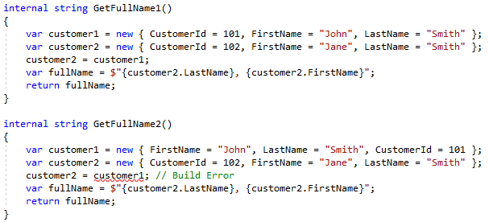
Example 07

Slide 11
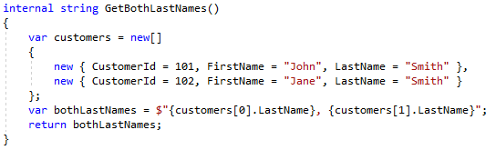
Example 08

Slide 12
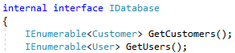
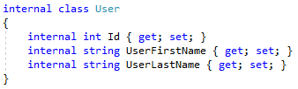
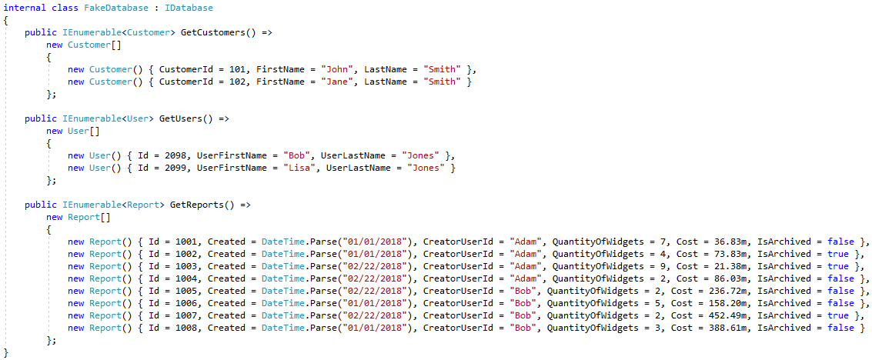
Example 09

Slide 13
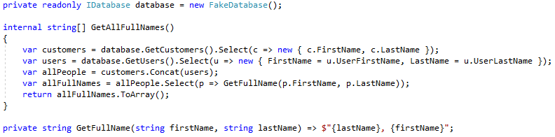
Example 09

Slide 14
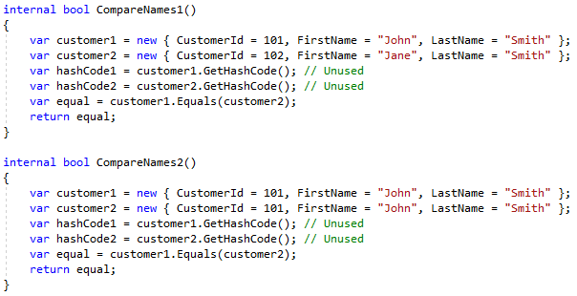
Example 10

Slide 15
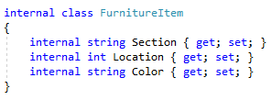
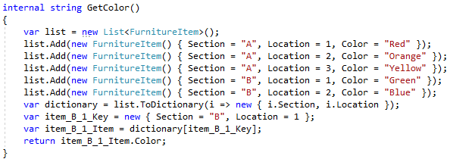
Example 11

Slide 16
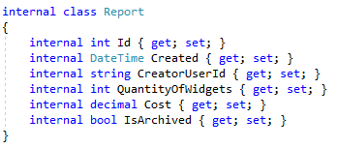
Example 12

Slide 17
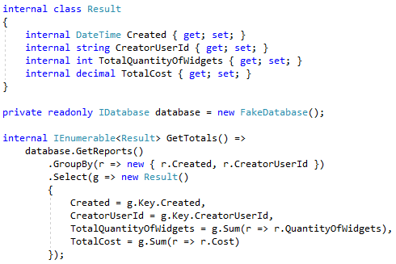
Example 12

Slide 18
Summary
Anonymous Types are classes
Anonymous Types have no names
Type information generated by compiler
Only allowed members are read-only properties
Property types are inferred
Property names can be inferred if source is not an expression
Properties can be almost any type
Anonymous functions and pointers are not permitted.

Slide 19
Summary
Compiler can re-use anonymous types
Based on property names, types, and order
Compiler generates Equals and GetHashCode
Uses Equals and GetHashCode of all properties

Slide 20
Other Considerations
Anonymous Types derive directly from Object
Instances can be passed to other methods
Type must be Object or dynamic
Can be inspected via Reflection

Slide 21
Decision Making
Short-lived ad-hoc set of properties
Immutable set of properties
Need proper Equals/GetHashCode
Type less code
Already have named source properties
Need to pass between methods
Need mutability
Need behavior

Slide 22
Info
Derick Linkous
dl@steadyscience.com

