Slide 1
Base Class Biases
Avoiding Two Common Pitfalls

Slide 2
Introduction
Derick Linkous
dl@steadyscience.com

Slide 3
Warm-Up
Single Responsibility Principle
Open/Closed Principle
Inheritance-Heavy
Liskov Substitution Principle
Interface Segregation Principle
Dependency Inversion Principle

Slide 4
Two Biases
Unofficial – May exist under other names
Two things to avoid – Common enough to discuss
Examples first – Names later

Slide 5
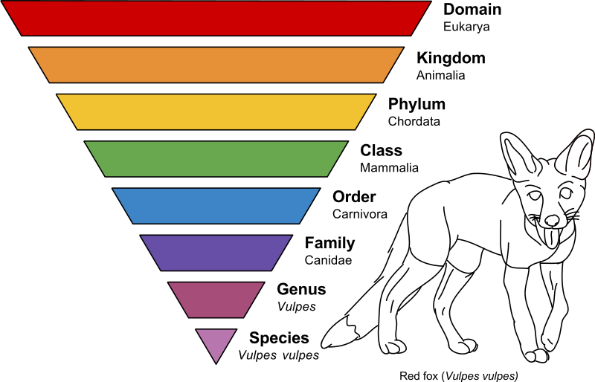
Biological Classification - Taxonomy
Image by Annina Breen

Slide 6
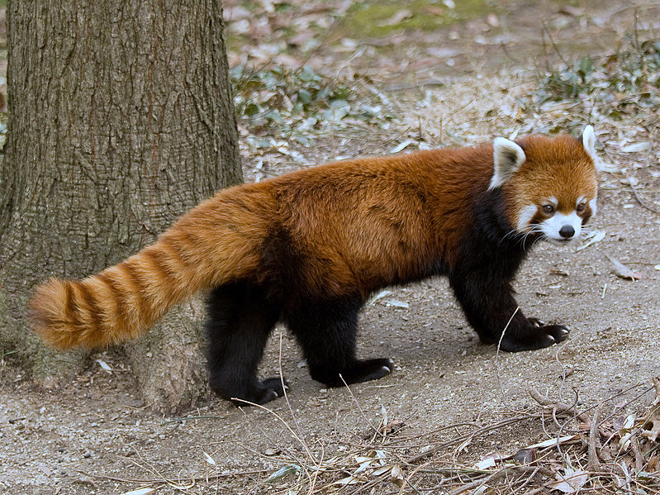
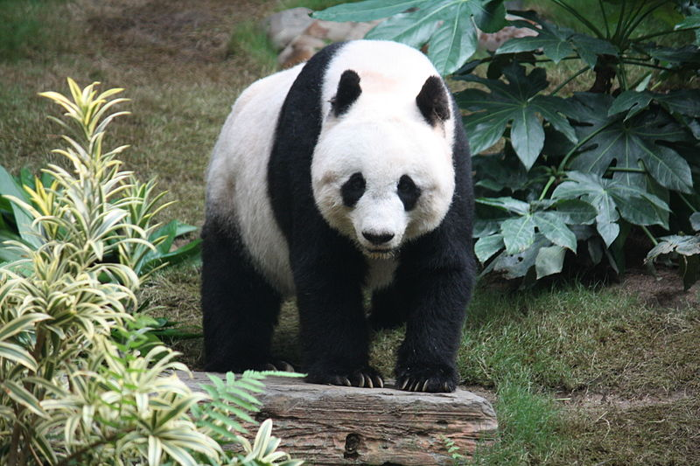
Pandas
Photo by Greg Hume
Photo by J. Patrick Fischer
Previously both in the family Ursidae (bears)
Red Panda moved to family Ailuridae (racoons)
Giant Panda belongs to order Carnivora, although its diet is 99% Bamboo

Slide 7
Giant Panda
Domain: Eukarya
Kingdom: Animalia
Phylum: Chordata
Class: Mammalia
Order: Carnivora
Photo by J. Patrick Fischer
Family: Ursidae
Genus: Ailuropoda
Species: A. melanoleuca

Slide 8








Giant Panda
Domain: Eukarya
Kingdom: Animalia
Phylum: Chordata
Class: Mammalia
Order: Carnivora
Family: Ursidae
Genus: Ailuropoda
Species: A. melanoleuca

Slide 9
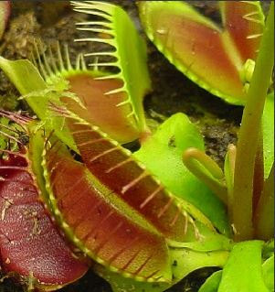
It’s a trap!
Domain: Eukarya
Kingdom: Plantae
Clade: Angiosperms
Clade: Eudicots
Order: Caryophyllales
Family: Droseraceae
Image by PlantHut on Etsy
Genus: Dionaea
Species: D. muscipula

Slide 10







It’s a trap!
Domain: Eukarya
Kingdom: Plantae
Clade: Angiosperms
Clade: Eudicots
Order: Caryophyllales
Family: Droseraceae
Genus: Dionaea
Species: D. muscipula

Slide 11
Two species, both alike in dignity
Most Recent Shared Node

Slide 12
Two species, both alike in dignity
Most Recent Shared Node
If we move MeatConsumptionRate to DomainEukarya,
then ALL Eukaryotes are suddenly meat-eaters;
All plants and all animals would be meat-eaters

Slide 13
Two species, both alike in dignity
Most Recent Shared Node

Slide 14
Two species, both alike in dignity
Most Recent Shared Node
We may feel the urge to move MeatConsumptionRate
to the DomainEukarya base class…

Slide 15
Our First Bias
Most Recent Shared Node
We may feel the urge to move MeatConsumptionRate
to the DomainEukarya base class…
This urge is a bias; this is an urge to share shape via inheritance
Inherited Shape Bias
*Not an official term
This bias often results in shape appearing in parts of the
class hierarchy where it does not make sense

Slide 16
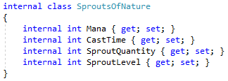
Spellbound

Slide 17
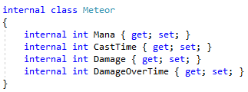
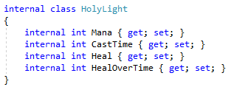
Spellbound

Slide 18




Spellbound
Inherited Shape Bias

Slide 19
Spellbound
Spell
Mana
CastTime
SproutsOfNature
SproutQuantity
SproutLevel
Meteor
Damage
DamageOverTime
HolyLight
Heal
HealOverTime
Now we want Lightning Strike, which has Damage, but no DoT

Slide 20
Spellbound
Spell
Mana
CastTime
SproutsOfNature
SproutQuantity
SproutLevel
DirectDamage
Damage
HolyLight
Heal
HealOverTime
Meteor
DamageOverTime
LightningStrike
Voltage
We had to refactor the hierarchy;
We are beginning to fight our classes

Slide 21
Spellbound
Spell
Mana
CastTime
SproutsOfNature
SproutQuantity
SproutLevel
DirectDamage
Damage
HolyLight
Heal
HealOverTime
Meteor
DamageOverTime
LightningStrike
Voltage
Dark Pact: A high-efficiency downtime healing spell;
It damages the target, then heals over time.
It does NOT immediately heal

Slide 22
Spellbound
Spell
Mana
CastTime
SproutsOfNature
SproutQuantity
SproutLevel
DirectDamage
Damage
HolyLight
Heal
HealOverTime
Meteor
DamageOverTime
LightningStrike
Voltage
Where can we put this spell?
Needs: Mana, CastTime, Damage, HealOverTime
Should not contain irrelevant properties

Slide 23
Spellbound
Spell
Mana
CastTime
SproutsOfNature
SproutQuantity
SproutLevel
DirectDamage
Damage
HolyLight
Heal
HealOverTime
Meteor
DamageOverTime
LightningStrike
Voltage
Our bias for shape-sharing has made life difficult

Slide 24
Remove The Goal
SRP
OCP
LSP
ISP
DIP
No duplicate code
No duplicate properties
Encapsulation
No service locator anti-pattern
Minimal comments
Well-named methods
Short argument lists
…
Remove the shape-sharing goal
Base class properties can be great
Allow them to arise naturally
Stop trying to create taxonomies
Taxonomies are distracting
What about DRY???
Assertion: Bugs often appear in logic
Assertion: Bugs rarely appear in shape
Option: Use interfaces

Slide 25
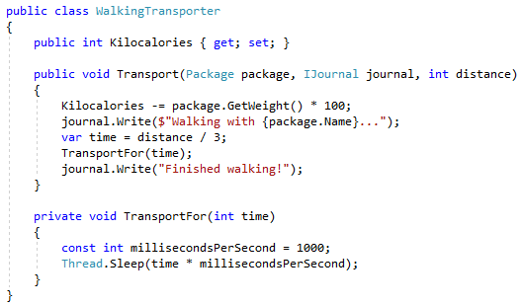
Transportation

Slide 26
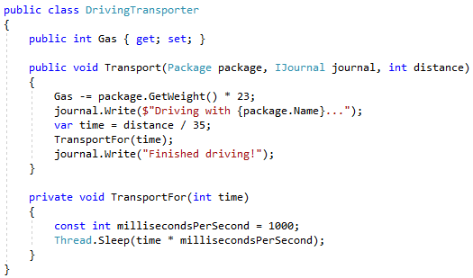
Transportation

Slide 27
Transportation
Plenty of duplication… DRY comes to mind

Slide 28

Transportation

Slide 29
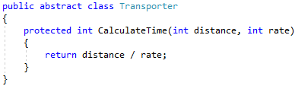
Transportation

Slide 30
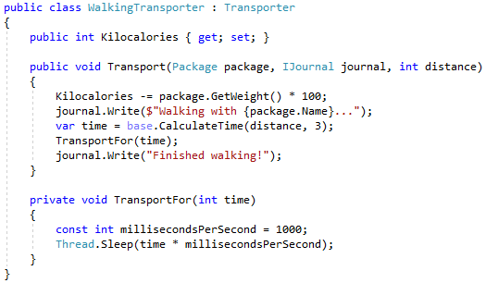
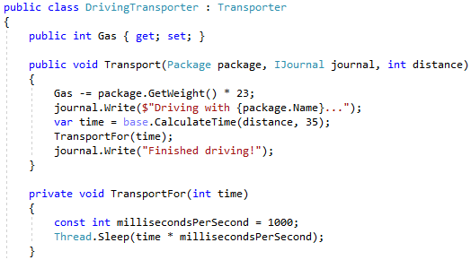
Transportation

Slide 31
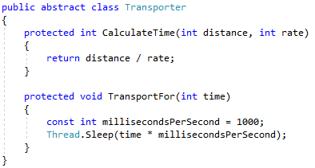
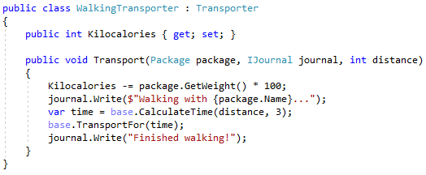
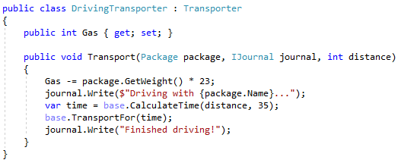
Transportation

Slide 32
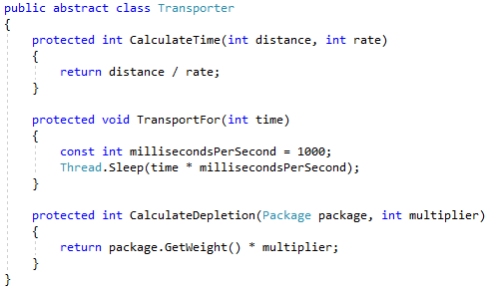
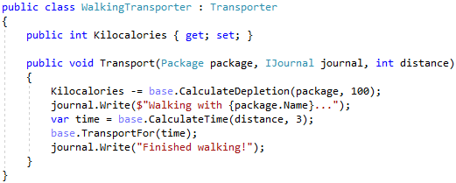
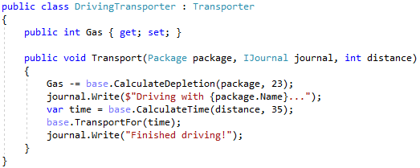
Transportation
How do we feel about this refactor?

Slide 33
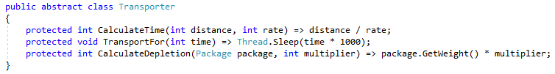
Transportation
How do we feel about this refactor?

Slide 34
Transportation
Some duplicate code was removed
Classes are smaller
Is this the right solution?

Slide 35
Transportation
New transporters may forget to derive
New transporters may forget to call base class methods
The class relationship is backwards…

Slide 36
Transportation
Derived classes point to base class methods
Base class never points to child classes
Reality: The base class is actually a dependent class,
masquerading as a base class

Slide 37
Transportation
Inheritance is a one-trick pony
Once a class inherits from another, this trick cannot be repeated
This urge to use base classes as method bins is a bias

Slide 38
Our Second Bias
Inherited Logic Bias
*Not an official term
Just like the Inherited Shape Bias, this bias can also result in
methods being present that are irrelevant for some derived classes

Slide 39
Our Second Bias
Inherited Logic Bias
*Not an official term
We may end up fighting these classes as well

Slide 40
Two biases, both alike in indignity
Inherited Shape Bias
A bias to use base classes for shape-sharing
Results in taxonomies that may not handle change well
Inherited Logic Bias
A bias to use base classes for logic-sharing
Results in base classes become large vats of methods

Slide 41
Two biases, both alike in indignity
Inherited Shape Bias
A bias to use base classes for shape-sharing
Results in taxonomies that may not handle change well
Inherited Logic Bias
A bias to use base classes for logic-sharing
Results in base classes become large vats of methods

Slide 42

The sun will come out tomorrow!
Image from Schwekendiek

Slide 43
A new day
Object-Oriented languages are powerful
Inheritance is a good thing
Inheritance is more about behavior varying by subtype
Let’s revisit Transportation

Slide 44
Transportation Redux
We have one class; no inheritance needed
Ship it!

Slide 45
Transportation Redux
Now we have two concretions; now we can form an abstraction

Slide 46
Transportation Redux
We want new implementations to be simple
We want new implementers to be guided into success
No memorization needed

Slide 47
Transportation Redux
Let’s create a base class that enforces:
What steps are critical
The order of the steps
How transportation occurs

Slide 48
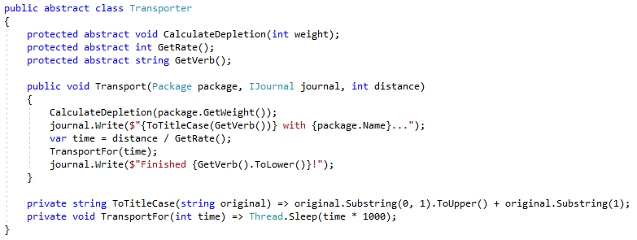
Transportation Redux

Slide 49
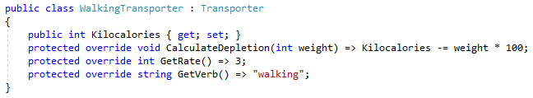
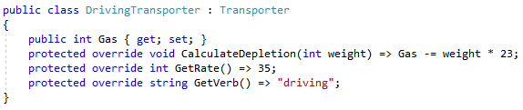
Transportation Redux
Base class points to
derived classes
Derived classes only contain
what makes them different

Slide 50
Transportation Redux
Let’s add a new Solar Transporter!

Slide 51
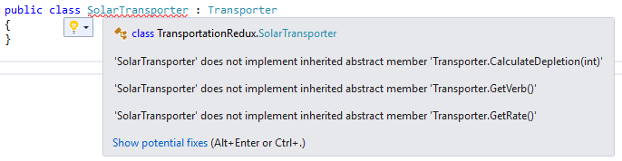
Transportation Redux
IDE tells new developer
what needs to be done

Slide 52
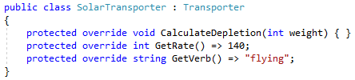
Transportation Redux

Slide 53
Transportation Redux
New classes are easy to add
New developers can start work immediately
Abstract members may cause developer to ask good questions
If algorithm changes, compiler will drive changes (not memory)

Slide 54
Transportation Redux
In this example, behavior did not change much by subtype
In this example, primarily values changed by subtype
Solar Transporter had different behavior (i.e. no fuel consumption)
More complex solutions will have more behavior variance

Slide 55
Transportation Redux
Shape could show up in Transporter base class
Example: IsCompleted
Boolean value would be private; derived classes clueless
There is a pattern hiding here…

Slide 56
Transportation Redux
Template Method Pattern
Deliberate avoidance of inheritance biases can lead to great patterns

Slide 57
Final Thoughts
Shape/State/Properties/Fields are good things
Avoid building taxonomies; shape duplication is okay
Shared code is good
Avoid using base classes as shared code containers
For polymorphic shape, favor interfaces
Favor composition over inheritance
Use base classes to enforce non-negotiables
Use derived classes to vary behavior by subtype

Slide 58
Info
Derick Linkous
dl@steadyscience.com
"When debugging, novices insert corrective code;
experts remove defective code.”
-Richard E. Pattis

