Slide 1
Circle Of Wealth
An architecture for a fun game

Slide 2
Introduction
Derick Linkous
dl@steadyscience.com

Slide 3
Motivation
Conversations with people
Discussions about what classes are really dependencies
Difficulty of testing some classes
What is a business object? DTO? Entity? Service?
Pulling it all together

Slide 4
Starting Points
Unit Test vs Integration Test
Unit testing classes without any dependencies is easy
Unit testing multiple related classes
without dependencies is easy
Unit testing classes with dependencies is
intermediate/moderate difficulty
Integration tests are difficult

Slide 5
Starting Points
Customers are buying functionality
We will prioritize their business needs first
We will write the business logic first
We will defer most implementation decisions
Databases
UIs

Slide 6
Starting Points
Given:
Writing business logic first
Unit tests are more difficult when using dependencies
We will break the core of our project into two pieces:
Classes with dependencies
Classes without dependencies

Slide 7
Starting Points
Many teams describe customer needs via:
Use Cases
User Stories
Specifications
Etcetera
Wouldn’t it be nice if there was a one-to-one relationship
between Use Cases and classes in our code?

Slide 8
Starting Points Summary
Prioritize the ease of writing unit tests
Prioritize customer needs, instead of databases/UIs/etc.
Separate classes into two groups:
With dependencies
Without dependencies
Create one class per Use Case

Slide 9
Game Design
A simple game, where contestants try to guess a phrase
A blank phrase is presented
Each turn, a player can either spin the circle, or guess the phrase
A spin is either a dollar amount, a lost turn, or bankrupt
Dollar spins allow the picking of a letter
Successful picks allow another spin or guess
Unsuccessful picks, lost turns, and bankrupt ends a player’s turn
A successful guess wins the game for that player

Slide 10
Use Cases
Start New Game
Input: A set of player names
Output: A game identifier, the initial blank phrase,
and the current player name
Description: All players start with no money. The first
player starts the game.

Slide 11
Use Cases
Spin Circle
Input: Game identifier
Output: A description of the result of the spin, a value
indicating if a letter should be picked, and the current
player name
Description: Spin is random. If Bankrupt or LoseTurn,
no letter pick allowed, play moves to next player. If dollar
amount, requests a letter pick, and play stays on current player.

Slide 12
Use Cases
Pick Letter
Input: Game identifier, and a letter
Output: Current phrase, and current player name
Description: If at least one letter is found, player gets money
for each letter found, and gets to continue playing. If letter
is not found, play moves to next player.

Slide 13
Use Cases
Guess Phrase
Input: Game identifier, and a guess
Output: Current phrase, current player name, and reward
Description: If guess is correct, show complete phrase,
reward current player, and end the game. If guess is incorrect,
play moves to next player.

Slide 14
Solution Layout
Use Cases
Business Objects
Interfaces
Classes
Dependencies
No Dependencies
(Orchestration)
(Logic)
Use Case Unit Tests
Business Object Unit Tests
Mocking
No Mocking
“Dependency”: Not just a technical reliance upon; a class we will not write anywhere in the core of our application

Slide 15
An example Flow
Use Case
Load User object from IUserDatabase
Call Deactivate() on User object
User
Save User object via IUserDatabase
IUserDatabase
User

Slide 16
Naming
Use Cases
Business Objects
Interactors
Entities

Slide 17
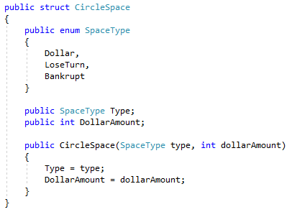
Easy Stuff First

Slide 18
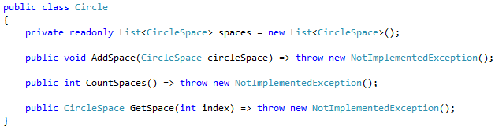
Easy Stuff First

Slide 19
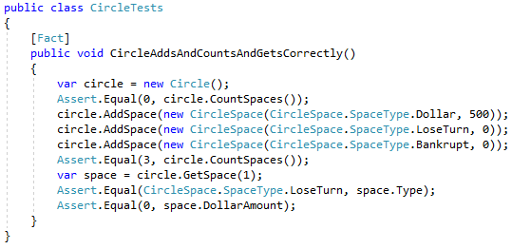
Easy Stuff First

Slide 20
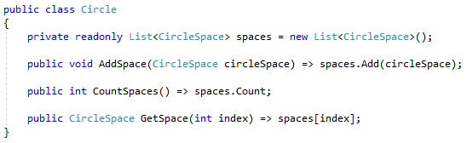
Easy Stuff First

Slide 21
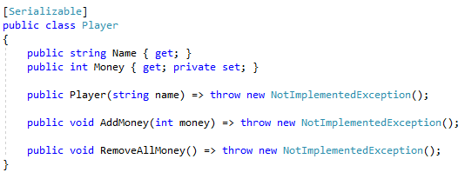
Easy Stuff First

Slide 22
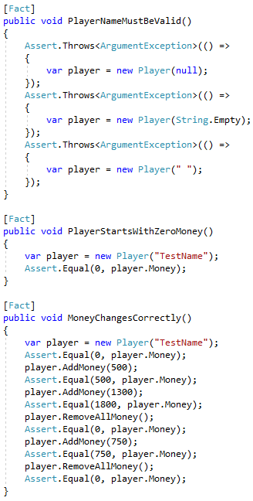
Easy Stuff First

Slide 23
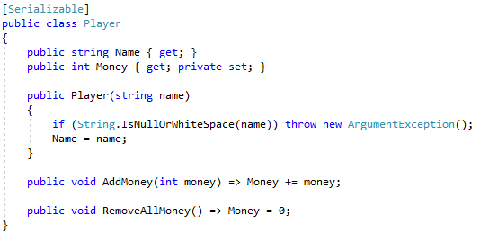
Easy Stuff First

Slide 24
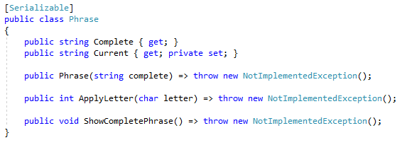
Easy Stuff First

Slide 25
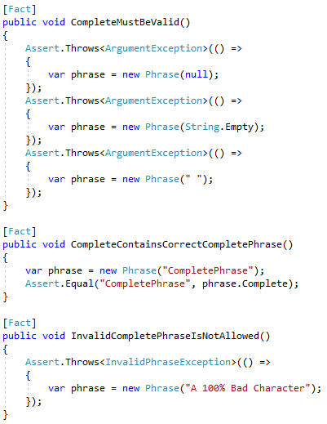
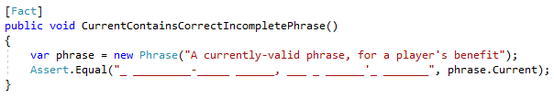
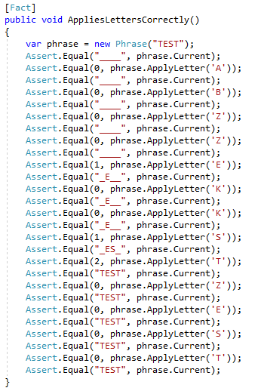
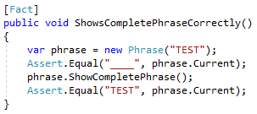
Easy Stuff First

Slide 26
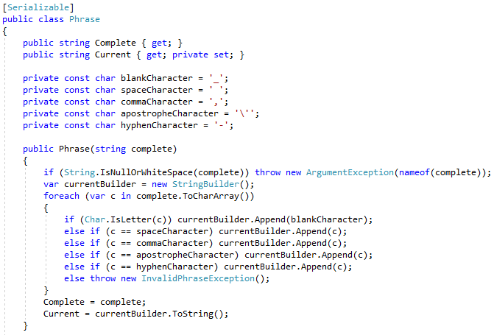
Easy Stuff First

Slide 27
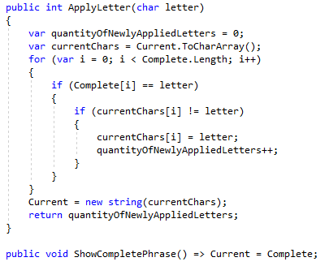
Easy Stuff First

Slide 28
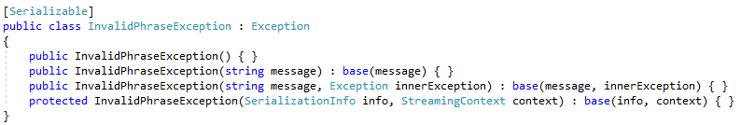
Easy Stuff First

Slide 29
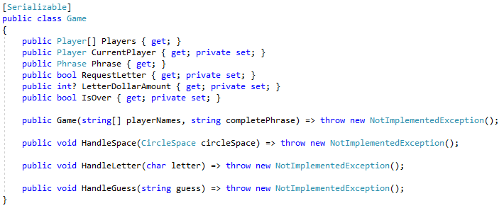
The Game Is On

Slide 30
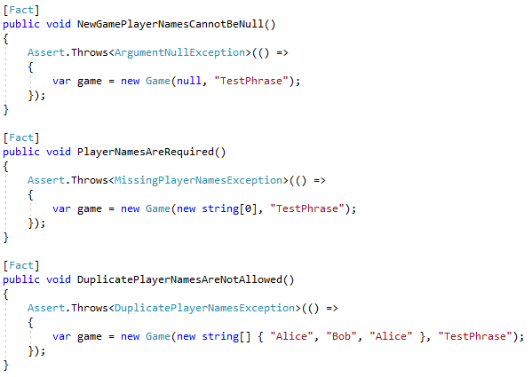
The Game Is On

Slide 31
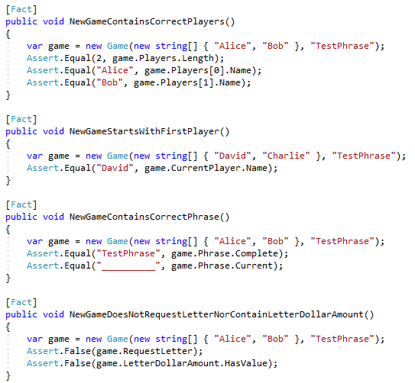
The Game Is On

Slide 32
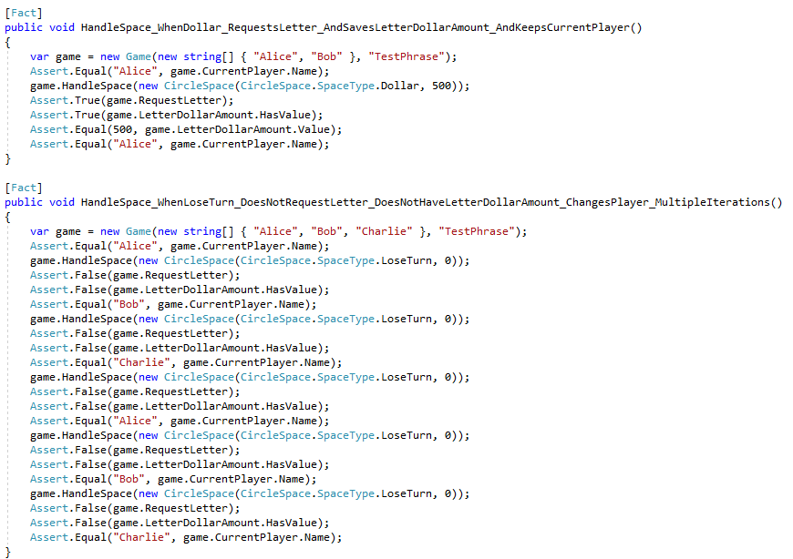
The Game Is On

Slide 33
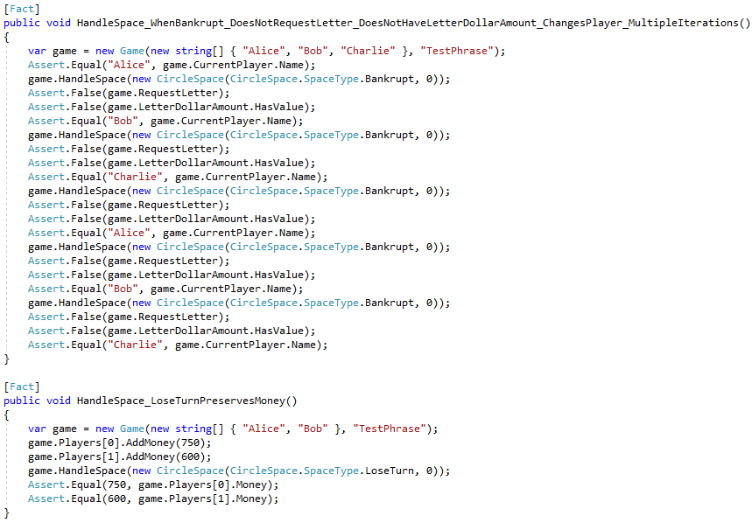
The Game Is On

Slide 34
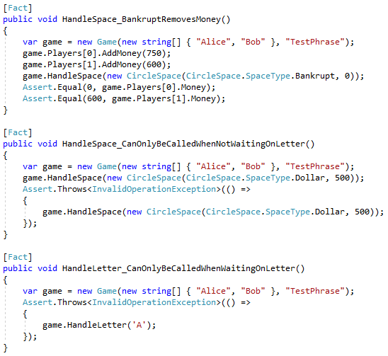
The Game Is On

Slide 35
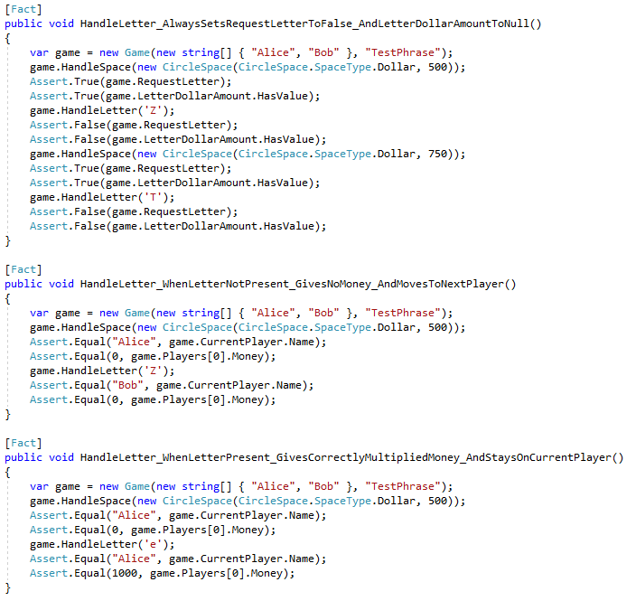
The Game Is On

Slide 36
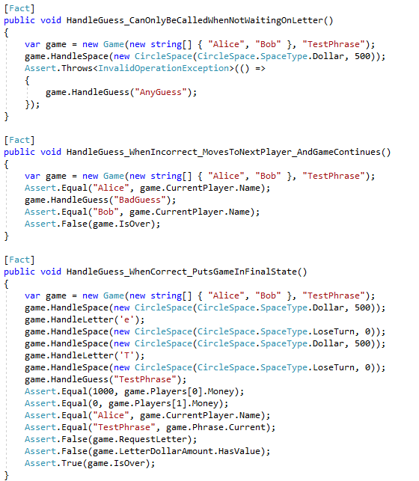
The Game Is On

Slide 37
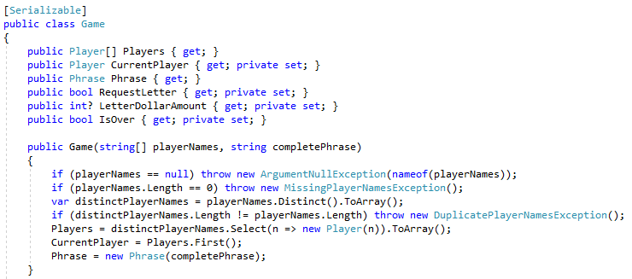
The Game Is On

Slide 38
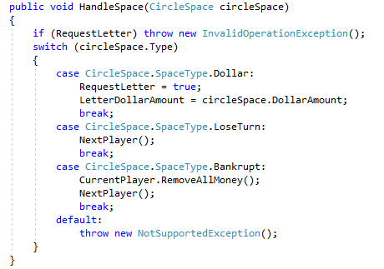
The Game Is On

Slide 39
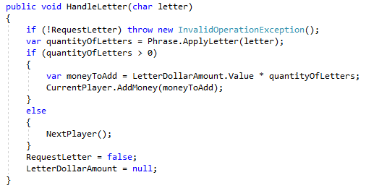
The Game Is On

Slide 40
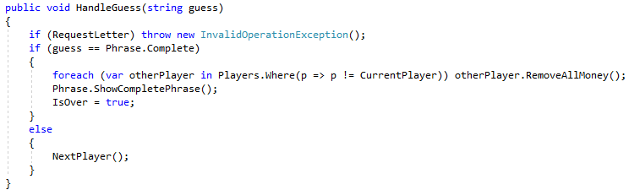
The Game Is On

Slide 41
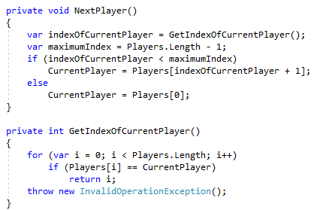
The Game Is On

Slide 42
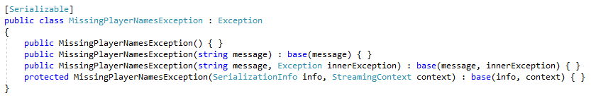
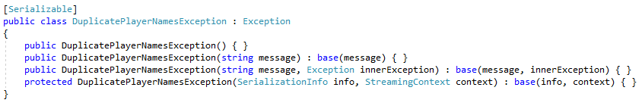
The Game Is On

Slide 43
The Game Is On
Entities are finished!

Slide 44


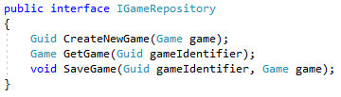

Interactors - Dependencies

Slide 45

Interactors - Consistency

Slide 46
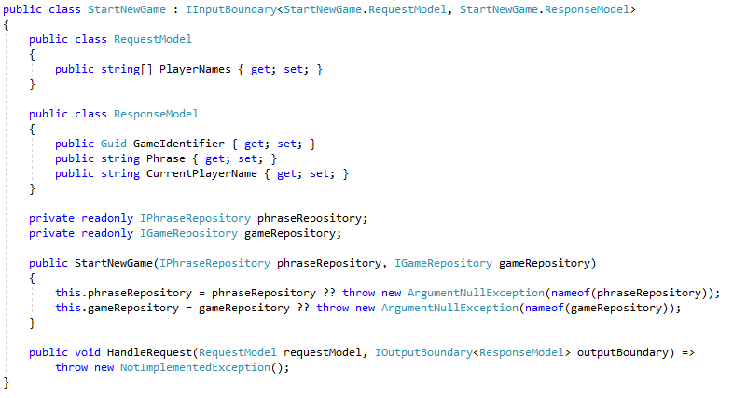
Use Case - Start New Game

Slide 47
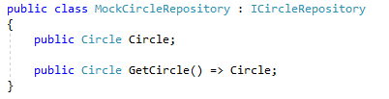

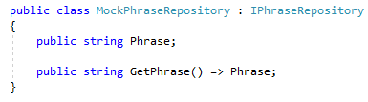
Use Case - Start New Game

Slide 48
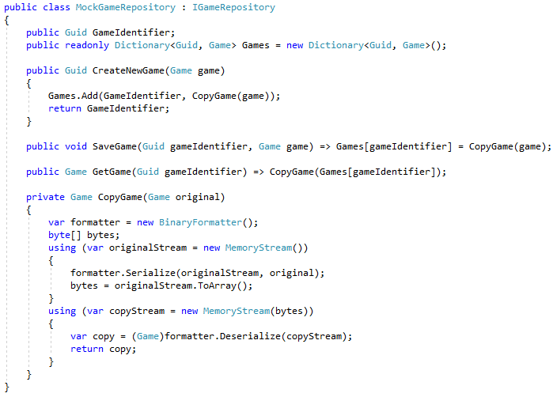
Use Case - Start New Game

Slide 49
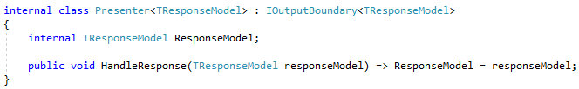
Use Case - Start New Game

Slide 50
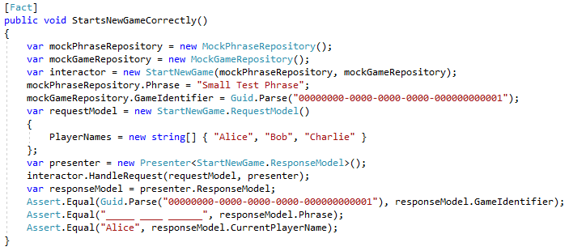
Use Case - Start New Game

Slide 51
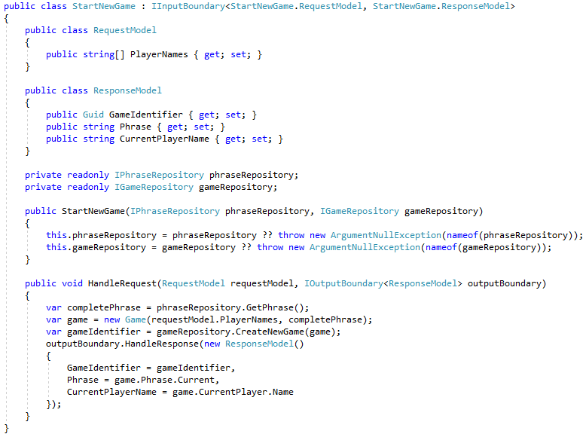
Use Case - Start New Game

Slide 52
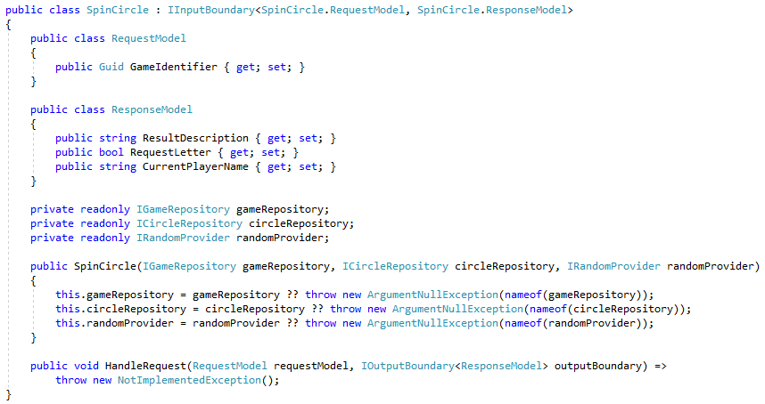
Use Case - Spin Circle

Slide 53
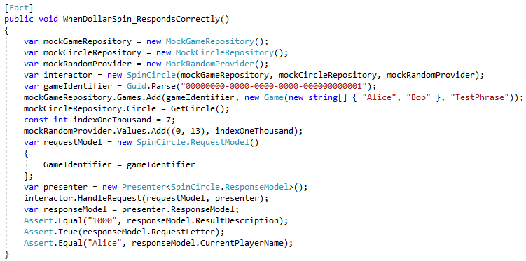
Use Case - Spin Circle

Slide 54
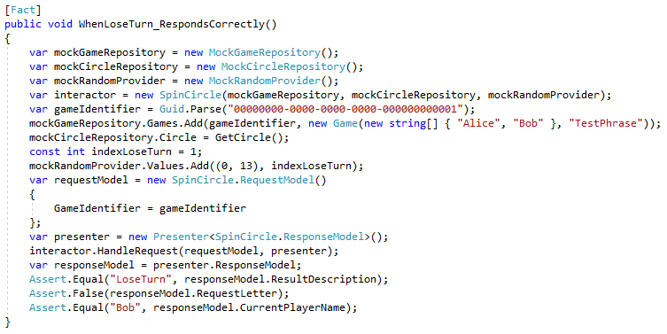
Use Case - Spin Circle

Slide 55
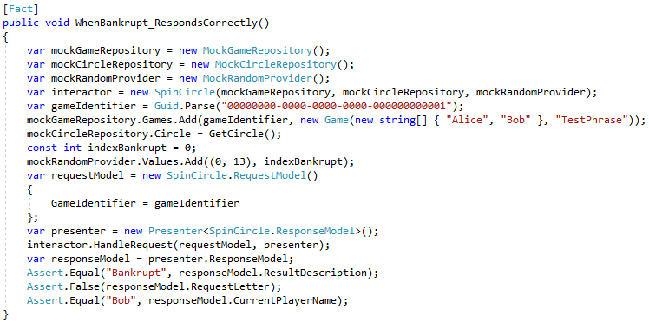
Use Case - Spin Circle

Slide 56
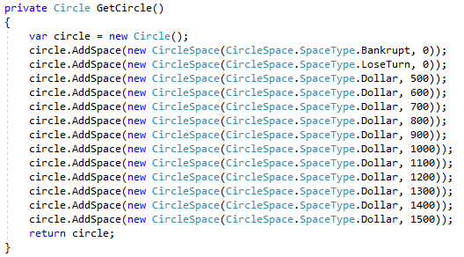
Use Case - Spin Circle

Slide 57
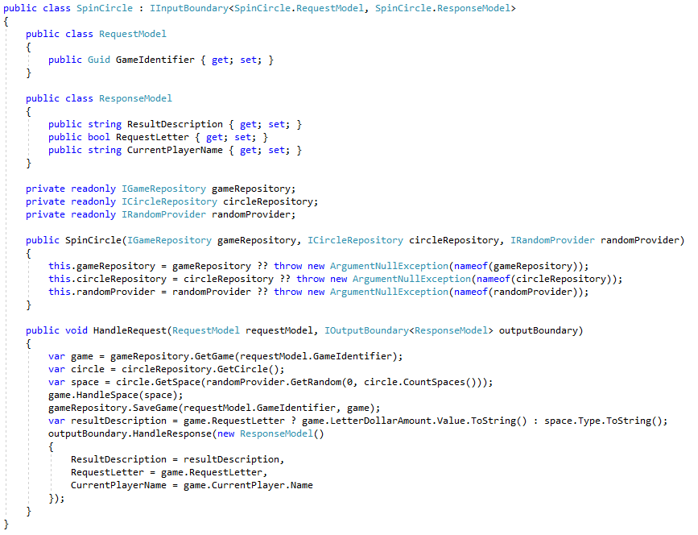
Use Case - Spin Circle

Slide 58
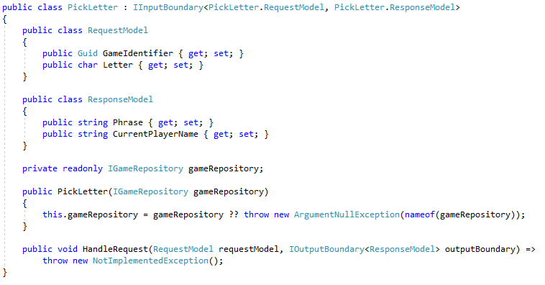
Use Case - Pick Letter

Slide 59
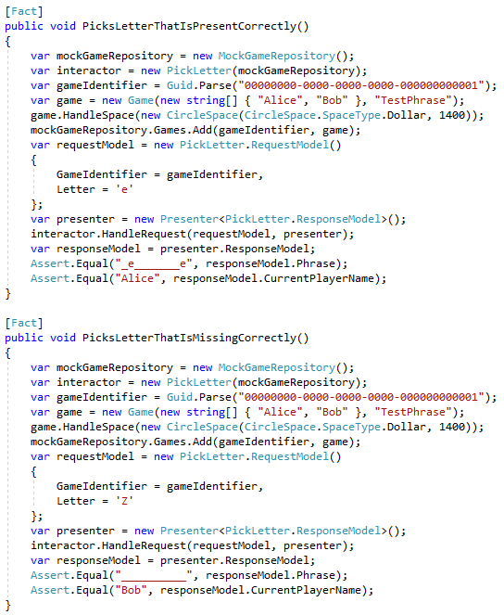
Use Case - Pick Letter

Slide 60
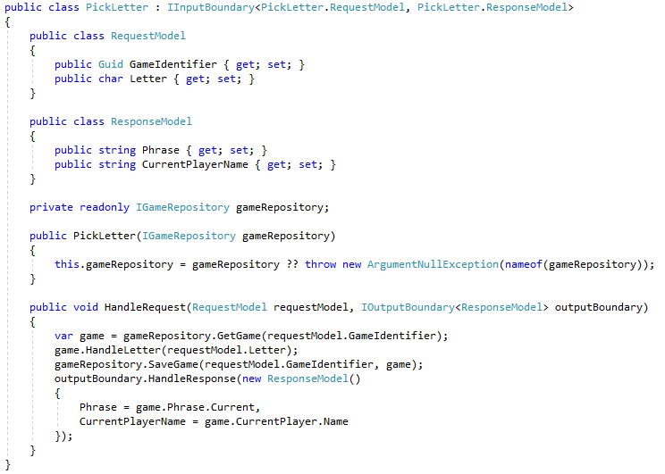
Use Case - Pick Letter

Slide 61
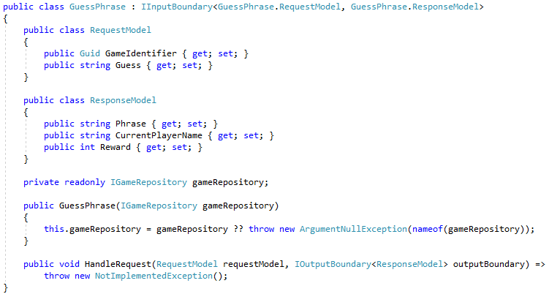
Use Case - Guess Phrase

Slide 62
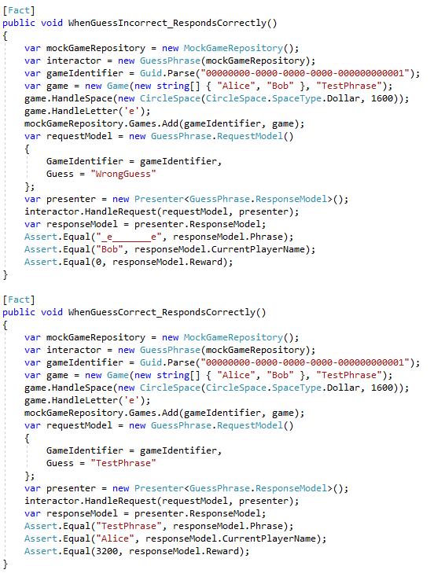
Use Case - Guess Phrase

Slide 63
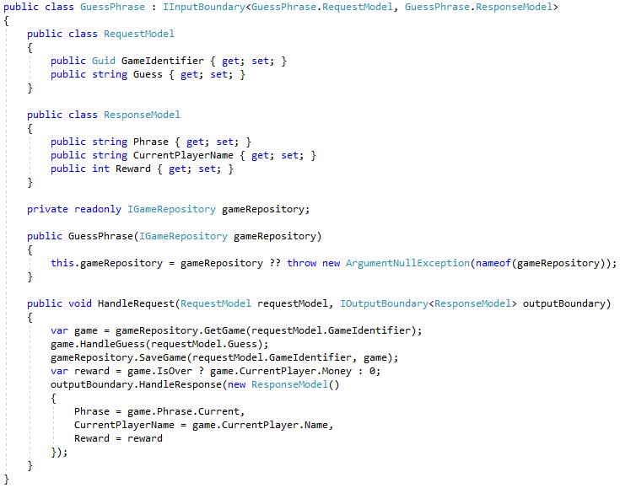
Use Case - Guess Phrase

Slide 64
Summary
Customers talk about logic first; let’s write logic first
Customers talk about use cases; let’s write use case classes
Write classes that are easy to test; less dependencies is better
Business logic goes in dependency-free classes called Entities
Use case flow goes in Interactors, which have dependencies
Unit test Entities and Interactors
Push as much logic into Entities as possible

Slide 65
Info
Derick Linkous
dl@steadyscience.com

