Slide 1
Containers
Dependency Injection using Containers (with bonus: Domain Events)

Slide 2
Introduction
Derick Linkous
dl@steadyscience.com

Slide 3
Terminology
Inversion of Control (IoC) container
Dependency Injection (DI) container
Container-specific terms

Slide 4
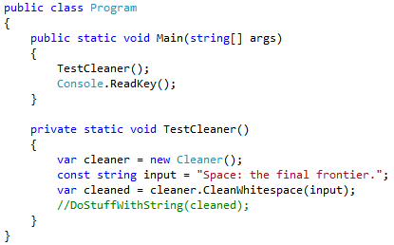
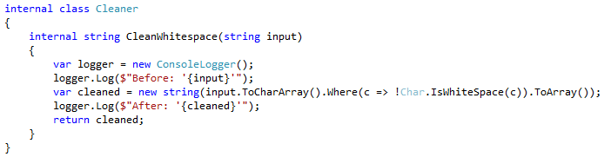
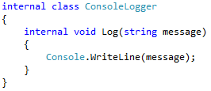
Dependency Injection – A Review
Coupling Alert!

Slide 5

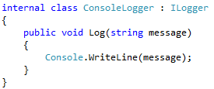
Dependency Injection – A Review

Slide 6

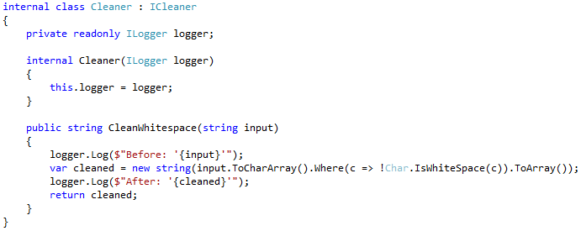
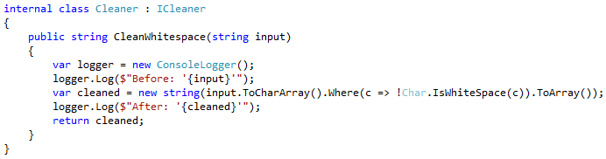
Dependency Injection – A Review

Slide 7
Dependency Injection – A Review
Dependency Injection is now in place in the Cleaner class

Slide 8
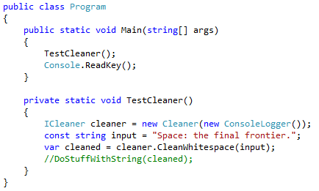
Dependency Injection – A Review
Instantiation is now
occurring at the “top”
level of the application
Imagine how painful
the line would be if
the classes were dozens
of levels deep
If only there were a utility that could help…

Slide 9
Dependency Injection Containers
Dependency Injection containers help
instantiate objects and manage their lifecycles

Slide 10
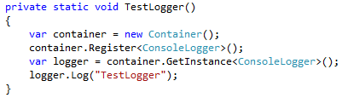
Console Logger Only
Let’s pretend all we want to do is console logging
Instantiate the DI container
Register the concrete ConsoleLogger
Get instance of ConsoleLogger
Use instance as usual

Slide 11
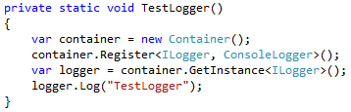
Console Logger Only
Let’s pretend all we want to do is console logging
Nearly identical; the only difference is the type of ‘logger’

Slide 12
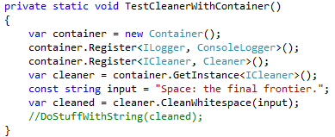
Cleaning With Container
When using the container,
we do not have to instantiate objects
In this very simple example, the container is overkill

Slide 13
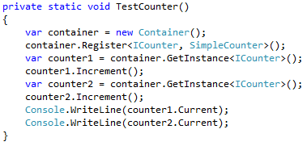
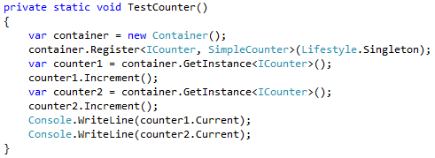
LifeCycles (Lifestyles)

Slide 14
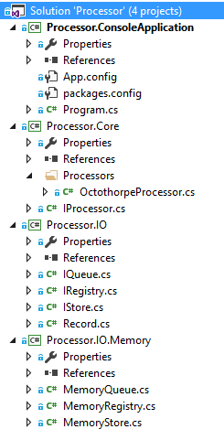
Processor Overview
Application
IProcessor
# Processor
IQueue
IStore
IRegistry
MemoryQueue
MemoryStore
MemoryRegistry

Slide 15
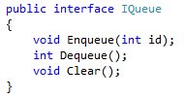

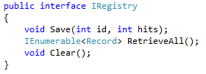
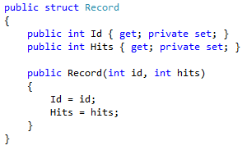
Processor Overview
Application
IProcessor
# Processor
IQueue
IStore
IRegistry
MemoryQueue
MemoryStore
MemoryRegistry

Slide 16
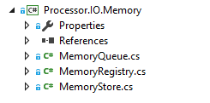
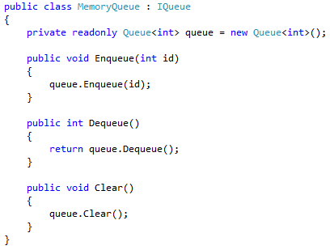
Processor Overview

Slide 17
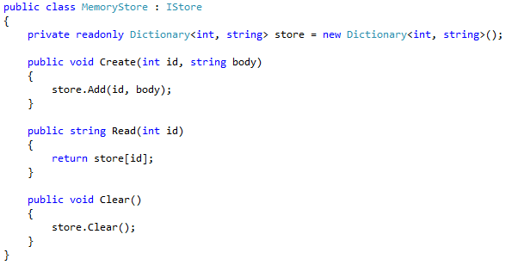
Processor Overview

Slide 18
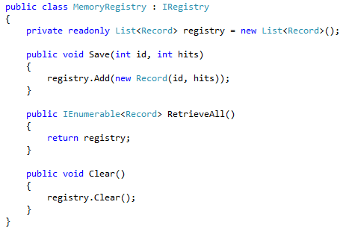
Processor Overview

Slide 19
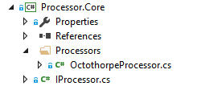
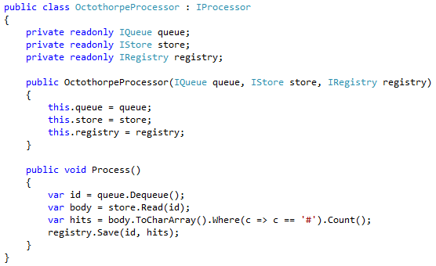

Processor Overview

Slide 20
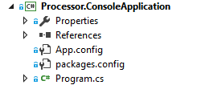
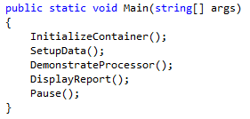
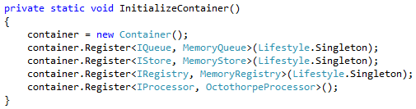
Processor Overview

Slide 21
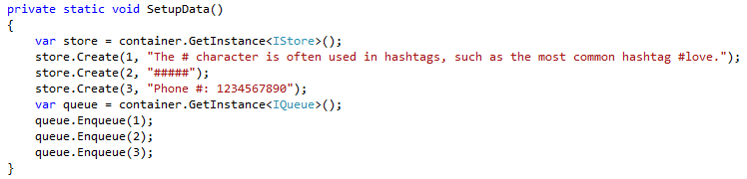
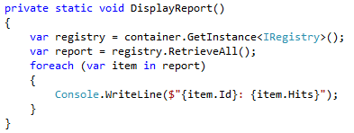
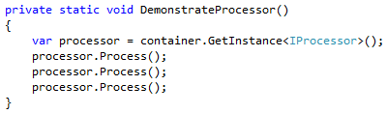

Processor Overview

Slide 22

Processor Overview

Slide 23
Files
We have been storing everything in memory…
Let’s add implementations that use the file system

Slide 24
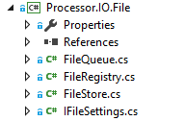
Files

Slide 25
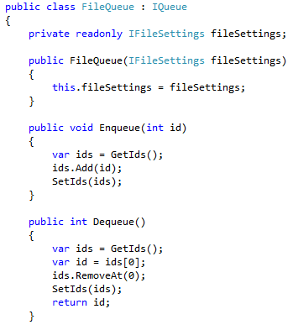
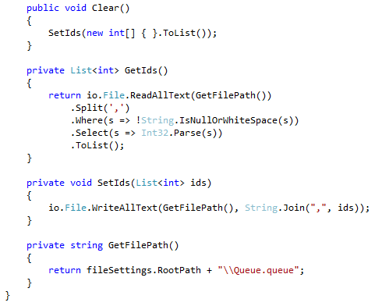

Files

Slide 26
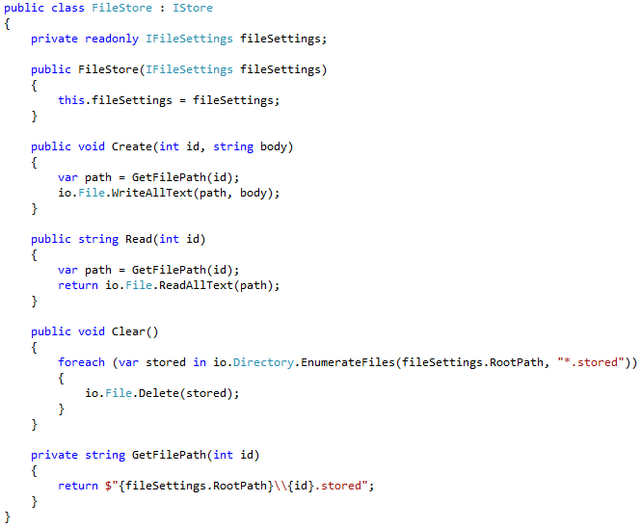
Files

Slide 27
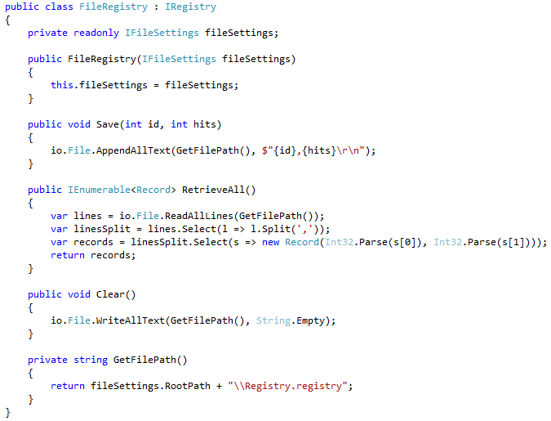
Files

Slide 28
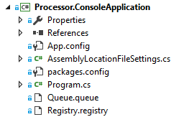
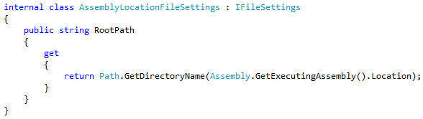
Files

Slide 29
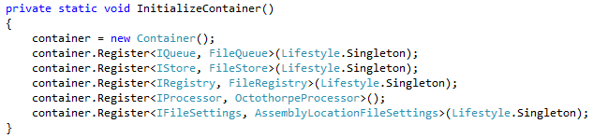
Files

Slide 30

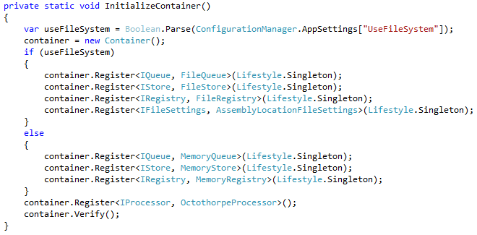
Logical Registration

Slide 31
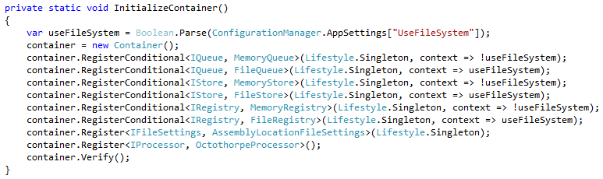
Conditional Registration

Slide 32

ASP.NET MVC

Slide 33
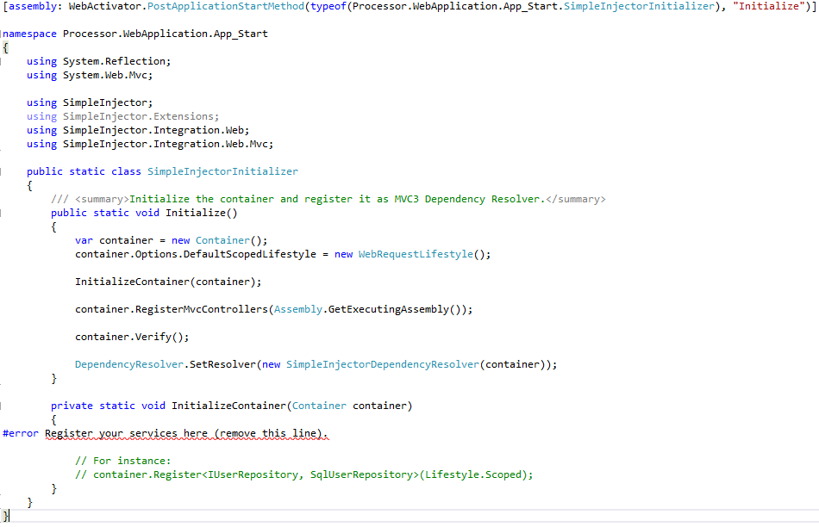
ASP.NET MVC

Slide 34
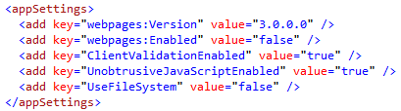
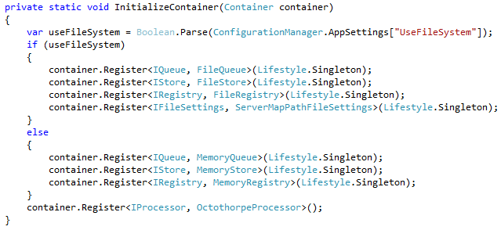
ASP.NET MVC

Slide 35
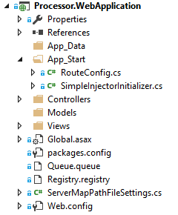
ASP.NET MVC

Slide 36
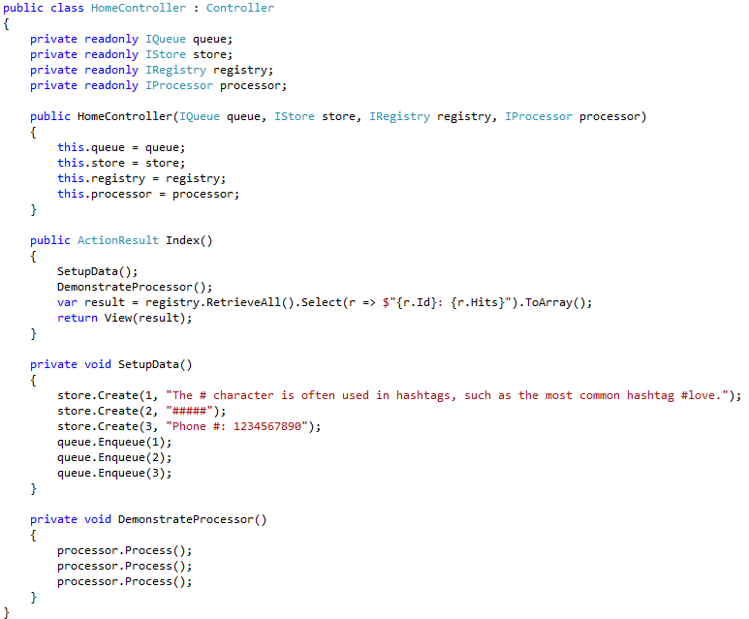
ASP.NET MVC

Slide 37
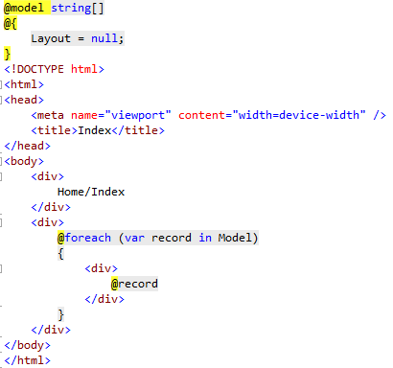

ASP.NET MVC

Slide 38
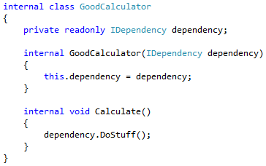
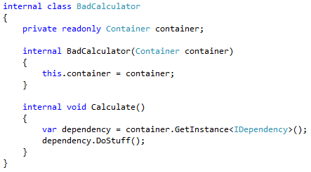
Service Locator

Slide 39
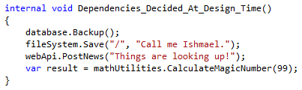
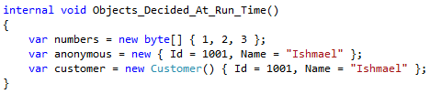
Design-Time versus Run-Time

Slide 40



Domain Events
Event
Describes event; Stores data
Handler
Does work in response to event
Publisher
Announces an event has occurred

Slide 41
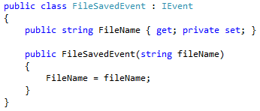
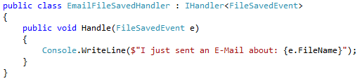


Domain Events

Slide 42

Domain Events

Slide 43


Domain Events

Slide 44

Domain Events

Slide 45


Domain Events

Slide 46
Domain Events
Level1
Level2
Level3
Level4
Level5
SimpleInjectorPublisher
Execute()
Execute()
Execute()
Execute()
Publish(new Event())
Gets all handlers for event type
Loops through all handlers and calls Handler(Event)
Each handler handles even without knowledge of caller(s) or other handler(s)

Slide 47
Final Thoughts
Simple projects may only need simple instantiation at the “top”
Always use DI regardless of container choice
Use containers for instantiating “design-time” objects
(or objects that will not vary during the application lifetime)
Advanced features are available
Contextual binding
Scopes
Lifecycles/Lifestyles (including IDisposable)
Assembly scanning
Initialization control
Further customization

Slide 48
Final Thoughts
Favor injection over location
(Exceptions for features such as Domain Events, Factories, etc.)
KISS principle
Inject dependencies, not containers
(Exceptions for features such as Domain Events, Factories, etc.)
Use containers to pick vendor-specific implementations
Use containers to pick customer-specific implementations
Use Domain Events to remove unnecessary dependencies
(The handlers are burdened with the details of event handling, not the originating class)
Celebrate good times!

Slide 49
Info
Derick Linkous
dl@steadyscience.com
"It is not enough for code to work."
-Robert C. Martin, Clean Code: A Handbook of Agile Software Craftsmanship

