Slide 1
Dapper
A Simple (Micro) ORM

Slide 2
Introduction
Derick Linkous
dl@steadyscience.com

Slide 3
A Micro-ORM
“ORM” is a strong term
Most ORMs are large
Dapper is tiny
Dapper is a small set of methods

Slide 4
What is it really?
Dapper is a set of extension methods
Dapper extends IDbConnection
SqlConnection implements IDbConnection
Dapper uses reflection, but remains FAST

Slide 5
Risk
Performance - FAST
Longevity – 6 years and counting
Origin – Stack Exchange
Activity – Recent commits, .NET Standard support

Slide 6
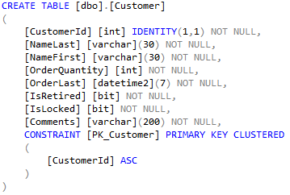
A Database

Slide 7
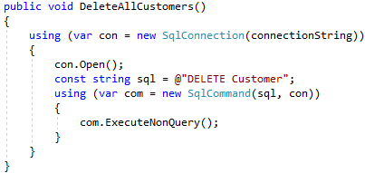
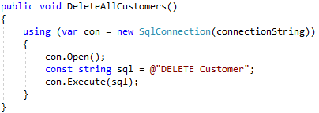
Delete All Customers

Slide 8
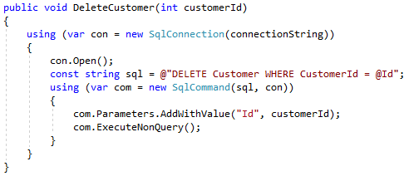
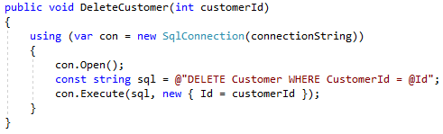
Delete One Customer

Slide 9
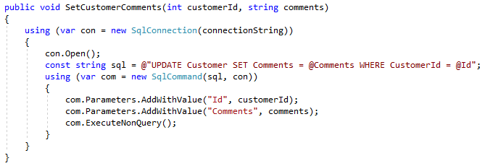
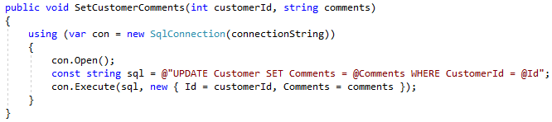
Set Customer Comments

Slide 10
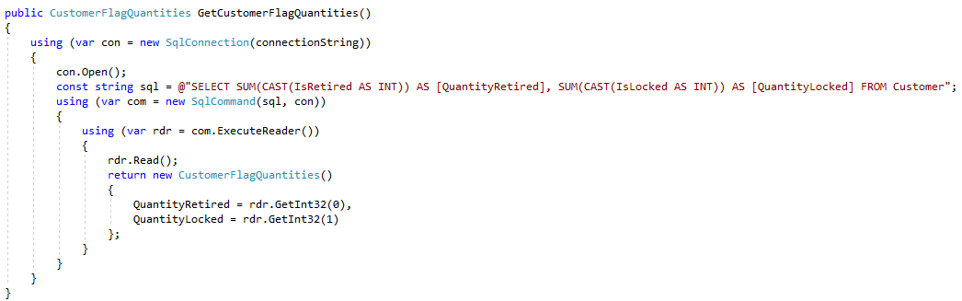
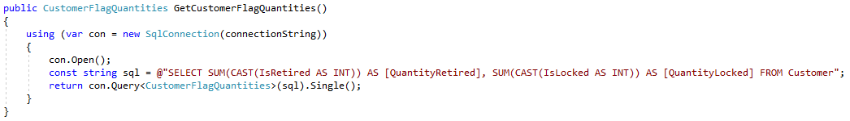
Get Customer Flag Quantities

Slide 11
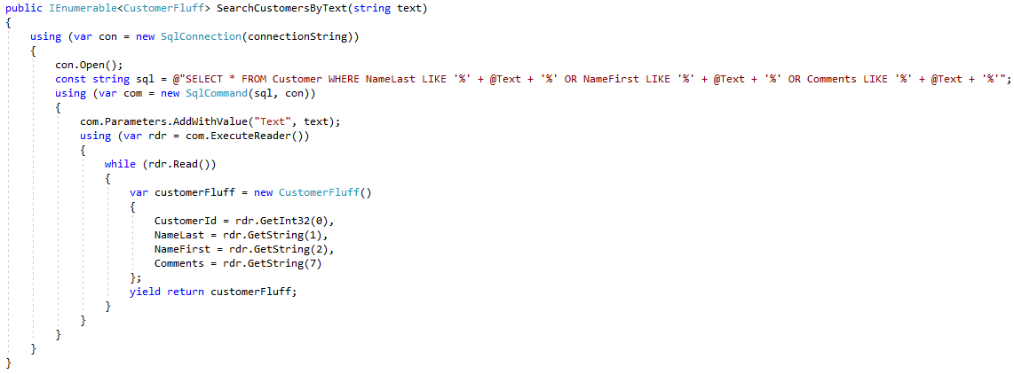
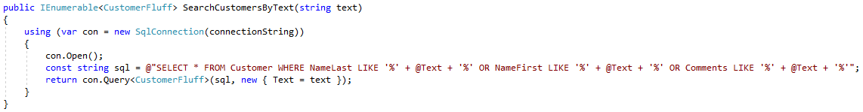
Search Customers By Text

Slide 12
Benefits
Same functionality with less code
Can be introduced into a project slowly
Reduced chance of logic in database layer
Shallow learning curve for new teammates

Slide 13
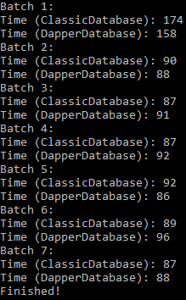
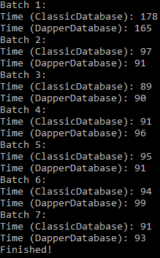
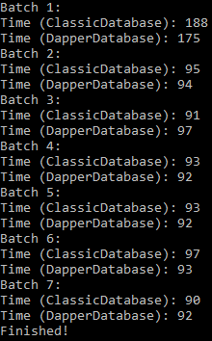
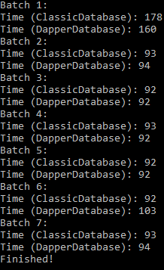
Speed

Slide 14
Info
Derick Linkous
dl@steadyscience.com
“Controlling complexity is the essence of computer programming.”
- Brian Kernighan

