Slide 1
An Exception To The Rule
What’s The Catch?

Slide 2
Introduction
Derick Linkous
dl@steadyscience.com

Slide 3

No Exceptions

Slide 4

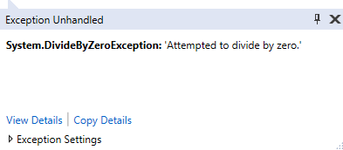
Average
Zero?

Slide 5

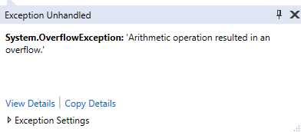
Value
int.MaxValue?

Slide 6

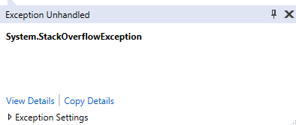
Value
???

Slide 7
Exception Avoidance

Slide 8
Existing Exceptions

Slide 9
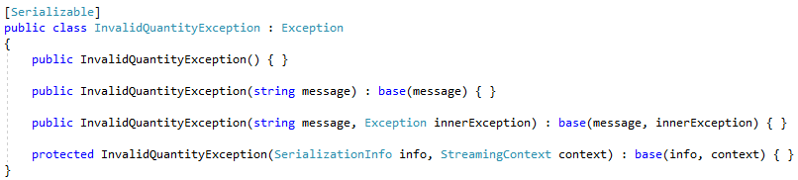
Custom Exceptions

Slide 10
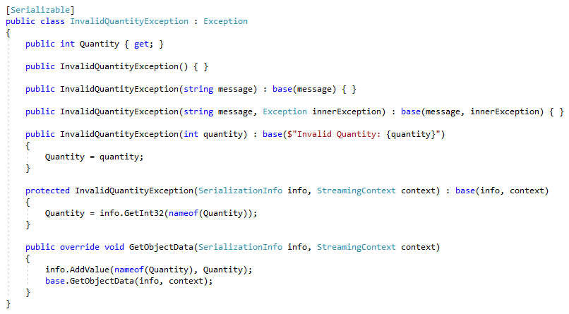
Custom Exceptions

Slide 11
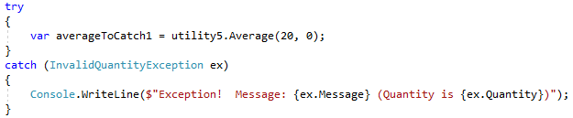
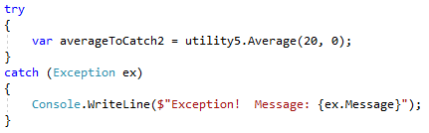
Custom Exceptions

Slide 12
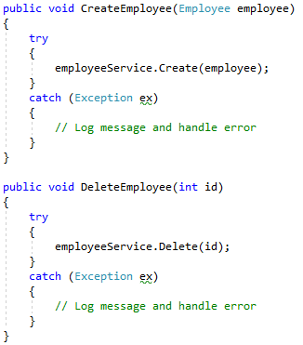
Exceptions Everywhere
Exceptions for every method?

Slide 13
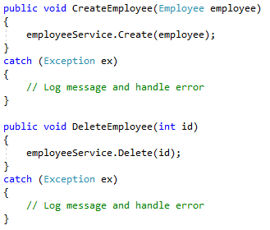
Exceptions Everywhere
Exceptions for every method?
This is not in the language

Slide 14
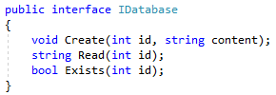
Abstraction Breaking

Slide 15
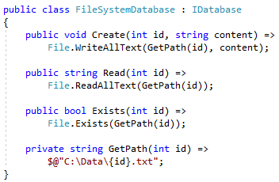
Abstraction Breaking

Slide 16
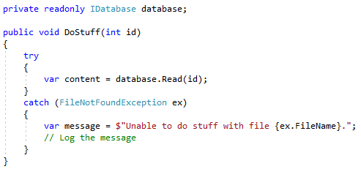
Abstraction Breaking

Slide 17
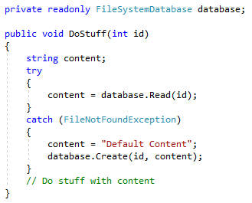
Logic Via Catch

Slide 18
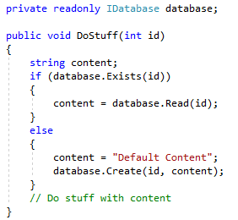
No Catch!
*Possible race condition

Slide 19
Where Are We?
No exceptions? Check!
Automatic system-thrown exceptions? Check!
How to throw built-in exceptions? Check!
How to create and throw custom exceptions? Check!
How to catch exceptions? Check!
How to avoid exceptions? Check!

Slide 20
Exception Usage
To throw, or not to throw?
To catch, or not to catch?

Slide 21
Scenarios
Who takes action to solve the problem?

Slide 22
Scenarios
Connection string was accidentally omitted from the
web.config file during deployment, causing a
KeyNotFoundException to get logged.
Who takes action to solve the problem?

Slide 23
Scenarios
Connection string is in web.config, but all calls to
SqlConnection.Open() throw an exception after
30 seconds attempting to connect.
Who takes action to solve the problem?

Slide 24
Scenarios
An XML file is always deployed with the application.
The file contains important settings; one of them is a color.
Your code reads the settings, and validates that the color
is either “Red”, “Yellow”, or “Green”, in a switch statement.
You must decide what to place in the “default” label.
Who takes action to solve the problem?

Slide 25
Scenarios
The login page on the site accepts username and password.
Your code looks up users based on username in a database.
You must decide what to do when the database returns
an empty recordset.
Who takes action to solve the problem?

Slide 26
Scenarios
The application allows users to do a string search
to find content within the site.
Your code performs the search.
When content is found, results are shown to the user.
You must decide what to do when no content is found.
Who takes action to solve the problem?

Slide 27
Scenarios
The application uses a DI container to inject dependencies.
Your constructor has one dependency, an interface.
You realize interfaces are reference types, and
are therefore nullable.
Null reference exceptions are common and annoying.
Should you do anything in the constructor?
If so, what?
Who takes action to solve the problem?

Slide 28
Scenarios
The Badge type has a status, indicated as a color.
When a User’s Badge is green, the user can read data.
When a User’s Badge is not green, no data can be read.
Admins can change a User’s Badge status at any time.
Your code returns a chunk of data, if the current User’s
Badge is green.
You must decide what to do if the Badge is not green.
Who takes action to solve the problem?

Slide 29
Scenarios
The application uses a third-party maps API.
The maps functionality is critical to the application.
You are writing the implementation behind the
IMapsApi interface.
The third-party API may have downtime.
You must decide what to do in the case of API downtime.
Who takes action to solve the problem?

Slide 30
Scenarios
You are writing a NuGet package for your team.
One of the methods accepts a decimal (e.g. 0.63),
and returns a human-readable percentage (e.g. “63%”)
Values below 0 and above 1 are not permitted.
You must write validation for the input parameter.
What should you do if the input is invalid?
Who takes action to solve the problem?

Slide 31
Scenarios
The application can find Employees by a human-friendly,
human-defined identifier, EmpId.
EmpId arrives in the database during a CSV import.
The import process is completed every two weeks via
a UI that was created for the customer.
Your database holds child data for Employees.
Your code finds child data first, and should retrieve
corresponding Employee data as well.
You must decide what to do when the Employee is not found.
Who takes action to solve the problem?

Slide 32
Good Or Bad (Or…?)
UsernameNotFoundException
PasswordMismatchException
ConnectionStringInvalidException
PhoneNumberFormatException
ForeignKeyException
InvoiceNotApprovedException

Slide 33
Logging
Yes, log exceptions
Keep log S:N high
Address spammy logs quickly
Countless third-party tools for logging
Better exception types = Better logs

Slide 34
Respect The User
Yes, friendly error messages are a good thing
UI error messages need not contain useful information
Logging stores the scary stuff
Translating exceptions into RESTful codes is okay
Use common handlers; avoid try/catch litter

Slide 35
Final Thoughts
If end users can resolve issues, no exceptions needed
If IT experts are required, throw exceptions
Throw built-in, or custom exceptions
Avoid catches; what can you do anyway?
If you need logic, use logic (i.e. Booleans, ifs, etc)
Log all exceptions, and hide them from end users

Slide 36
Info
Derick Linkous
dl@steadyscience.com

