Slide 1
Functions, Actions, and Lambdas
Exploring the many ways to create methods

Slide 2
Introduction
Derick Linkous
dl@steadyscience.com

Slide 3
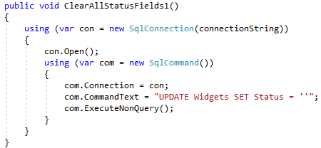
Code Review

Slide 4
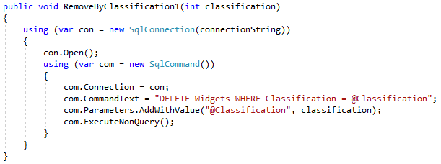
Code Review

Slide 5
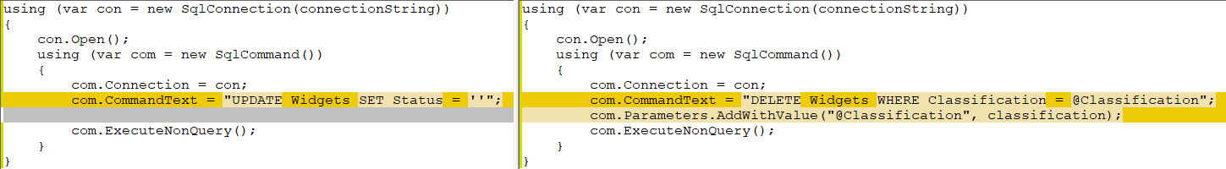
Code Review

Slide 6
What We Want

Slide 7
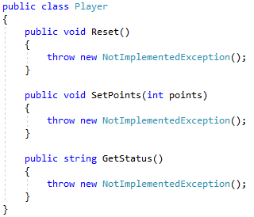
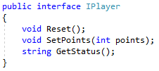
Player

Slide 8
Player

Slide 9
Player

Slide 10
Player

Slide 11
Player

Slide 12
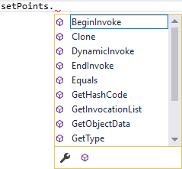
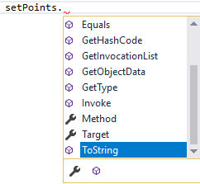
Player

Slide 13

Value Is Even

Slide 14
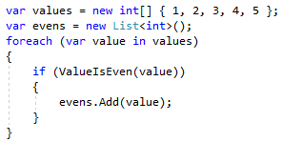
Value Is Even

Slide 15
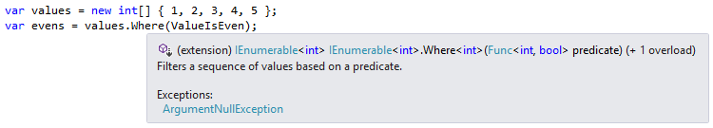
Value Is Even

Slide 16

Value Is Even

Slide 17
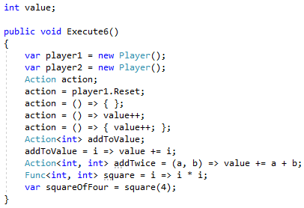
Lambdas

Slide 18
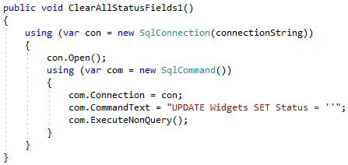
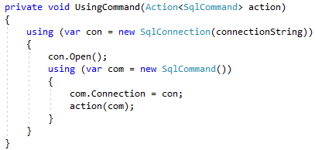
What We Want

Slide 19
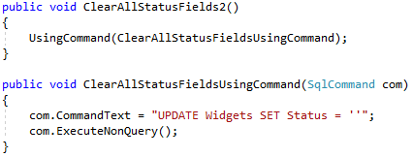
What We Want

Slide 20
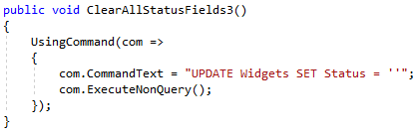
What We Want

Slide 21
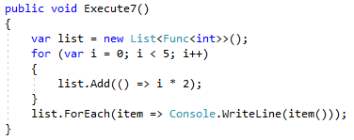
Gotchas

Slide 22
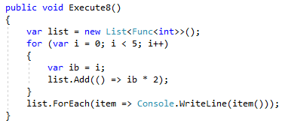
Gotchas

Slide 23

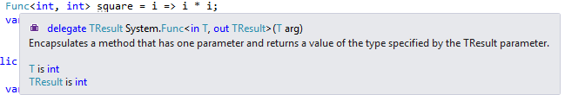
Delegates

Slide 24
Info
Derick Linkous
dl@steadyscience.com

