Slide 1
How To Get Dates
A safe and reliable technique for getting dates

Slide 2
Introduction
Derick Linkous
dl@steadyscience.com

Slide 3
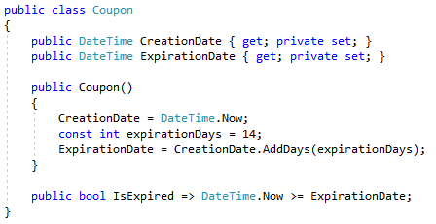
Coupon

Slide 4


Interface

Slide 5
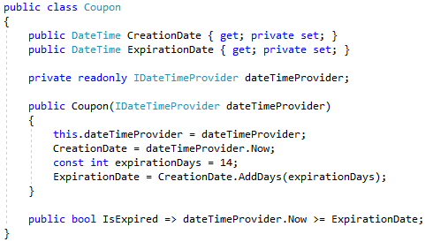
Coupon

Slide 6
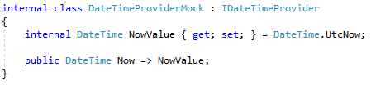
Mock

Slide 7
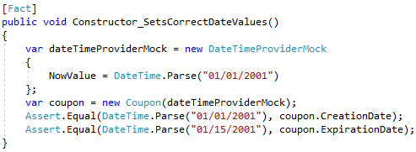
Constructor Test

Slide 8
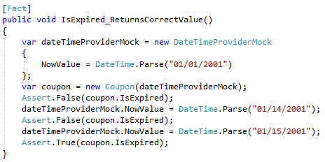
Expiration Test

Slide 9
Tests Pass

Slide 10
Info
Derick Linkous
dl@steadyscience.com

