Slide 1
Interface Segregation Principle
“Don’t Depend on things you don’t need” -Robert C. Martin

Slide 2
Introduction
Derick Linkous
dl@steadyscience.com

Slide 3
Warm-Up
Single Responsibility Principle
Open/Closed Principle
Liskov Substitution Principle
Interface Segregation Principle
Dependency Inversion Principle

Slide 4
Interfaces And Dependencies
All about interfaces as dependencies
Don’t depend on things you don’t need
Consumers should only see what they care about
Embrace multiple interfaces

Slide 5



Interface Extraction
A good feature…
… but its use is backwards.

Slide 6
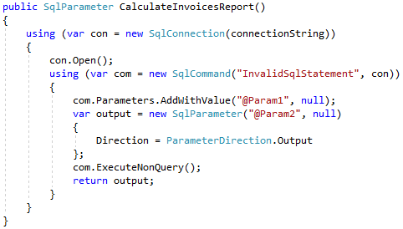

Interface Extraction

Slide 7
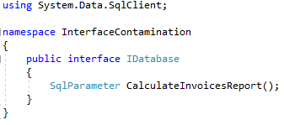
Interface Extraction
This interface has not abstracted the database
The value of this interface is low

Slide 8
Perspective
Customers have needs
Those needs are described in a specification
Developers are implementers
This order is important

Slide 9
Perspective
Customer
Specification
Developer
1
2
3
The customer chooses what is to be done
The customer describes the specification
The developer chooses how to do the work
The developer is not in charge of the specification
The developer is the last to work

Slide 10
Perspective
Customer
Specification
Developer
1
2
3
Consumer
Interface
Implementation
Consuming code is written first
Interfaces created as needed
Write implementations last

Slide 11
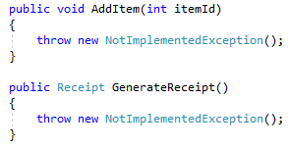
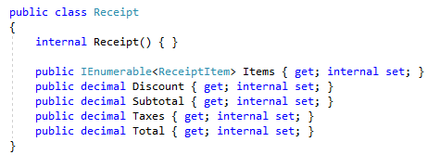
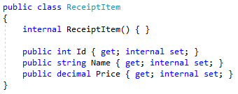
Receipts

Slide 12
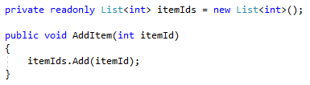
Add Item

Slide 13



Receipts
Stop and write database class?
NO!

Slide 14

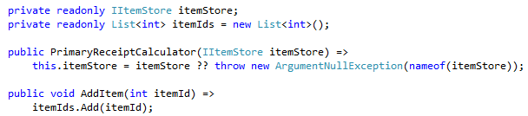
Receipts

Slide 15
Receipts
We have created the dependency we want
That dependency is shaped as we want
We allow the dependency to be injected
We continue forward on our current task

Slide 16
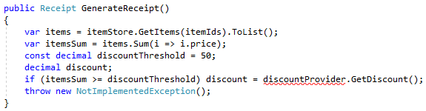
Receipts
Write discount retrieval code here?
NO!
Write discount retrieval class?
Get distracted by tasks other than this one?

Slide 17

Receipts

Slide 18
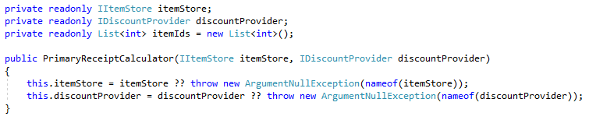
Receipts

Slide 19
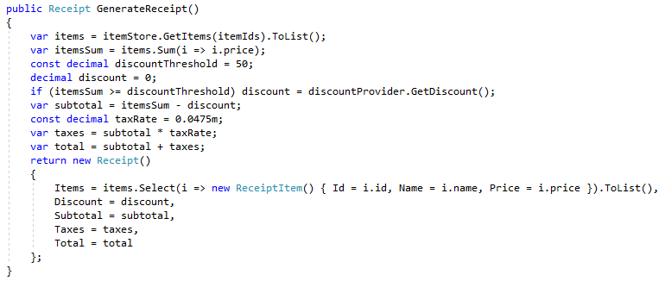
Receipts

Slide 20
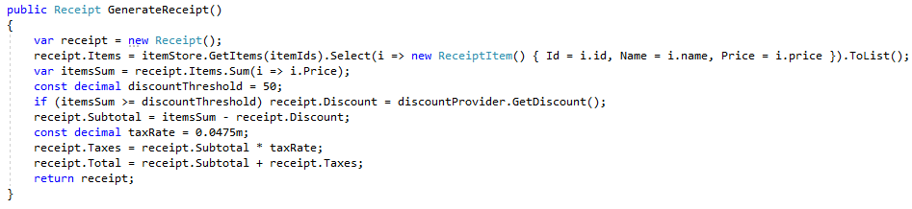
Receipts

Slide 21
Receipts

Slide 22
Outcome
The GenerateReceipt method’s class
automatically follows the ISP
Both of its dependencies are interfaces that
do exactly what the class needs…
No more.
No less.

Slide 23
Outcome
The interfaces may have different data sources;
There may be two different classes
The interfaces may have the same data source;
One class could implement both interfaces

Slide 24
Perspective Revisited
Customer
Specification
Developer
1
2
3
Consumer
Interface
Implementation
Generator
Interfaces
Implementations

Slide 25
Perspective Revisited
Generator
IItemStore
IDiscountProvider
SqlServer
SqlServer
Mongo

Slide 26
Summary
Add dependencies to classes as needed
When adding a dependency, use an interface
Build the interface definitions selfishly
Give top priority to the needs of the class
Ignore how dependencies will be implemented
Interfaces are cheap; add as many as needed

Slide 27
Summary
ISP is a simple principle
ISP also keeps your code simple
If your dependencies only contain:
What the consuming class needs…
… and nothing more…
Congratulations! You are following the ISP!

Slide 28
Info
Derick Linkous
dl@steadyscience.com
“Any fool can write code that a computer can understand.
Good programmers write code that humans can understand.”
- Martin Fowler

