Slide 1
LINQ
Working with sets using LINQ

Slide 2
Introduction
Derick Linkous
dl@steadyscience.com

Slide 3
Preparation
Using IEnumerable<T>
Using lambdas
LINQ to objects
Method syntax
All methods – Not all overloads

Slide 4
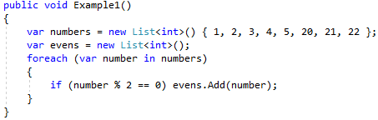
First Look

Slide 5
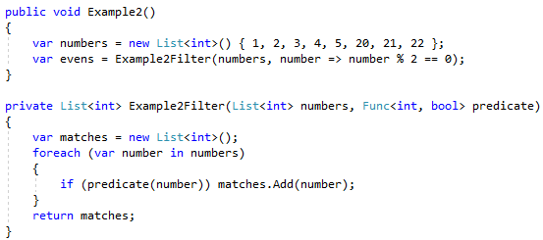
First Look

Slide 6
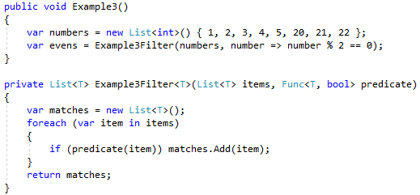
First Look

Slide 7
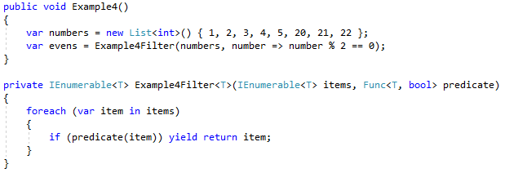
First Look

Slide 8

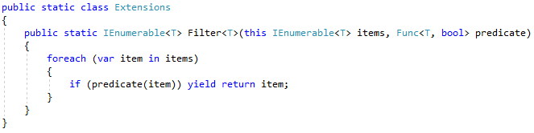
First Look

Slide 9
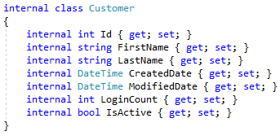
Common Code

Slide 10
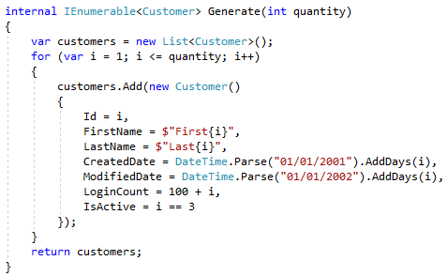
Common Code

Slide 11
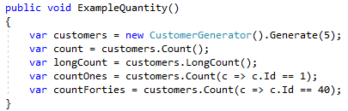
Quantity

Slide 12
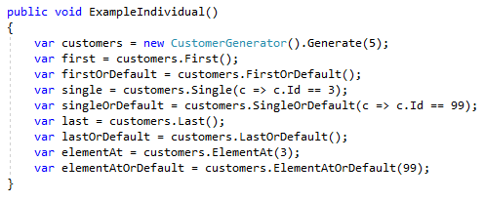
Individual

Slide 13
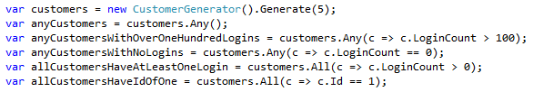
Boolean

Slide 14
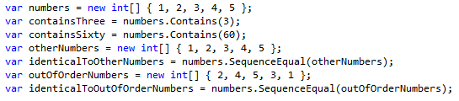
Boolean

Slide 15
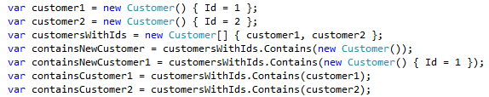
Boolean

Slide 16
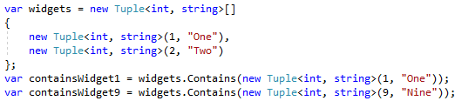
Boolean

Slide 17
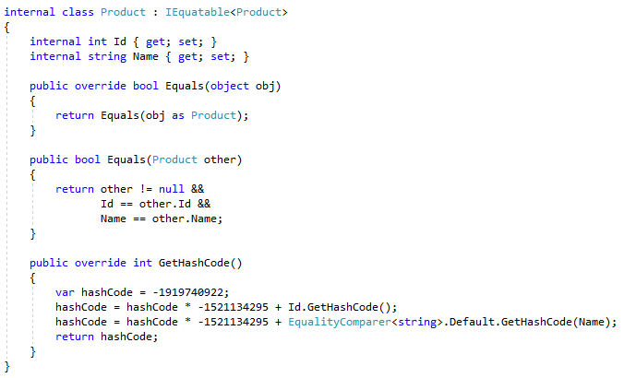
Boolean
Let Visual Studio write these!
*Optional, but recommended

Slide 18
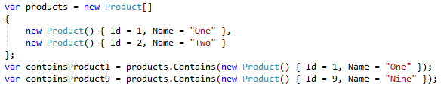
Boolean

Slide 19
Reduction

Slide 20
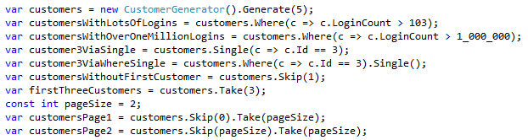
Reduction

Slide 21
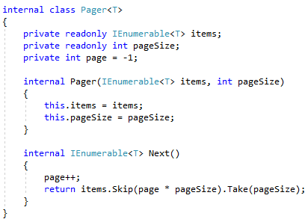
Reduction

Slide 22

Reduction
(5)
(2)

Slide 23
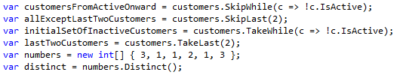
Reduction

Slide 24
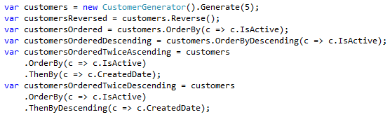
Ordering

Slide 25
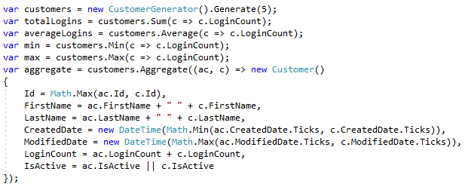
Aggregation

Slide 26
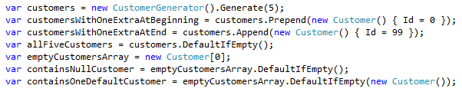
Modification

Slide 27
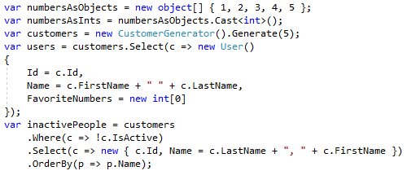
Conversion of items

Slide 28
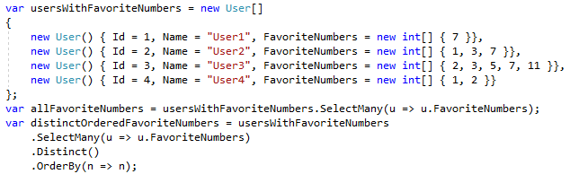
Conversion of items

Slide 29
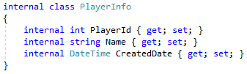

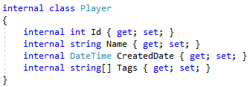
Conversion of items

Slide 30
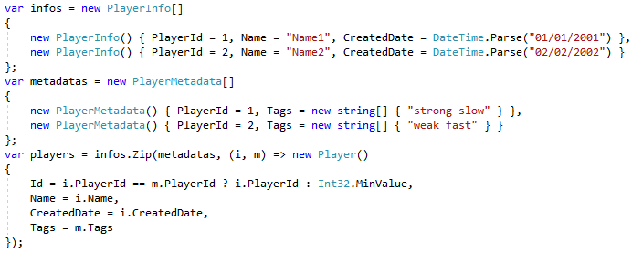
Conversion of items

Slide 31
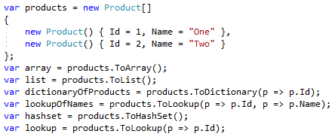
Conversion of sets

Slide 32

Combining

Slide 33
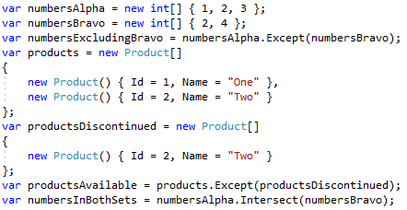
Joining

Slide 34
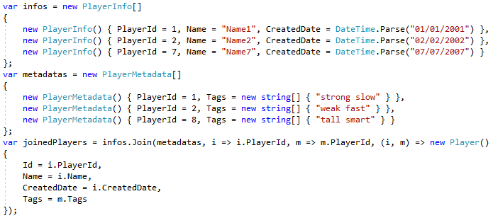
Joining

Slide 35

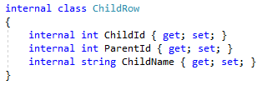
Joining

Slide 36
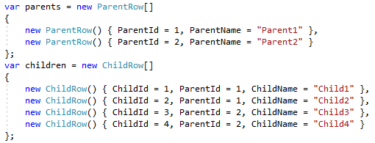
Joining

Slide 37
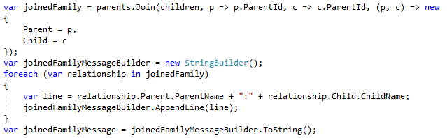

Joining

Slide 38
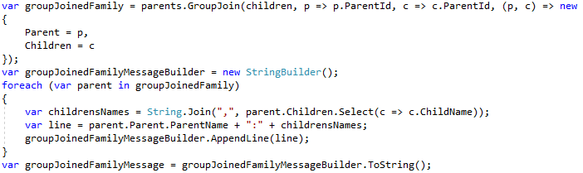
Joining

Slide 39
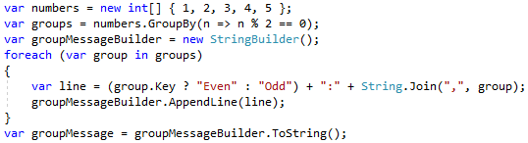

Joining

Slide 40
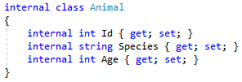
Joining

Slide 41
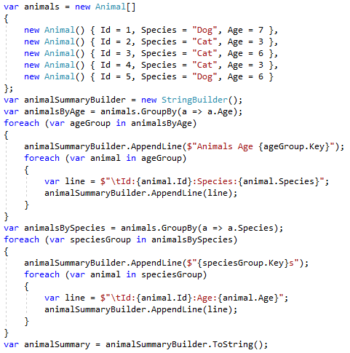
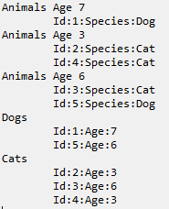
Joining

Slide 42
Summary
System.LINQ is based on IEnumerable<T>
We often use lambdas for anonymous methods
These were examples of LINQ to objects
LINQ to SQL is used for querying databases
These were examples of method syntax
Query syntax is similar; most differences are syntax
Many method overloads were skipped
Many methods have overloads for: index, comparers, selectors, etcetera
LINQ methods can be chained together
When a chain of methods is long, it is common to put each new method on a new line

Slide 43
Info
Derick Linkous
dl@steadyscience.com

