Slide 1
Liskov Substitution Principle
Successful Subtype Substitution

Slide 2
Introduction
Derick Linkous
dl@steadyscience.com

Slide 3
Warm-Up
Single Responsibility Principle
Open/Closed Principle
Liskov Substitution Principle
Interface Segregation Principle
Dependency Inversion Principle

Slide 4
Terminology
“What is wanted here is something like the following
substitution property: If for each object o1 of type S
there is an object o2 of type T such that
for all programs P defined in terms of T,
the behavior of P is unchanged when
o1 is substituted for o2 then S is a subtype of T.”

Slide 5
A picture is worth…
P
Program
T
Class (possibly abstract)
S
Subclass

Slide 6
A picture is worth…
P
P remains unchanged!
T
S5
S2
S3
S4
S

Slide 7
Varying Behavior
P
P should not be changed based on subtypes!
If P is aware of a subtype, likely LSP violation
T
Subclasses are all about varying behavior
S
S2
Different implementations are okay
S3
S4
S5

Slide 8
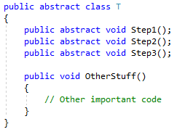
Ordering

Slide 9
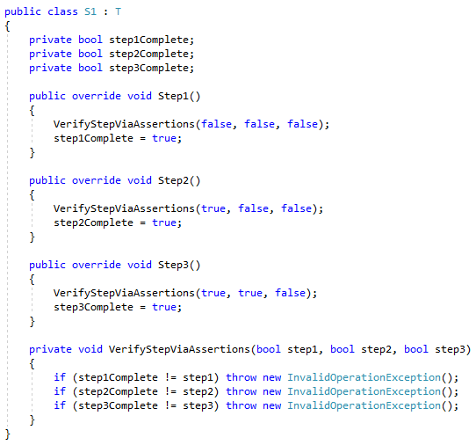
Ordering

Slide 10
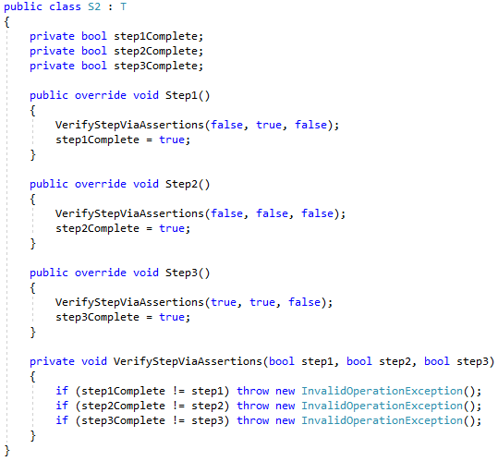
Ordering

Slide 11
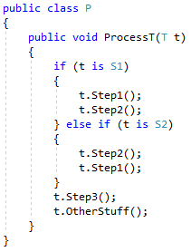
Ordering
P
T
S1/S2
S2
S3
S4
S

Slide 12
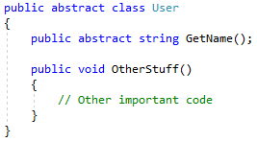
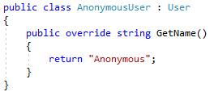
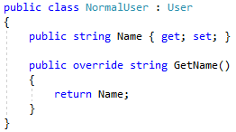
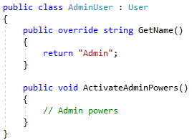
User Management

Slide 13
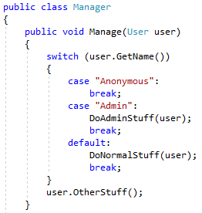
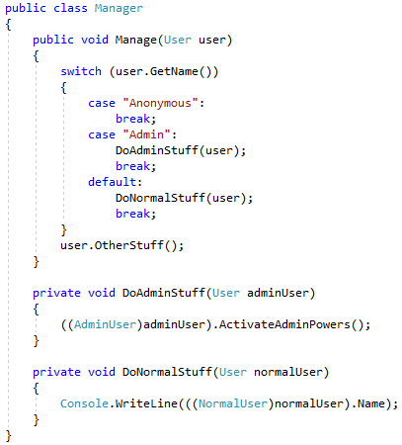
User Management

Slide 14
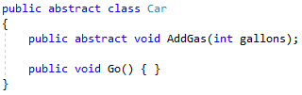
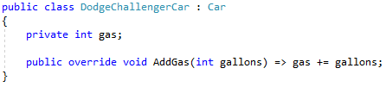
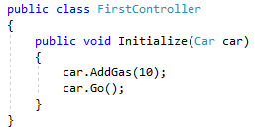
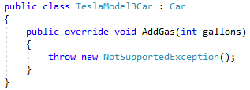
Vehicles

Slide 15
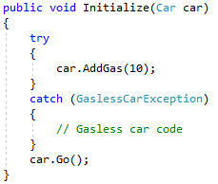
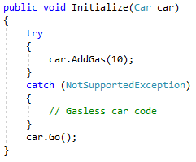
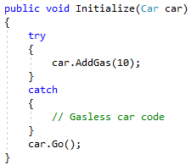


Vehicles

Slide 16

Storage

Slide 17
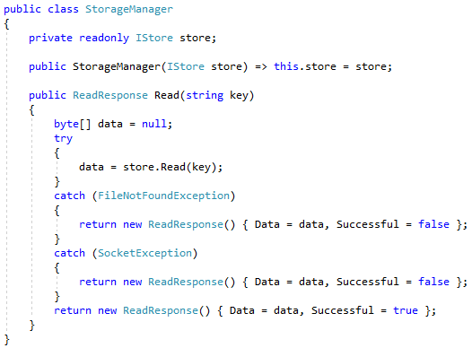

Storage

Slide 18
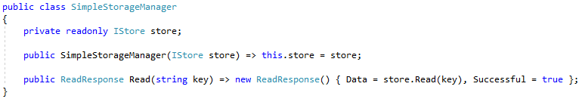
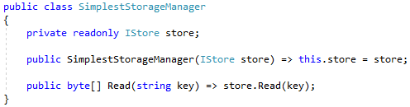
Storage

Slide 19
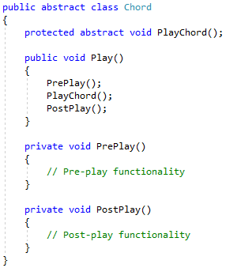
Music

Slide 20
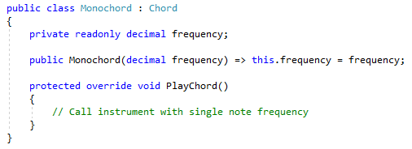
Music

Slide 21
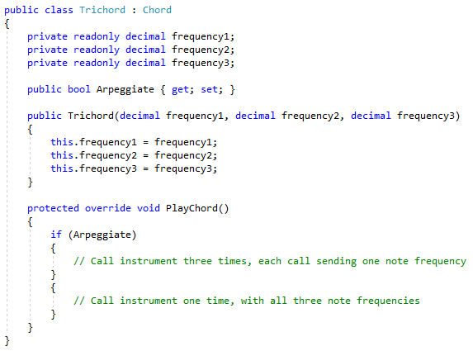
Music

Slide 22
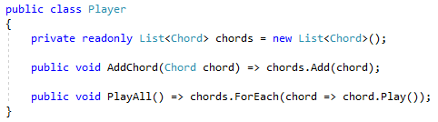
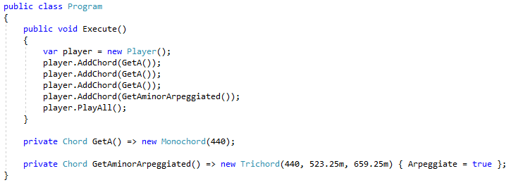
Music

Slide 23
Summary
Use subtypes to vary/add behavior
P
Write code to use supertypes/abstractions
All subtypes should be “swappable”,
without changes to consuming code (e.g. ‘P’)
T
If your code attempts to “peek” into subtypes,
either directly or directly, you may be violating
the LSP (and you made need a redesign)
S1
S2
S3
S4
S

Slide 24
Info
Derick Linkous
dl@steadyscience.com
“Simplicity is prerequisite for reliability.”
- Edsger Wybe Dijkstra

