Slide 1
A Medley In C#
An assortment of C# tips and tricks

Slide 2
Introduction
Derick Linkous
dl@steadyscience.com

Slide 3
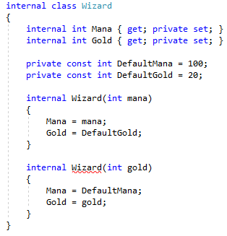
World of Wizards

Slide 4
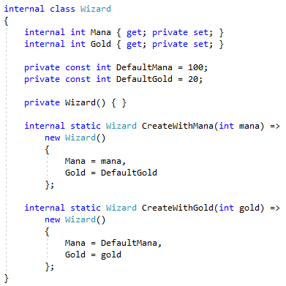
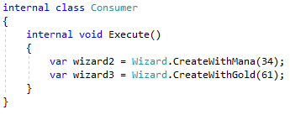
World of Wizards

Slide 5
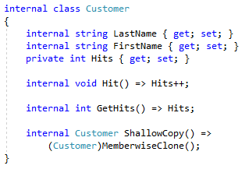
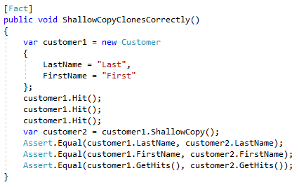
Cloning

Slide 6
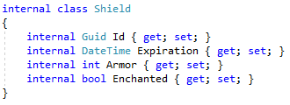
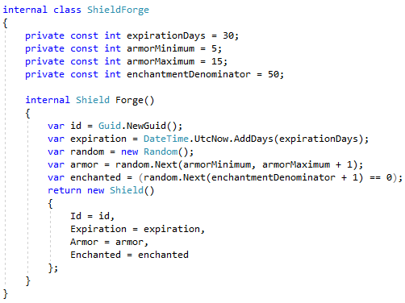
Shields

Slide 7



Providers

Slide 8
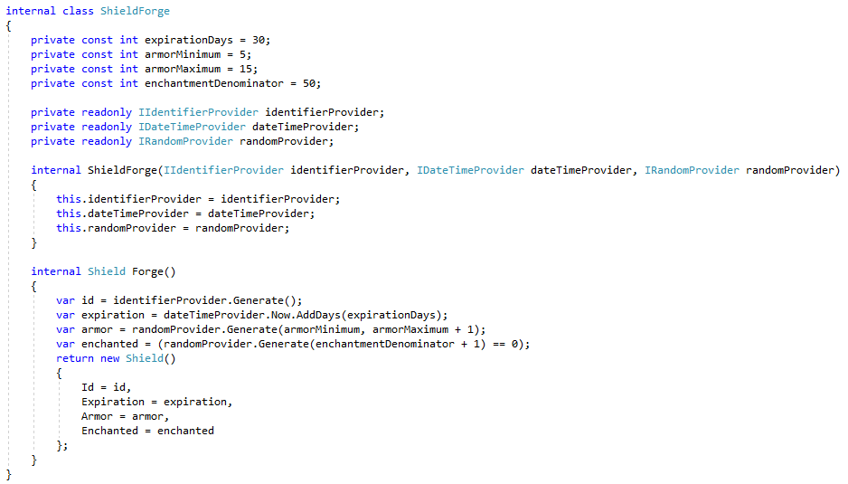
Providers

Slide 9
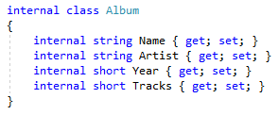
Albums

Slide 10
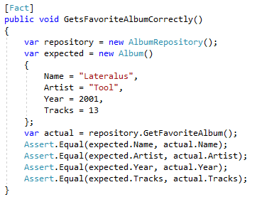
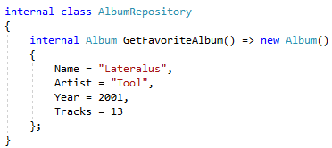
Albums

Slide 11
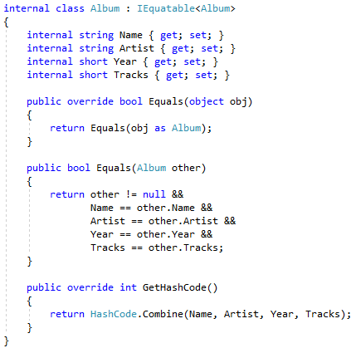
Albums

Slide 12
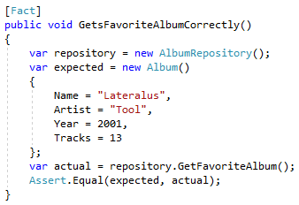
Albums

Slide 13

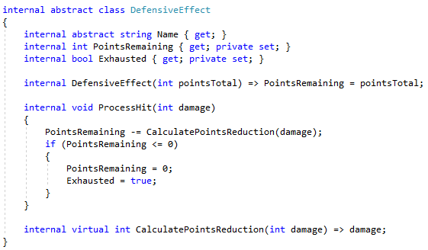

Defensive Effects

Slide 14

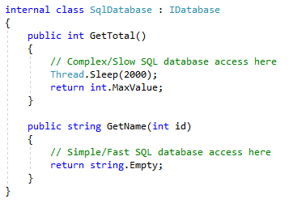
Database Performance

Slide 15

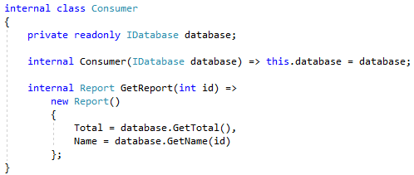
Database Performance

Slide 16
Database Performance

Slide 17
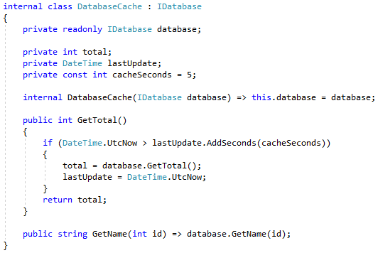
Database Performance

Slide 18
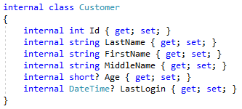

Database Nullability

Slide 19
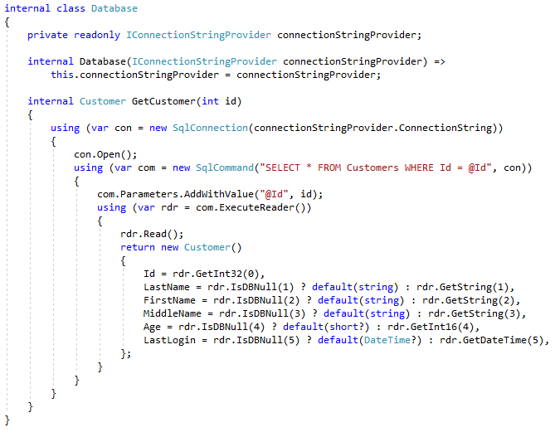
Database Nullability

Slide 20

Database Nullability Extensions

Slide 21
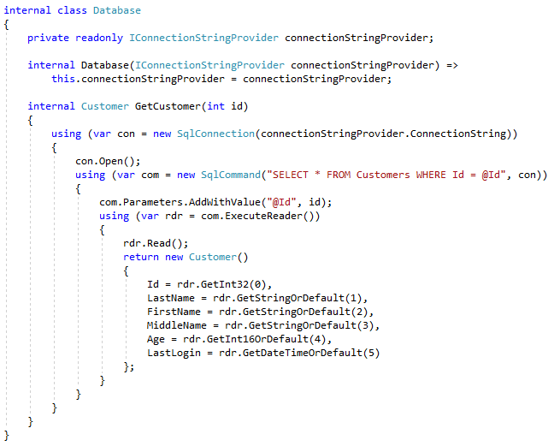
Database Nullability Extensions

Slide 22
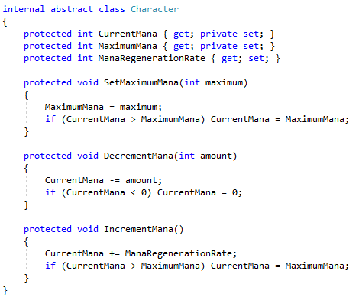


Goblins

Slide 23
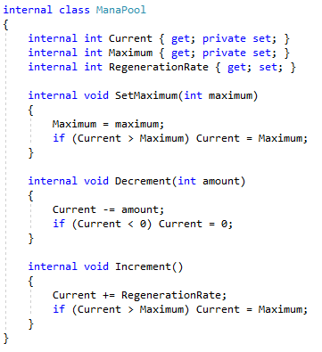
Mana Pools

Slide 24


Mana Pools

Slide 25
Info
Derick Linkous
dl@steadyscience.com

