Slide 1
Memory Leaks & Massive Loops
Stable code. Fast code.

Slide 2
Introduction
Derick Linkous
dl@steadyscience.com

Slide 3
Presentation Plan
Memory Leaks
Massive Loops
IDisposable
IEnumerable
Consumption
Creation
Consumption
Creation
Shallow
Shallow

Slide 4
Why these two interfaces?
Both are specialized interfaces
Both involve specialized keywords in the language
Both have many uses in the majority of projects

Slide 5
A Managed Language
C# is a managed language
Most memory issues taken care of automatically

Slide 6
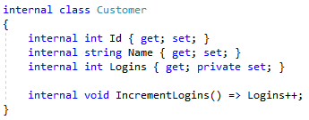
Safe Code

Slide 7
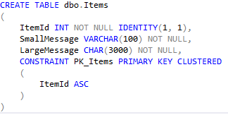
A Database

Slide 8
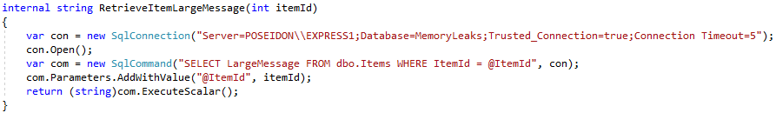

Retrieving An Item

Slide 9
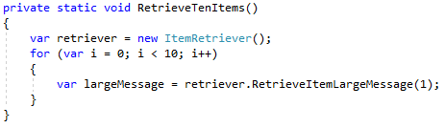
Retrieving An Item

Slide 10
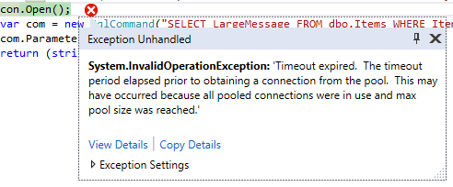
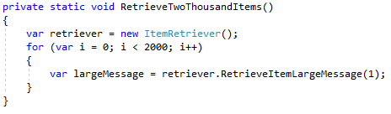
Retrieving An Item

Slide 11
Retrieving An Item
Computers cannot handle 2000 items???
We need 2000 database connections???
No!

Slide 12
Managed Memory
C# Managed RAM
Customer
Customer
Customer
When object no longer needed…
Runtime can clean up all the data in memory

Slide 13
Managed Memory
C# Managed RAM
Unmanaged RAM
SqlConnection
???
SqlCommand
SqlDataReader
Database
Drives/Files
???
We need a way to clean up
resources on the right side
Ports/Connections

Slide 14
IDisposable
IDiposable is an interface
Comes with .NET
Contains one method: Dispose()
Dispose() must clean up all unmanaged resources
C# contains special statement: “using”

Slide 15
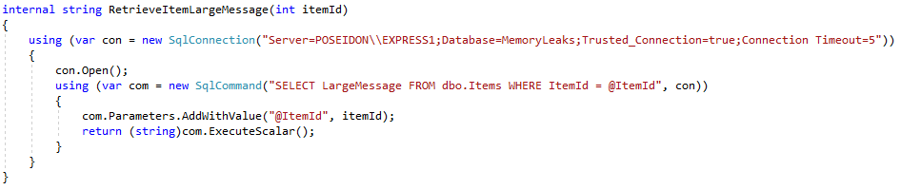
Refactor With Using Statement
Success!

Slide 16
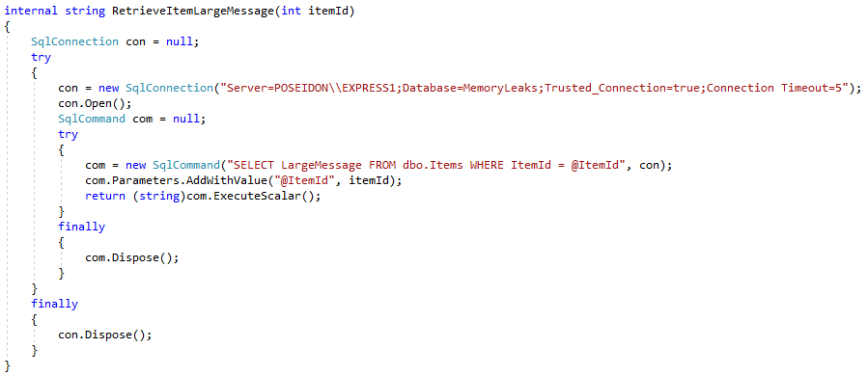
Effectively A Try-Finally

Slide 17
When To Use Using
We know some things need unmanaged resources
We know how to safely use these resources (i.e. “using”)
But how do we know WHEN to use “using”?

Slide 18
When To Use Using
Simple: If you instantiate an object that implements IDisposable…
ALWAYS use the “using” statement/block!
How do you know it implements IDisposable?
F12, Object browser, documentation, etc.
It will always have a Dispose() method.

Slide 19
Tip: Create Helpers
Feel free to create helpers that use “using” correctly
This way you do not need to remember to use “using”
Teammates do not need to know/remember either

Slide 20
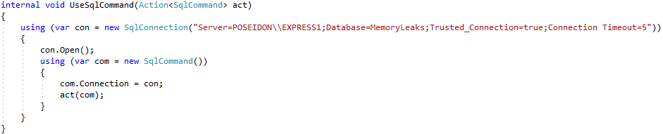
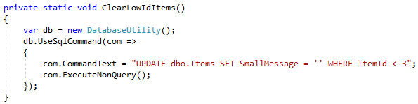
Tip: Create Helpers
Sometimes a little complexity is worth
protection against memory leaks

Slide 21
IDisposable Is Everywhere!
Many classes in System.Data
Many classes in System.Drawing
Many classes in System.IO
Many classes in System.Net
Many classes in System.Security.Cryptography
Many classes in System.Windows.Forms
And many more, including those from third parties

Slide 22
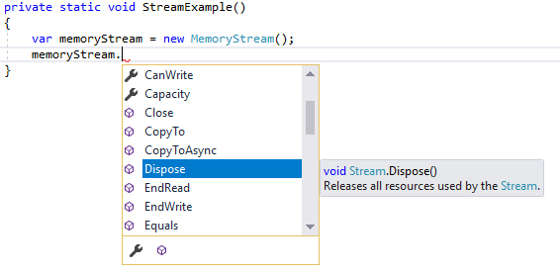
Be On The Lookout!

Slide 23

Implementing IDisposable
It is possible to implement IDisposable on your own classes…
However…
Here Be Dragons!
Photo Credit: National Library of Sweden

Slide 24
Implementing IDisposable
A full discussion on the proper way to implement IDisposable
is outside the scope of this presentation
The goal is to show that it is possible, how to begin,
and how to learn more about the proper way
The example shown next is not a recommended best practice
The purpose of the example is to be an introduction
to the subject, with further learning left to the audience

Slide 25
Implementing IDisposable
There may be times when you need a class, which has a long
lifetime, and itself uses an unmanaged resource
Imagine a class with a long lifecycle, which reads from a file
over the course of its long lifecycle

Slide 26
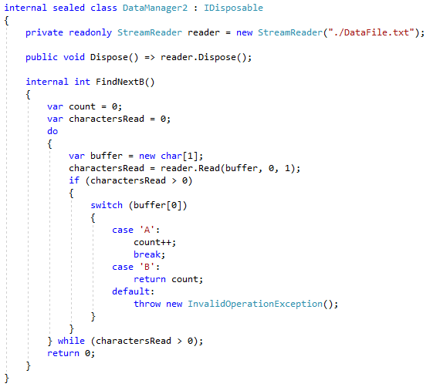
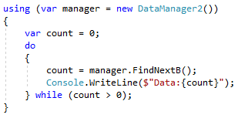
Implementing IDisposable
IDisposable
Unmanaged resource
Dispose()

Slide 27
Implementing IDisposable
This is safe only under strict circumstances
One developer; no distribution
Sealed; no derived classes
Perfect use of “using” by all consuming code

Slide 28
Implementing IDisposable
Proper disposal has a pattern, stubbed by Visual Studio

Slide 29
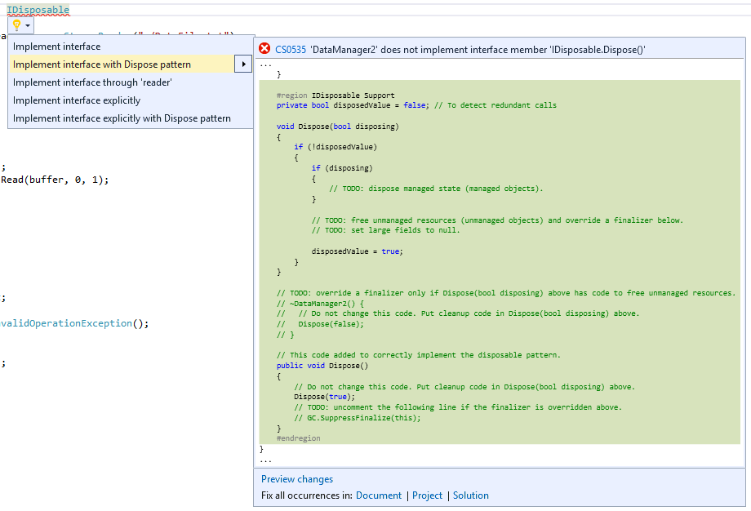
Implementing IDisposable

Slide 30
Idisposable Summary
Managed constructs are safe
Unmanaged constructs require clean up
Convention for clean up is IDisposable.Dispose()
The “using” statement is bound to IDisposable.Dispose()
The “using” statement basically a try-finally
The rule is simple: Always use “using” on IDisposables
Most I/O on a system is unmanaged
Be very careful if you choose to implement IDisposable

Slide 31
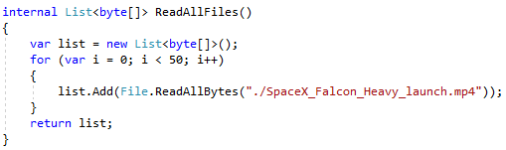
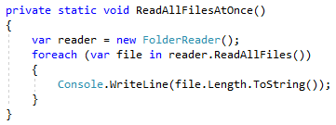
A Big List

Slide 32
A Big List
Movie1
Movie2
Movie3
List
Then we loop over each in memory
Movie4
Movie5

Slide 33
A Big List
Movie1
Process the movie
Movie2
Process the movie
Movie3
Process the movie
Movie4
Process the movie
Movie5
Process the movie

Slide 34
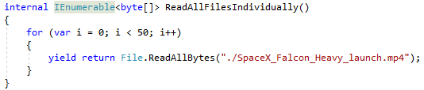
One At A Time

Slide 35
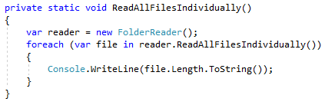
One At A Time

Slide 36
One At A Time
Yielding one at a time has other benefits…

Slide 37
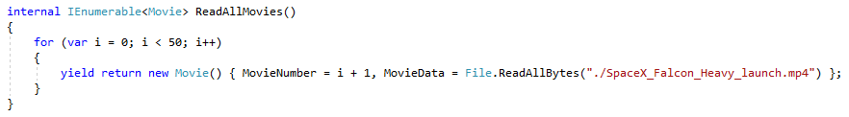
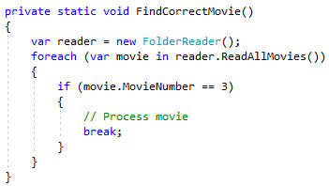
Evacuating Early
…effectively “ends” this loop.
Only 3 reads actually occur
Breaking out of the foreach…

Slide 38
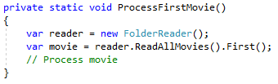
Evacuating Early
One read; we broke from the loop after one iteration

Slide 39
A Promise To Loop
IEnumerable is a promise to loop
Every request to loop (i.e. “foreach”) is a new loop
It is not a lazy-loaded cache

Slide 40
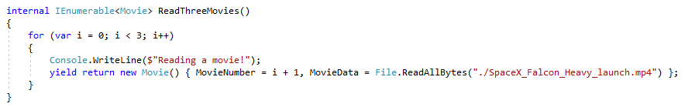
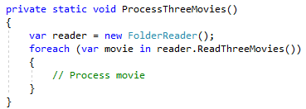
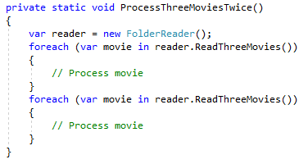
A Promise To Loop
We see three lines on the console
We see six lines on the console

Slide 41

Ienumerable Preferred
Even if calling code wants a List, leave it to the caller to decide

Slide 42
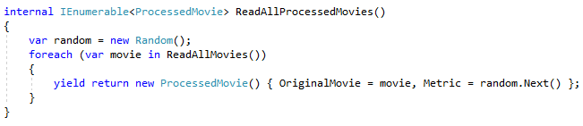
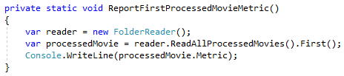
Nesting Works
Both loops break early

Slide 43
Custom Enumeration
It is possible to write your own enumerable objects
Extremely rare that this is necessary
For educational purposes, it can be fun to experiment
Two interfaces at work:
IEnumerable – An object that can be enumerated (i.e. foreach)
IEnumerator – An object that knows how to enumerate
Due to rareness, only basics will be presented

Slide 44
Custom Enumeration
First requirement: An object that knows how to enumerate
Can be generic type, or weakly-typed
Minimum implementation:
Current – The current object
MoveNext – Move to the next object if possible
Reset – Start the enumeration over from scratch
Generic-typed enumerators have two “Current” properties,
and are IDisposable (called at the end of the loop)

Slide 45
Custom Enumeration
Second requirement: An object that can be enumerated
Will use the previously-created enumerator
IEnumerable just returns enumerators

Slide 46
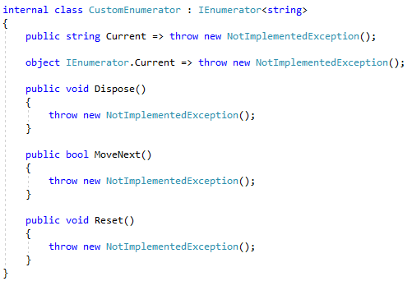
Custom Enumeration

Slide 47
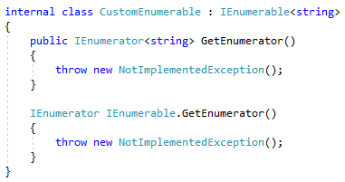
Custom Enumeration

Slide 48

Custom Enumeration

Slide 49
Ienumerable Summary
The “foreach” statement works over IEnumerable
An IEnumerable is a promise to loop
An IEnumerable returns one item at a time
IEnumerable uses IEnumerator to enumerate over a set
Most sets in .NET implement IEnumerable
When returning sets, prefer IEnumerable, especially
in cases where each item is “heavy” (performance-wise)
Custom enumeration is possible, but rarely necessary

Slide 50
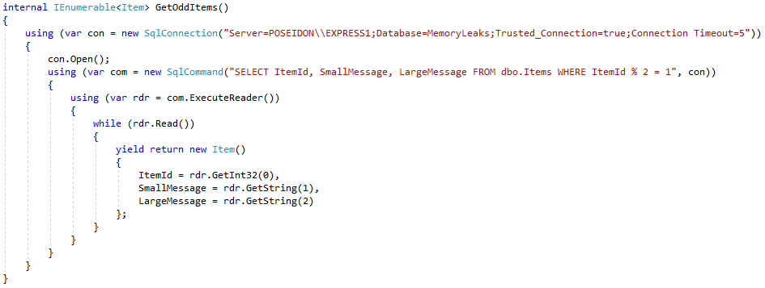
The Best Of Both Worlds
A non-leaking and efficient method!

Slide 51
Info
Derick Linkous
dl@steadyscience.com

