Slide 1
Mocking
Making fun of unit tests using Dependency Injection

Slide 2
Introduction
Derick Linkous
dl@steadyscience.com

Slide 3
Two Topics
Dependency Injection
Mocking

Slide 4
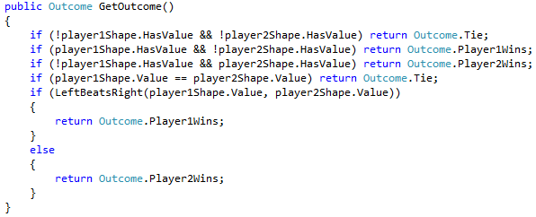
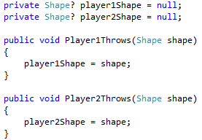
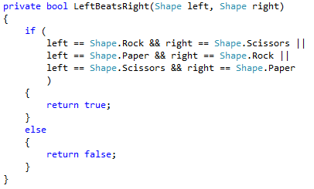
Roshambo – A Leaf Node
No dependencies
Class is a leaf node

Slide 5
Roshambo – A Leaf Node
Class
???
Leaf Node
???
Leaf nodes are easy to test as-is
???
Other nodes require mocking
???
Prefer leaf nodes when possible
???
???
???
???
???
???
???
???
Roshambo
???
???

Slide 6
Home Automation – Thermostat
Controller gets information from sensor,
and decides what to do next
Controller
Sensor
Sensor gets current temperature
Where is the dependency?

Slide 7
Home Automation – Thermostat
Controller gets information from sensor,
and decides what to do next
Controller
Sensor
Sensor gets current temperature
A Controller must have a Sensor in order to accomplish its goals
Therefore, a Controller depends on a Sensor.
A Controller has a dependency, a Sensor.

Slide 8
Home Automation – Thermostat
Controller gets information from sensor,
and decides what to do next
Controller
Sensor
Sensor gets current temperature
Hint: If you delete one side of the relationship, and the other
side no longer builds, the deleted item is the dependency.

Slide 9
Home Automation – Thermostat
Controller gets information from sensor,
and decides what to do next
Controller
Sensor
Sensor gets current temperature
Hint: If you delete one side of the relationship, and the other
side no longer builds, the deleted item is the dependency.

Slide 10
Home Automation – Thermostat
Controller
Dashboard
Sensor
HVAC
The Dashboard represents a user interface (i.e. a control panel)
The HVAC is the system we want to control

Slide 11
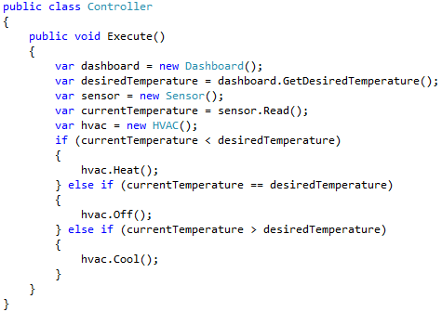
Controller – First Look
Where are the dependencies?
Hint: Look for the ‘new’ keyword

Slide 12
Controller – First Look
How can we test our logic?
Here is our business logic

Slide 13
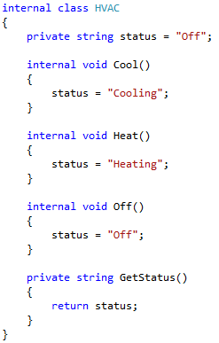
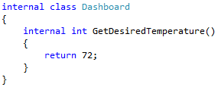
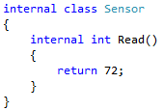
Dependencies
How can we test our logic?
What if you cannot
change these classes?

Slide 14
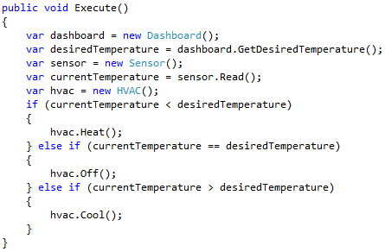

Dependencies
How can we test our logic?
?
?
We must refactor!

Slide 15
Dependencies
We want to decouple
these dependencies

Slide 16
Dashboard First
Controller
The Controller is tightly coupled to the Dashboard.
Dashboard
We must break the coupling!
We will use an interface to break the relationship.

Slide 17
Dashboard First
Controller
The Controller will now use the interface
IDashboard
Dashboard
The IDashboard interface is our new abstraction
The Dashboard class will implement our new interface
Dependency Inversion Principle
“Depend upon abstractions. Do not depend upon concretions.”
*There is more to the DIP, but that is outside the scope of this presentation.

Slide 18

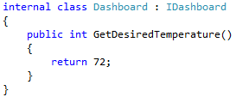
Dashboard First
Before
After

Slide 19

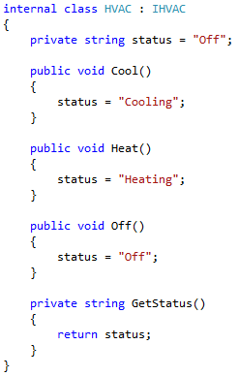
HVAC Next

Slide 20

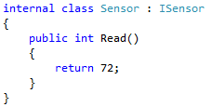
Sensor Last

Slide 21
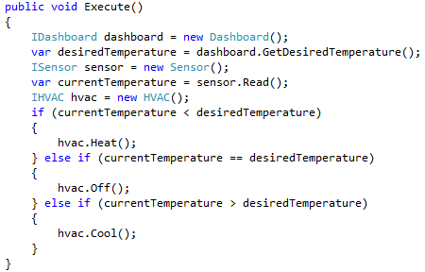
Slightly Altered Execute
We can now change
Execute() to use the new
interfaces
This step is just for demonstration purposes.

Slide 22
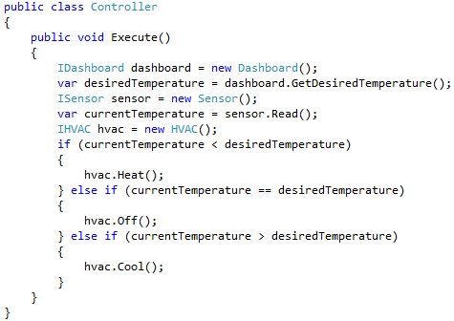
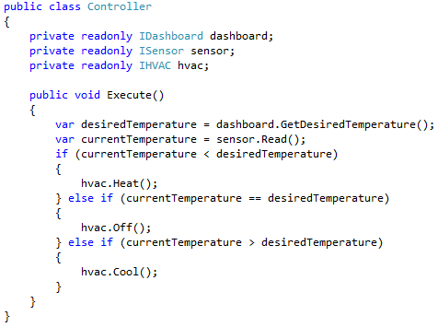
Controller Dependency Injection
We will move our dependencies
from the method level to the
class level

Slide 23
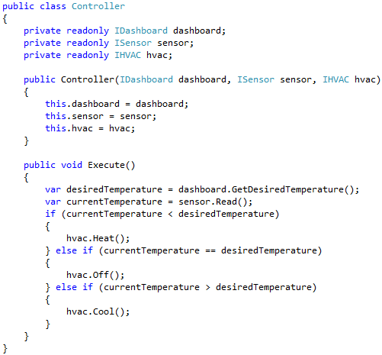
Controller Dependency Injection
We will add a constructor,
allowing the calling code to
specify (aka inject) dependencies

Slide 24
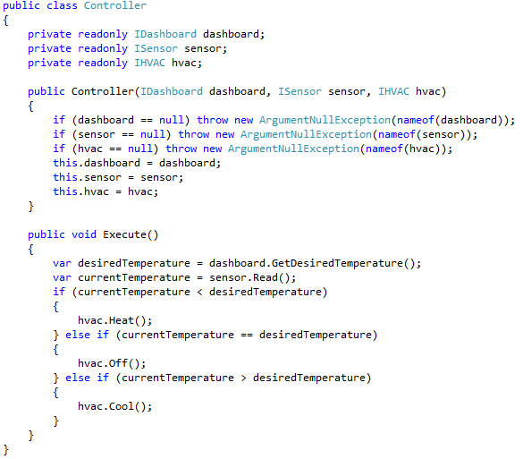
Controller Dependency Injection
We will add some null checks,
as a good practice
Let’s take another look at
our Execute() method

Slide 25
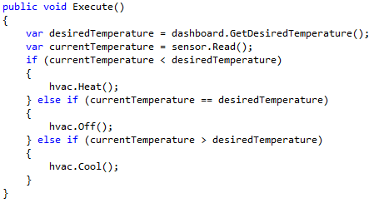
Execute – A Closer Look
After refactoring, this method is:
shorter
simpler
decoupled

Slide 26
Instantiation
Now that our dependencies are injected,
callers are responsible for specifying our dependencies

Slide 27
Mocking – Terminology
Mock:
to attack or treat with ridicule, contempt, or derision.

Slide 28
Mocking – Terminology
an imitation; counterfeit; fake.
Mock:
an imitation; counterfeit; fake.

Slide 29
Mocking – Terminology
an imitation; counterfeit; fake.
Terms used to describe a mock:
Test Double
Dummy
Stub
In this presentation, all will be
referred to as “mocks”
Spy
Mock
Fake

Slide 30
Mocking Frameworks
an imitation; counterfeit; fake.
There are many mocking frameworks available
Mocking frameworks can help overcome issues such
as an explosion of mock classes
Using a mocking framework keeps mock values
‘close’ to the test
Mocking frameworks are optional
This presentation will not use any mocking frameworks

Slide 31
What is a Mock, really?
an imitation; counterfeit; fake.
A mock:
Is a normal class
Often implements an abstraction
(i.e. interface or abstract class)
Exists in the unit test assembly

Slide 32
Mocking Assessment
an imitation; counterfeit; fake.
Too cold
Just right
Too hot
Our business logic has three use cases

Slide 33
Mocking Assessment
an imitation; counterfeit; fake.
1
2
3
We need three unit tests. In each test…
... we need to be able to specify both temperatures…
... and make sure the correct HVAC method was called.

Slide 34
Mocking Assessment
an imitation; counterfeit; fake.
We need a counterfeit desired temperature…
… so we will create an imitation dashboard.
All we need is a normal class, that implements IDashboard.

Slide 35
Dashboard First
an imitation; counterfeit; fake.
Let’s write our first mock!
Our mock dashboard:
Needs to implement IDashboard
Needs to allow the unit tests to specify a desired temperature
Needs to return the specified desired temperature
Needs to stay out of production code

Slide 36
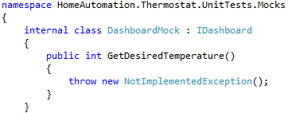


Dashboard First
an imitation; counterfeit; fake.
Second, we specify the interface we wish to implement
First, we create the mock in our unit test project
Next, we let our IDE write our non-functional method

Slide 37
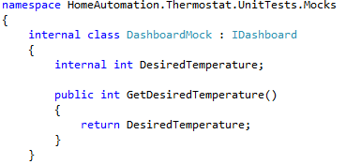
Dashboard First
an imitation; counterfeit; fake.
Now we add the magic mock code!
We add a field (which is
internal) that any unit
test can access and set
In the interface method,
we simply return the field value

Slide 38
Dashboard First
an imitation; counterfeit; fake.

Slide 39
Dashboard First
an imitation; counterfeit; fake.
Our finished mock dashboard:
Lives only in the unit test project
Can be instantiated by multiple unit tests
Can have its desired temperature set by unit tests at any time
Returns the latest desired temperature value

Slide 40
Sensory Imitation
an imitation; counterfeit; fake.
Reading the sensor to get the current temperature
is very similar to getting the desired temperature
from the dashboard
We will create a mock for the sensor that
is very similar to the dashboard mock

Slide 41
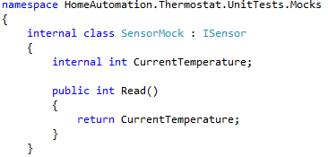
Sensory Imitation
an imitation; counterfeit; fake.
We used the same technique, and that’s all we need

Slide 42
Recordkeeping
an imitation; counterfeit; fake.
Our first two mocks just returned values
Our third dependency is never asked a question;
It is told what to do
Our unit tests will need to know
if the correct method was called
Our last mock will need to store information
about what it was told to do, so the unit test
can verify that it was give the correct instruction

Slide 43
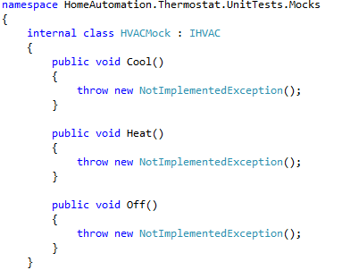
Recordkeeping
an imitation; counterfeit; fake.
We add our new mock to the unit test project
We implement the IHVAC interface
Now we need to keep a record of the methods
that were called, so unit tests can investigate
how our mock was used by the production code

Slide 44
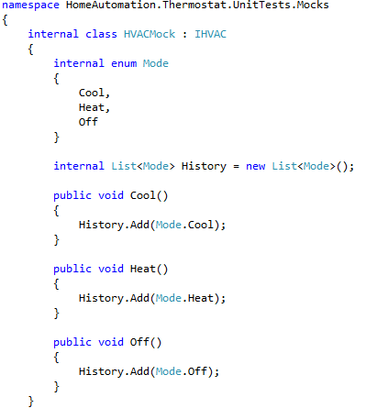
Recordkeeping
an imitation; counterfeit; fake.
We create an enum to store the type of call
We use a List to store the history of calls
When a method is called, we simply store
the correct value in the List

Slide 45
Recordkeeping
an imitation; counterfeit; fake.
The enum and the List are internal
Any unit test that uses this mock
can directly inspect the history of
its usage by callers (i.e. the code being
unit tested)

Slide 46
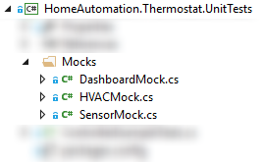
Three Mocks
an imitation; counterfeit; fake.
Hidden within our unit test project…
Are three mocks, imitating their real
(i.e. production) counterparts
Two of them tell lies about temperature values,
and one silently keeps a record of what it was told

Slide 47
Production versus Testing
an imitation; counterfeit; fake.
Controller
Production
Dashboard
Sensor
HVAC
Controller
Testing
DashboardMock
SensorMock
HVACMock
Production uses the real classes; Tests use mock classes

Slide 48
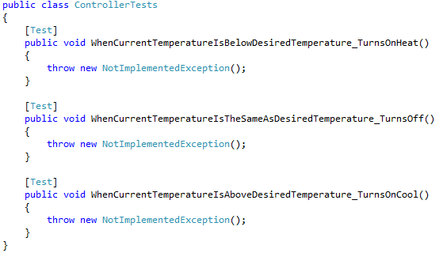
Three Use Cases
an imitation; counterfeit; fake.

Slide 49
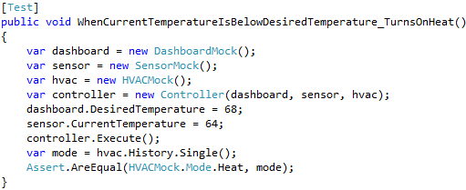
Turn up the heat
First, instantiate all of our mocks
Then instantiate the real controller,
which is the class we are testing

Slide 50
Turn up the heat
Next, we set the mock values
that are specific to this test

Slide 51
Turn up the heat
Now we Execute, which is the
method we are actually testing

Slide 52
Turn up the heat
Finally, we make sure that
the Heat method was called,
exactly one time

Slide 53
Turn up the heat
Arrange
Act
Assert
The common Arrange-Act-Assert pattern is hiding in this method

Slide 54
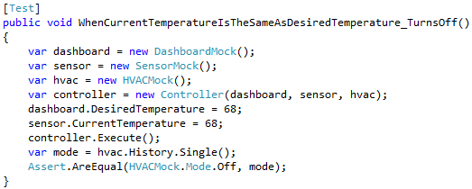
This porridge is just right
This unit test is almost identical

Slide 55
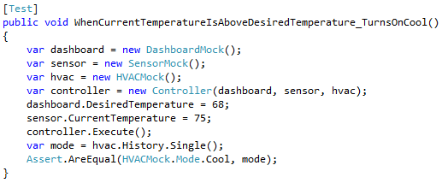
Cool your jets
This unit test is also almost identical

Slide 56

Did we pass the test?
Our tests pass on the first try!

Slide 57
Duplicate Code reduction
Most unit test frameworks support parameterized tests
Syntax varies by framework
NUnit calls the feature a “TestCase”

Slide 58
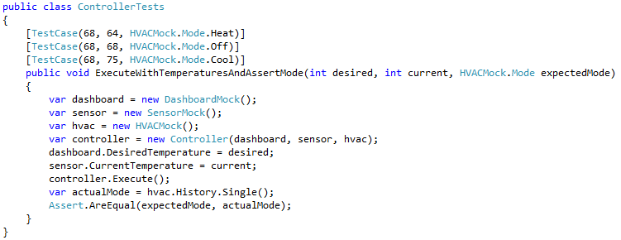
Duplicate Code reduction
Our three unit tests
can actually be written
as a single method with
three test cases
Call the method three times
With these parameters

Slide 59

Duplicate Code reduction
Our tests still pass on the first try!

Slide 60

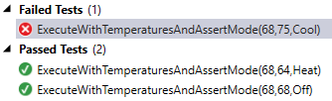

Unit Tests – Your safety net
Our wonderful code, which passes all tests, gets modified

Slide 61
More good news
Controller
IDashboard
ISensor
IHVAC
DashboardMock
SensorMock
HVACMock
LcdDashboard
SqlSensor
TraneHVAC
Controller can be tested even when LCD device is not attached
Controller can be tested without changes to SQL data
Controller can be tested without a real HVAC connected

Slide 62
More good news
Controller
IDashboard
ISensor
IHVAC
DashboardMock
SensorMock
HVACMock
LcdDashboard
SqlSensor
TraneHVAC
SavantDashboard
New implementations can be added…
without any changes to Controller code.

Slide 63
Inversion of Control
In Production, something must inject dependencies
Class instantiation and lifecycle management are critical
Anything critical should be isolated
Frameworks already exist to meet this need
Inversion of Control Container
Sometimes called a DI (Dependency Injection) Container
Avoid the urge to reinvent the wheel
Avoid the urge to do any version of “Poor Man’s Injection”
A detailed discussion of IoC is outside the scope of this presentation

Slide 64
Final thoughts
Classes without dependencies are easy to test without mocks
Favor classes without dependencies
When a class has a dependency, favor interfaces over coupling
Favor constructor injection
Use property/setter injection to change dependencies
Unit test your classes with mocks
Favor unit tests over integration tests
Use a mocking framework if you feel like it
Use an IoC container for all design-time class instantiations

Slide 65
Info
Derick Linkous
dl@steadyscience.com
"Why do most developers fear to make continuous
changes to their code? They are afraid they'll break it!
Why are they afraid they'll break it?
Because they don't have tests."
-Robert C. Martin, The Clean Coder: A Code of Conduct for Professional Programmers

