Slide 1
Open/Closed Principle
Extension > Modification

Slide 2
Introduction
Derick Linkous
dl@steadyscience.com

Slide 3
Warm-Up
Single Responsibility Principle
Open/Closed Principle
Liskov Substitution Principle
Interface Segregation Principle
Dependency Inversion Principle

Slide 4
Terminology
Open for Extension
“Open” = Welcome
“Extension” = Addition
Closed for Modification
“Closed” = Unwelcome
“Modification” = Modification

Slide 5
Modification
Regression occurs when code is modified
Modification often requires more knowledge
Customer: New Features = New Code
Customer: Distant changes unsettling

Slide 6
Two Examples
Inheritance
Composition

Slide 7
Spellcaster
Characters can cast spells on one another
When a spell is cast, we need to show a message on UI
We also want to log the event for debugging purposes
Characters have hit points and mana
While casting, we want to ignore caster user input
Some spells have lasting effects

Slide 8
Questions
Do we always ignore caster input? Yes
When do we log? At the end of the spell cast
Do different spells have different messages? Yes
Do they have different effects?
Yes, both caster and target can have different effects
When is the message shown? Near beginning of cast
Effects? Direct, DoT, Armor Reduction

Slide 9
Questions
Will we be adding more spells? Maybe
How many effects are there? We’ll start with three
Are there multiple logs? No, just one for debugging
Do spells have names? Yes
Do spell names change? No
Are spell messages dynamic? No

Slide 10



Spellcaster

Slide 11
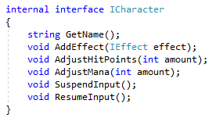
Spellcaster

Slide 12
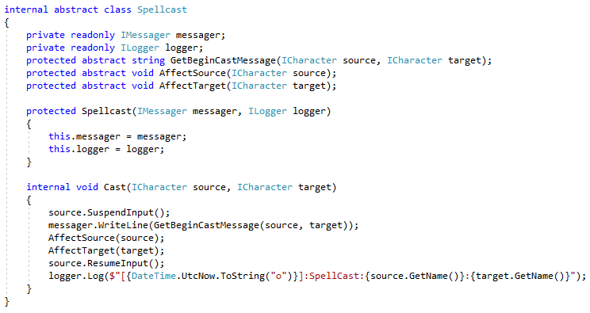
Spellcaster

Slide 13
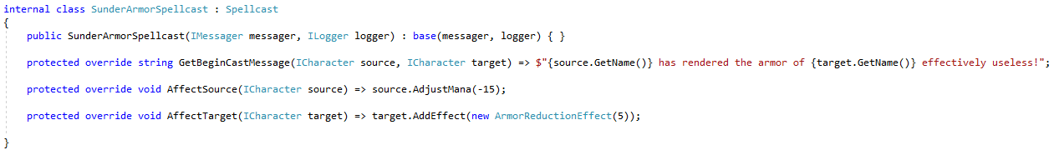
Spellcaster

Slide 14
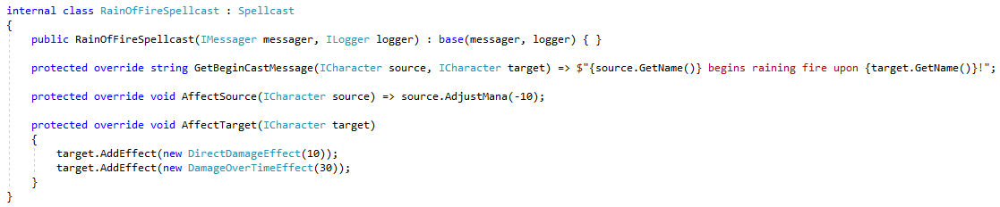
Spellcaster

Slide 15
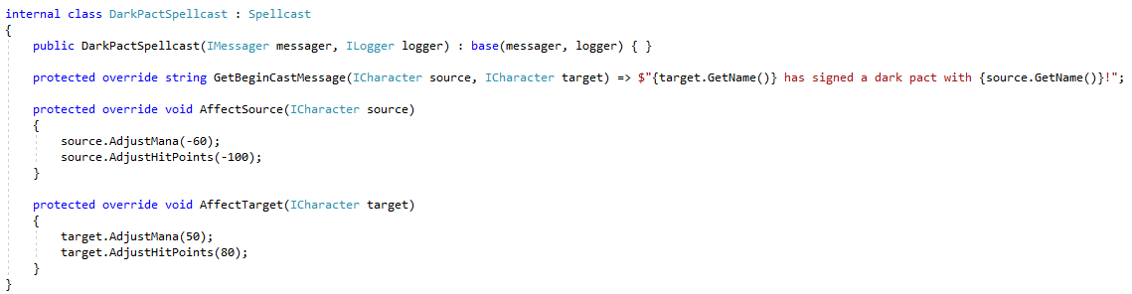
Spellcaster

Slide 16
Drones
Drones like “mech” games
Drone has weapon bays
Weapon bays can contain any weapon
Drones are sensitive to heat
Drones have electrical power

Slide 17
Questions
How many weapon bays? 2, and won’t change
What is heat?
Some weapons produce different amounts of heat
What happens if heat is too high? Explosion
What is power?
Some weapons require power
What happens if power runs out? Incapacitation

Slide 18
Questions
What is incapacitation? No more firing
What happens when firing?
User picks amount to fire
Amount of what?
Depends on weapon
How much heat/power?
Depends on weapon. Some weapons can incapacitate

Slide 19


Drones

Slide 20
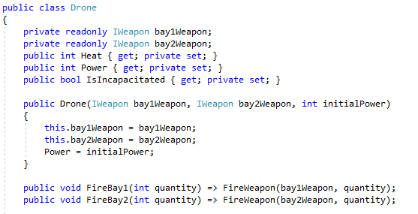
Drones

Slide 21
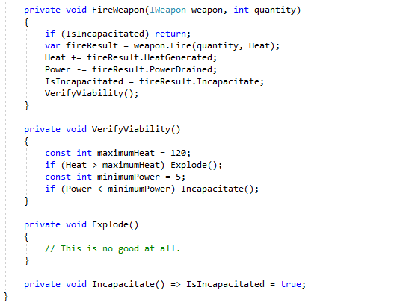
Drones

Slide 22
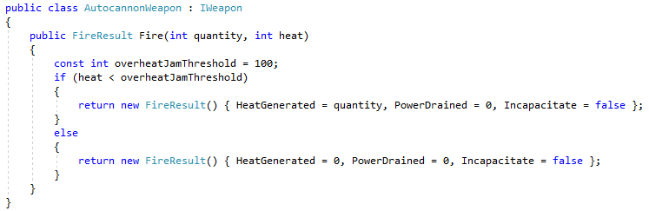
Drones

Slide 23
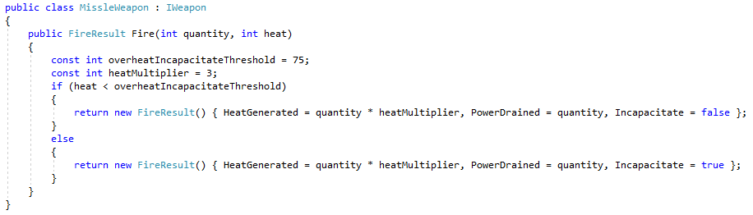
Drones

Slide 24
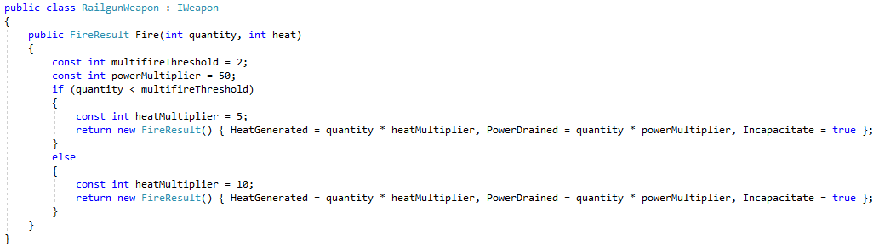
Drones

Slide 25
Seeing the future
Difficult to see the future
Ask lots of questions
Listen for indicators of (future) plurality
Ask: “Will there ever be more than one X?”
Domain knowledge invaluable
Previous changes can hint at future changes
Think about all possibilities; only implement most likely

Slide 26
Info
Derick Linkous
dl@steadyscience.com
"Quality is free, but only to those
who are willing to pay heavily for it.”
-Tom DeMarco

