Slide 1
Please Pass The Salt
A discussion about password security

Slide 2
Introduction
Derick Linkous
dl@steadyscience.com

Slide 3
Notice
Presentation will contain examples
Examples are for educational purposes only
Many examples are bad (dangerous) practices
Examples should not be used in production
As-is, no warranty, hold-harmless, at-your-own-risk

Slide 4
Recommendations
Use trusted third-party authentication services
Use trusted third-party authentication libraries
However, learning is a good thing
Sometimes we need to do it ourselves

Slide 5
High-level Design
Integration Tests
Password Services
User Database

Slide 6
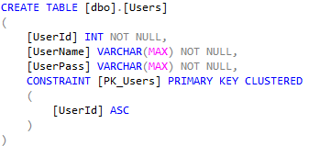
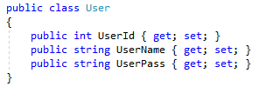

Database

Slide 7
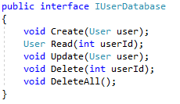
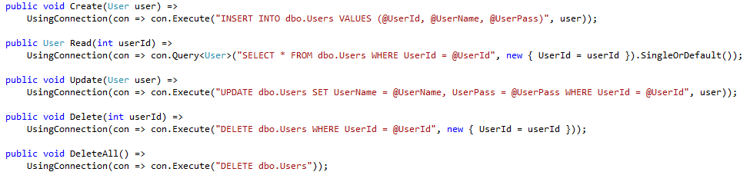
Database
Dapper

Slide 8
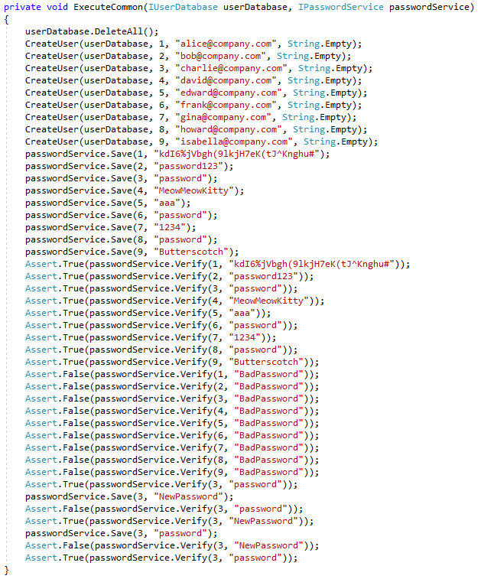

Integration Tests

Slide 9
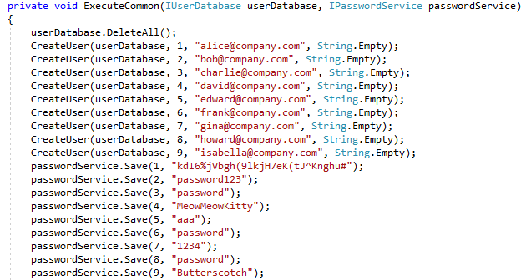
Integration Tests

Slide 10
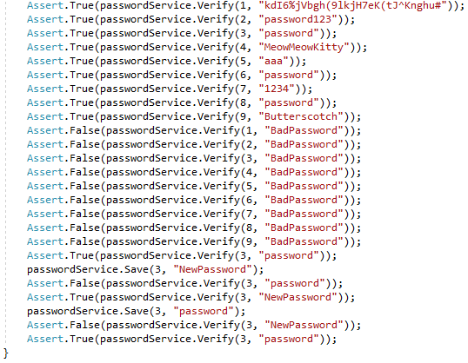
Integration Tests

Slide 11
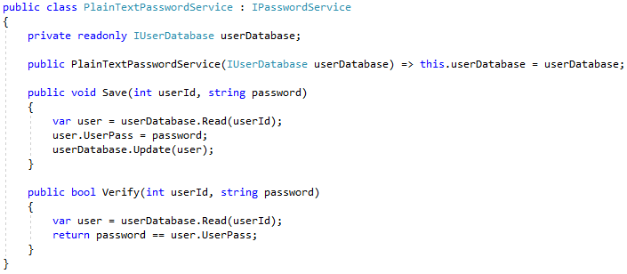
Plain Text

Slide 12
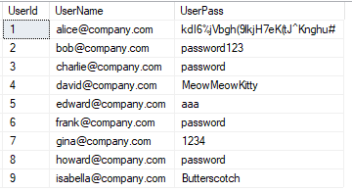
Plain Text

Slide 13
Plain Text
Passwords have no security at all
Easily human readable
Even if database is secured, developers can see passwords
Worst-case scenario

Slide 14
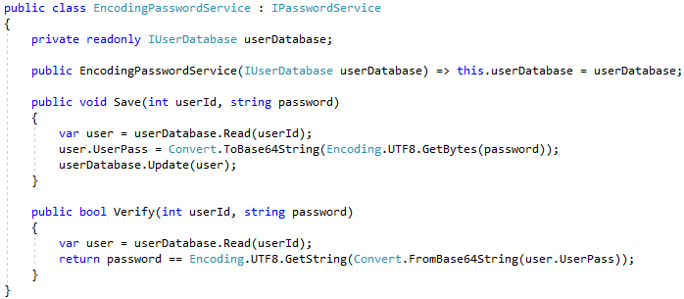
Encoding

Slide 15
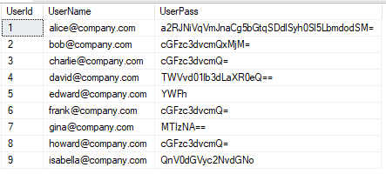
Encoding

Slide 16
Encoding
Passwords still have no security
The “cipher” is globally known
Even if database is secured, developers can see passwords
Effectively just as bad as plain text for developers

Slide 17
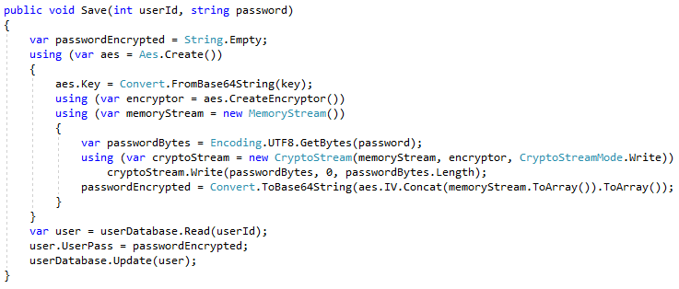
Symmetric Encryption

Slide 18
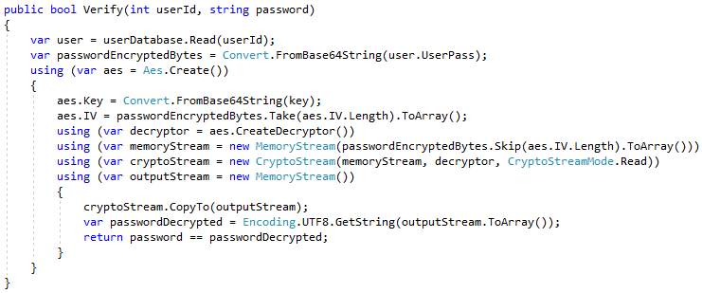
Symmetric Encryption

Slide 19
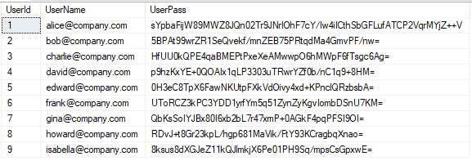
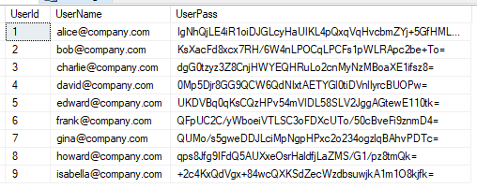
Symmetric Encryption

Slide 20
Symmetric Encryption
Passwords are secure!
Passwords are effectively randomized
New problem: private key is critical
Private key must be distributed to all readers and writers
Key management and rotation is a new concern

Slide 21
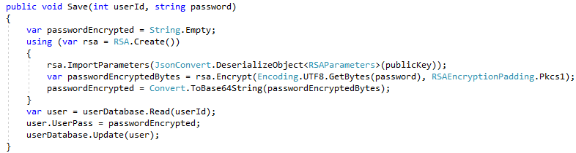
Asymmetric Encryption

Slide 22
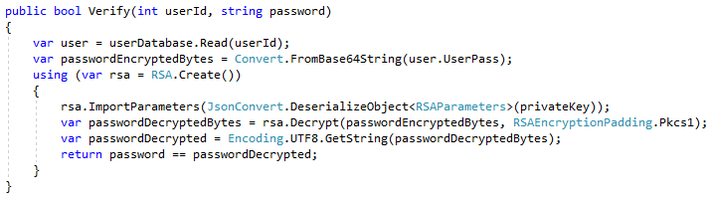
Asymmetric Encryption

Slide 23
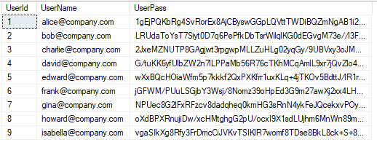
Asymmetric Encryption

Slide 24
Asymmetric Encryption
Passwords are still secure
Passwords are still effectively randomized
Still have to deal with private key security
Private key only needed for reading/verifying/decrypting
Asymmetric encryption prefers small data, and is often slower

Slide 25
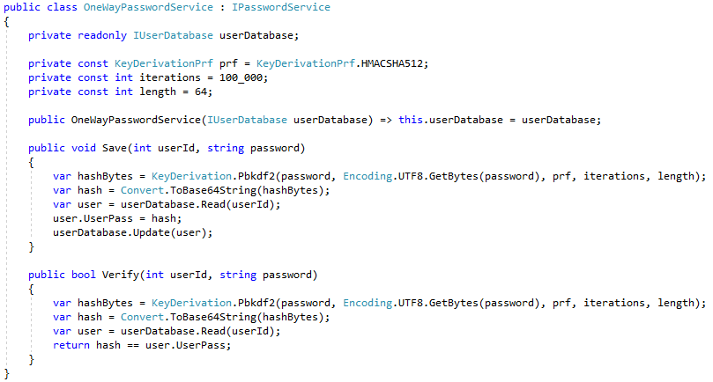
One-Way Hashing

Slide 26
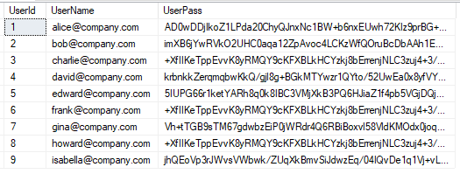
One-Way Hashing

Slide 27
One-Way Hashing
Passwords are even more secure; they are not retrievable
No private keys to manage
Iterating increases brute-force time
Small storage size
Deterministic; large datasets can expose common passwords

Slide 28
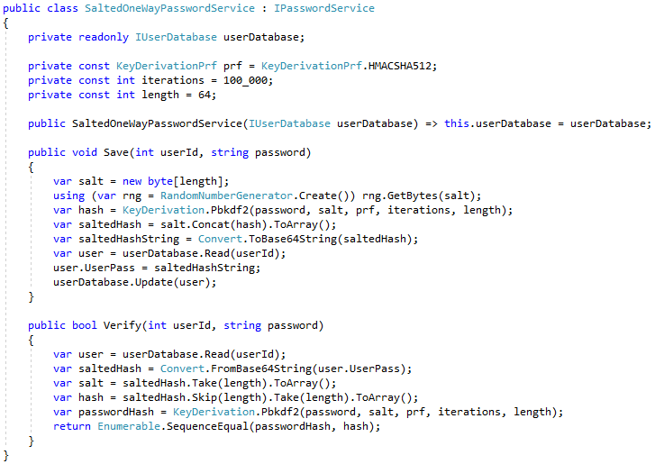
Salted One-Way Hashing

Slide 29
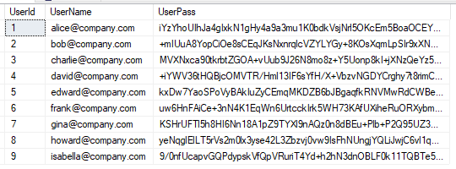
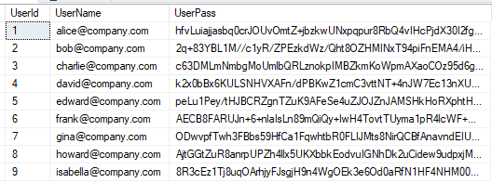
Salted One-Way Hashing

Slide 30
Salted One-Way Hashing
Passwords are very secure; they are still not retrievable
No private keys to manage
Iterating increases brute-force time
Small storage size
Identical passwords are randomized

Slide 31
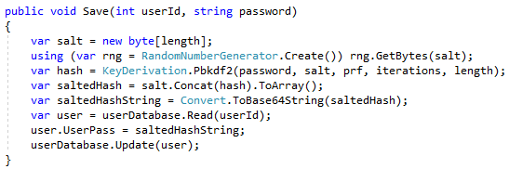
Salted One-Way Hashing (Review)

Slide 32
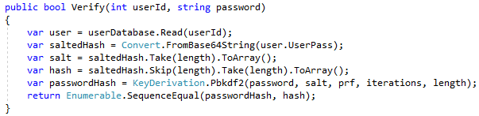
Salted One-Way Hashing (Review)

Slide 33
Summary
When:
Need to store user data securely
No need to retrieve data; only need to compare
Want to avoid potential exposure/loss of private keys
Defend against brute-force, dictionary, and rainbow attacks
Data needs to be safe even if fully compromised (i.e. public exposure)
Pass the salt? Salt the pass!

Slide 34
Info
Derick Linkous
dl@steadyscience.com

