Slide 1
Serverless AWS
An introduction to serverless AWS - Rock, Paper, Scissors

Slide 2
Introduction
Derick Linkous
dl@steadyscience.com

Slide 3
The Plan
Create a small, provider-agnostic game, using clean architecture
Domain first, with many unit tests, written first
Utilize AWS serverless offerings, with integration tests, written first
Deploy a real, public-facing, secure, highly-scalable application
Play the game
Learn as much as possible in timeframe

Slide 4
Why Serverless
Highly-scalable
Economy-of-scale pricing, even for tiny projects
Easily-controlled costs and throttling via simple settings
Low maintenance, minimal upkeep, low overhead
Developer focus on features, not infrastructure
Near-linear cost-to-usage; “going viral” is easy

Slide 5
Disadvantages
New techniques/technologies; learning curve
Wheel reinvention; existing technologies are sometimes simpler
Third-party dependency; possible vendor lock-in
Security; data, content, and code is “in the cloud”
Legal; legacy contracts may be written with legacy mindset

Slide 6
Specification
Rock, Paper, Scissors
Begin Game: Starts with a throw, returns identifier
Finish Game: Accepts identifier and a throw, returns outcome
Check Game: Accepts identifier, returns outcome
We will use Entities and Interactors

Slide 7
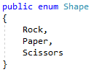

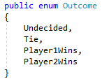
Entities First

Slide 8
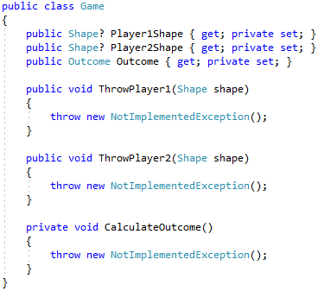
Entities First

Slide 9

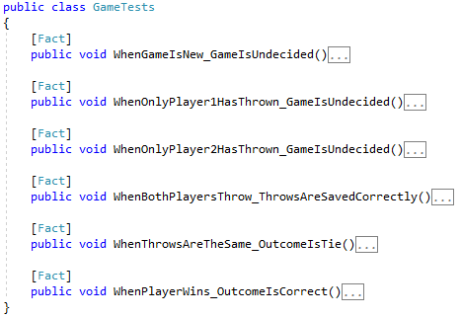
Entities First

Slide 10
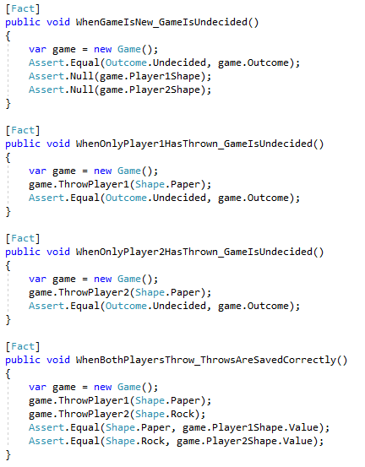
Entities First

Slide 11
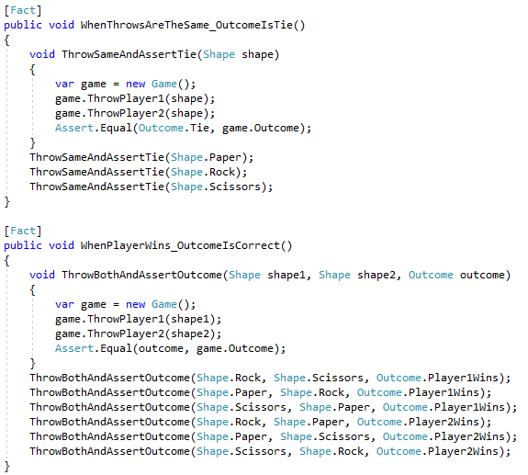
Entities First

Slide 12
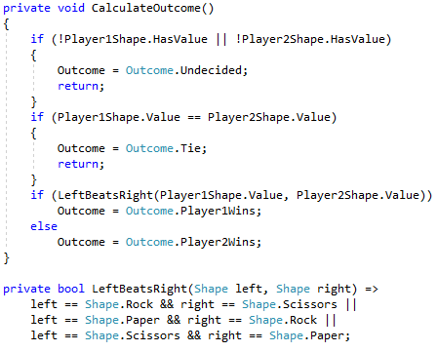
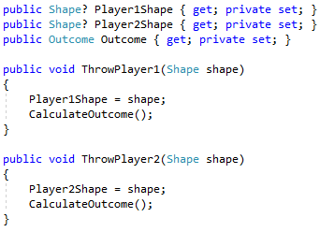
Entities First

Slide 13
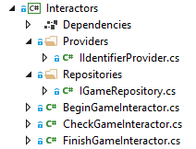
Interactors Second

Slide 14
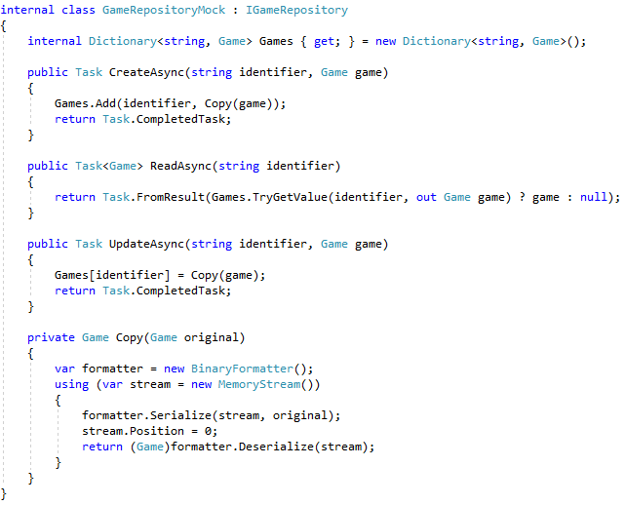


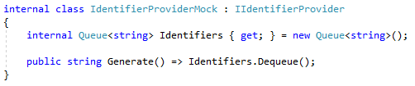
Interactors Second

Slide 15
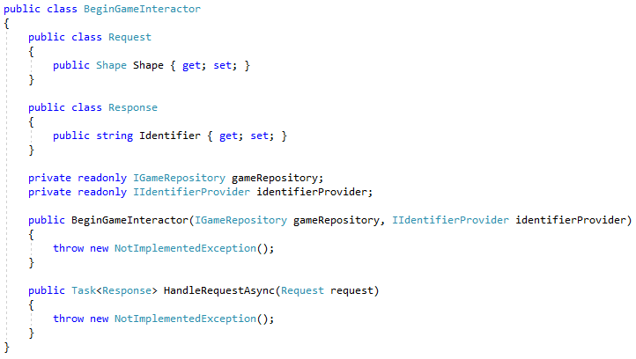
Interactors Second

Slide 16
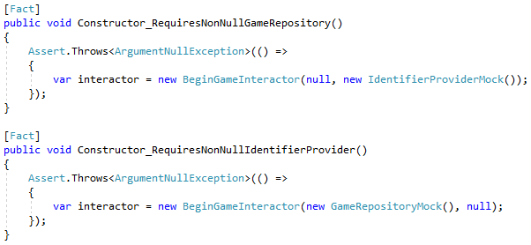
Interactors Second

Slide 17
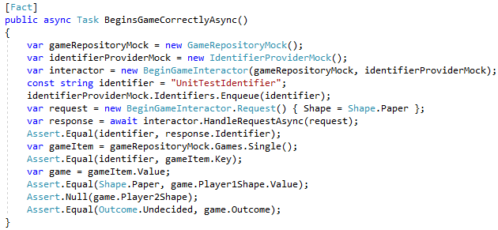
Interactors Second

Slide 18
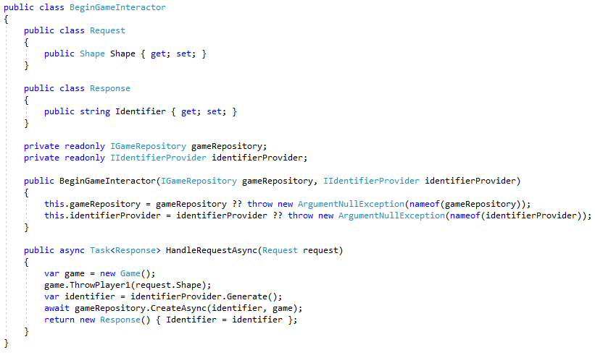
Interactors Second

Slide 19
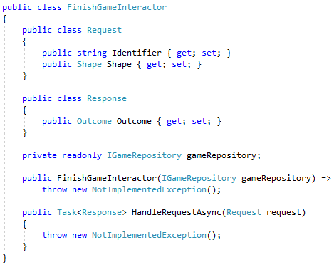
Interactors Second

Slide 20
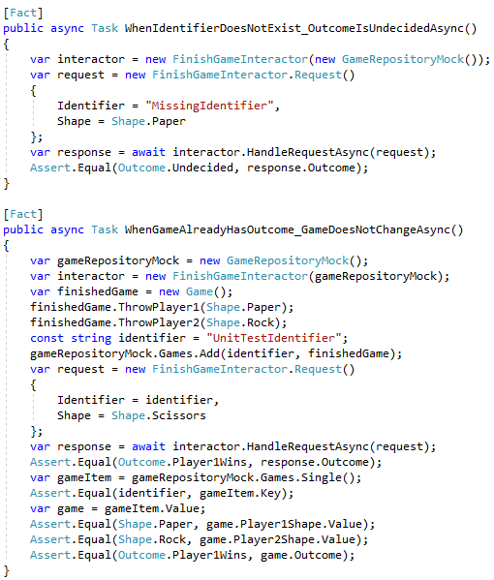
Interactors Second

Slide 21
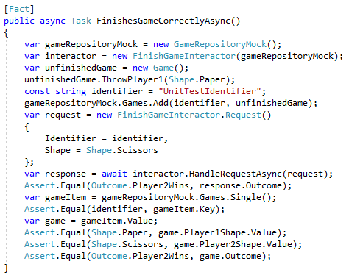
Interactors Second

Slide 22
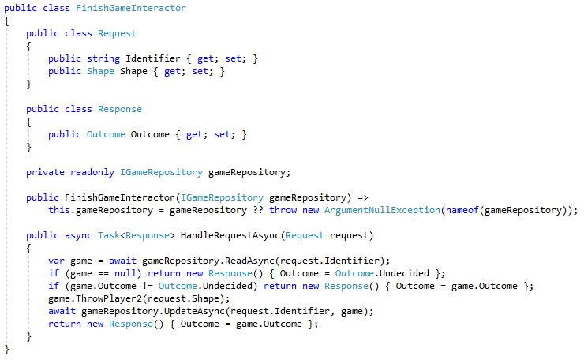
Interactors Second

Slide 23
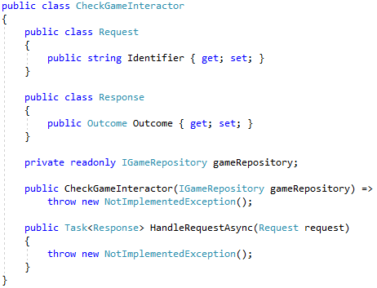
Interactors Second

Slide 24
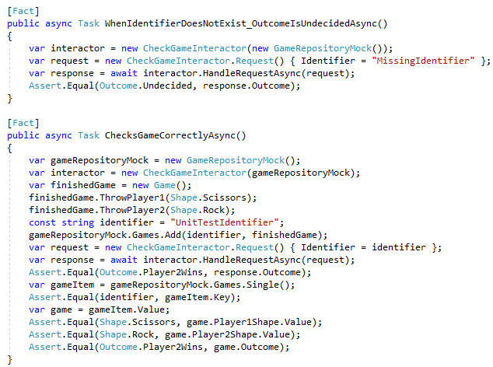
Interactors Second

Slide 25
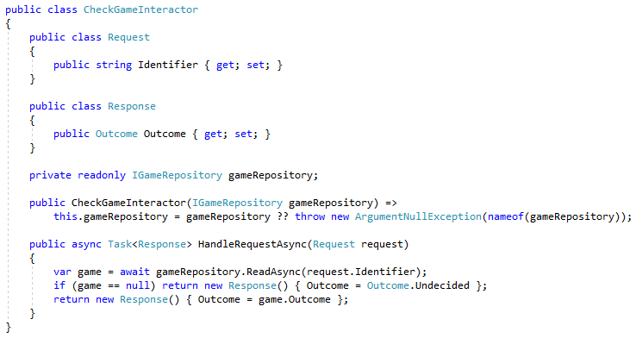
Interactors Second

Slide 26


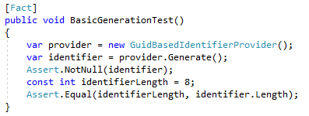
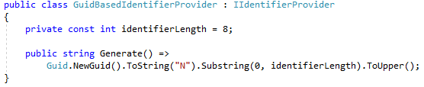
Identifier Provider Service

Slide 27
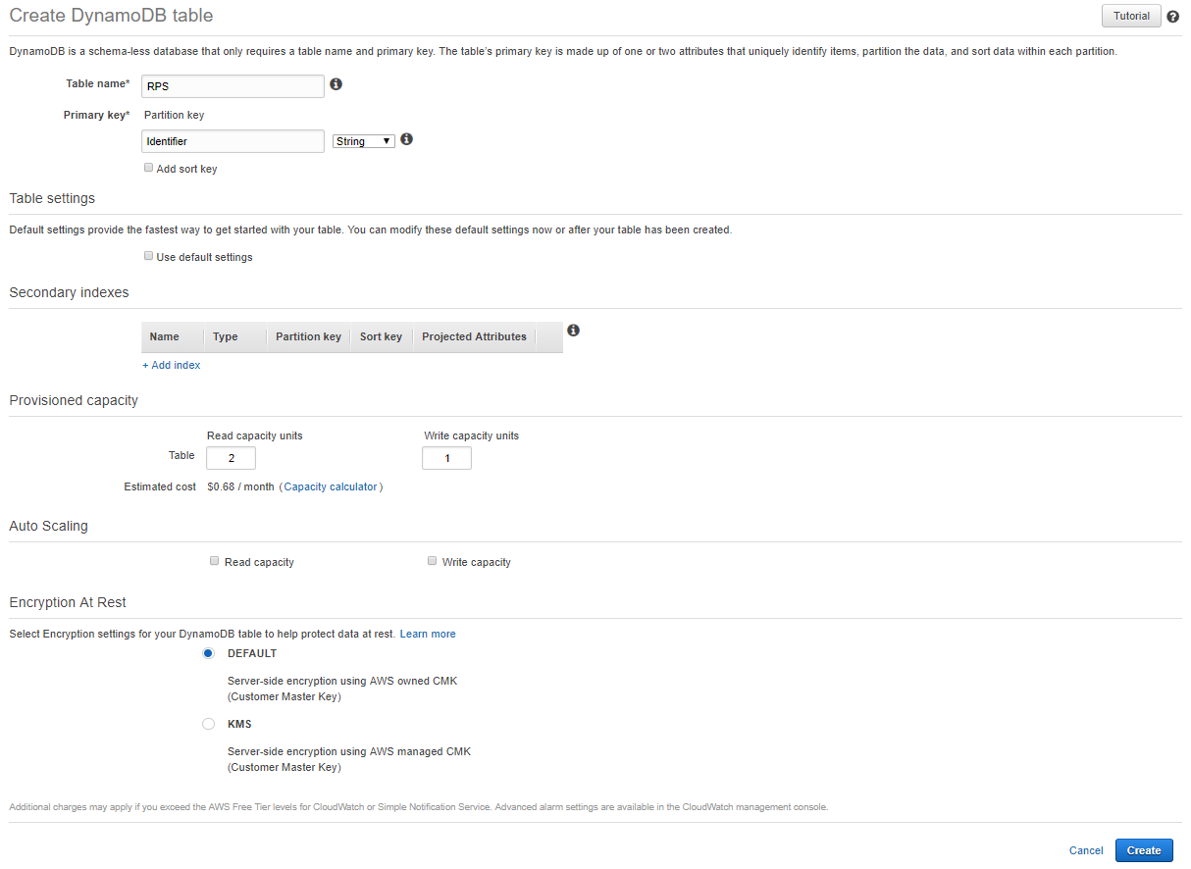
Serverless Database - DynamoDB

Slide 28
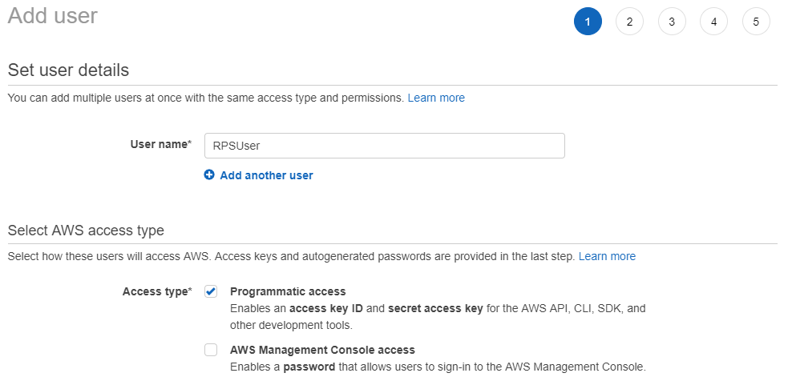
Permissions - User

Slide 29
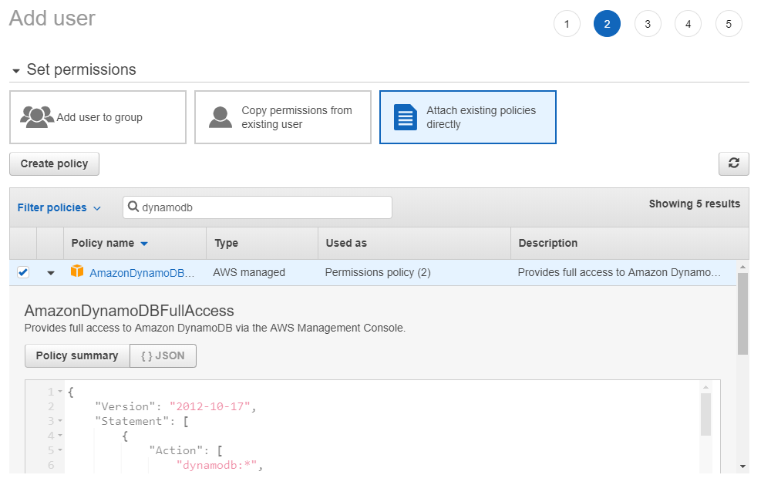
Permissions - User

Slide 30
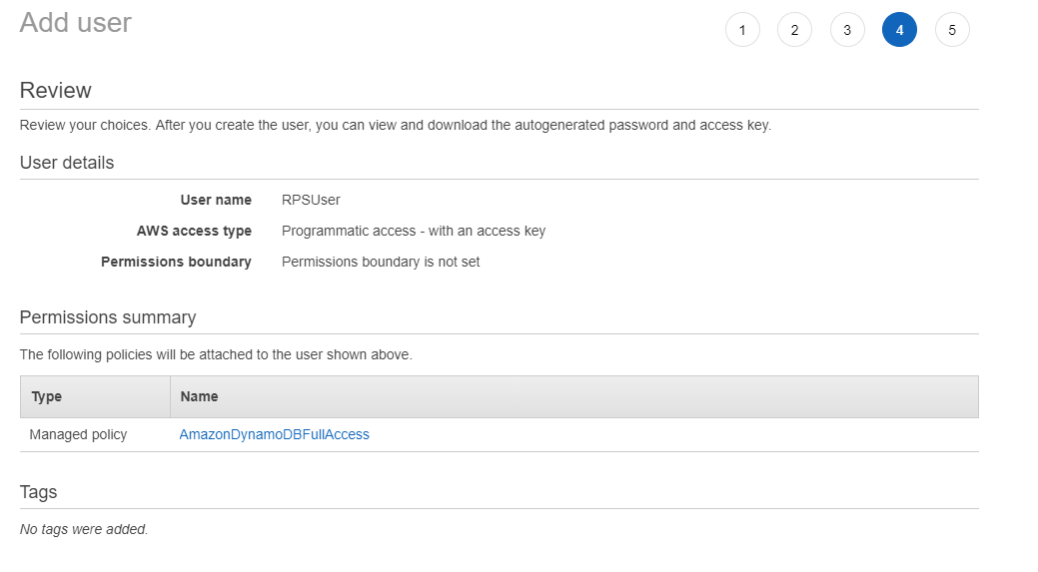
Permissions - User

Slide 31
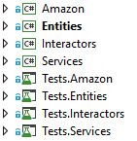
Amazon Implementation

Slide 32
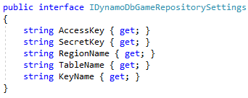
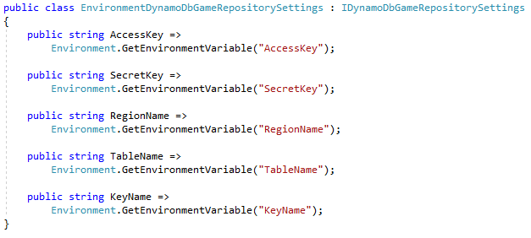
Amazon Implementation

Slide 33
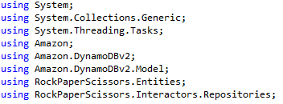
Amazon Implementation

Slide 34
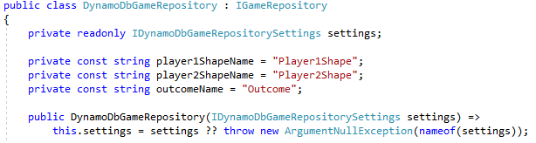
Amazon Implementation

Slide 35
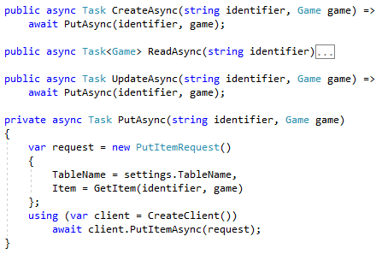
Amazon Implementation

Slide 36
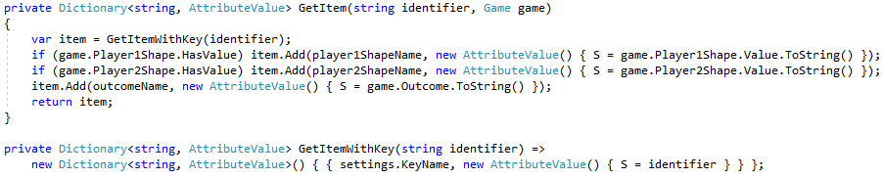
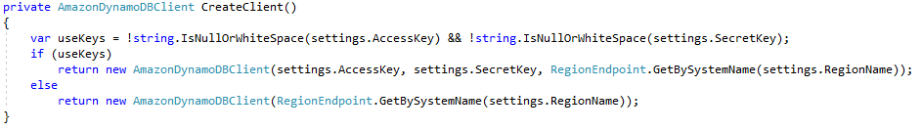
Amazon Implementation

Slide 37
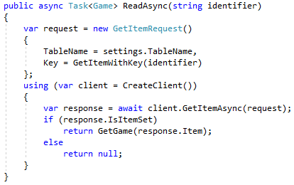
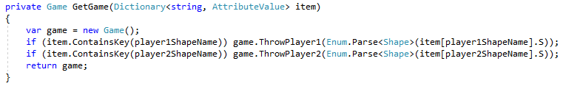
Amazon Implementation

Slide 38
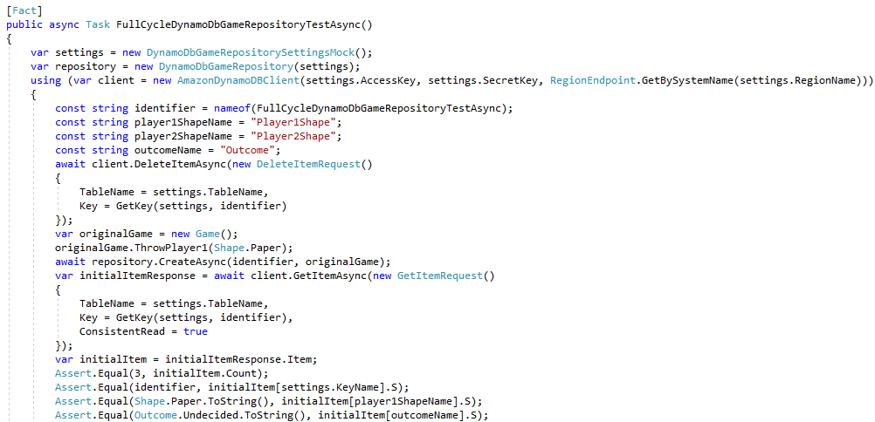
Amazon Implementation Testing

Slide 39
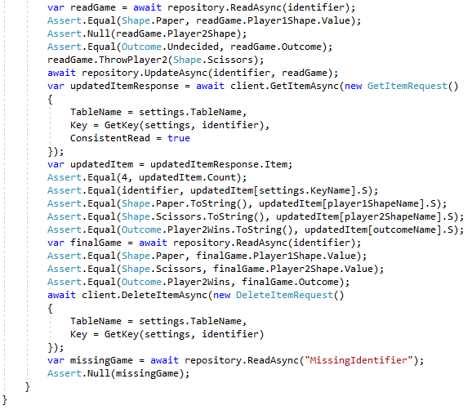
Amazon Implementation Testing

Slide 40
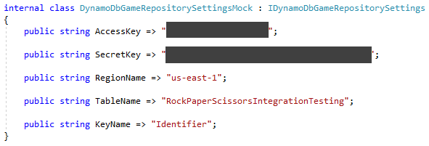
Amazon Implementation Testing

Slide 41
Layout
Interactors
DynamoDbGameRepository
Entities
DynamoDB
Dyn
Tests
Amazon
Tests
Services
Interactors
Tests
Tests
Entities

Slide 42
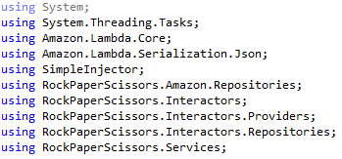
Amazon Implementation

Slide 43
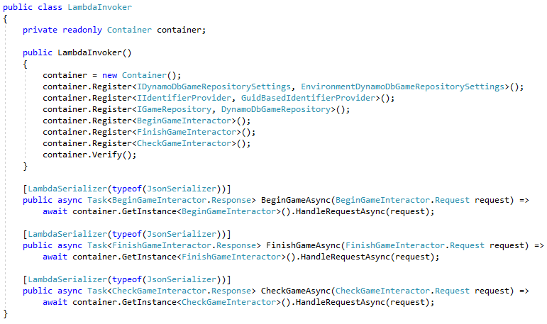
Amazon Implementation

Slide 44
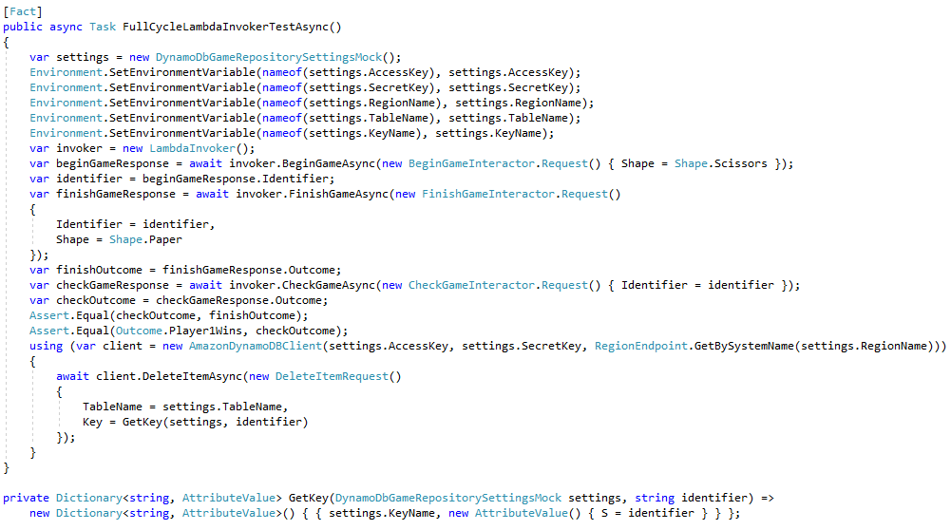
Amazon Implementation Testing

Slide 45
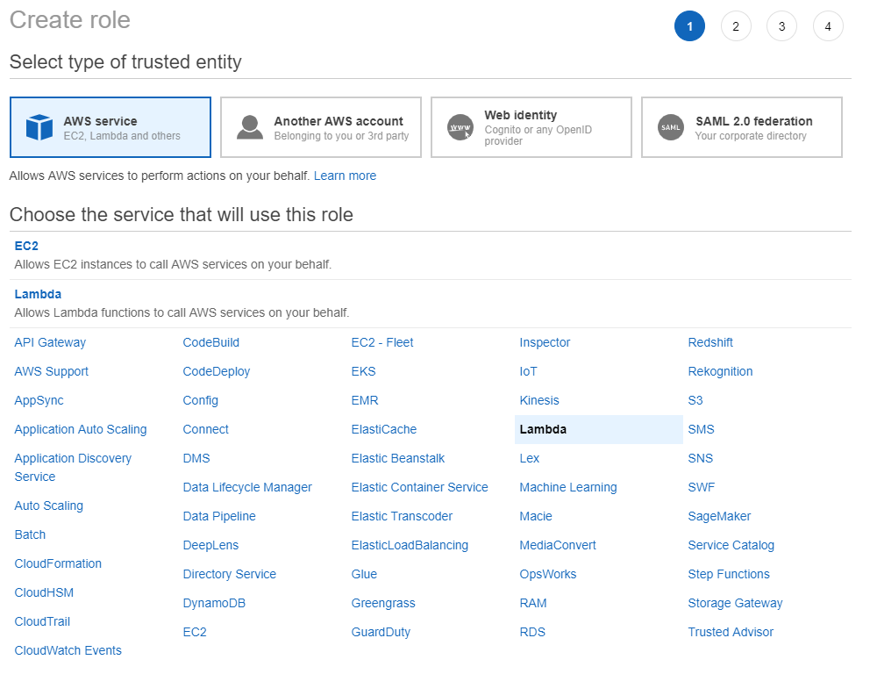
Permissions - Role

Slide 46
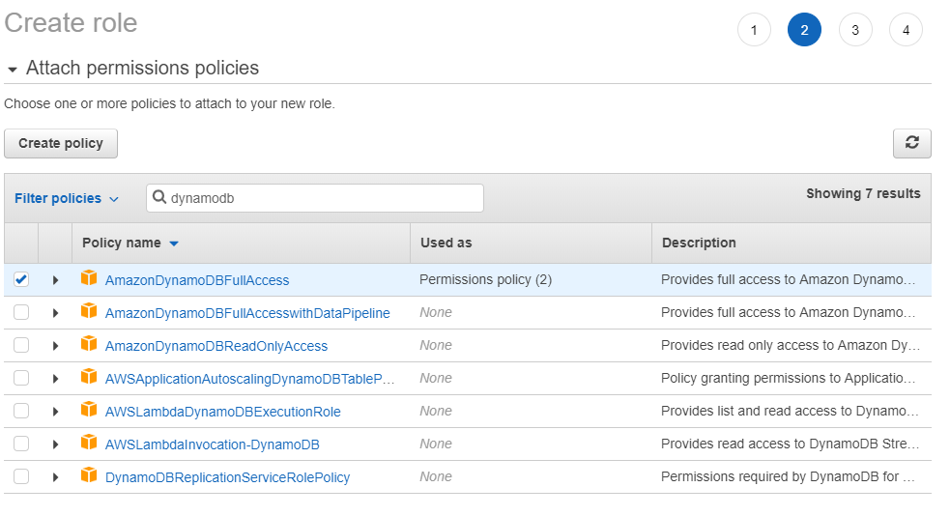
Permissions - Role

Slide 47

Permissions - Role

Slide 48
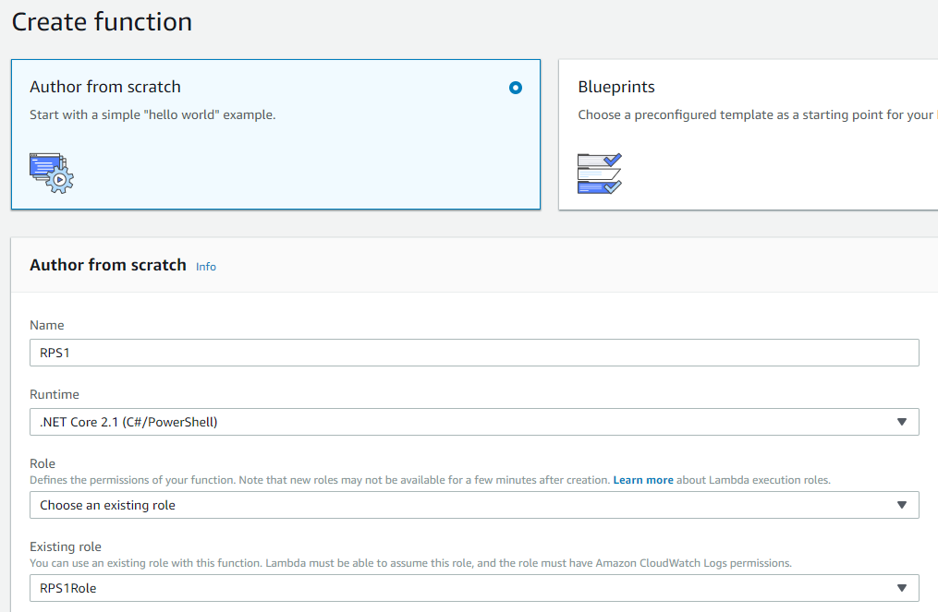
Serverless Function - Lambda

Slide 49
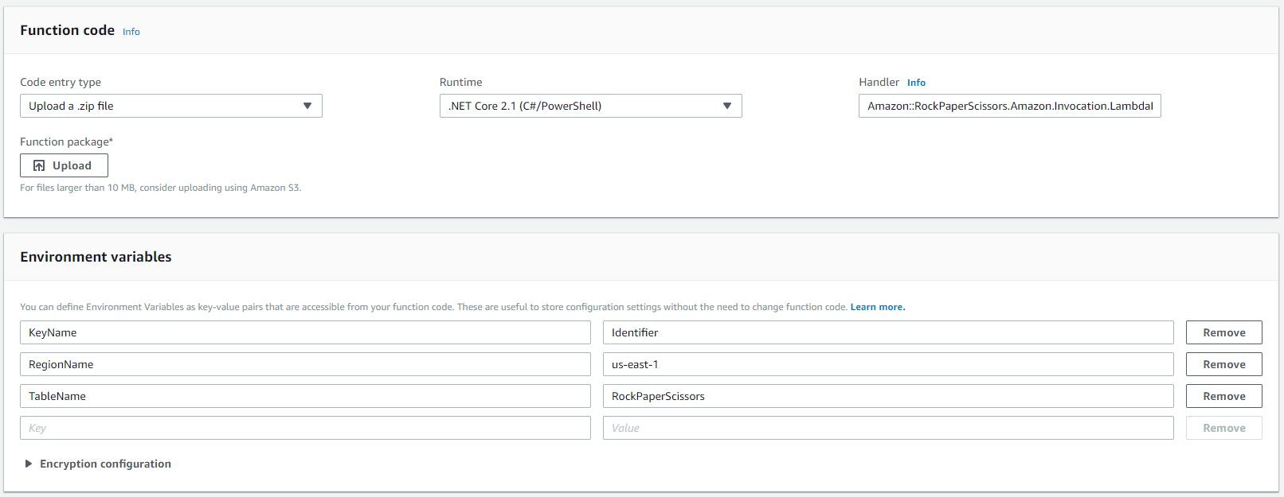
Serverless Function - Lambda

Slide 50
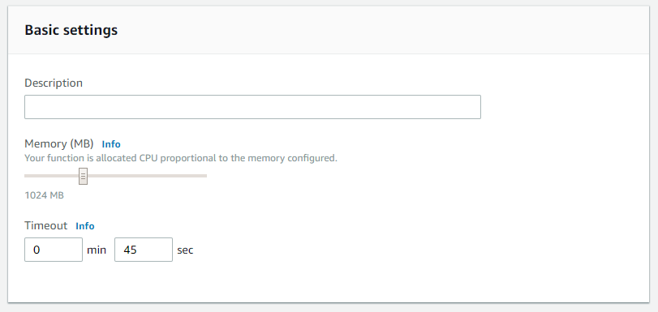
Serverless Function - Lambda

Slide 51
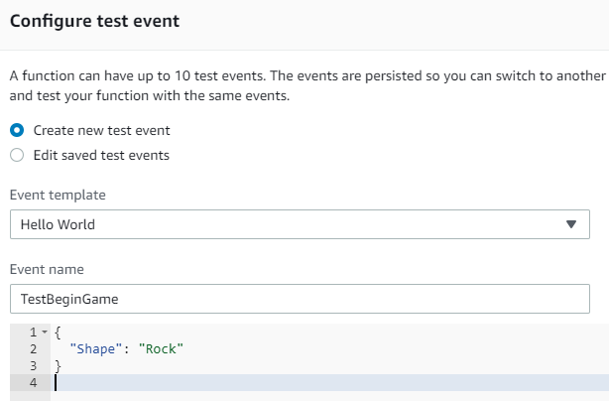
Serverless Function - Lambda

Slide 52
Serverless Function - Lambda

Slide 53
Layout
Lambda
LambdaInvoker
Interactors
DynamoDbGameRepository
Entities
DynamoDB
LI
Dyn
Tests
Amazon
Tests
Services
Interactors
Tests
Tests
Entities

Slide 54

Amazon Implementation

Slide 55

Amazon Implementation
Bad Practice!

Slide 56
Layout
Lambda
GatewayInvoker
LambdaInvoker
Interactors
DynamoDbGameRepository
Entities
DynamoDB
GI
LI
Dyn
Tests
Amazon
Tests
Services
Interactors
Tests
Tests
Entities

Slide 57

Serverless API – API Gateway

Slide 58

Serverless API – API Gateway

Slide 59

Serverless API – API Gateway

Slide 60

Serverless API – API Gateway

Slide 61

Serverless API – API Gateway

Slide 62
Layout
Lambda
GatewayInvoker
API Gateway
LambdaInvoker
Interactors
DynamoDbGameRepository
Entities
DynamoDB
GI
LI
Dyn
Tests
Amazon
Tests
Services
Interactors
Tests
Tests
Entities

Slide 63

Serverless DNS – Route 53

Slide 64


Serverless Certificates – Certificate Manager

Slide 65

Serverless API – API Gateway

Slide 66
Layout
Lambda
GatewayInvoker
API Gateway
LambdaInvoker
Interactors
DynamoDbGameRepository
Entities
DynamoDB
CloudFront
GI
LI
Dyn
Tests
Amazon
Tests
Services
Interactors
Tests
Tests
Entities

Slide 67

Serverless Files – S3

Slide 68


Serverless Files – S3

Slide 69

Serverless Files – S3

Slide 70


Serverless Files – S3

Slide 71
Layout
Lambda
GatewayInvoker
API Gateway
LambdaInvoker
Interactors
DynamoDbGameRepository
Entities
DynamoDB
S3
CloudFront
GI
LI
Dyn
Tests
Amazon
Tests
Services
Browser
Interactors
Tests
Tests
Entities

Slide 72



Serverless CDN – CloudFront

Slide 73
Layout
Lambda
GatewayInvoker
API Gateway
LambdaInvoker
Interactors
DynamoDbGameRepository
Entities
DynamoDB
S3
CloudFront
CloudFront
GI
LI
Dyn
Tests
Amazon
Tests
Services
Browser
Interactors
Tests
Tests
Entities

Slide 74

Web UI

Slide 75

Web UI

Slide 76

Web UI

Slide 77

Web UI

Slide 78
Layout
Lambda
GatewayInvoker
API Gateway
LambdaInvoker
Interactors
DynamoDbGameRepository
Entities
DynamoDB
S3
CloudFront
CloudFront
GI
LI
Dyn
Tests
Amazon
Tests
Services
Browser
Interactors
Tests
Tests
Entities

Slide 79

Web UI

Slide 80
Summary
Clean architecture
Heavy test coverage
Serverless:
Database
Function
API (Custom, Distributed)
UI (Static, Distributed)
DNS (Custom)
SSL (Custom, Distributed)

Slide 81
Layout
Lambda
GatewayInvoker
API Gateway
LambdaInvoker
Interactors
DynamoDbGameRepository
Entities
DynamoDB
S3
CloudFront
CloudFront
GI
LI
Dyn
Tests
Amazon
Tests
Services
Browser
Interactors
Tests
Tests
Entities

Slide 82
Info
Derick Linkous
dl@steadyscience.com

