Slide 1
SQL Server Standard Candles
Slow Queries vs. Fast Queries

Slide 2
Introduction
Derick Linkous
dl@steadyscience.com

Slide 3
Slow Queries
Slow query experiences
How do you know if a query is slow?
What about platform/hardware differences?
Timing based on human-feel?
Timing based SSMS F5/F4?
What about the quantity of rows?

Slide 4
A Candle To Light Our Way
What if we had a standard candle in SQL Server?
And what if we had an equation?

Slide 5
A Candle To Light Our Way
Introducing the data page
Assume that every IO in SQL Server is 8K
Assume that 132 bytes are reserved, leaving 8060 bytes
Assume all IO is expensive (physical and logical)

Slide 6
Data Type Sizes
Bits are bits, but are bit-packed into bytes
Integers: tinyint=1, smallint=2, int=4, bigint=8
Decimal/Numeric: Precision 1-38=5-17 bytes
Currency: smallmoney=4, money=8
Strings: char=L, nchar=2L, varchar=L+2, nvarchar=2L+2
Float/Real: Precision 7=4, Precision 15=8, Real=4
Dates: date=3, time=3-5, datetime=8, datetime2=6-8

Slide 7
Equation Is Complex
The equation is complex, but learnable
Variable length adds to complexity
B-tree is 8K as well
Fragmentation can occur
For presentation, will skip most of these complexities
Assume overhead of 8 bytes per row
Allow large margin of error, ~20% (this is small)

Slide 8
Starting Off On The Right Foot
Small data types, with room for growth
Normalize first, then denormalize for performance (do both!)
Use right tool for the job; consider other technologies

Slide 9
Thought Experiment
Pretend we are writing a naïve database engine
Two columns, both integers
We filter on first column, and sum values in second column
There are one million rows
We store data in 8K pages (8060 available for row data)
Row header is 8 bytes
How many IOs?

Slide 10
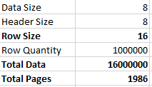
Thought Experiment
A
B
4 bytes
4 bytes
(Data+Header) * 1M = Total
(4+4 + 8) * 1M = 16MB
16MB / 8060 = 1986 pages
1 million

Slide 11
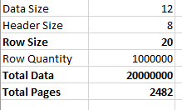
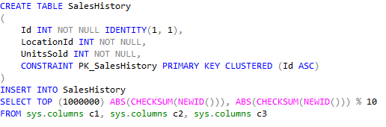
A Real Table

Slide 12

A Real Table

Slide 13
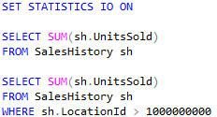
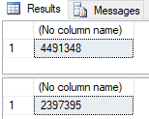

A Real Table
Table Size: 2609

Slide 14

A Real Table
Table Size: 2609

Slide 15
A Real Table
Table Size: 2609

Slide 16
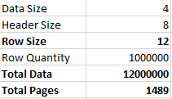
A Real Table
Table Size: 2609

Slide 17
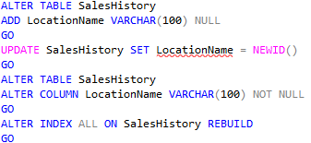
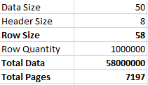
The Table Grows
Table Size: 2609
Table Size: 7595

Slide 18
The Table Grows
Table Size: 7595
Slow?

Slide 19
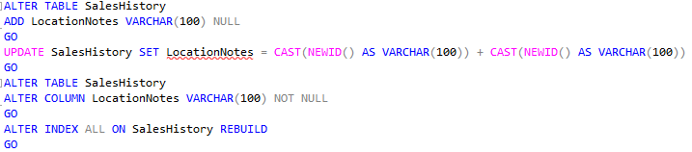
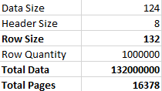
Additional Growth
Table Size: 7595
Table Size: 16982

Slide 20
Additional Growth
Table Size: 16982
Slow?

Slide 21


Deleted Rows
Table Size: 16982
How many IOs?
16982

Slide 22
Deleted Rows
Table Size: 16982

Slide 23
A Distant Utopia
Table Size: 16982
Our table experienced growth
The difference between utopia and real-world grew as well
How do we bring ourselves closer to utopia?
We want a data set that only contains relevant data
Option: Non-Clustered Index

Slide 24
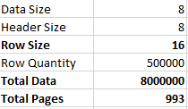

Non-Clustered Index
Table Size: 16982

Slide 25
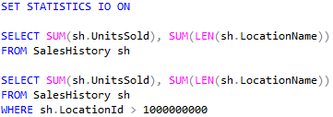

Non-Clustered Index
Table Size: 16982

Slide 26


Modified Non-Clustered Index
Table Size: 16982
Table Size: 8495

Slide 27

Modified Non-Clustered Index
Table Size: 8495

Slide 28
Page Comparison
Table Size: 8495
Clustered
Non-Clustered

Slide 29
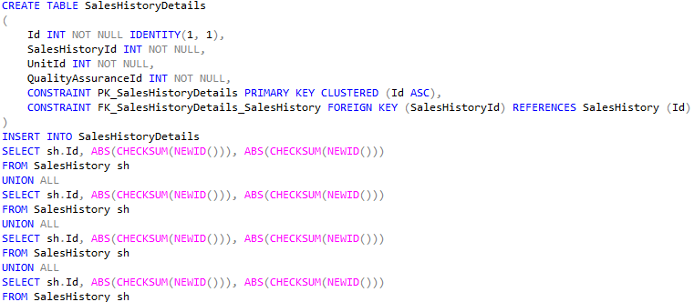
New Table

Slide 30
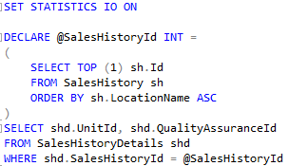
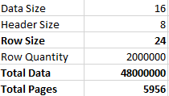
New Query

Slide 31
New Index

Slide 32

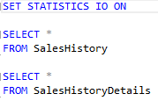

Drop Indexes
All Tables: 14711

Slide 33
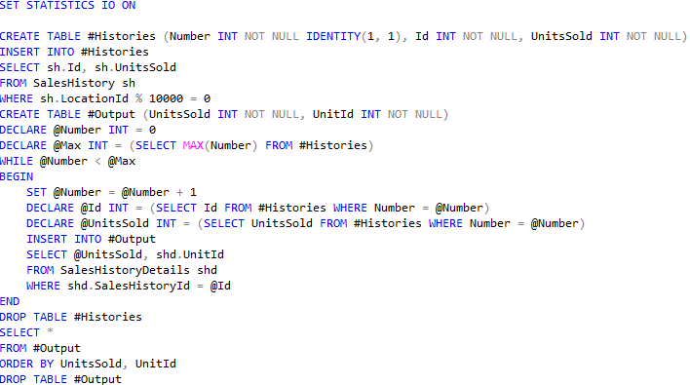
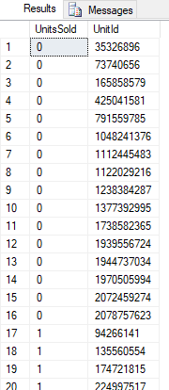

Query Review
All Tables: 14711

Slide 34
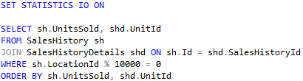
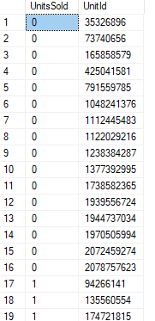

Query Improvement
All Tables: 14711

Slide 35
Summary
Input/Output is what makes databases slow
SQL Server has a standard candle, the 8K data page (1 IO)
“Slow” is not so much a measurement of time…
… it is the difference between utopia and reality
“Utopia” is the perfect minimal amount of data IO for a query
“Reality” is the actual amount of data IO for a query
Regardless of time, a query is “slow” when the difference is large

Slide 36
Summary
Most servers/platforms treat all IOs as equal
DBAs may be able to vary the IO/performance relationship
Trust facts and math over human-feel of “slowness”
If a query’s actual IO is close to its utopia, the query is “fast”
IO usage can change based on a number of other factors
Data type sizes are very important
Strings, as always, are huge

Slide 37
Summary
Use “SET STATISTICS IO ON” when reviewing in SSMS
Use “Reads” column when reviewing in Profiler
Use non-clustered indexes to reduce IO for certain queries
One index can help a large number of queries
Indexes negatively impact CUD; add with caution
Focus on huge IO differences (100x, 1,000x, 10,000x)
Ignore small IO differences (2x, 3x, 5x)

Slide 38
Info
Derick Linkous
dl@steadyscience.com

