Slide 1
Single Responsibility Principle
“A class should have only one reason to change.”

Slide 2
Introduction
Derick Linkous
dl@steadyscience.com

Slide 3
SOLID
Single Responsibility Principle
Open/Closed Principle
Liskov Substitution Principle
Interface Segregation Principle
Dependency Inversion Principle

Slide 4
One Reason
A class should have only one reason to change
Ambiguous/Vague terminology should be avoided

Slide 5
People, Roles, and Actors
Many people care about the product
Each person cares differently about different parts of the product
Everyone involved has at least one role to play
When a person is acting within a role, that person is an actor
An actor is primarily concerned with a subset of the product
All actors want things to be as simple as possible
Most actors are not software developers
Developers write software on behalf of actors

Slide 6
In Their Shoes
Empathize! Then brainstorm!
What code would this actor want to write?
What code would this actor want to avoid writing?
How can we bring all of this actor’s concerns into one place?
How can we exclude all other concerns?

Slide 7
Product Owners, and Roles
Product Owners/Managers do not coalesce roles/actors
Just because you get your tasks/tickets/stories from
one source does not mean there is only one role/actor
Request tasks be described from the point of view of an actor
Example: “As a <actor>, I want <goal>, so that <reason>”
Small, granular roles are preferred; avoid godlike roles
Small organizations often have people wearing many ‘hats’
Therefore, although a person may have many roles, at any given moment, he/she is in a single role

Slide 8
Class Introspection
When looking at a class, ask the following questions:
What role does this class serve?
Does this class serve other roles?
If the answer to the first question is a single granular role…
… and the answer to the section question is, “No”…
… the class likely follows the Single Responsibility Principle.

Slide 9
Example
Situation:
You have inherited a class library
The library is a “Review Manager”
This library manages the reviews for products
Reviews can be added and removed
Product overviews can be requested

Slide 10
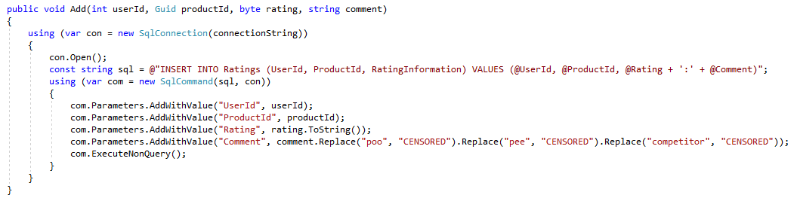
Original Review Manager

Slide 11
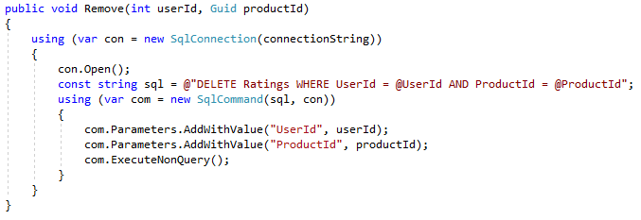
Original Review Manager

Slide 12
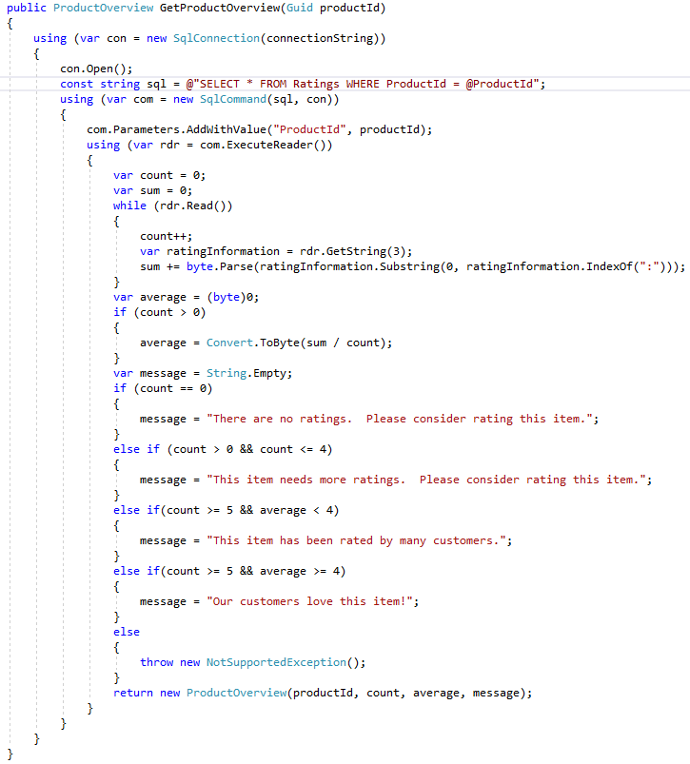
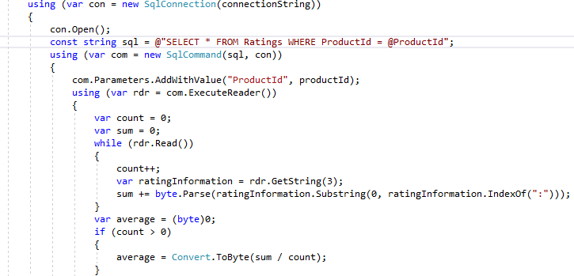
Original Review Manager

Slide 13
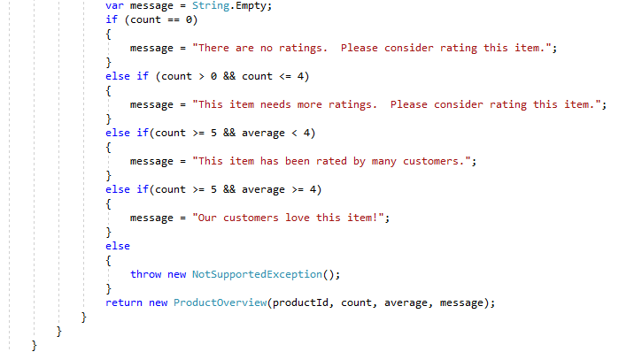
Original Review Manager

Slide 14
Asking Around
After reviewing the code, we ask around, and
learn about all the roles at the organization
Developer IT
Marketing Sales
HR Legal
Finance Support
UX DBA
Algorithms Product
Audit Clerical

Slide 15
Another Look
DBA
Formatting
Standards and Practices
This class does not follow the Single Responsibility Principle

Slide 16
Another Look
All DBA!

Slide 17
Original Review Manager
Many actors would care
about this method
DBA
Product
Formatting
Experience
This method/class has
many reasons to change

Slide 18
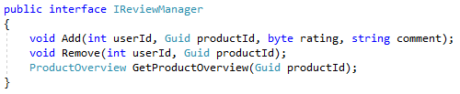
A New Review Manager
We are going to create a second Review Manager
Let’s first create some integration tests
We’ll make sure they pass using the old Review Manager first

Slide 19
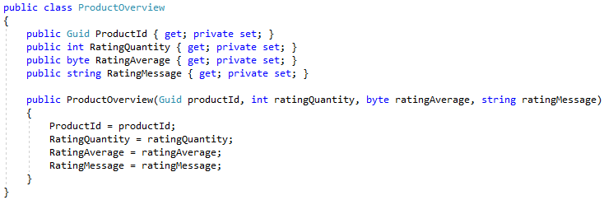
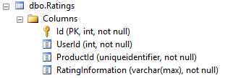
A New Review Manager

Slide 20
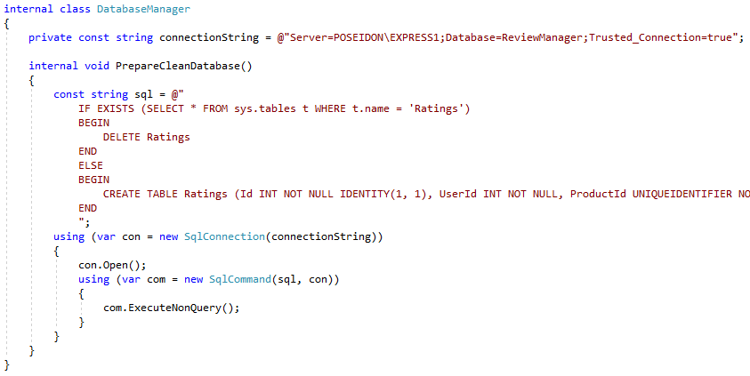
Integration Tests

Slide 21


Integration Tests

Slide 22
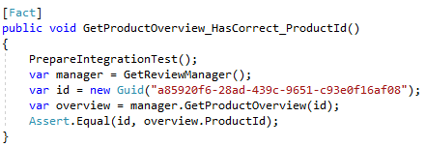
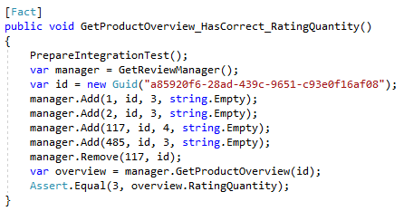
Integration Tests

Slide 23
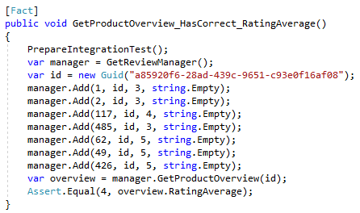
Integration Tests

Slide 24
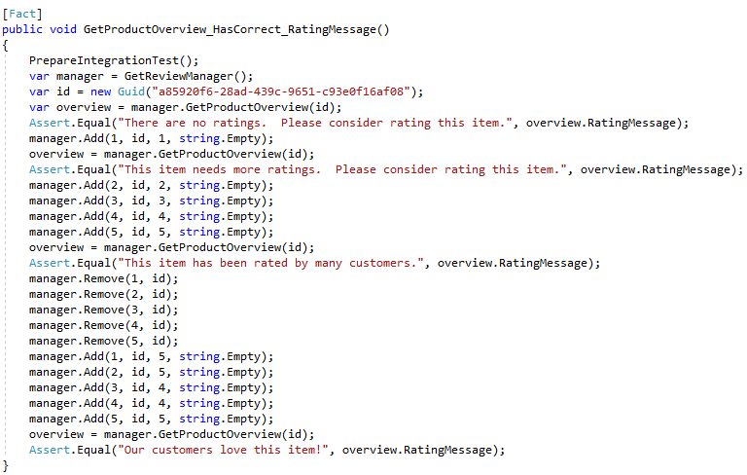
Integration Tests

Slide 25

Integration Tests

Slide 26
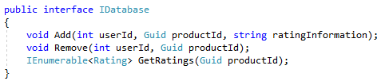
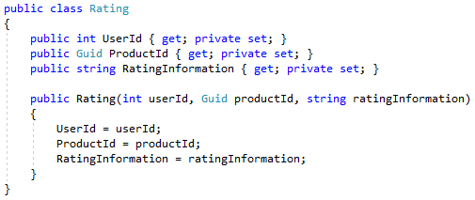
Database First

Slide 27
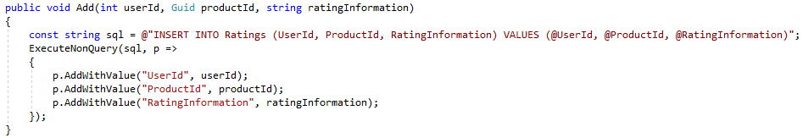
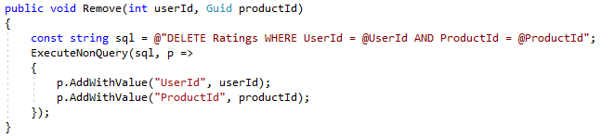
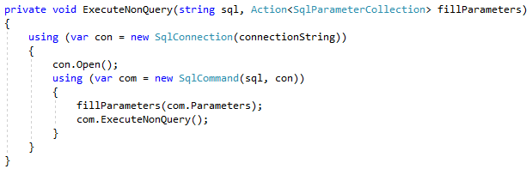
Database First

Slide 28
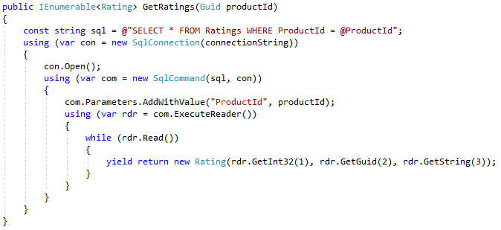
Database First

Slide 29

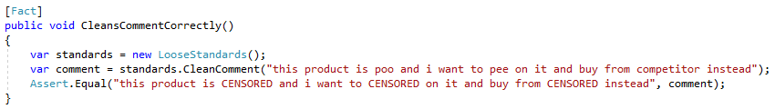
Standards and Practices

Slide 30
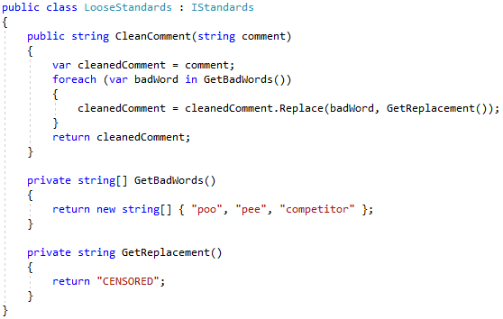
Standards and Practices

Slide 31

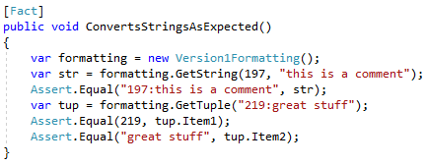
Formatting

Slide 32
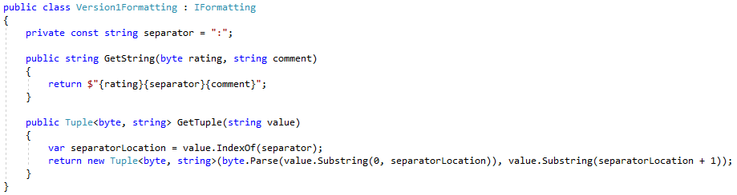
Formatting

Slide 33

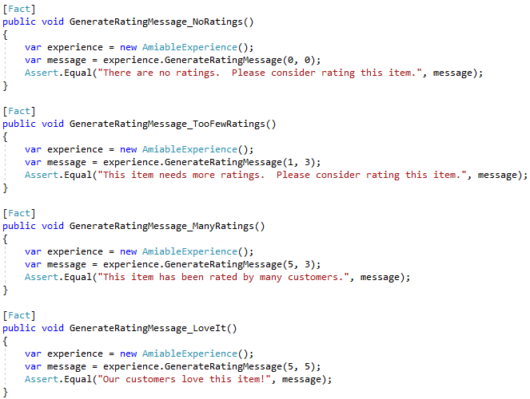
Experience

Slide 34
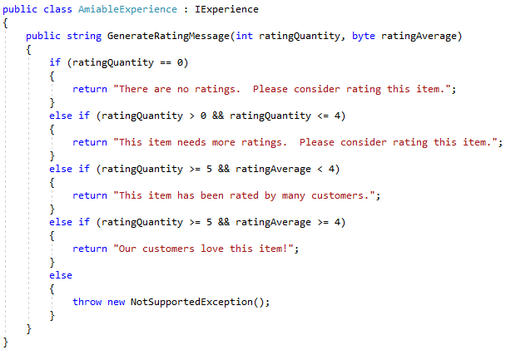
Experience

Slide 35

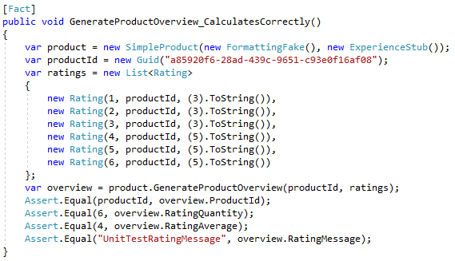
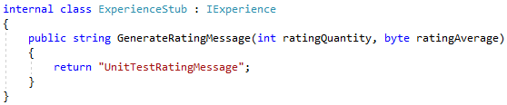
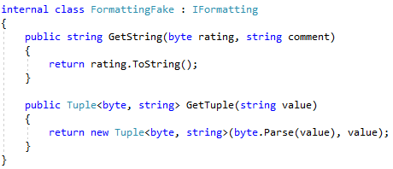
Product

Slide 36
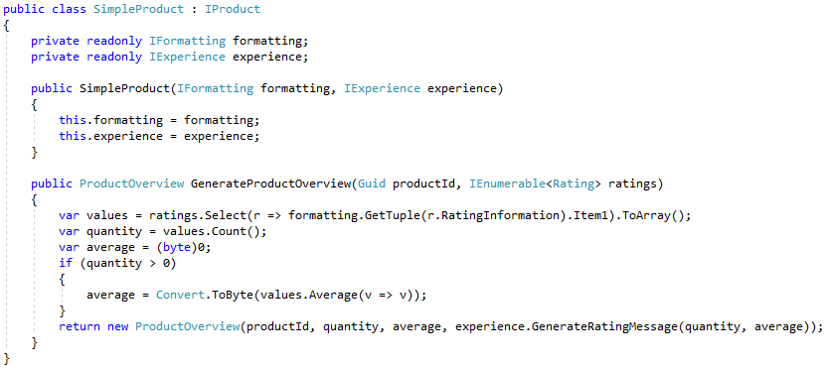
Product

Slide 37
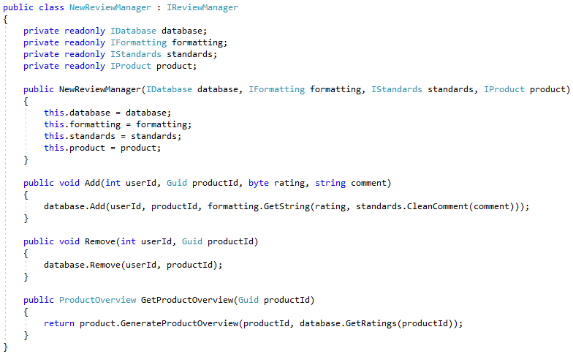
New Review Manager

Slide 38

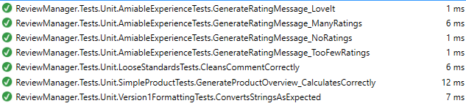
Testing

Slide 39
Two Implementations
We now have a second implementation
Integration tests give us confidence it will work correctly
Unit tests help prevent regression
Multiple classes, each with far less responsibility than the original
New classes are easier for new developers to understand
As the project grows, new functionality will collect
in role-specific classes, and stay separated from other features
Source control history will be more clear

Slide 40
Source Control
Old
New

Slide 41
Final Thoughts
The Single Responsibility Principle is the ‘S’ in SOLID.
When creating/modifying a class, ask:
“What is the one role that drives this functionality?”
Only one role should drive the changes to a given class.
Developers write software on behalf of actors
Satisfy one actor at a time (i.e. within a given class)
All actors are first-class citizens; all roles are equal
Everyone deserves a class, and that class should serve only that role
Not all developers are in a single role
Create separate classes for different specialties

Slide 42
Info
Derick Linkous
dl@steadyscience.com
"A class should have only one reason to change.”
-Robert C. Martin, Agile Principles, Patterns, and Practices in C#

