Slide 1



Slide 2
Test Doubles
Why We Mock The Way We Mock

Slide 3
Introduction
Derick Linkous
dl@steadyscience.com

Slide 4
Test Doubles
A term that encompasses all kinds of “mocks”
Many unit tests do not require test doubles
When code has dependencies, unit tests require test doubles

Slide 5
Purpose
Show what drives the needs our test doubles must meet
Short list; only a few different kinds of needs
Simplicity
Starting with simple example and work up to more complex examples
All test doubles will be created manually; no frameworks will be used

Slide 6


Setup

Slide 7
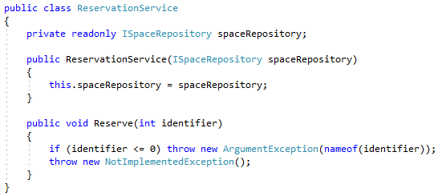
Type I

Slide 8
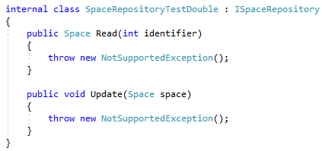
Type I

Slide 9
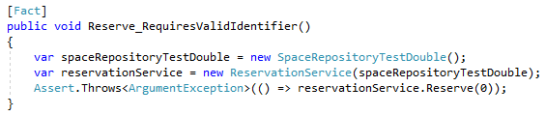
Type I

Slide 10

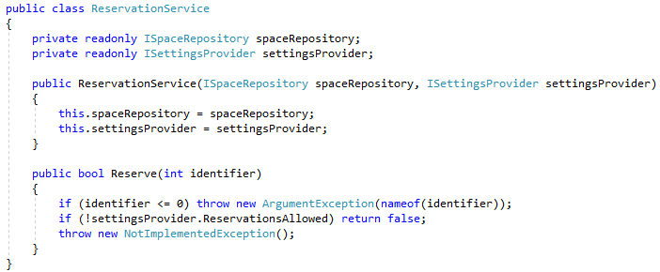
Type II

Slide 11

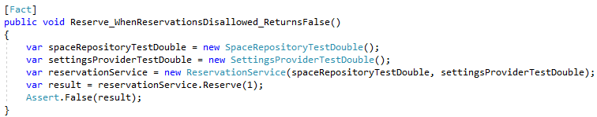
Type II

Slide 12
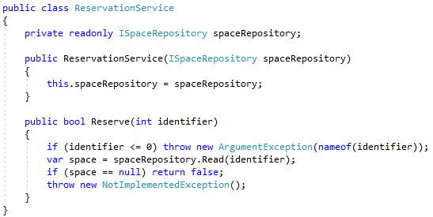
Type III

Slide 13
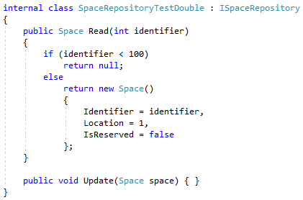
Type III

Slide 14
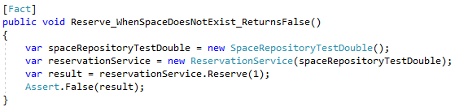
Type III

Slide 15

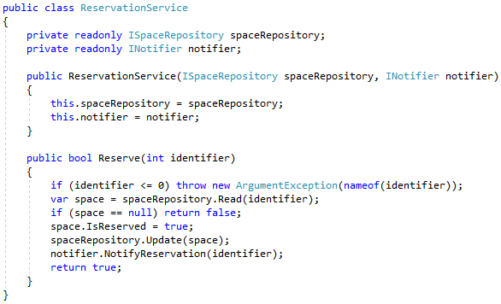
Type IV

Slide 16
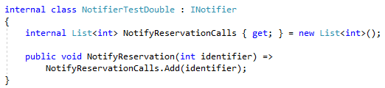
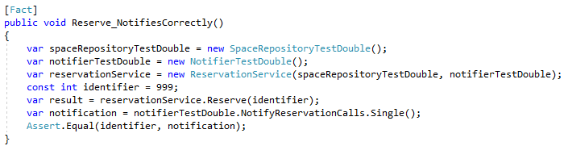
Type IV

Slide 17
Type IV

Slide 18
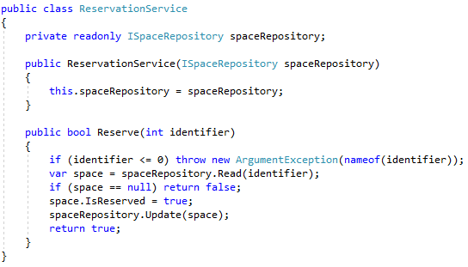
Type V

Slide 19
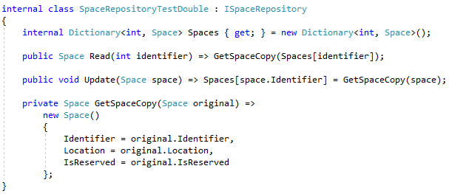
Type V

Slide 20
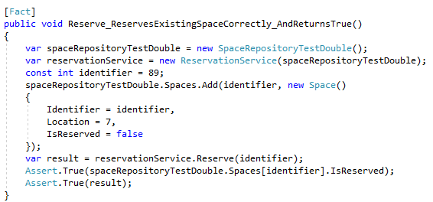
Type V

Slide 21
Summary
When dependency is unused, Type I
When simple state, Type II
When complex behavior, Type III
When dependency usage is important, Type IV
When realistic functionality is important, Type V

Slide 22
Info
Derick Linkous
dl@steadyscience.com

